Slide 1
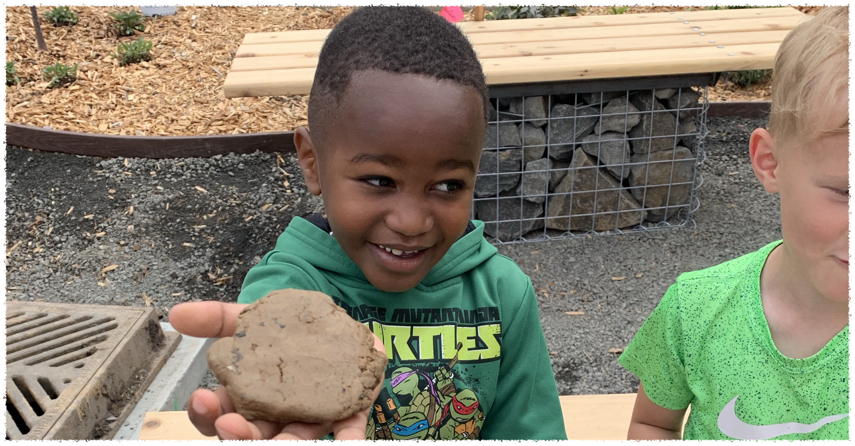
Identifying Farm to School Opportunities and Barriers
Meg Gollnick
Co-Founder Pullman Schools Pantry Program
gollnickm@gmail.com

Slide 2
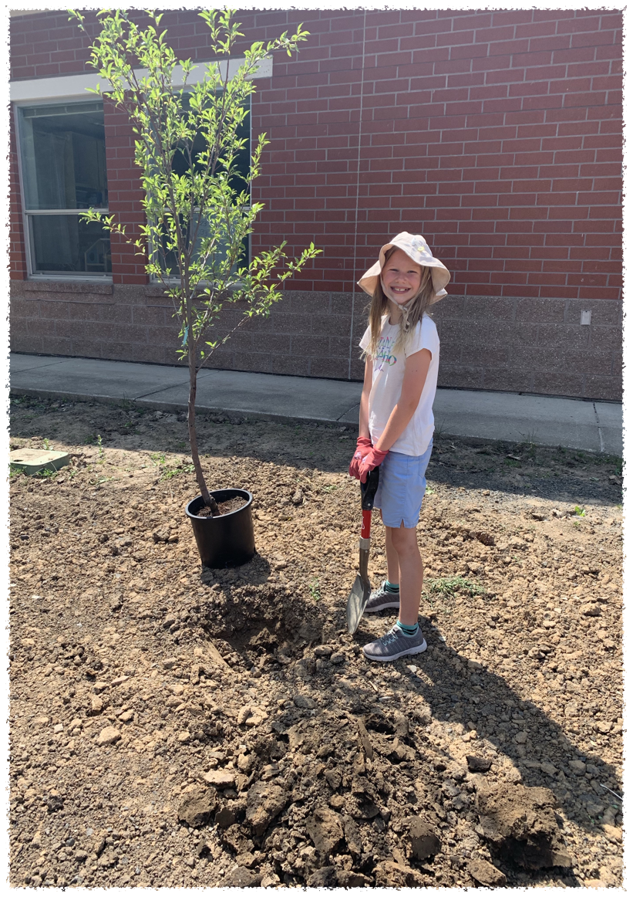
Introduction
What?
Why?
How?
Opportunities and Barriers

Slide 3
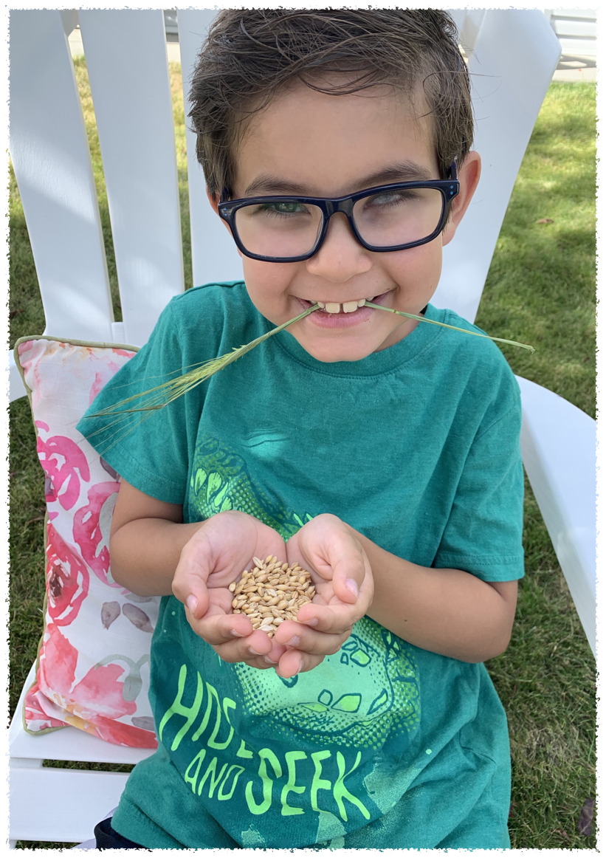
What is Farm to School?
Procurement
School Gardens
Education

Slide 4
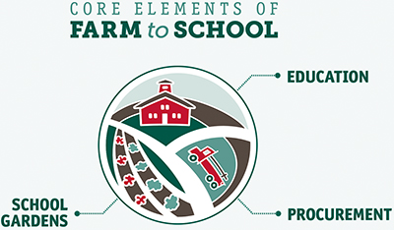

Slide 5
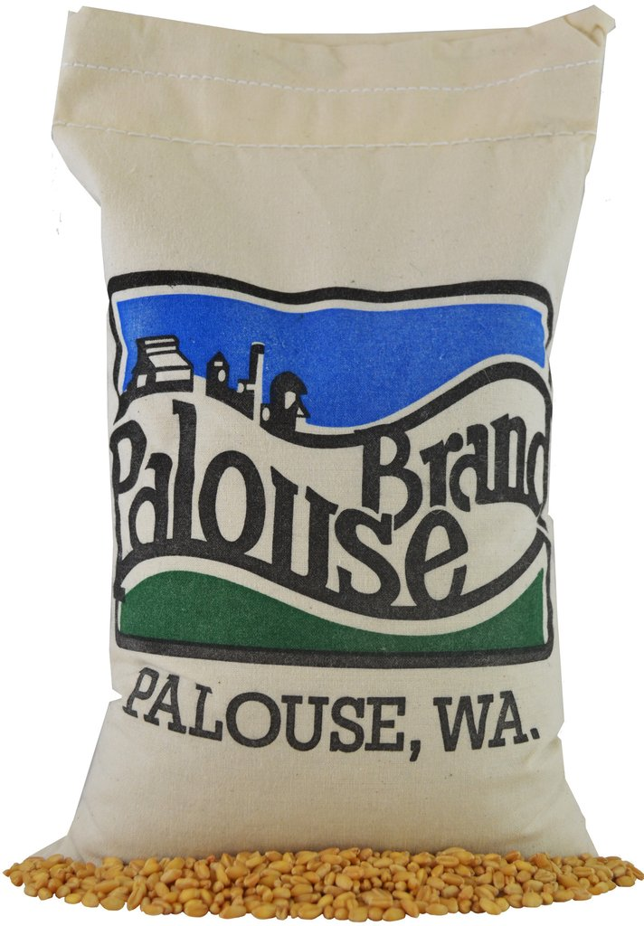

Procurement
Local foods are purchased, promoted and served in the cafeteria, as a snack or taste-tested

Slide 6
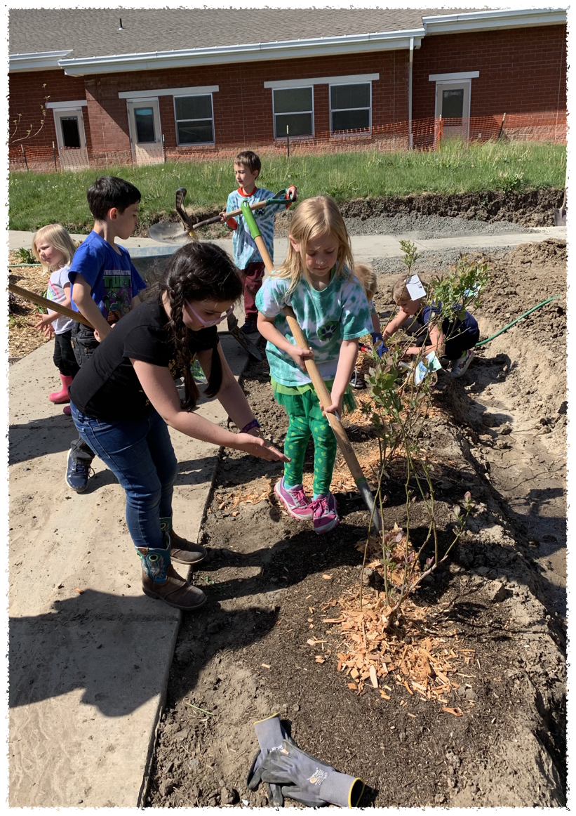
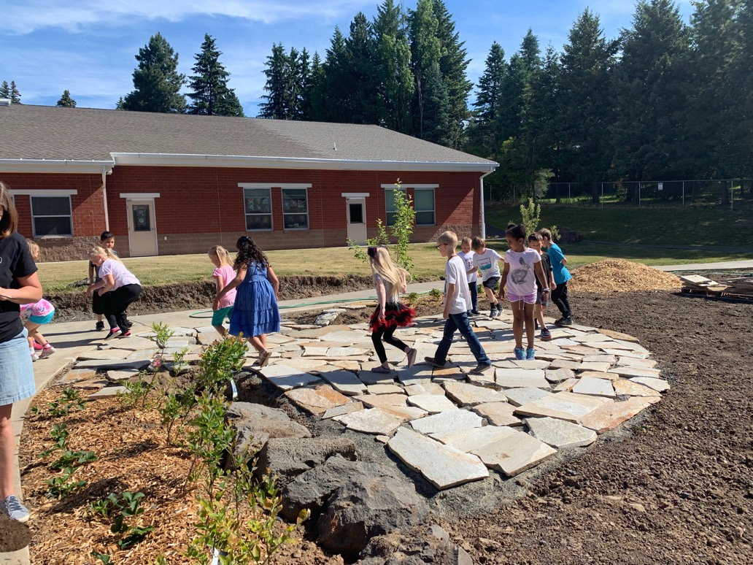
School Gardens
Students engage in hands-on learning.

Slide 7
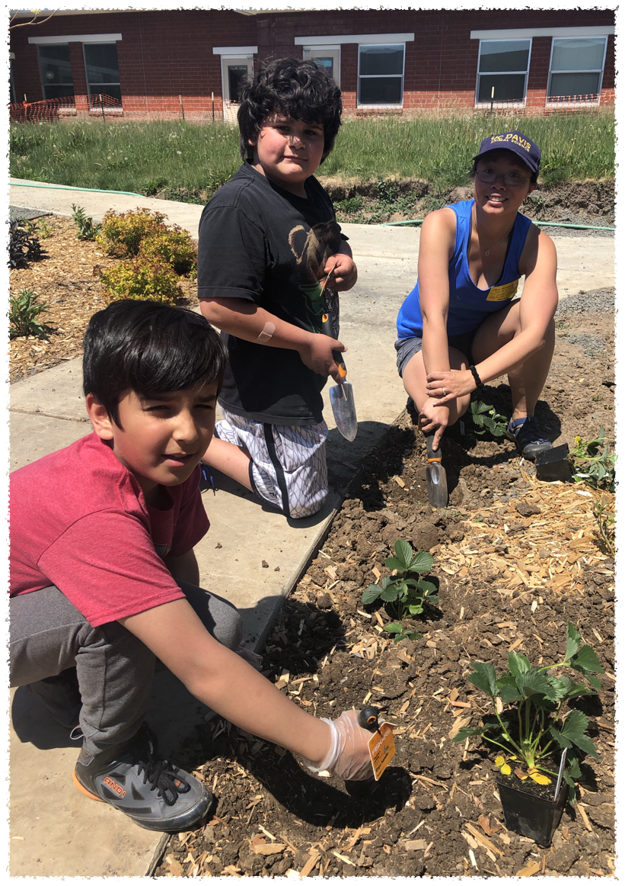
Education
Students participate in educational activities related to agriculture, food, health or nutrition.

Slide 8
Why Farm to School?

Slide 9
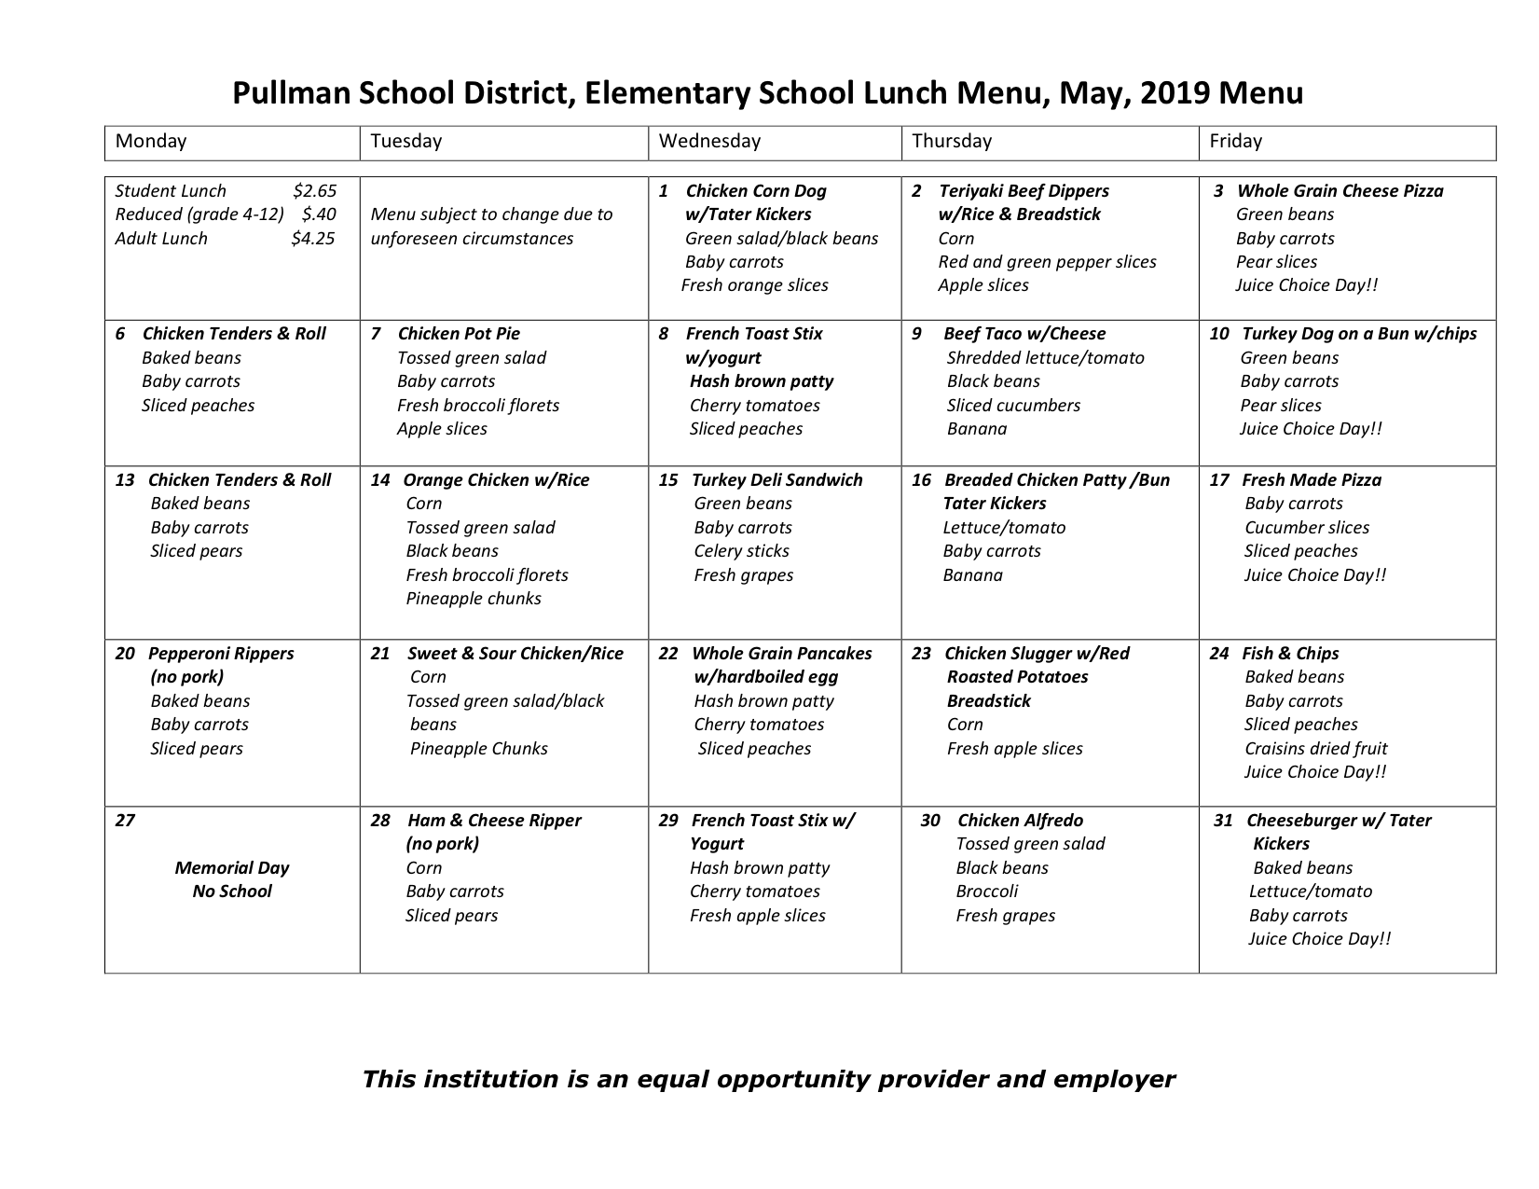

Slide 10
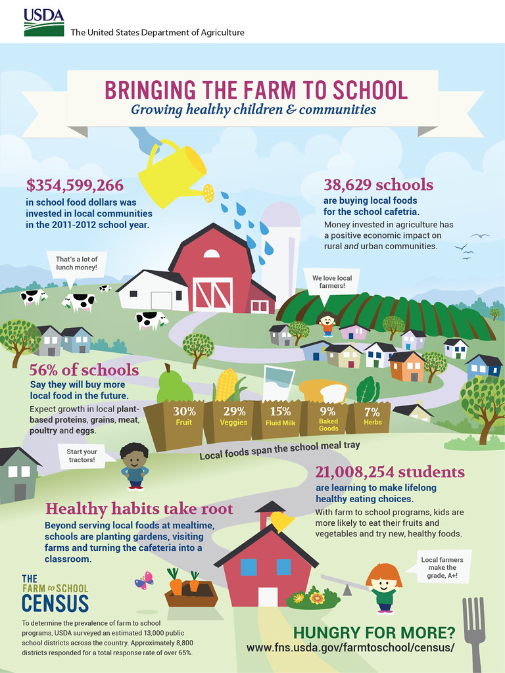

Slide 11
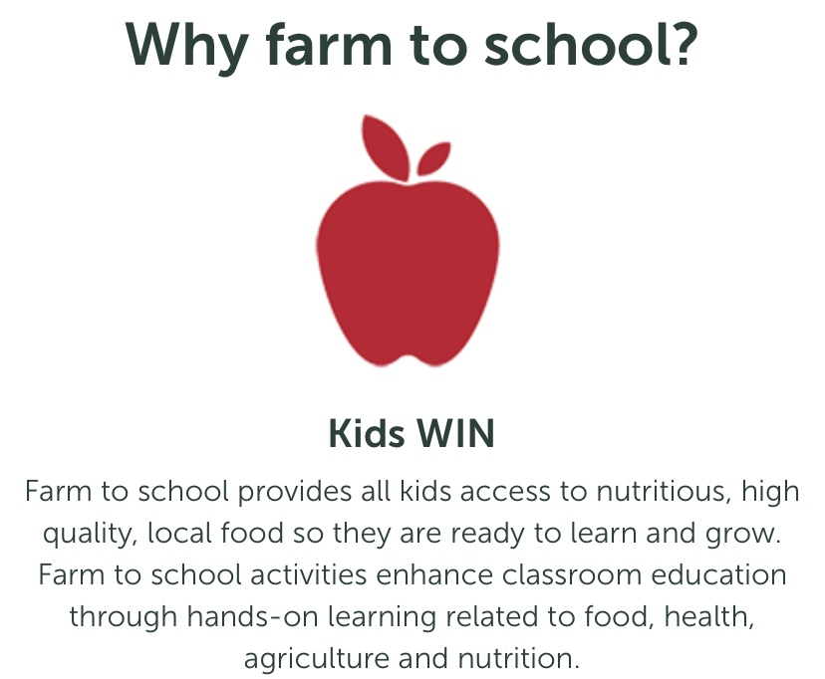

Slide 12
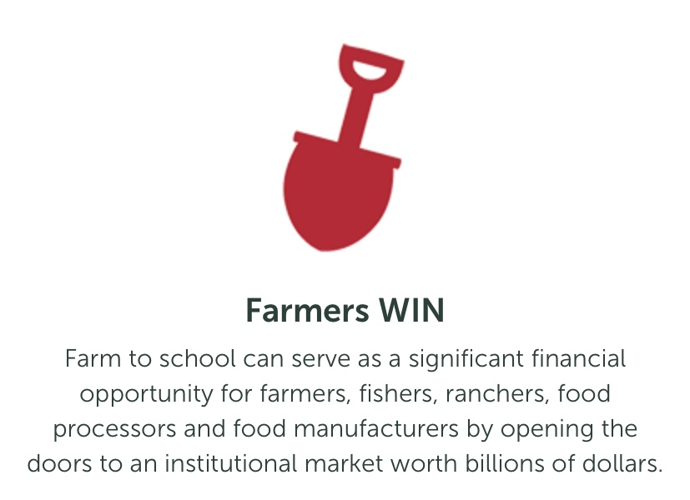

Slide 13
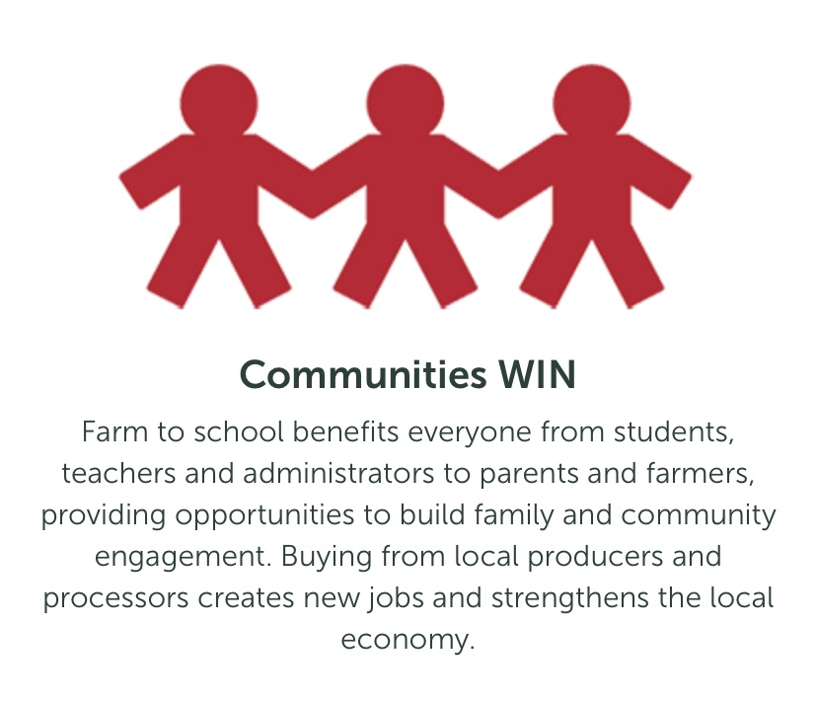

Slide 14
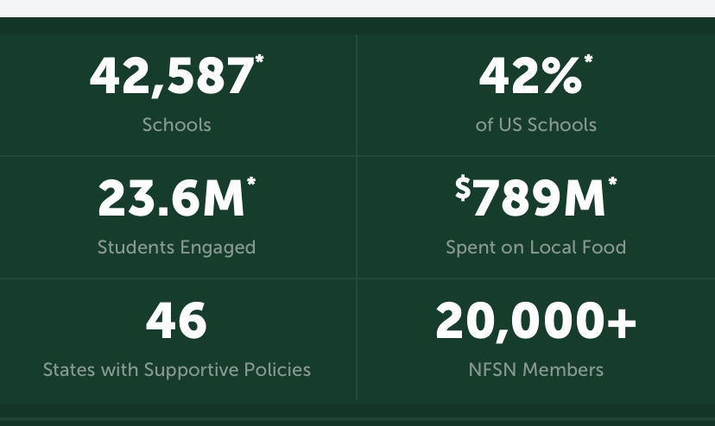
National Farm to School Network

Slide 15
Opportunities
Huge market
Access to different market
Higher quality and consumption of food
Addresses childhood obesity epidemic
Support for local economy and community

Slide 16
Barriers
  Time
  Cost
  Volume
  Reliability
  Ordering and Payment
  Perceived limitations in children’s tastes
  GAP (Good Agricultural Practices) Certification for farms
  Lack of appropriate kitchen facilities

Slide 17
Opportunities
Huge market
Access to different market
Higher quality and consumption of food
Addresses childhood obesity epidemic
Support for local economy and community

Slide 18
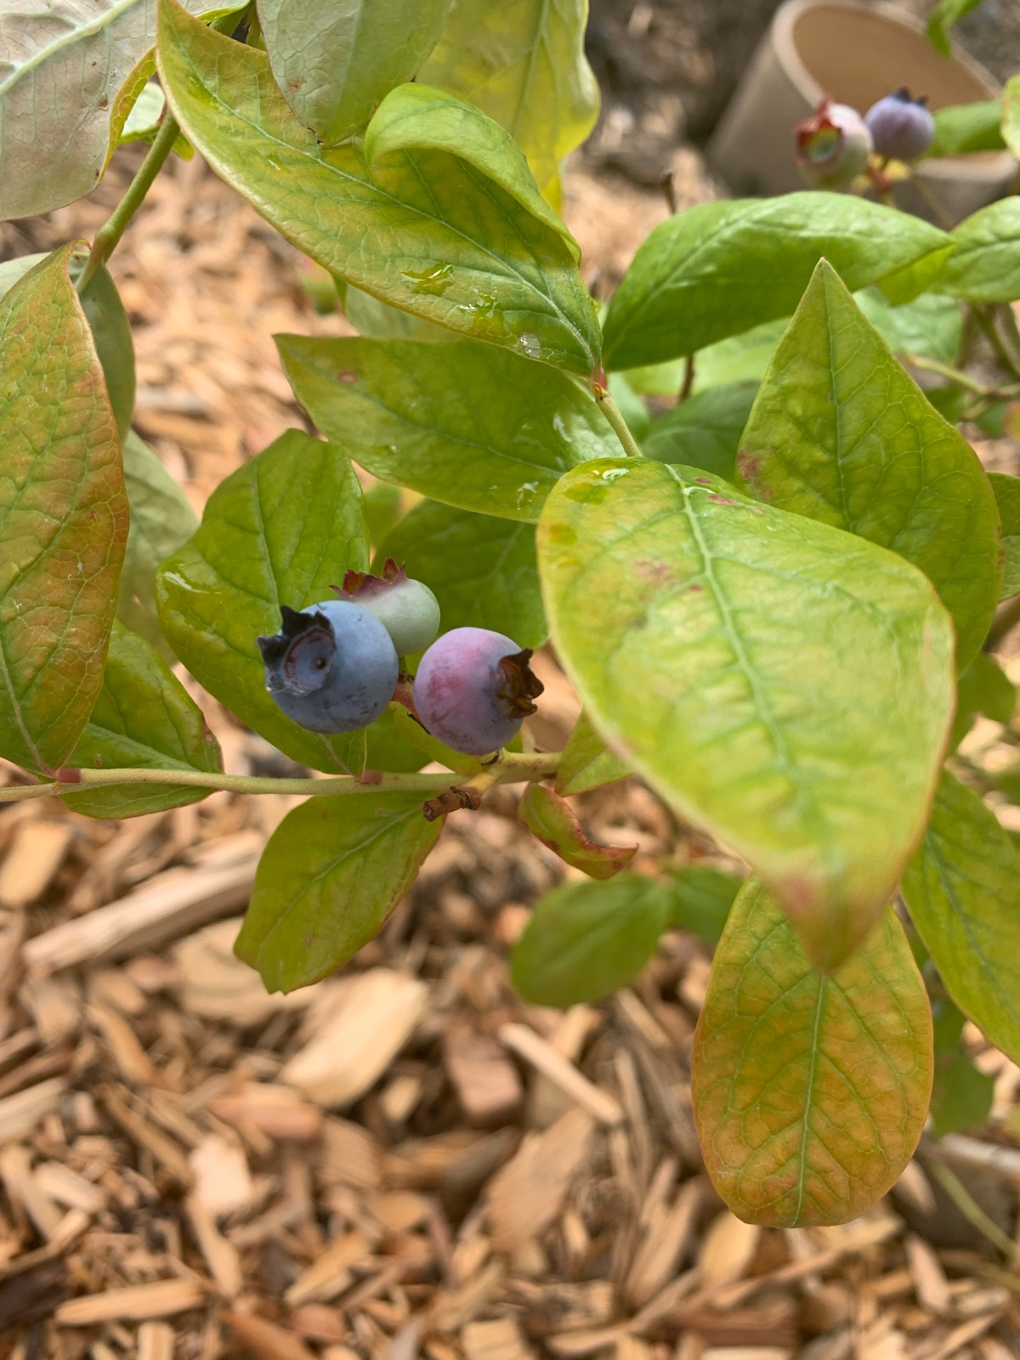

Slide 19
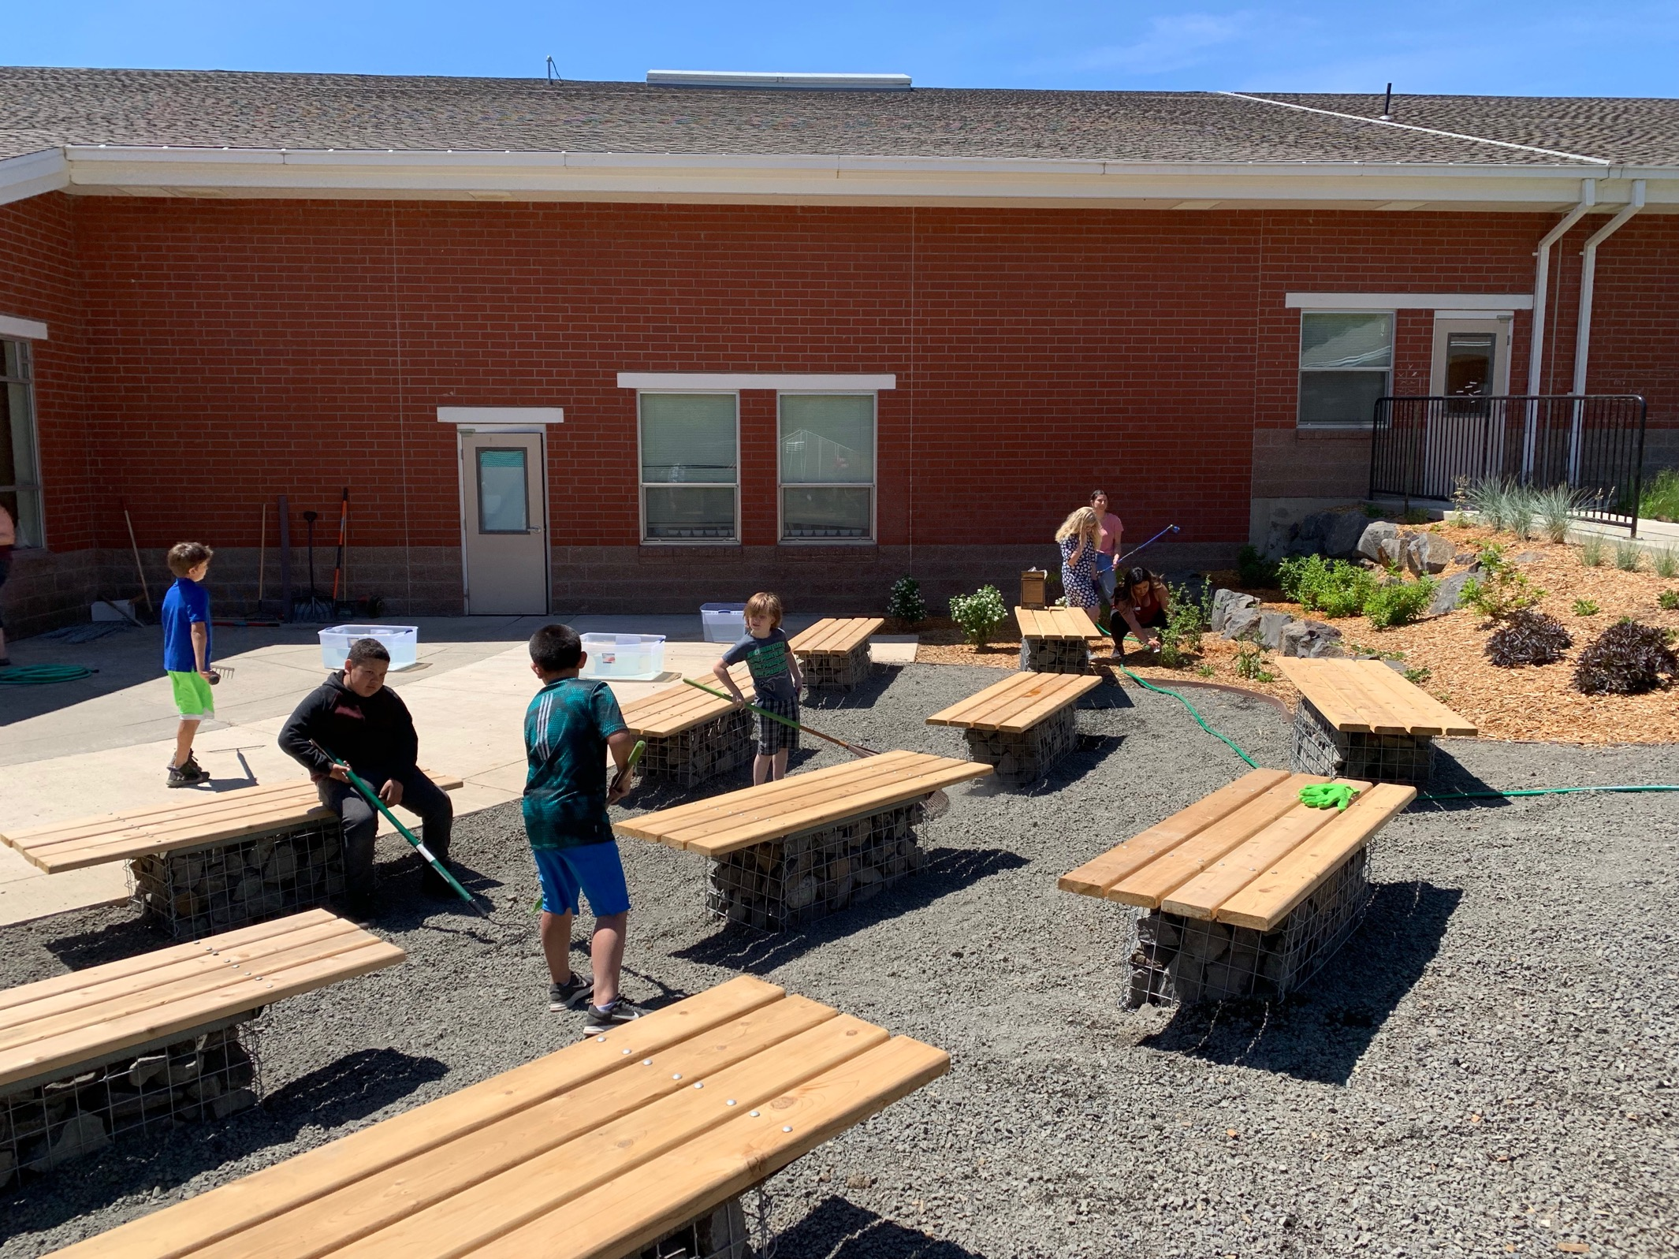

Slide 20
Questions?

Slide 21
