Slide 1
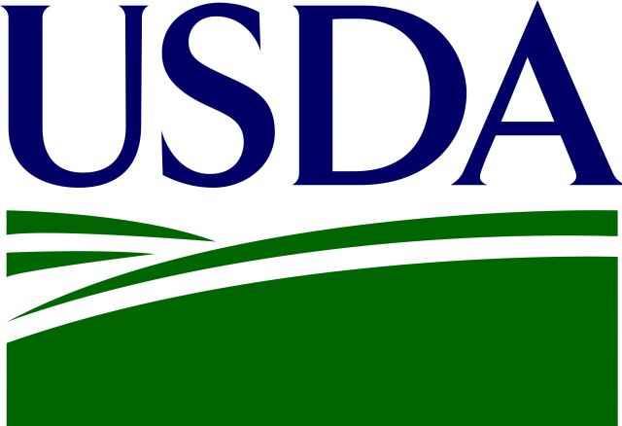
Farm Service Agency Farm Loan Programs

Slide 2
Andrea Sherry Palmieri
Farm Loan Officer
Farm Service Agency
Pasco, WA
andrea.palmieri@usda.gov
509-416-5707

Slide 3
USING DEBT TO REACH BUSINESS GOALS AND SUCCEED
Why are many beginning operations wary of debt?
What are the different types of debt?
How can debt be healthy for a business?
When is debt not healthy?
Where to go for funds for operating and start up costs
Loan programs offered by the Farm Service Agency

Slide 4
Why are many beginning operations wary of debt?
Fear of not being able to make payments
Concern of owing money to a bank, or strangers
Equating debt to not having money
Not wanting to pay interest cost

Slide 5
What are the different types of debt?
Short term operating funds – monthly or annual funding to keep money in the bank to pay bills. Paid back immediately.
Intermediate funds – money used to purchase equipment or items that will be used for several years. Paid back over a few years.
Long term funds – used to purchase permanent assets such as land or buildings. Paid back over many years.

Slide 6
How can debt be healthy for a business?
 | BUDGET
INCOME
Wheat Sales | $10,000
Barley Sales | $10,000
 | $20,000
EXPENSES
Seed |  | ($2,000)
Fertilizer |  | ($1,500)
Labor |  | ($3,000)
Rent |  | ($3,500)
 |  | ($10,000)
NET PROFIT | $10,000
Even if you have a great business, not having appropriate funding can cost you money or affect operations.
What if you could get better pricing on supplies by purchasing in bulk or prepaying? Or you are unable to deliver a product or service due to being unable to purchase supplies timely?
Having an operating line can ensure funds are available to take advantage of opportunity and operate efficiently.
Using term debt can keep money available for operating and spread out cost over time.

Slide 7
How can debt be healthy?
 | BUDGET
INCOME
Wheat Sales | $10,000
Barley Sales | $10,000
 | $20,000
EXPENSES
Seed |  | ($2,000)
Fertilizer |  | ($1,500)
Labor |  | ($3,000)
Rent |  | ($3,500)
Equipment Purchase $15,000 - payment |  | ($3,465)
 |  | ($13,465)
NET PROFIT | $6,535
If you know your plan will make money, but you don’t have $10,000 to operate until income can come in – an operating loan can ensure you have cash to get through the year
What if you need to buy a piece of equipment for $15,000? Maybe you had money to operate for the year but if you spend that cash you won’t have enough for next year – a term loan can space out the payments over time to keep cash flow positive

Slide 8
When is debt not healthy?
 | BUDGET
INCOME
Wheat Sales | $10,000
Barley Sales | $10,000
 | $20,000
EXPENSES
Seed |  | ($2,000)
Fertilizer |  | ($1,500)
Labor |  | ($3,000)
Rent |  | ($3,500)
Equipment Payment |  | ($3,465)
Mortgage Payment |  | ($7,000)
 |  | ($20,465)
NET PROFIT | ($465)
Too much debt can be a bad thing.
Interest cost is too high.
Payments can not be made by income produced.
Even if budget cash flows, if the business is too highly leveraged, a bank may not be willing to lend.

Slide 9
Where to go for funds for operating and start up costs?
Traditional banks that offer business lending.
Grants or community programs for small businesses or start ups.
Personal assets or private individuals.
Non traditional lenders such as Farm Service Agency.

Slide 10
How FSA offers opportunity to family sized farmers and ranchers
Loans for farmers and ranchers who are unable to qualify with a traditional lender due to inexperience or financial limitations
Lower interest rates, longer or flexible terms, and minimal security requirements help keep costs down while improving financials
Targeted focus on beginning farmers, racial and ethnic minority farmers and women producers
Can work with value-added, direct sale, organic, and specialty crop operations
Applicants must have some farming experience

Slide 11
Loan programs offered by Farm Service Agency
Farm Ownership loans help you purchase or enlarge a farm or ranch, construct a new or improve an existing farm or ranch building, pay closing costs, and pay for soil and water conservation and protection.
Operating loans help you purchase livestock and equipment and pay for minor real estate repairs and annual operating expenses.
Microloans are direct farm ownership and operating loans with a shortened application process and reduced paperwork designed to meet the needs of smaller, non-traditional, and niche-type operations.

Slide 12
Farm Loan Programs Information Chart

Slide 13
How to get started with FSA financing
Set up a meeting with your local office to discuss your goals and qualifications
Go online for more information on Farm Service Agency loans
https://www.fsa.usda.gov/programs-and-services/farm-loan-programs/index
Take a copy of “Your Guide to FSA Farms Loans” for more information
Contact me if you have any questions:
Andrea Palmieri 509-416-5707 andrea.palmieri@usda.gov

