Slide 1
Staple Crop Assessment Within BIPOC Communities of Washington State to Support Regional, Culturally Relevant Food Systems
CREATING ACCESS FOR CULTURALLY RELEVANT FOOD
By Mercy Kariuki-McGee/Haki Farmers Collective
and
Aba Kiser/WSU Food System
BIOAG Staple Crop Research Steering Committee
(Cascadia Regional Call - April 8th, 2021)

Slide 2
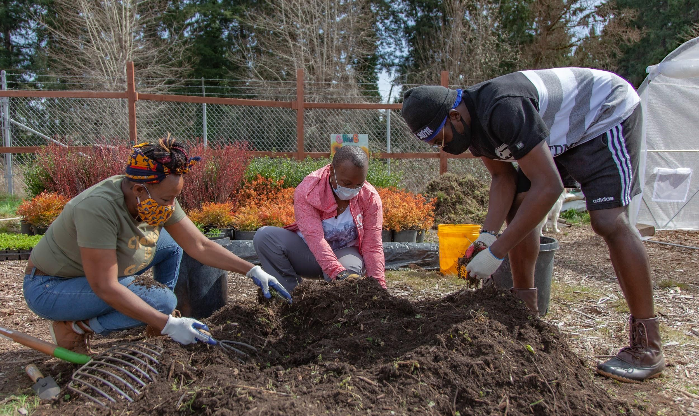
Background
BIPOCs are under represented in farming and have limited access to healthy and culturally appropriate foods.
In US there are 3.9% BIPOC farmer
BIPOC count for 62% of farm laborers compared to 38% white farmers in US
Today gaps still exist in agricultural system that:
limit access to land acquisition,
farming education, and
capital for small to mid-scale BIPOC farmers
The barriers limits abilities to find solutions to introduce these food solutions for BIPOC in regionally adapted staple crop markets.

Slide 3
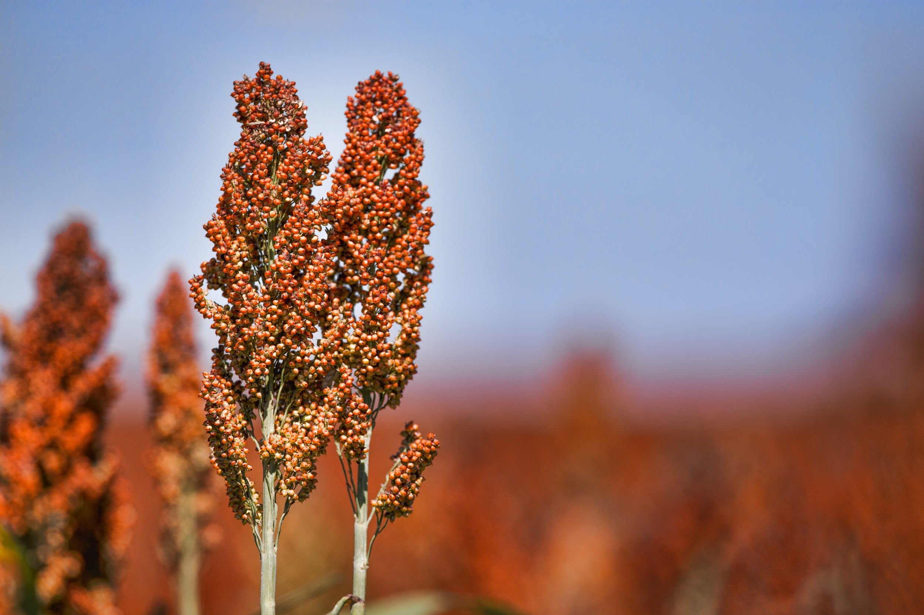
Research Purpose
Conduct a quantitative and qualitative needs assessment of culturally relevant staple crops within BIPOC farmer and consumer
Assess best practices
Develop next steps to:
reviving regional, culturally-relevant,
sustainable for small-to-mid scale farmer
Aim to understand the needs for BIPOC farmers and consumers
Identify gaps
Map pathway to establishing a thriving regional market for the crops
grains, pseudo-grains or seed crops, pulses, oil seeds, and nuts

Slide 4
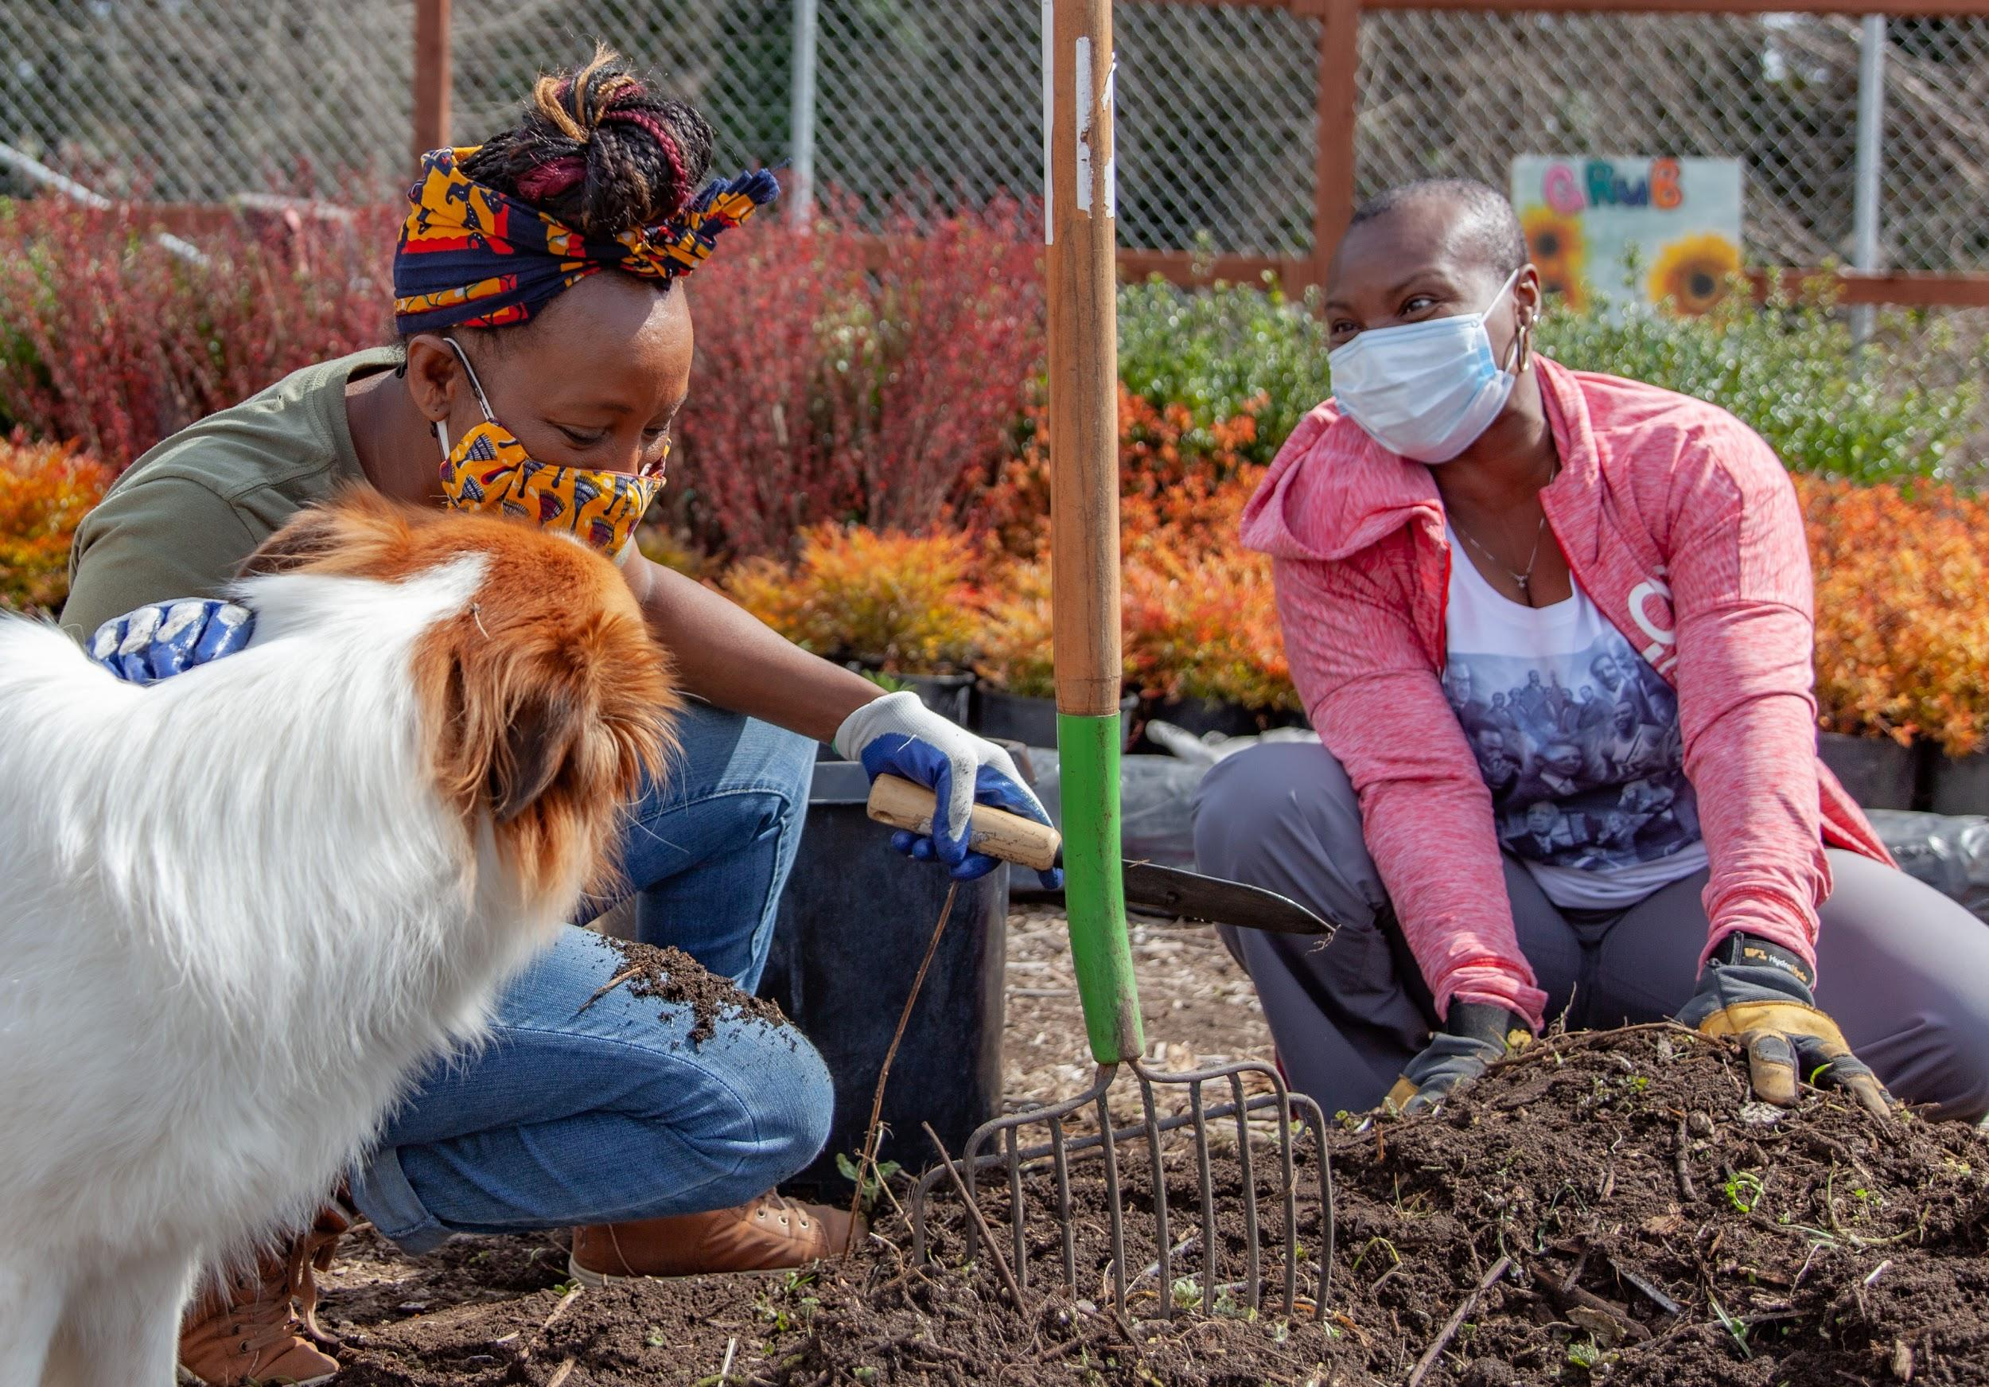
The Study Design
The research will use two methodologies to find community needs
Online survey using Qualtrics Platform (https://www.qualtrics.com -a popular user-friendly platform widely used for such research
Survey hopes to reach at 500 consumers
PhotoVoice and Most Significance Change
A participatory action-research method
Uses photo as a storytelling tool to inform or create social change
Allows participants to engage in a very passionate way
Gives the participants the power to shape the outcome of the research
Participants
Farmers
Consumers

Slide 5
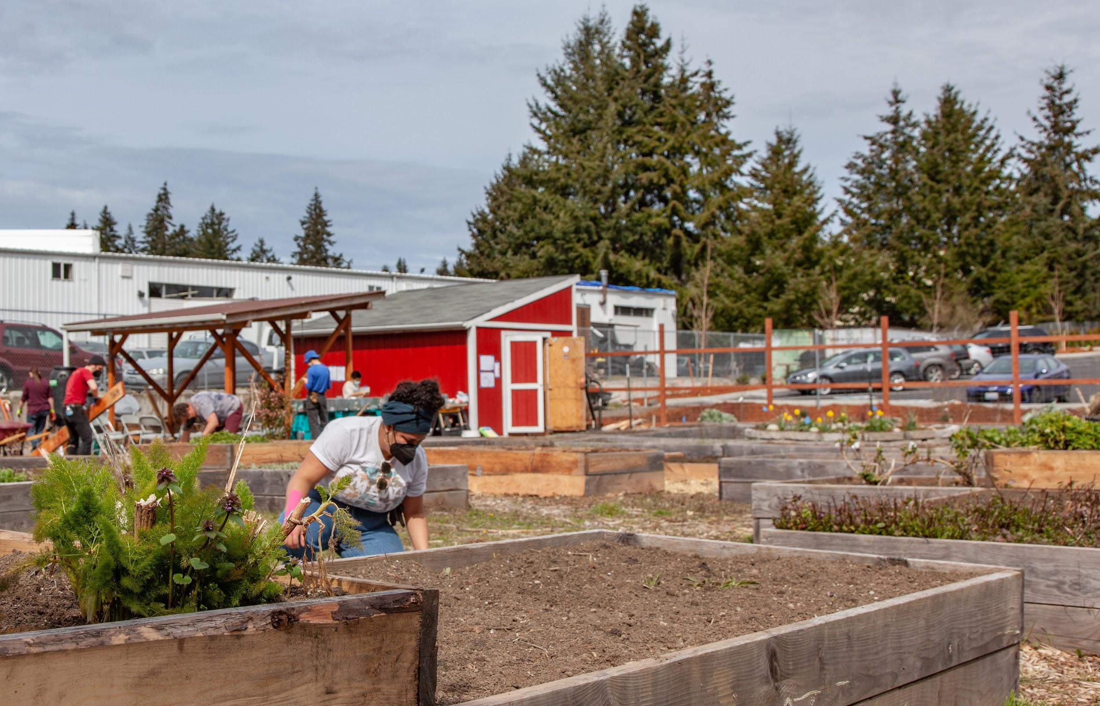
Results and Expected Impacts
Identify priorities and next steps for regional market development
Create a report and database for staple crops that are culturally relevant for specific BIPOC communities in Washington State
Document what current barriers farmers face in
in growing ing, processing
and distributing these crops.
Document what current barriers exists for consumers in:
Accessing their culturally relevant staple crop
Invite participants to gallery exhibition to access and quantify the results before distribution to the broader community
Outline partners to implement recommendations derived from the research.

Slide 6
THANK YOU FOR THE OPPORTUNITY

