Slide 1
A Baker’s Life Using Local Whole Grains
Via Wyld Bread

Slide 2
Why Local Whole Grains?
Nutrient Dense
Less distance and time it has to travel, the more nutrients it retains.
Fresher than your average.
Supporting Local Farms
Spending your dollar wisely and keeping your local economy strong is essential.
Maintaining good relationships with your grain farmers to learn more about the grain and pick their brain regarding specific harvests.
Flavor
Whole grains that don’t need to travel so far are not only fresh, but they’ve got insane flavor.
Experimenting
Taking a traditional recipe to the next level and finding new way to integrate whole grains into every baked good there is.

Slide 3
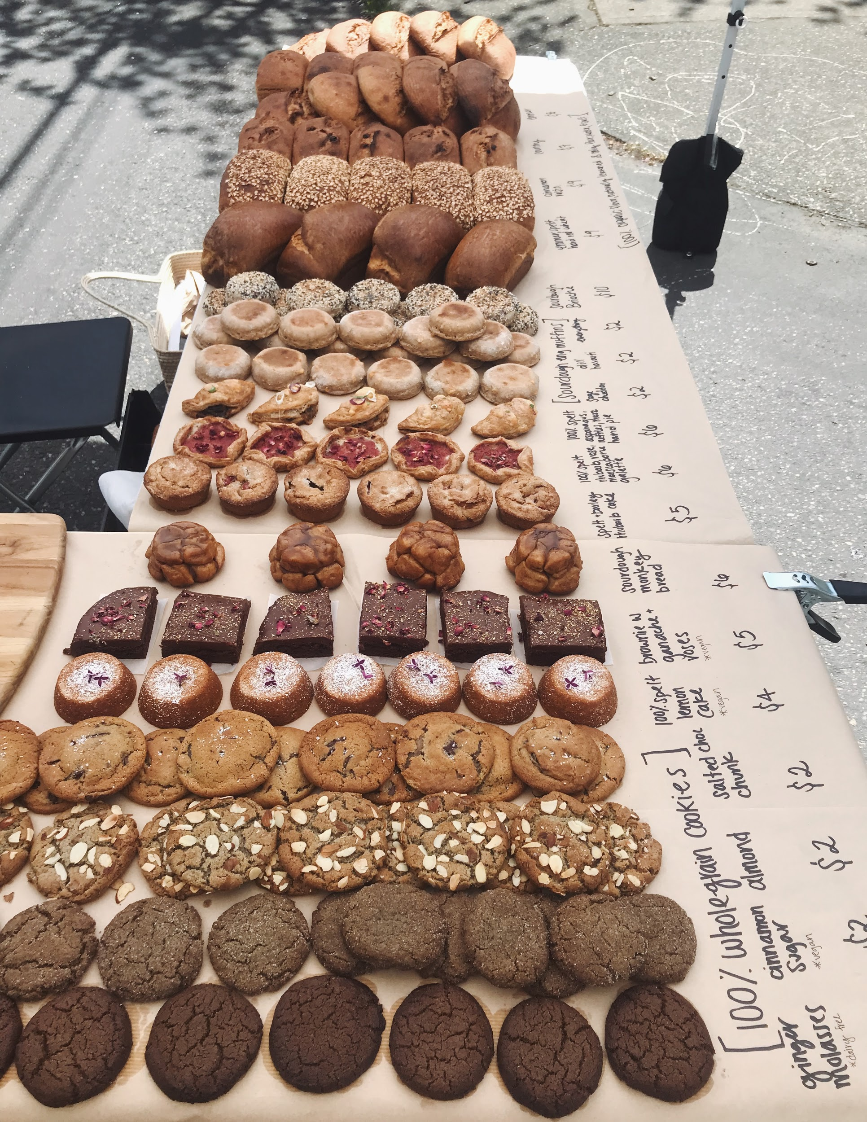
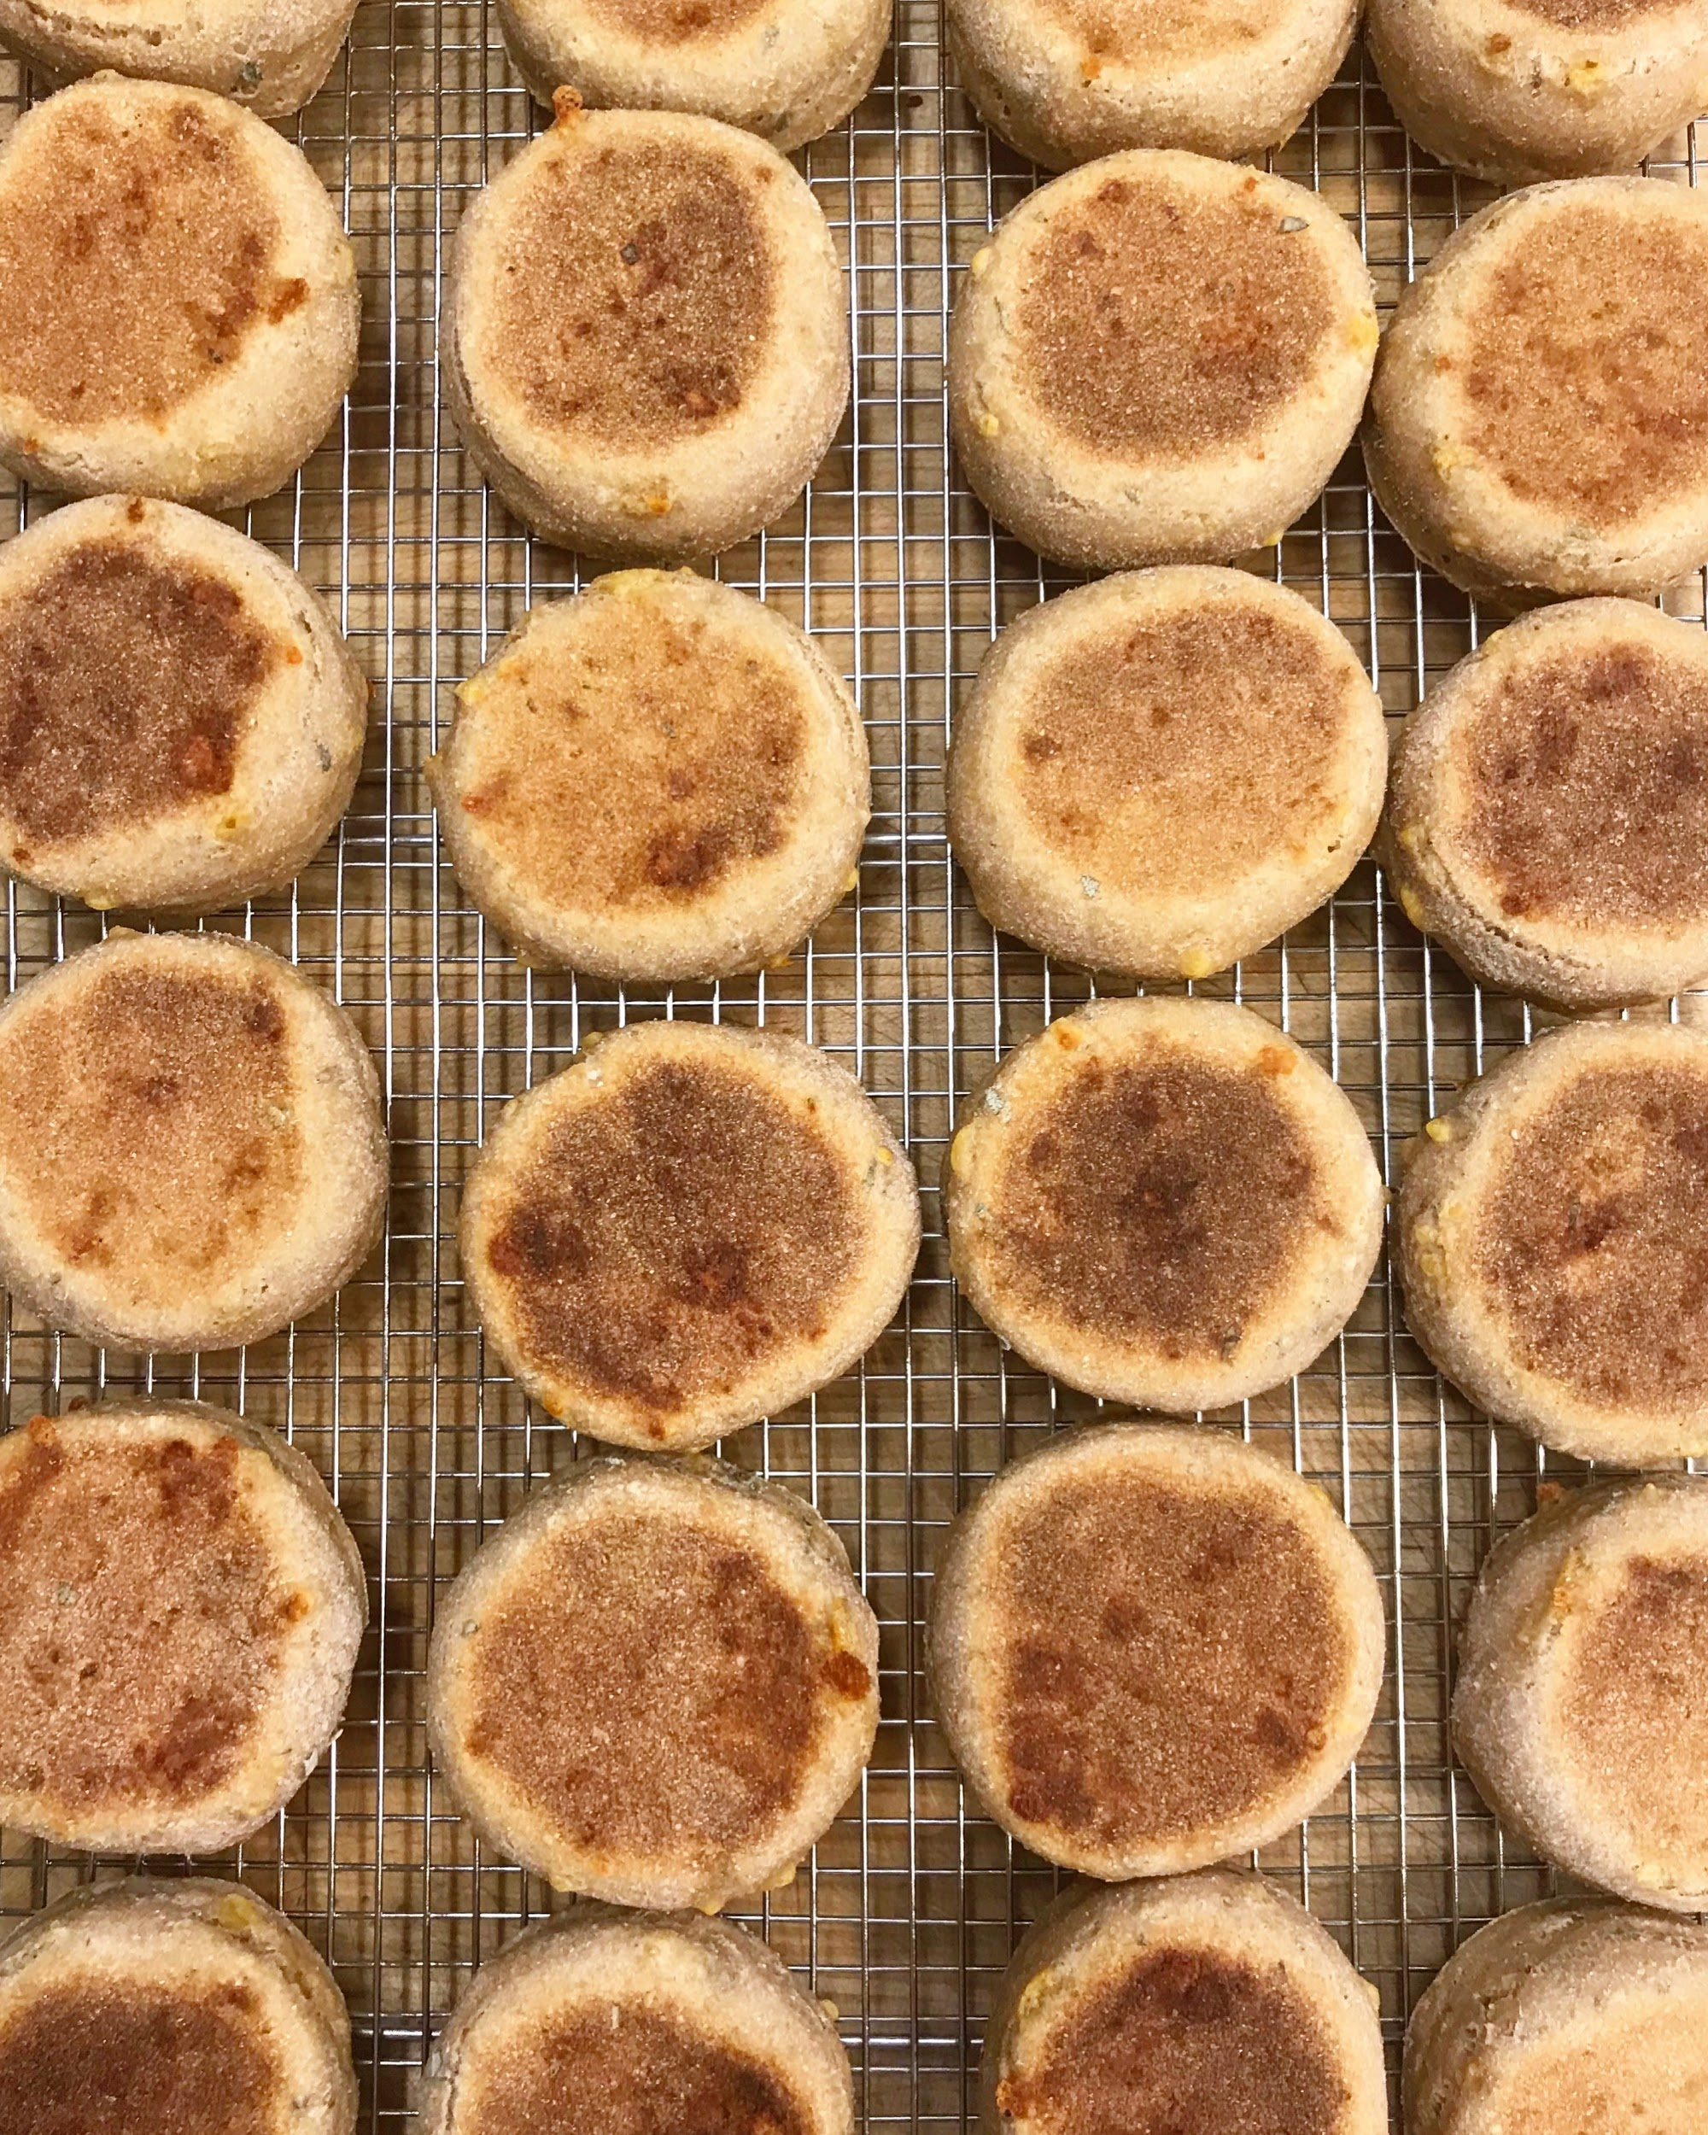
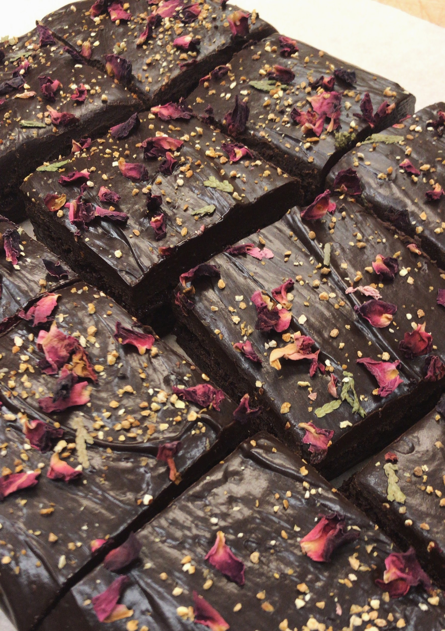
The Goods

Slide 4
Sourcing Local Grains
Camas Country Mill
Grown at their farms or by other small grain farms in the region.
Fantastic variety of grains and having Organic flour available.
Meeting the minimum as a microbakery
Wanting to source more varieties of grains, but not having the space.
Cost of Goods
Organic grains almost double the price as non-organic
Smaller margin makes it harder to make any sort of profit
Educating customers on the benefits of local whole grains and why the baked goods are priced higher than most other bakeries.

Slide 5
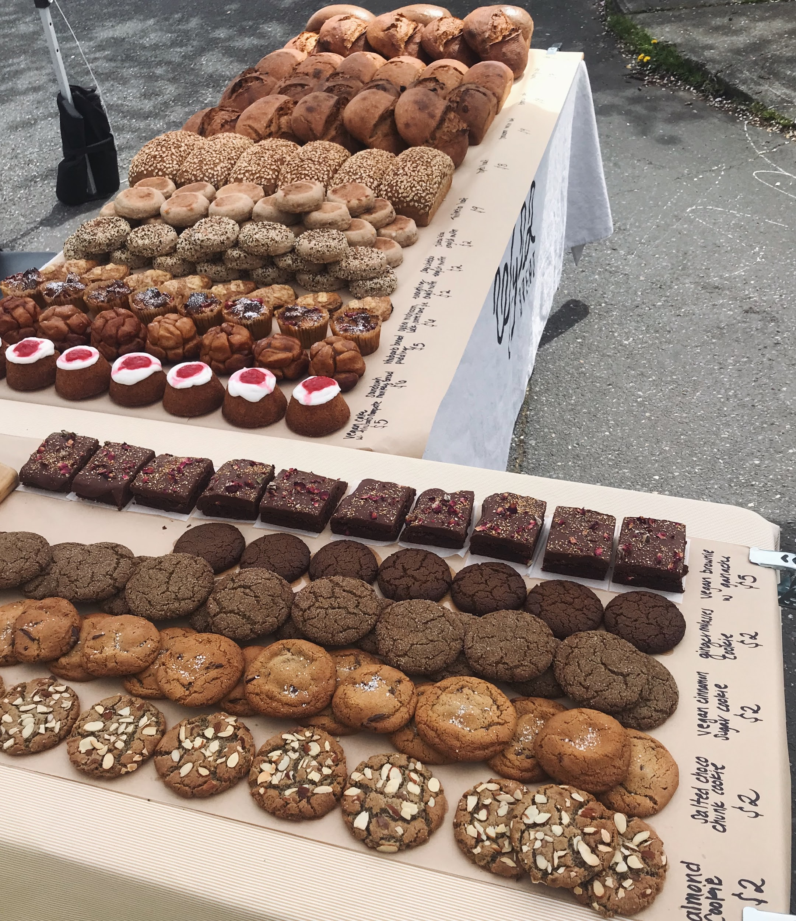
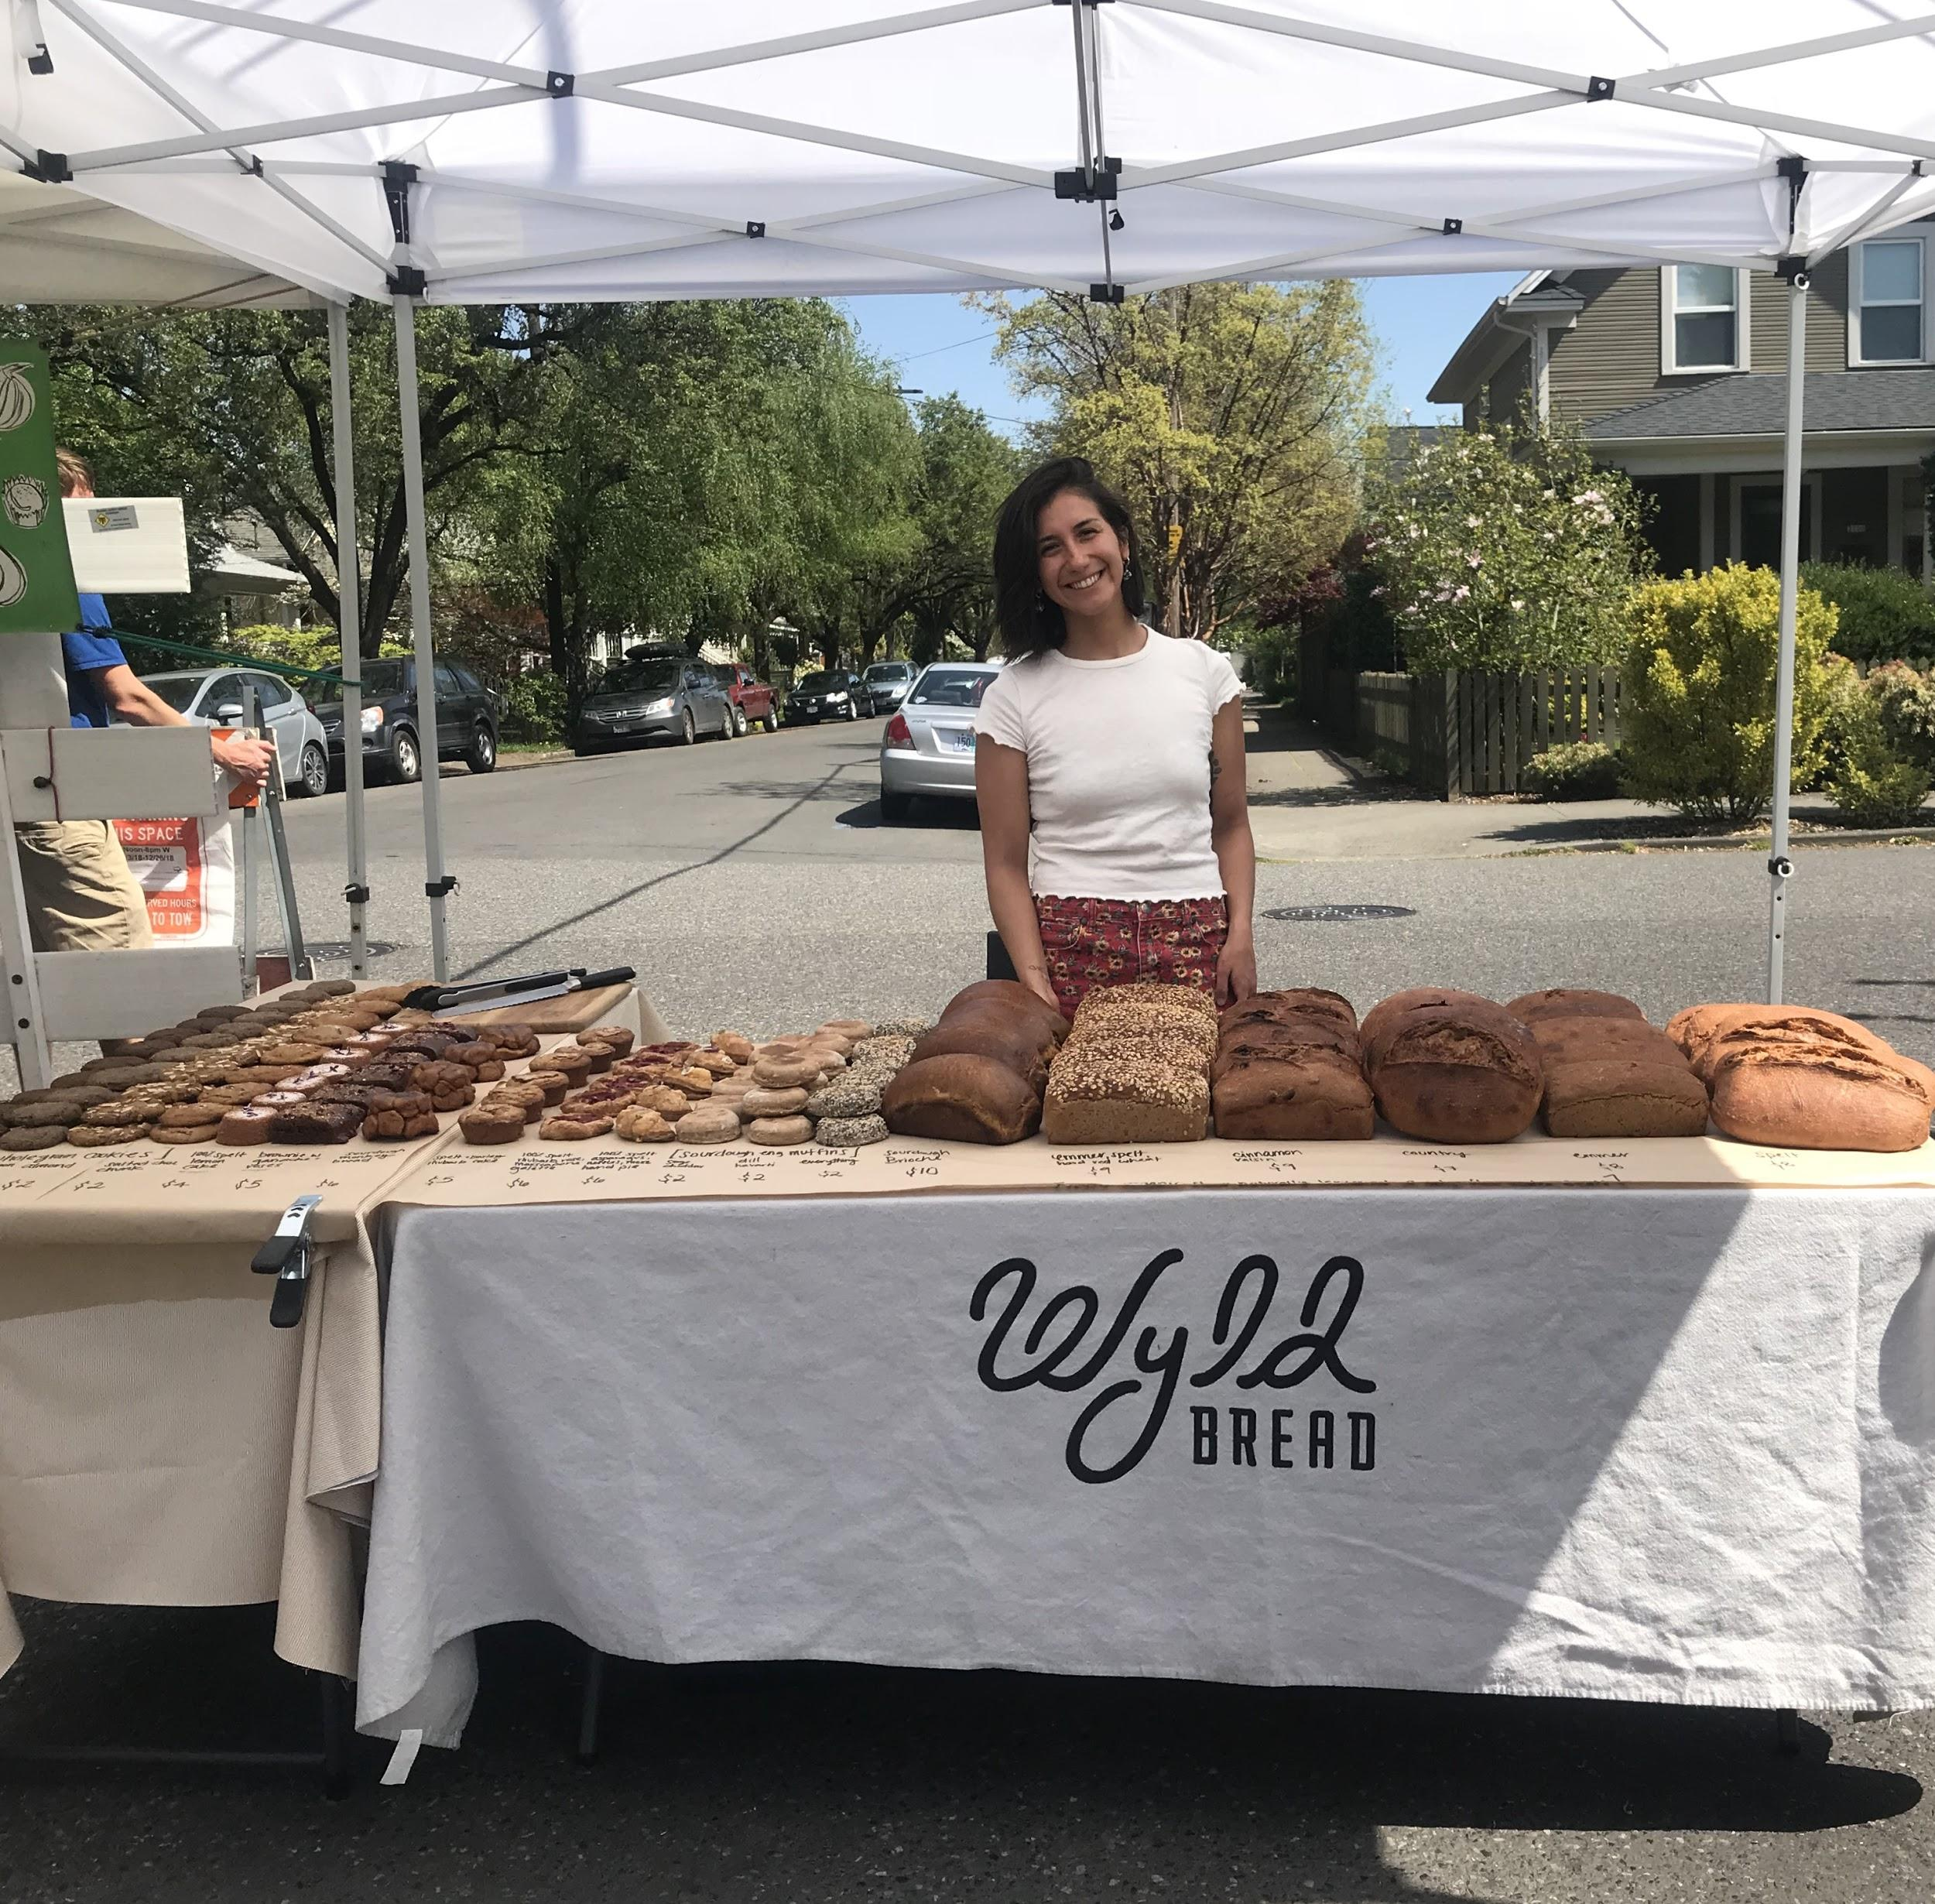
Seasons at Farmers Markets

Slide 6
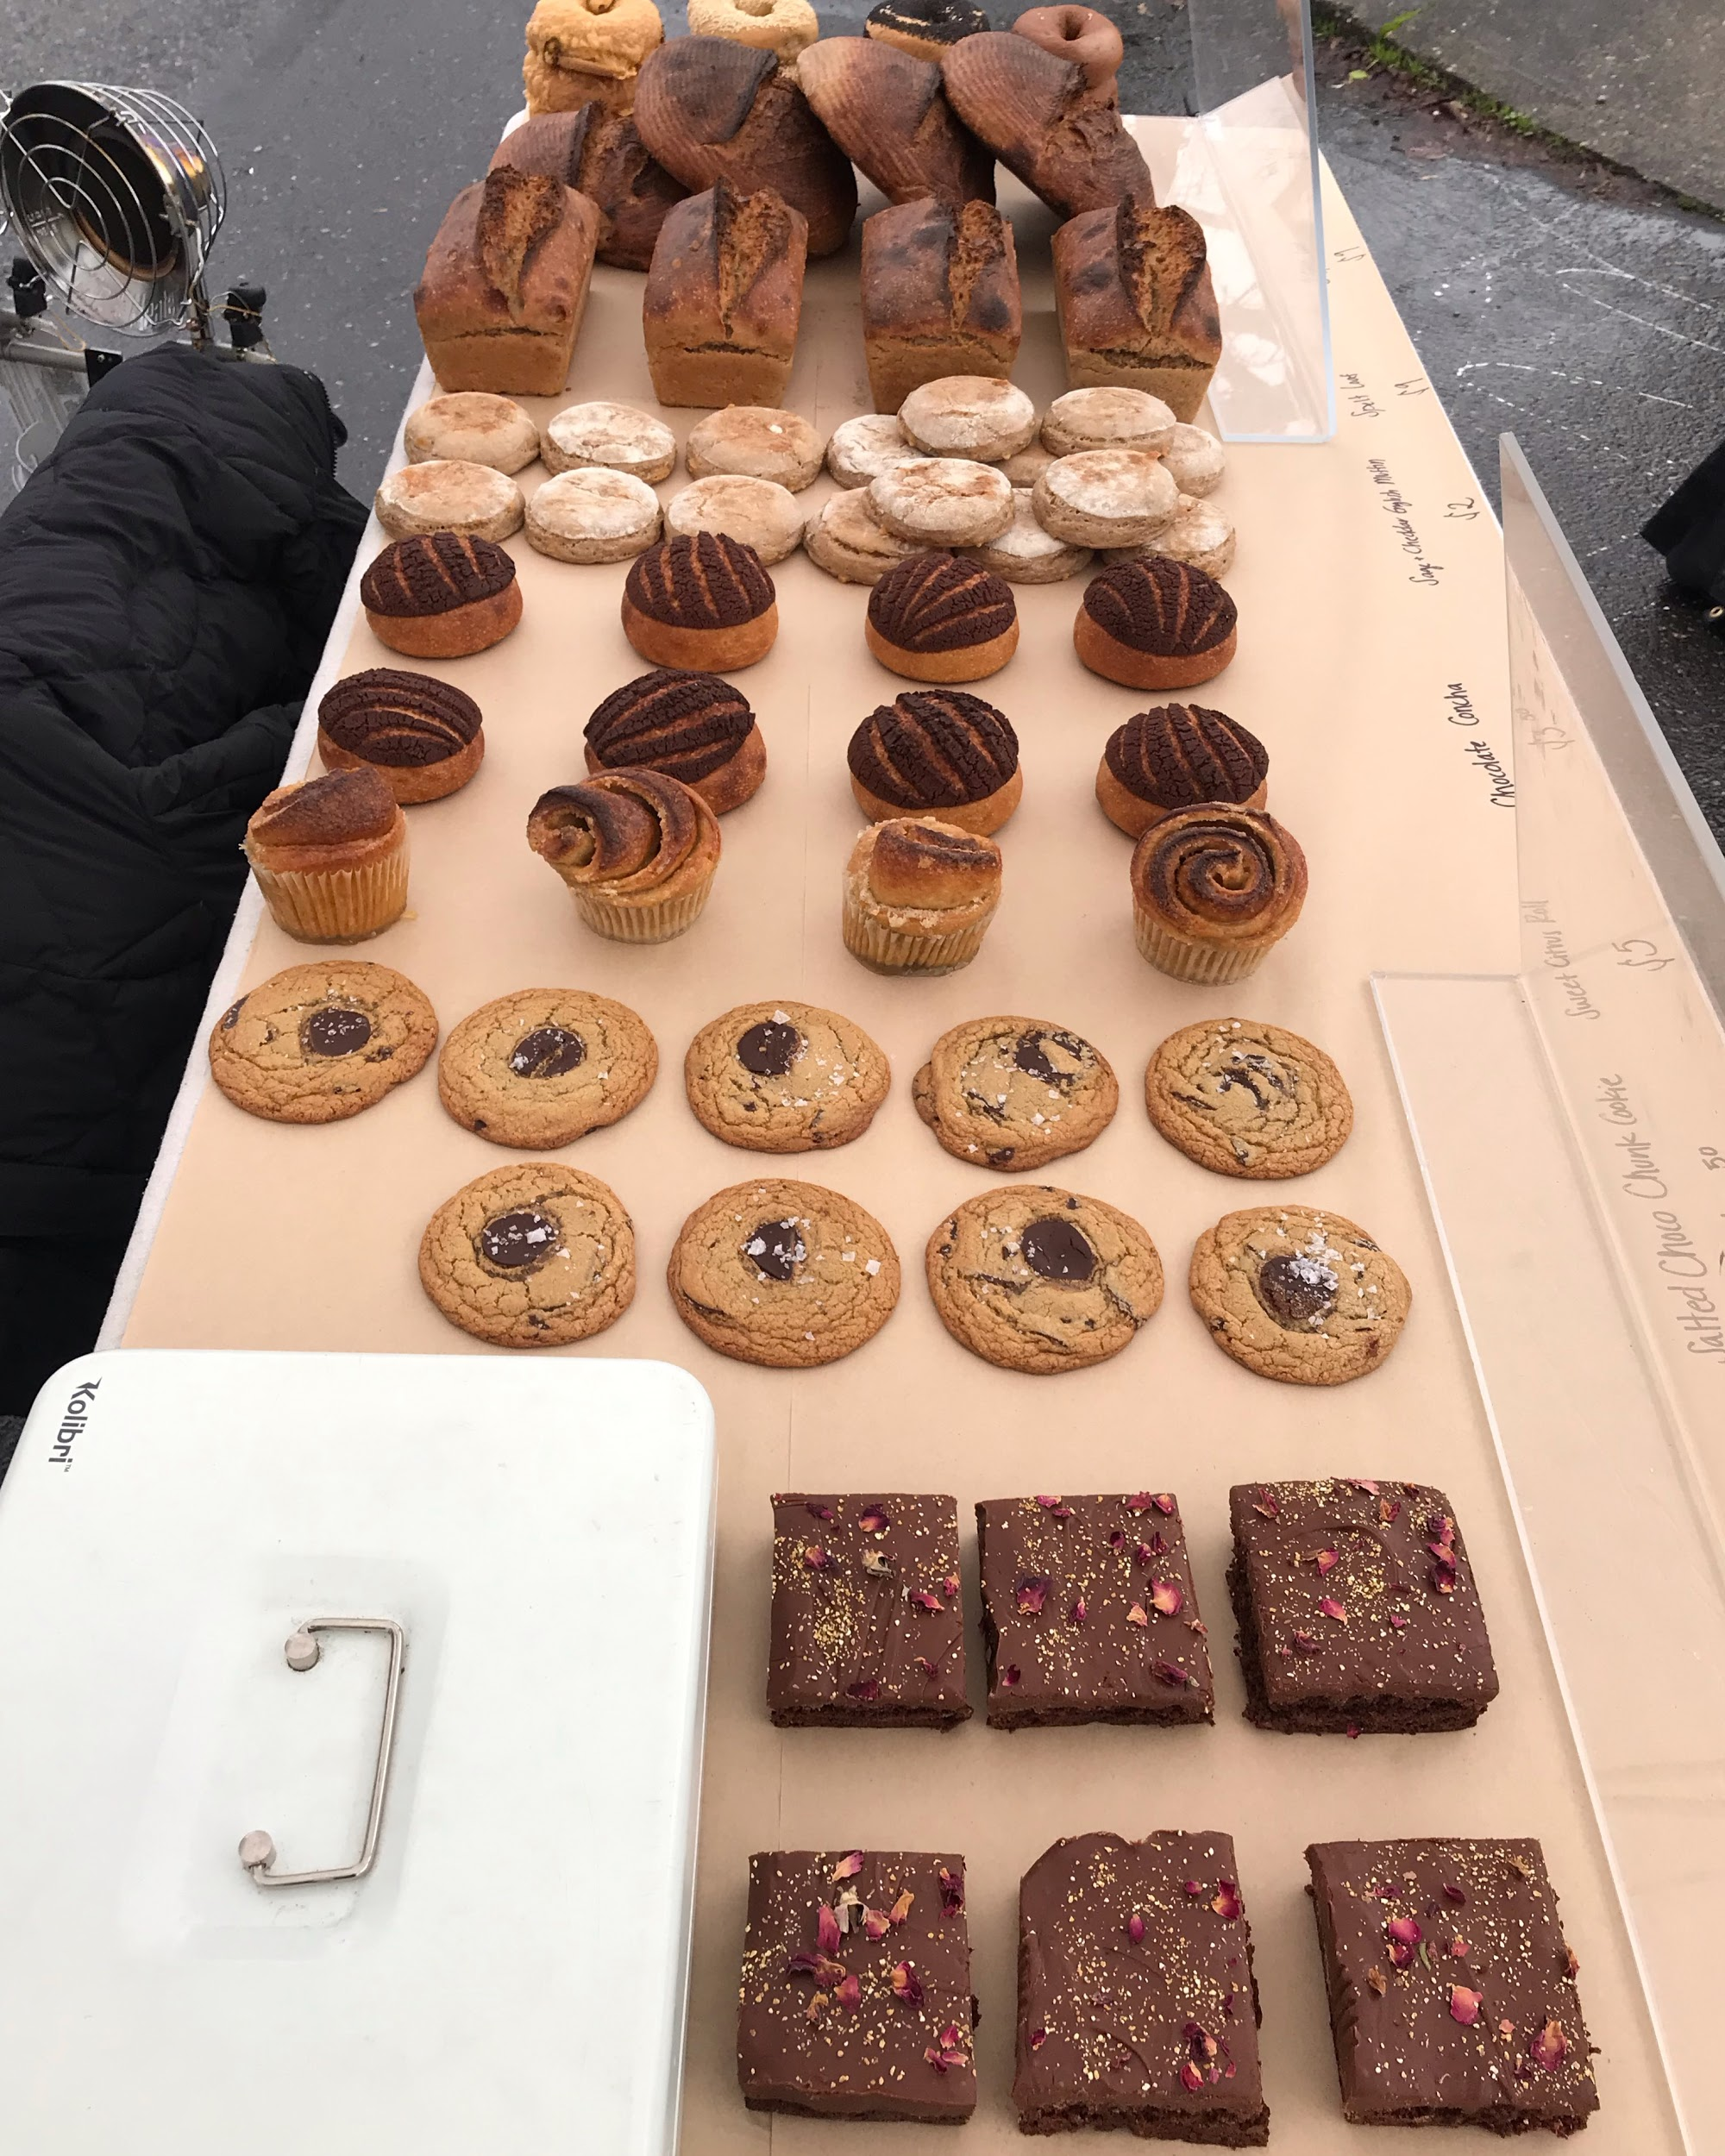
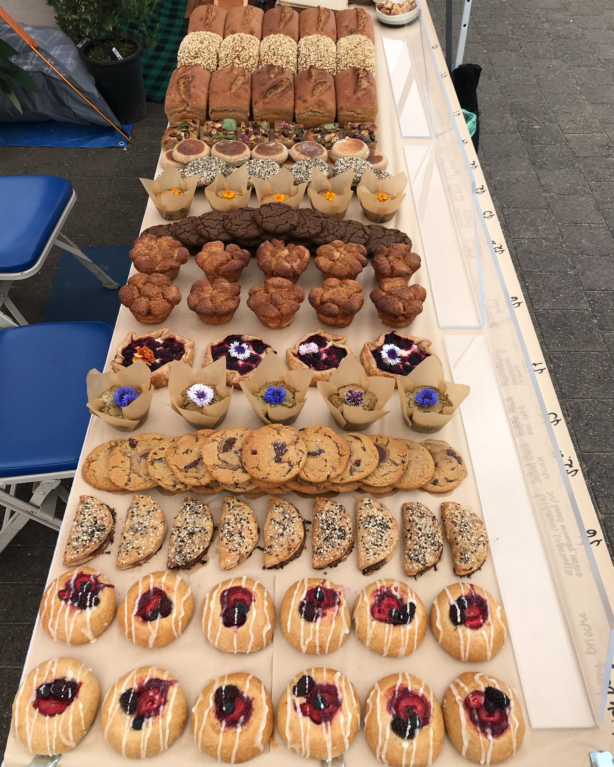
Notes:
Winter VS Spring

Slide 7
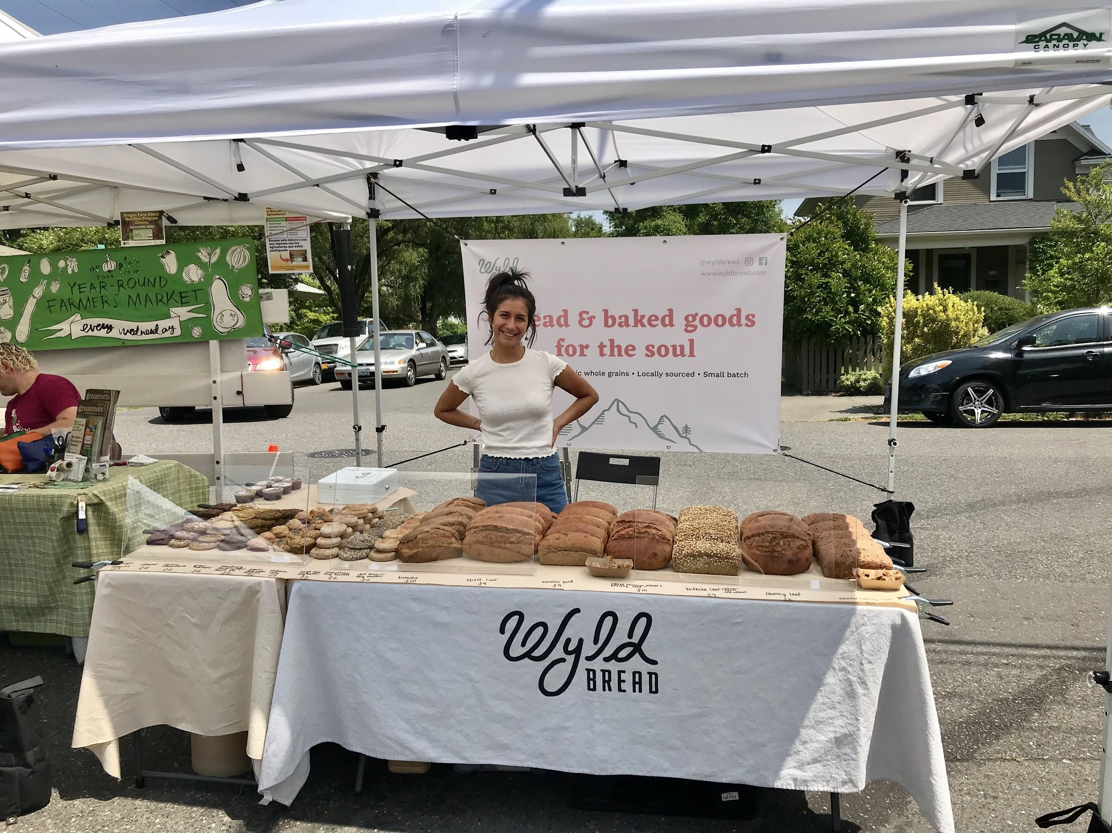
Thank you for your time!

