Slide 1
Baking bread in home kitchens to help supply
local food pantries

Slide 2
Beginning…
500 or so passionate bread bakers, affiliate group
All skill levels, based here in the Pacific Northwest
Enthusiastic about local grains and supporting the local grain economy
Cascadia Grains Conference
Our projects and events are designed to be win/win/win –
Foster a vibrant bread community
Support the local grain economy
Provide learning opportunities for our participants

Slide 3
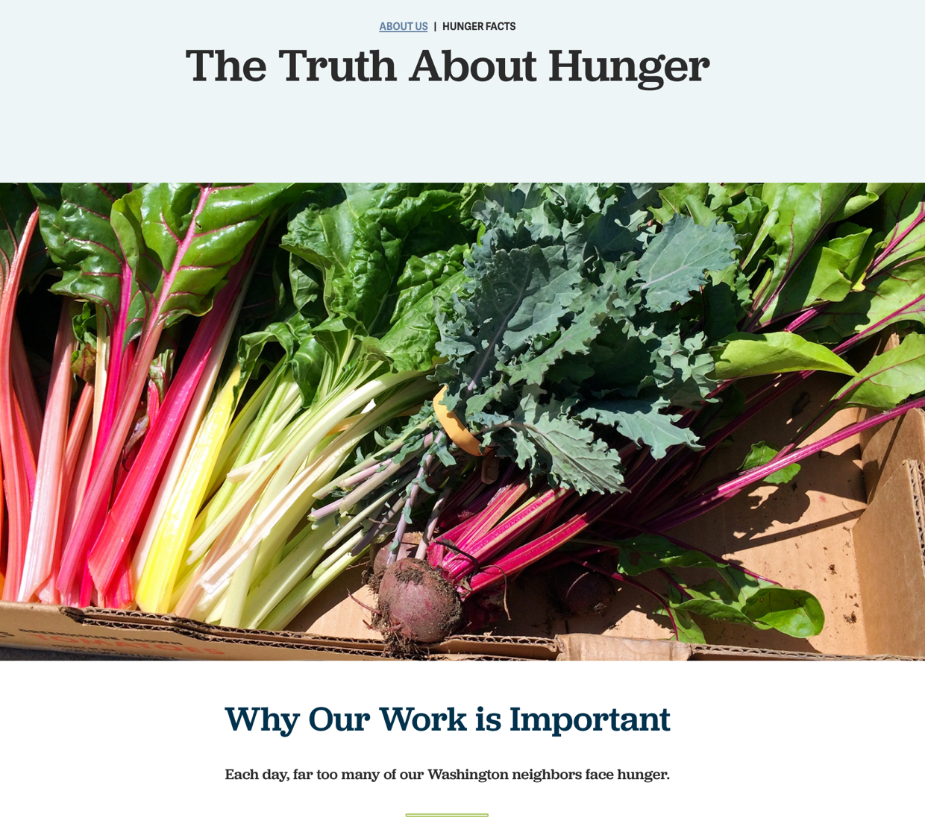
Hunger Facts
COVID-19 Economic Upheaval
Local food banks stretched thin
Many first-time families, projected to get worse
Donations restricted - fresh bread needed
Visit NorthwestHarvest.org, FeedingAmerica.org
One million Washington residents visited a food bank in the past year.
1 in 10 Washingtonians consistently struggle with hunger.
Notes:
Kathy Turk
Patrice Winter
Guy Frenkel

Slide 4
How Can WE HELP?

Slide 5
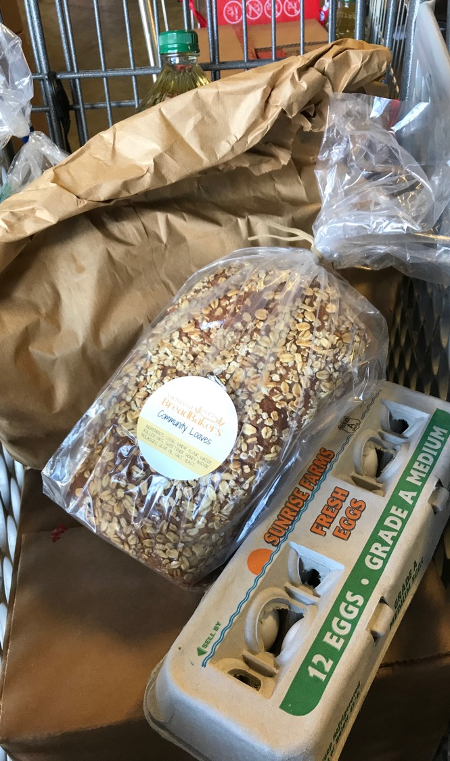
Bread Donations Allowed & Not Allowed
Department of Health – Baked goods, that do not need refrigeration may be received from donors.
Currently supporting 14 Food Banks/Pantries:
Hopelink – 3000 families a week
Fishline Helps – Poulsbo – 200 households a week
Bellingham Food bank – 1000 + households a week
Thurston County Food Bank – 1500 + households a week
Sunshine Pantry - Portland

Slide 6
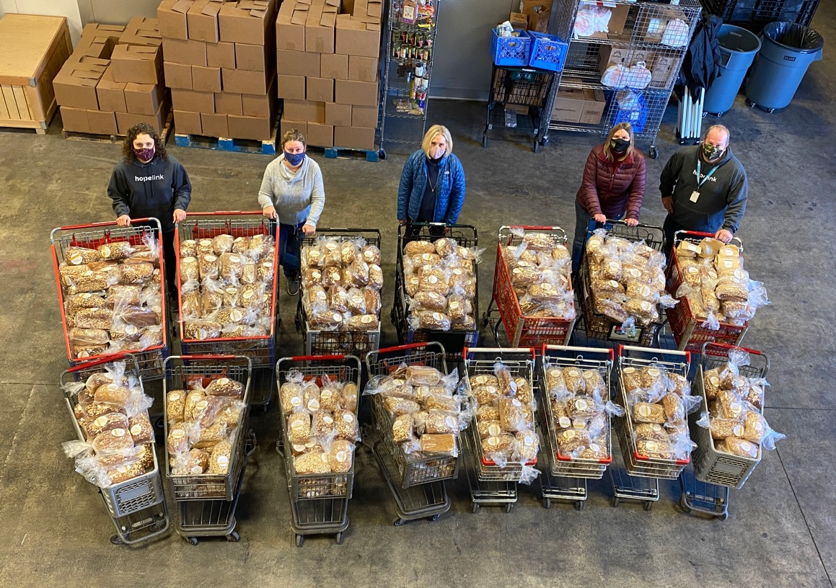
So Far, So Good
April 27 – 5 bakers, 19 Loaves
Twenty-Nine Donations To Date – 20,852
Close to 40,000 pounds - Nearly 20 Tons
850 + Volunteer Bakers (novice to professional), Drivers, Packers
Washington & Oregon… Idaho

Slide 7
2020
– 8349 Loaves
-489 Volunteers
2021 - 12,503 loaves
- 45,000 loaves goal
1000 Volunteers

Slide 8
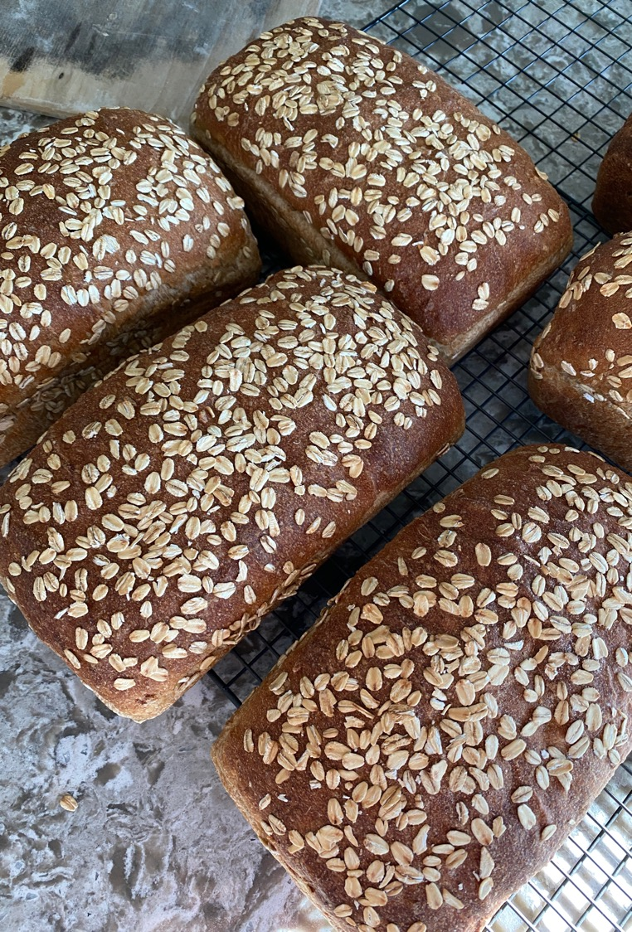
The Initial Loaf
Approachable, Familiar, Sandwich Friendly
Tastes Great
50% Whole Grains & High Extraction Flour + Oatmeal Porridge
FAIRHAVEN MILLS
CAIRNSPRING
HILLSIDE GRAIN (TESTING)
Supports NWBB Local Grains Mission
Has Some Natural Shelf Stability – Sourdough
A Little Yeast for Consistency

Slide 9
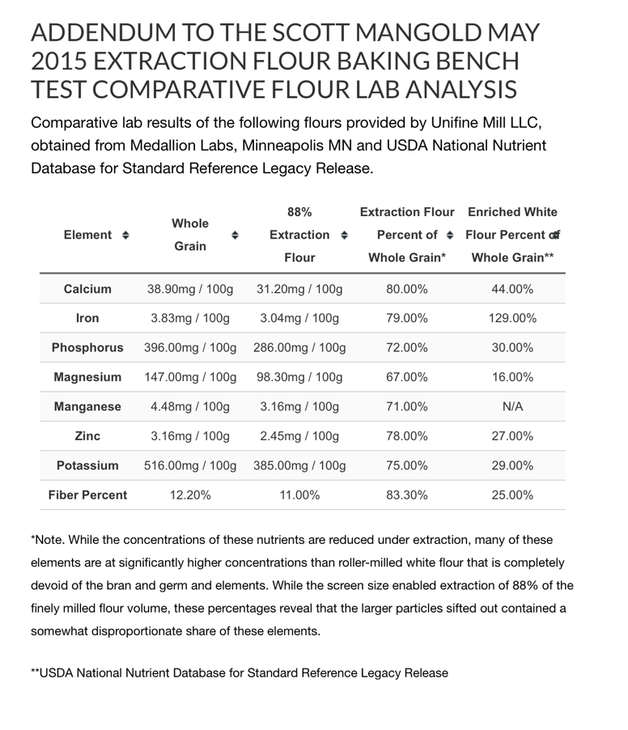
BREADUCATION
LOCAL FARMERS/LOCAL MILL
IN EARLY 1900’S – 24,000 MILLS
IN 2018 – 166 MILLS
FLOUR WITH FLAVOR & NUTRITION
50 LB BAGS ON FRIDAY – WWW.CAIRNSPRINGMILLS.COM
STONE MILLED – HIGHER NUTRIENT & FIBER https://unifinemill.com/news/item/comparative-flour-lab-analysis
TARTIN, GRAND CENTRAL, MACRINA, BREADFARM…ME

Slide 10
SUPPORTING HOME BAKERS
FLOUR & YEAST – THE GOOD STUFF
SOURCING – MET MARKET, PCC, Whole Foods
$2.88 - $3.63 a pound, 2.2 lb bags
We pack in 5 lb bags, currently $1.75 a lb.
Other flours available
WE NEED TO KNOW ABOUT YOUR FLOUR

Slide 11
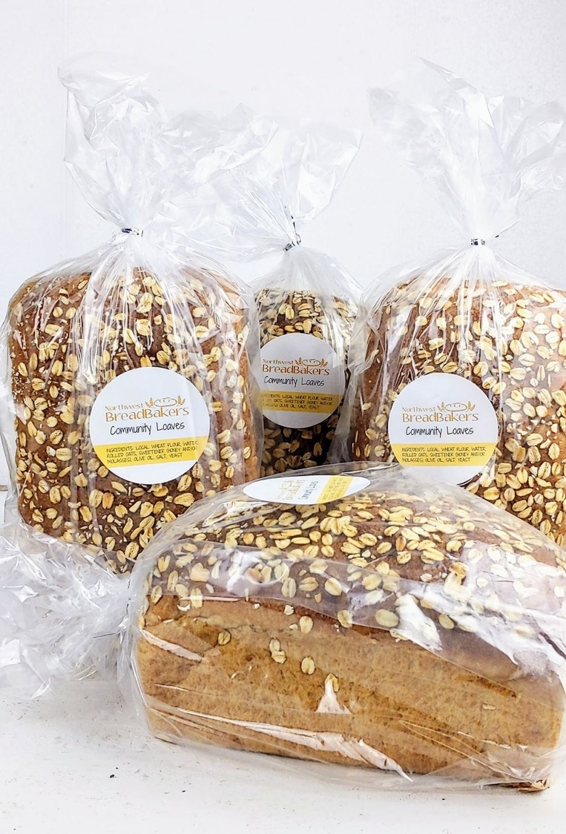
OUR HONEY-OAT FORMULA
Step By Step – FOLLOW FOR BEST SUCCESS
Three Formulas
Scalable – make more if you want
Two Mixing Styles – Hand Mix/Machine Mix
Links to helpful videos
SUPPORT email & phone number, call any time
Resource worksheet – WORK IN PROGRESS

Slide 12
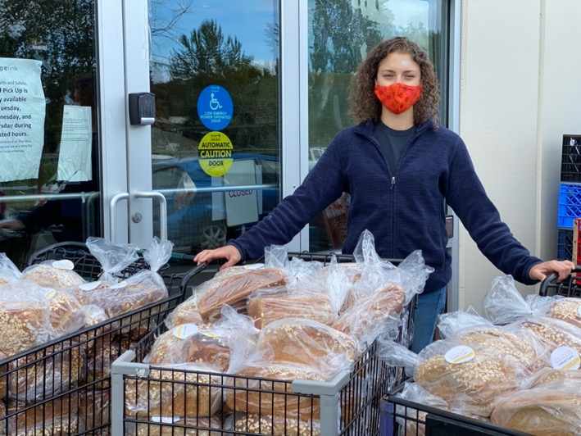
HOW IT WORKS
CREATE A VOLUNTEER PROFILE – AGREEMENTS, SELECT THEIR HUB
WATCH VIDEOS & PRACTICE BAKE
ORDER ANY SUPPLIES – MONTHLY “FLOUR TRUCK”
DONATE BREAD AT THEIR “HUB” – FIRST & THIRD SUNDAYS
RECRUIT BAKING FRIENDS
PARTICIPATION IS ALWAYS VOLUNTARY, OPTIONAL

Slide 13
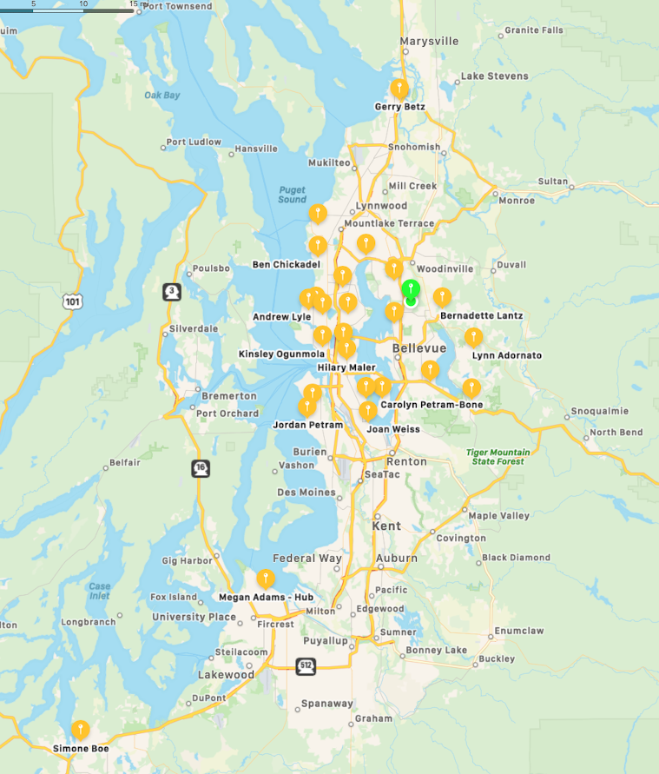
44 & Growning Hubs
Auburn
Bainbridge Island
Ballard – Whittier Heights
Ballard – Loyal Heights
Bellevue – Eastgate
Bellingham – 3 locations
Capitol Hill
Central District
Edmonds
Everett
Issaquah
Kenmore
Kirkland – Houghton
Kirkland - Juanita
Kirkland – N. Rose Hill - Main
Mercer Island
Normandy Park
Olympia
Phinney
Pinehurst
Queen Anne
Rainer Beach
Ravenna
Redmond
Sammamish
Seward Park
Shoreline
South Kitsap – Bremerton
South Kitsap - Poulsbo
Tacoma
West Seattle – Fauntleroy
West Seattle – Central
Oregon Portland – Sylvan Portland – Villa Ridge Eugene

Slide 14
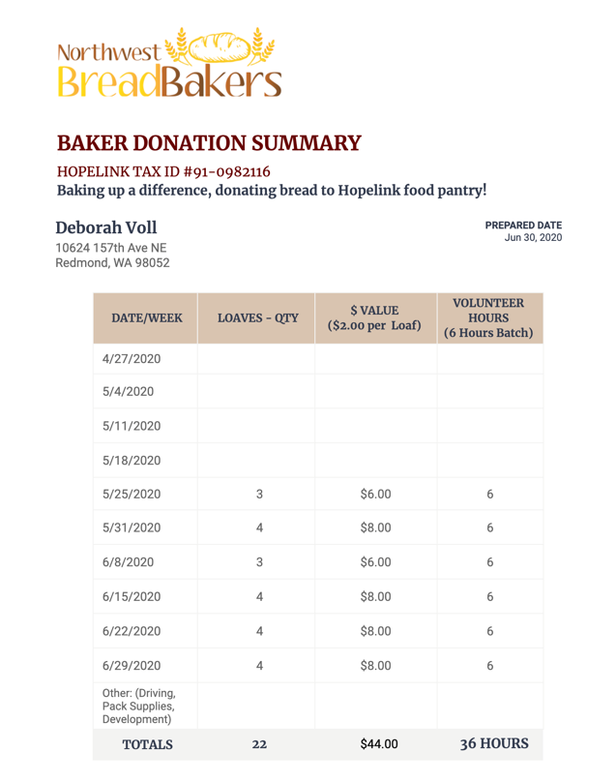
THIS IS A BAKING DONATION
One batch is 4 loaves, keep one, donate three
This is a baking donation – each batch of 4 loaves will cost between $7.00 and $8.00 to make
Yes, you can donate more
Submit your hours to your employer for “matching” dollars

Slide 15
Other Volunteer Roles
Right now focus is on the Bread Brigade
There are opportunities for other volunteer efforts
Being a neighborhood hub for ingredients or bread drop off
Drivers
Flour repacking – breaking down 50 lb bags into 5 lb increments
Administrative stuff, bookkeeping
TEST BAKERS – NEW FORMULAS WILL BE INTRODUCED DOWN THE ROAD
Katherine@communityloaves.org

Slide 16
A Group On The Rise
Know someone who needs to hear about us?
Send them my way – Katherine@CommunityLoaves.org
WEBSITE: www.communityloaves.org
FACEBOOK:
https://www.facebook.com/groups/CommunityLoaves
INSTAGRAM:
@Breader_Together @Community_Loaves #CommunityLoaves

Slide 17
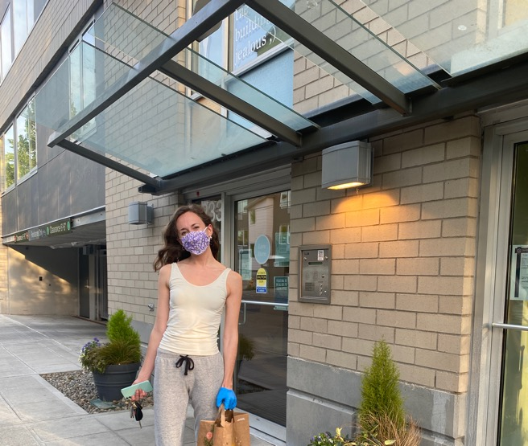
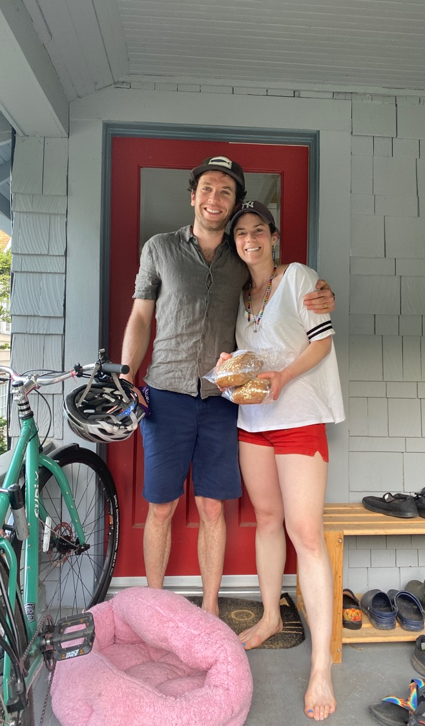
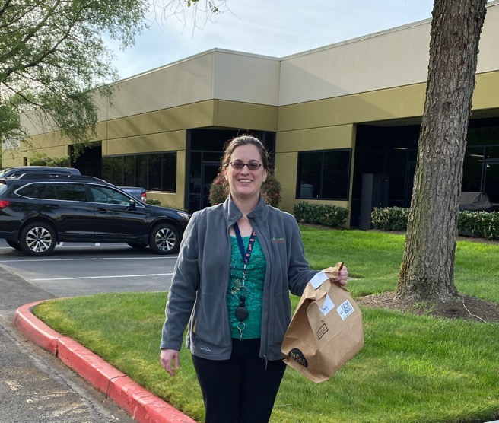
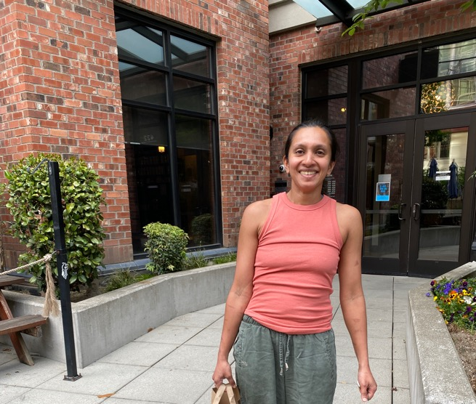
WE’RE BREADER TOGETHER

