Slide 1
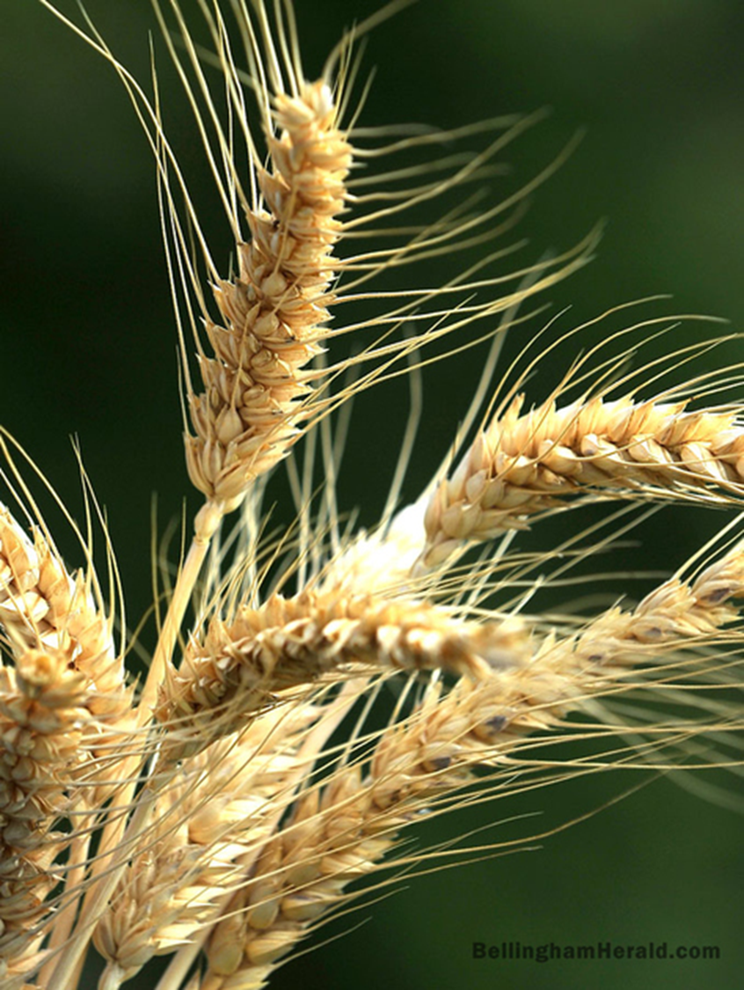
Grain in the Garden: Experiences from Skagit Valley, WA Farm to School Programing
Steve Crider
Viva Farms F2S Lead
Inland NW Artisan Grain Conference
Moscow, Idaho
July 12, 2019

Slide 2
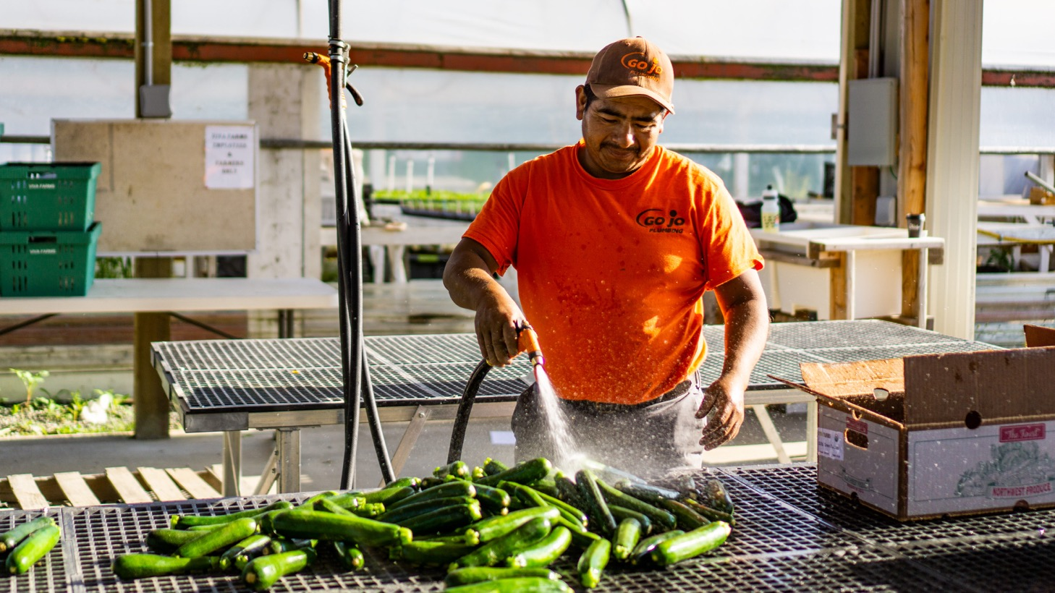
Notes:
Slide Image
Bringing Local Grain & Flour into Farm to School Programing: Examples for Skagit County, WA
Viva Farms – quick intro/overview Recent Farm images/montage/our farmers
Past three years BFRDP Grant w/ F2S Amber or Steve C. shot(s)
Side Story: Steve C. attended Grain Gathering, July, 2019
Yale Univ. Garden/Jeremy Oldfield’s presentation (see 3 recent slides choices from J.O.)
Example: Yale Classes using the Garden (Steve C. “slide of his slide”! Apologies!)
Barley shot / Mesopotamian Cuneiform tablet (Steve/Daniel internet search)
Grain in the Garden
Skagit County: Blessed with unique local resources (Montage of Bread Lab, S.V. Malting facility & Cairnspring Mills)
(See PP from Kim Binczewski via Chris Iberle; CSM Flour bag, or images from inside the Mill))
Three Pillars of F2S: Gardens, Food Service, & Curriculum (build or borrow)
Winter Wheat: A Fall/ Winter crop for Garden Beds (image of Skagit 1109 HRW Wheat)
Several slides of select programs (Examples inc. Anacortes, La Conner and VF King Co./Andrew)
Food Service: A local grain & flour opportunity! School Lunch Line
Example: Taste of WA Day La Conner Blueberry Crumble
Example: Anacortes series of images making the Edison Honey Butter Rolls, Oct., 2018
Example: Pastry Flour Workshop Georgia making scones, March 2019
WSDA-F2S Network: Recipe posted Image from June 10 event / Rolls on table, etc.
Curriculum: Making School Gardens and Meals support Essential Learning Goals
(image from Rachel Muia’s school kitchen – pancakes)
WA OSPI: Farm to School: Image from Elizabeth’s 6/10
STEM (or STEAM) in the Garden Image of Kim. B. at Anacortes Middle School kitchen
Next Generation Science Standards (NGSS)
CTE: Baking, Sourdough & Fermentation, Food Safety
(One more to develop & conclude this theme…)
Where do we go from here? Putting it all together /Connecting the Dots
Any one know of other existing Grain in Garden efforts nationally? Existing Curriculum?
Closing Slide sequence: La Conner school garden- June, 2019 (Boy with Barley ; close up Barley)
Last Slide: Thank You! (with my contact info; WSDA F2S link; Farmtoschoolskagit.org link)

Slide 3
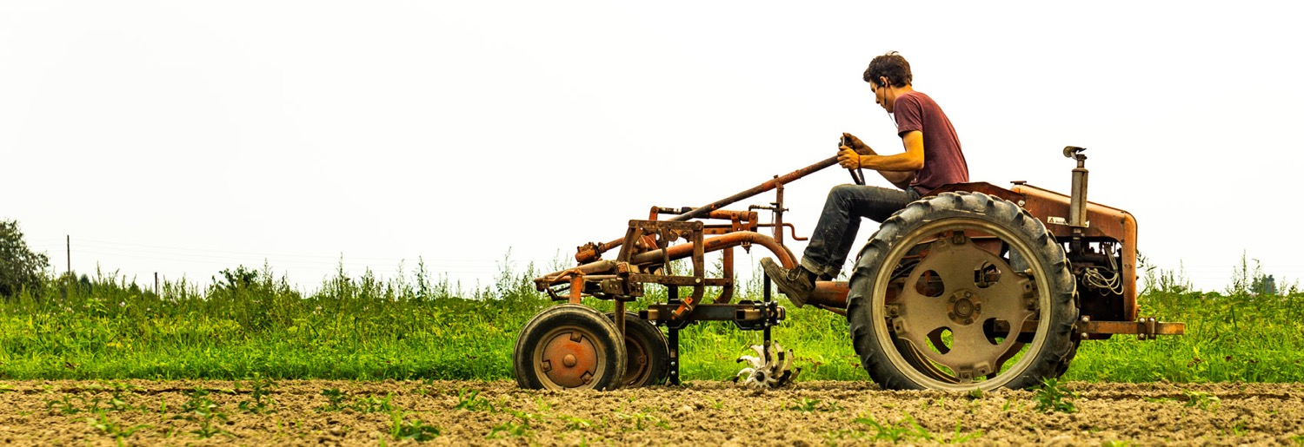
Mission
We empower aspiring and limited-resource farmers by providing bilingual training in holistic organic farming practices, as well as access to land, infrastructure, equipment, marketing and capital.

Slide 4
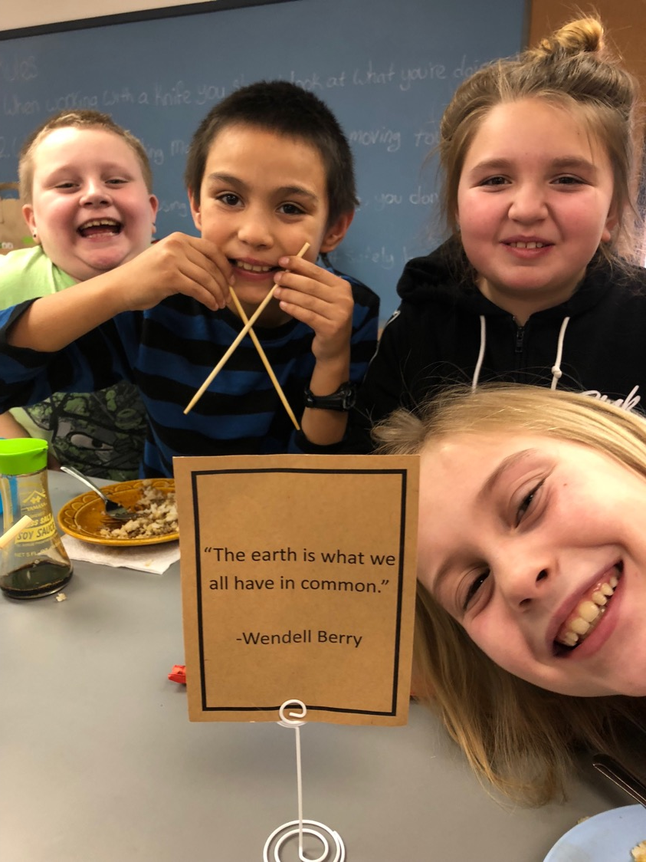
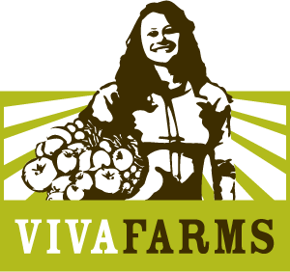
Viva’s Farm to School efforts are funded by a three-year USDA Beginning Farmer/Rancher Development Grant, that has a F2S component.
This includes training for our farmers in how to qualify and engage with school food service programs, sales, and technical support for school gardens. Curriculum is a new piece that has been added in 2018-19 school year.
Image: Concrete, WA F2S Kitchen Classroom

Slide 5
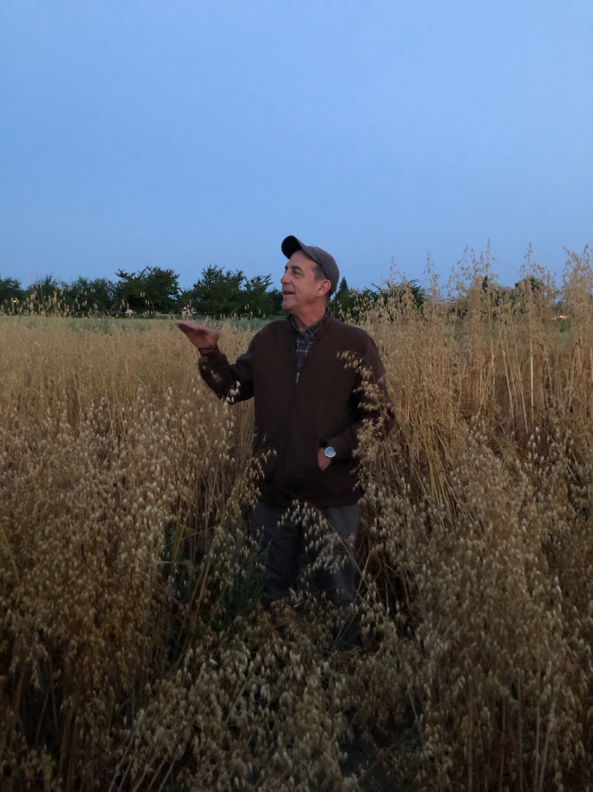
Skagit Valley, WA: We start with a few advantages… Dr. Steve Jones - WSU Bread Lab leading a 5 am tour of the NREC Grain Trials, The Grain Gathering, Mount Vernon, WA, July 2018.

Slide 6
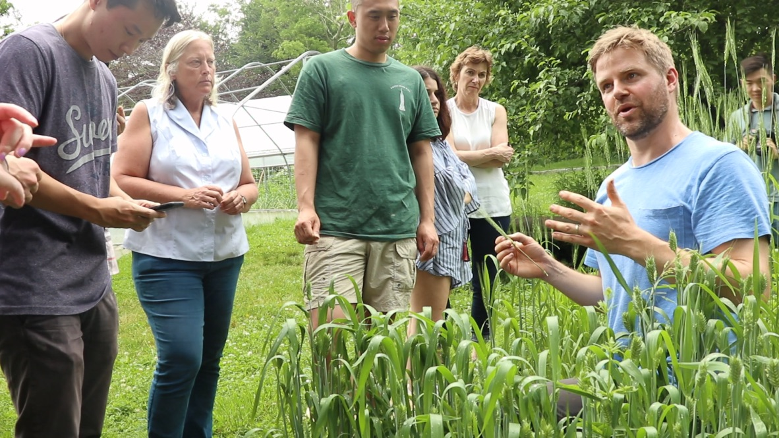
Jeremy Oldfield, Mgr. of Field Academics, Yale Sustainable Food Program in a grain plot at the Yale University Farm

Slide 7
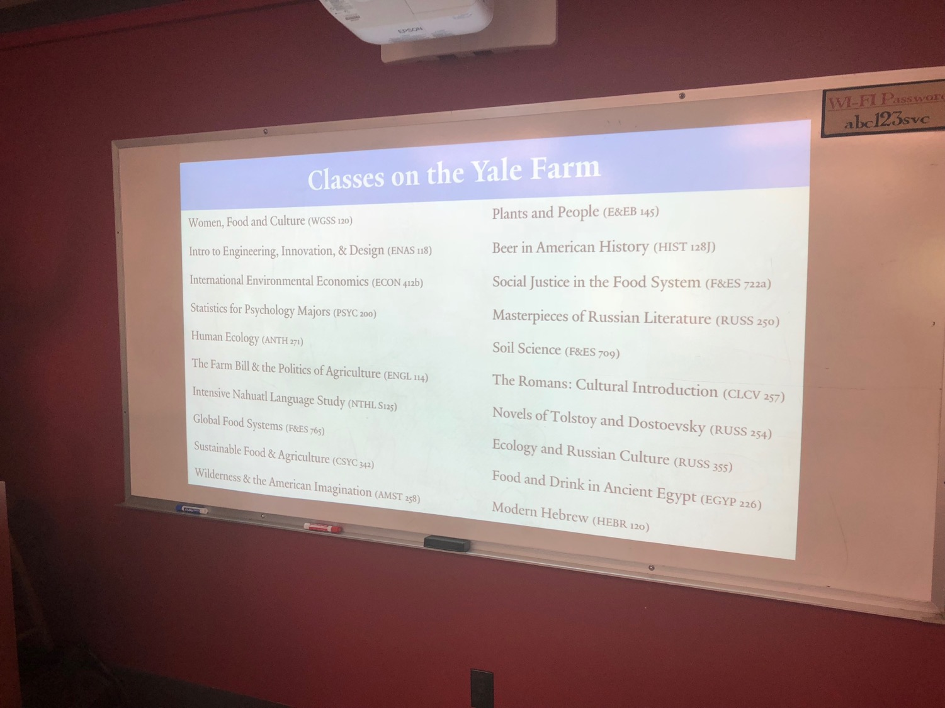
Write stuff here

Slide 8
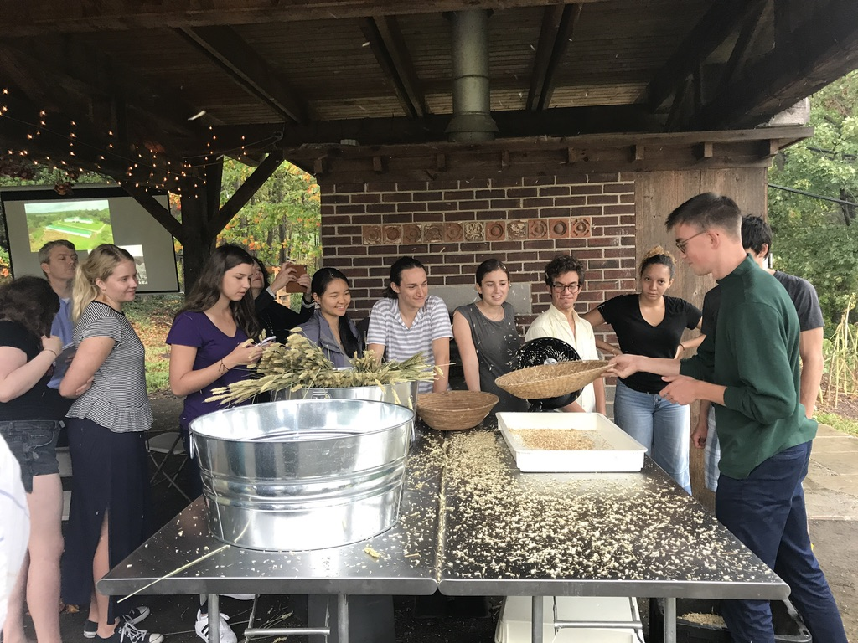
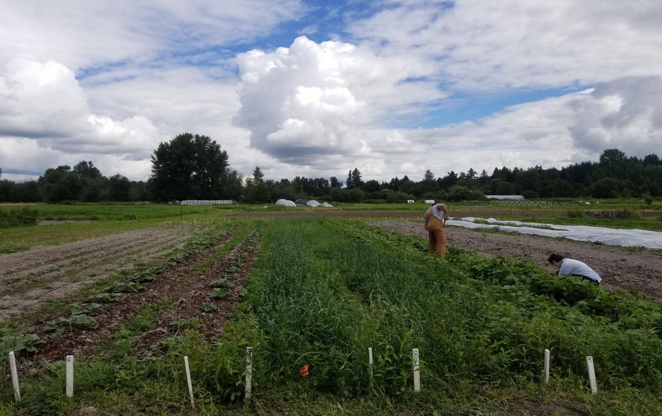
Grain Processing at the Yale Farm

Slide 9
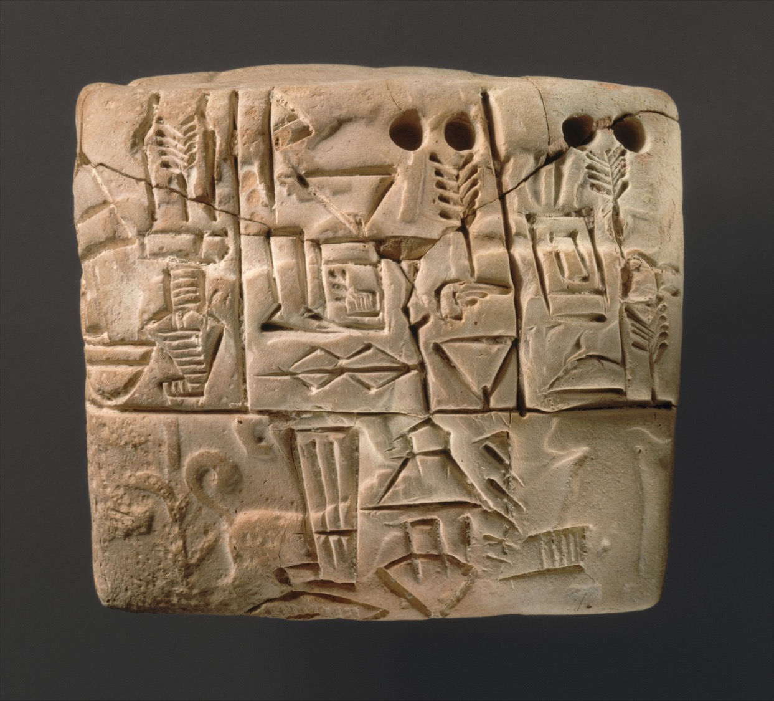
Write stuff here

Slide 10
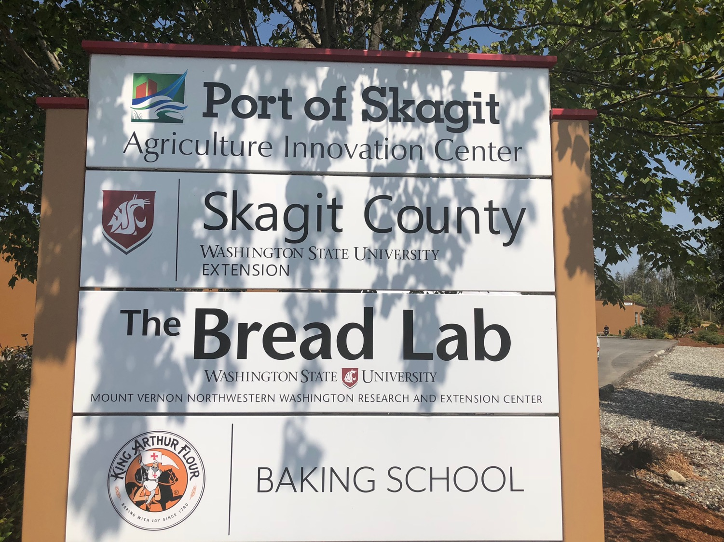

Slide 11
Kevin Morse giving a tour of Cairnspring Mills at the Port of Skagit, Burlington WA.

Slide 12
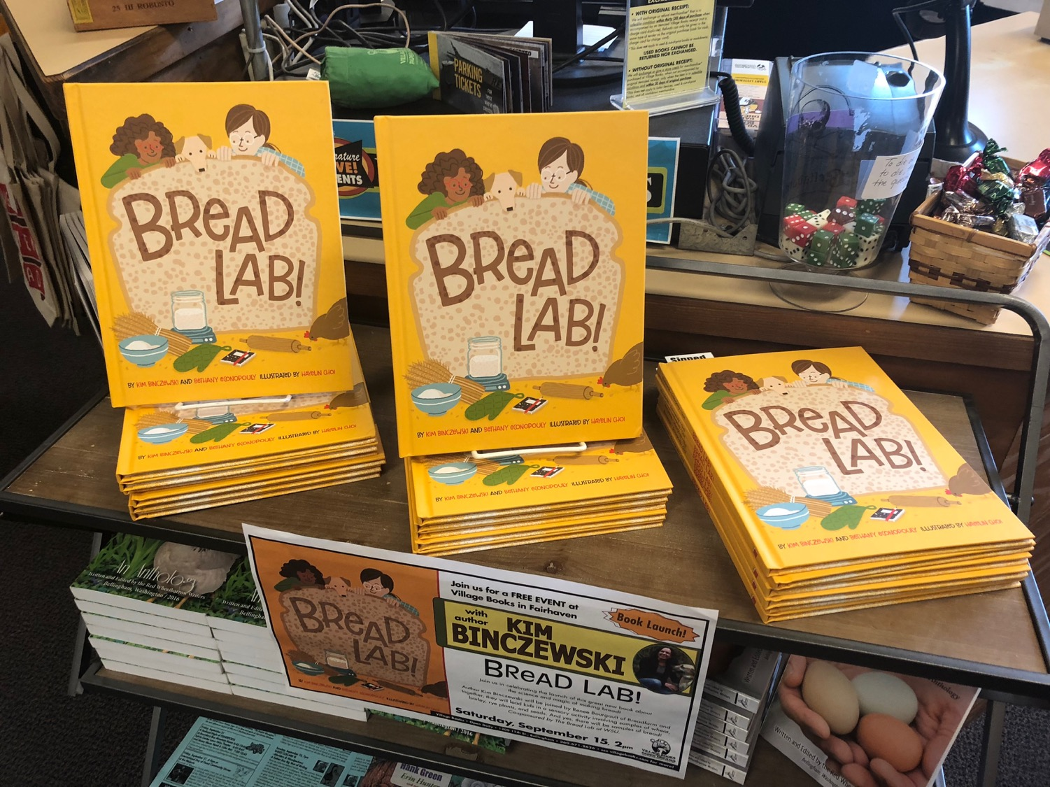

Slide 13
The Three Pillars of Farm to School
School Gardens
Food Service and Procurement
Curriculum

Slide 14
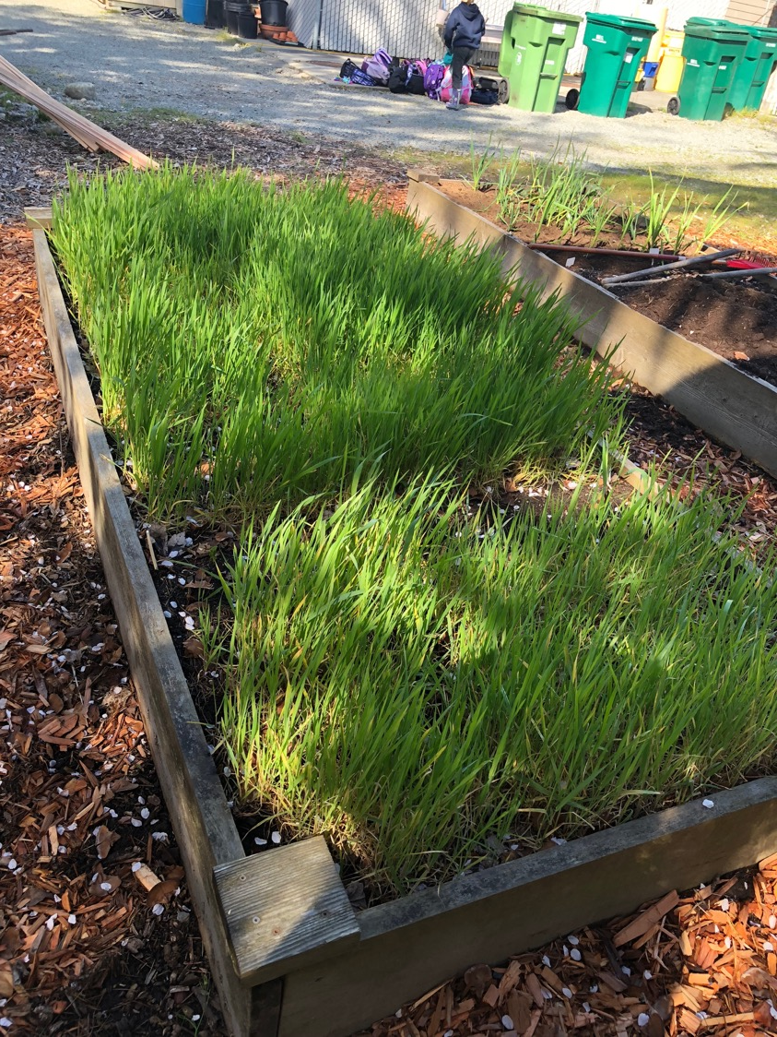
Grain in the Garden
Small plot of Barley and Skagit 1109 Winter Wheat
La Conner Elementary School Garden, La Conner, WA.

Slide 15
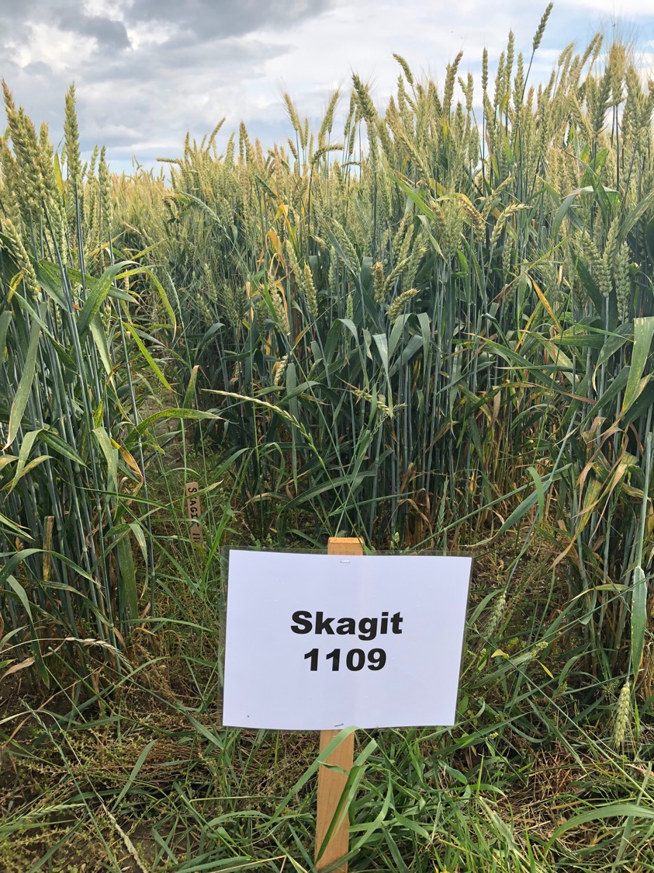
NREC Grain Trials
The Skagit 1109 HRW Wheat is a new landrace variety created by The Bread Lab to flourish in the moist, cool conditions west of the Cascades. It is Fall planted in Sept./Oct., making it an ideal variety for school gardens in our region.

Slide 16
Skagit 1109 HRW wheat growing at Viva Farms, King County. Planted by the Middle and High School Horticultural classes from The Chrysalis School, Woodinville, WA.

Slide 17
Food Service and Local Procurement
Cairnspring Mills whole wheat organic Edison flour and T85 Edison flour being used in the Anacortes School District Central Kitchen.

Slide 18
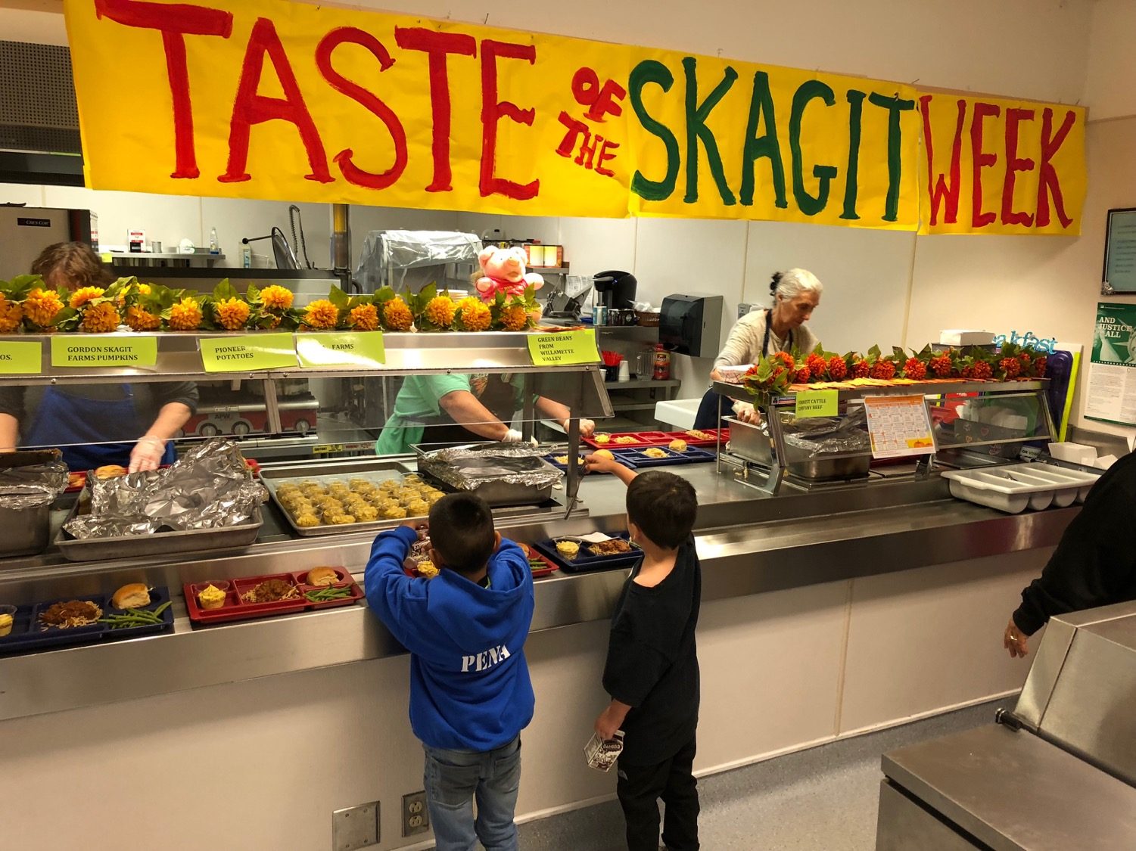

Slide 19
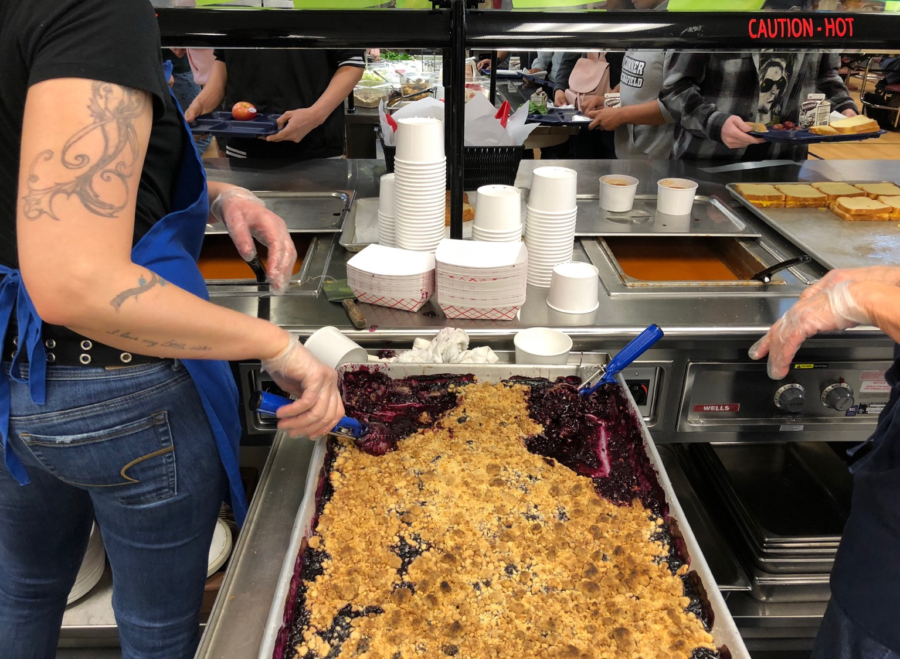

Slide 20
Anacortes H.S. Scratch Kitchen: Whole Wheat Rolls

Slide 21
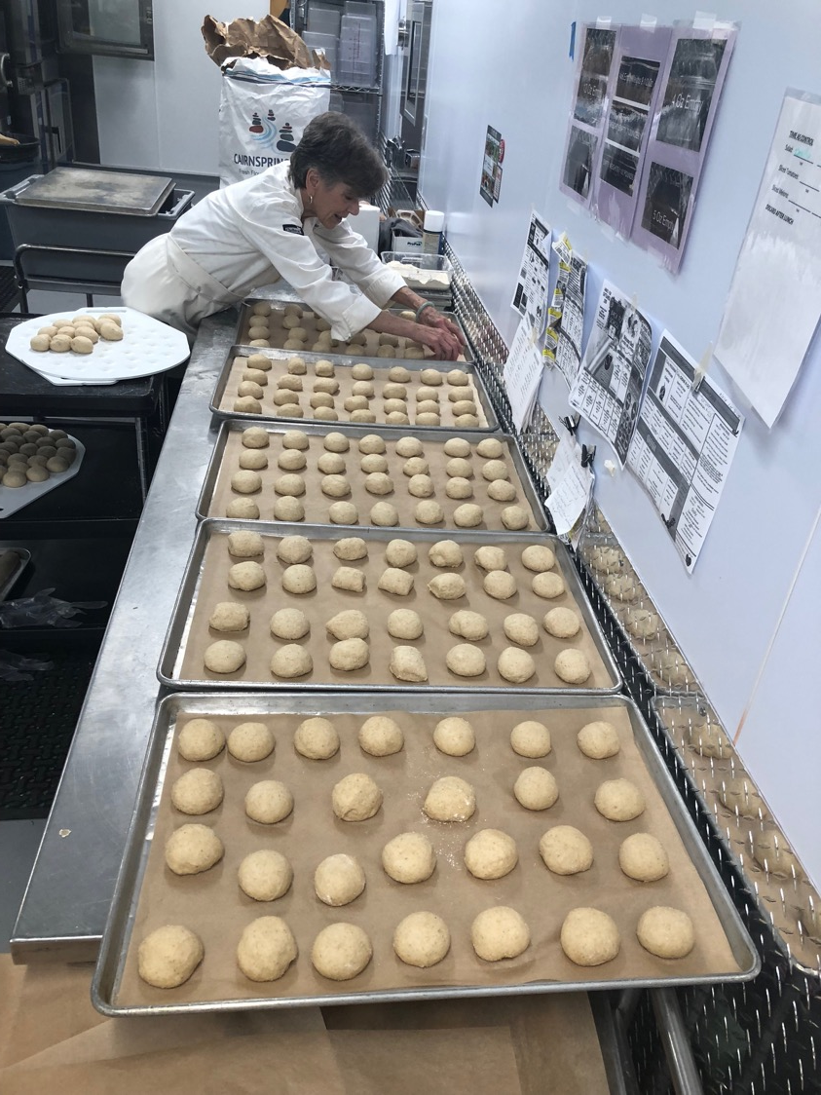

Slide 22
Anacortes School District “Taste of Washington Day”, Oct. 2018 – featuring an “all local” ingredient list and first large scale production and serving of the Cairnspring Mills Edison Honey Butter Roll

Slide 23
Using pastry and lower protein flours in school food service offerings: scones, biscuits, desserts and toppings.

Slide 24
Food Service Training and Awareness
March 2019 “Using Local Grain and Pastry Flour in Food Service” Workshop, La Conner School Kitchen, hosted by F.S. Dir. Georgia Johnson. Attendees received 3 professional credit hours for participation.

Slide 25
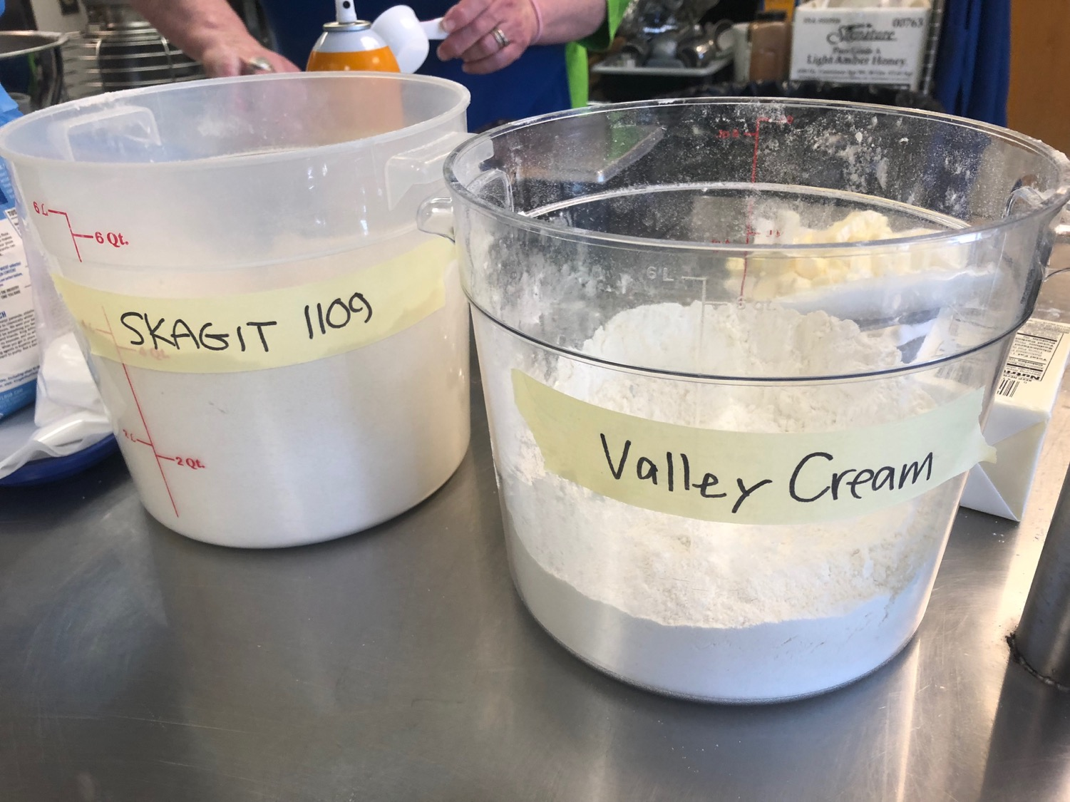

Slide 26
Curriculum
In general, integrating School Gardens and School Lunch into the academic life of a school remains one of the biggest challenges and major opportunities.
Teachers are already maxed out with their classroom work and student responsibilities.
Programing in general is woefully underfunded. Sustainability.
Dedicated or trained staff who have gardening expertise can be a limiting factor.
Garden programing that supports mandated learning and achievement goals: see Common Threads Farm.org

Slide 27
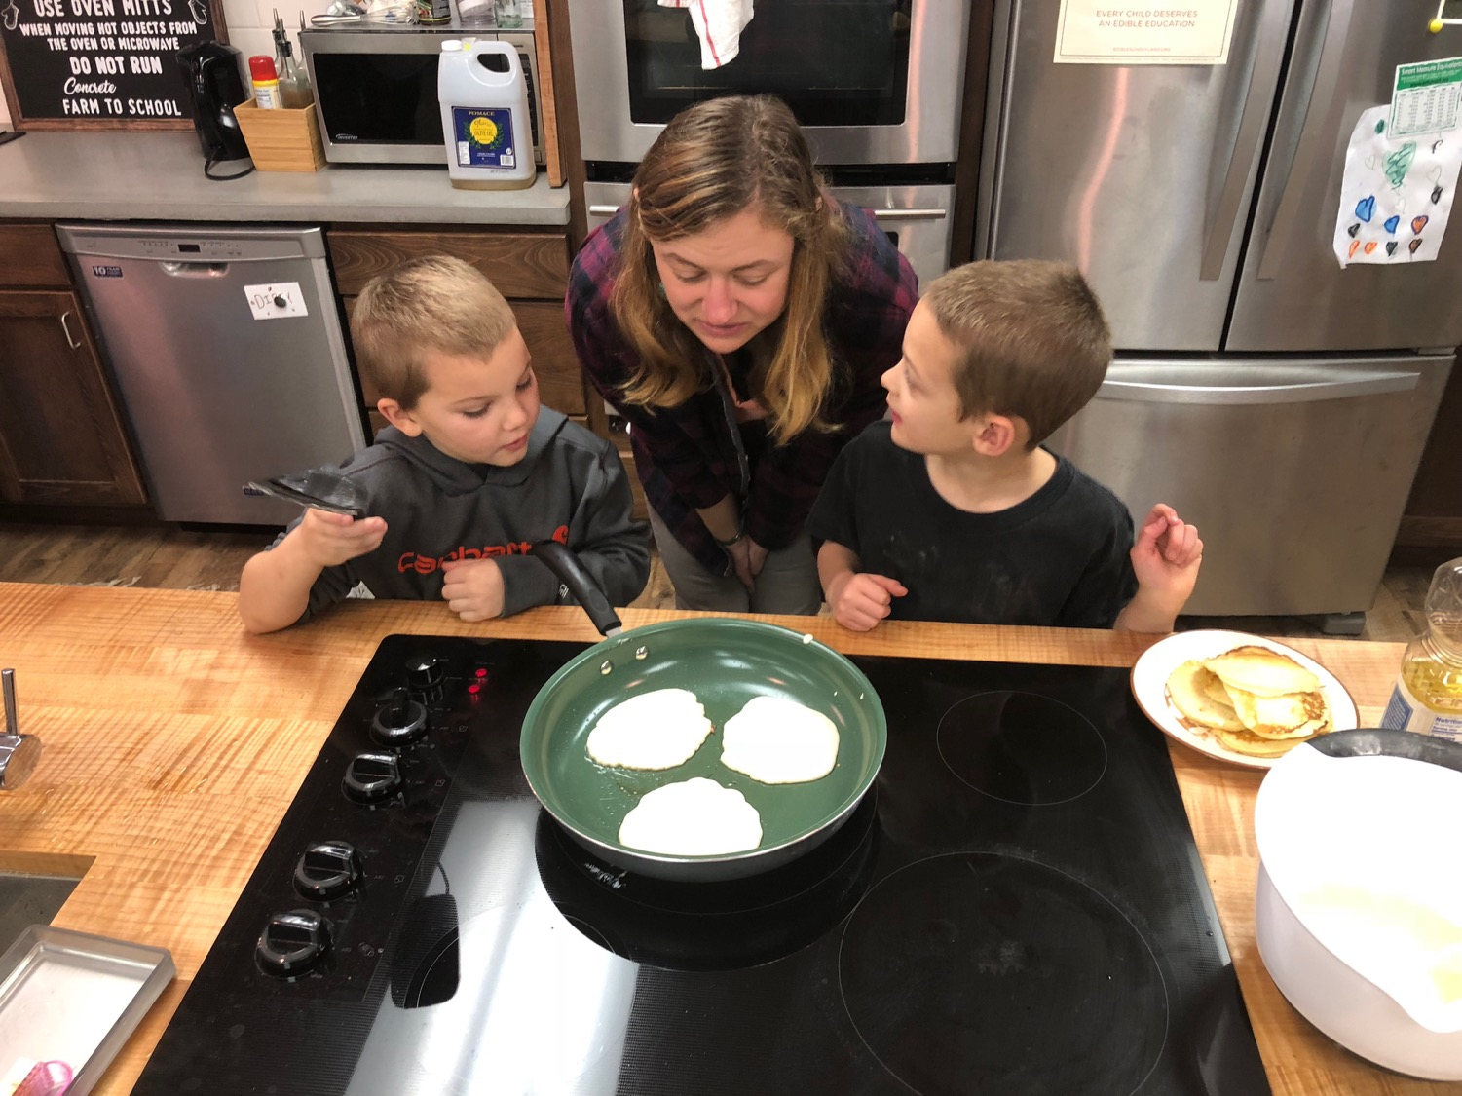

Slide 28
Anacortes Middle School
The Bread Lab’s Kim Binczewski leading a whole wheat scone making class with middle school students in the highly popular elective “School Garden to Kitchen” class. This program includes a garden, well equipped teaching kitchen, and science/art/humanities (STEAM) components.

Slide 29
STEM in the Garden
Elizabeth Schmitz
Environmental and Sustainability Education Program Supervisor
Learning and Teaching/Science, Environment, and Sustainability
Office of Superintendent of Public Instruction
Chris Reykdal, State Superintendent

Slide 30
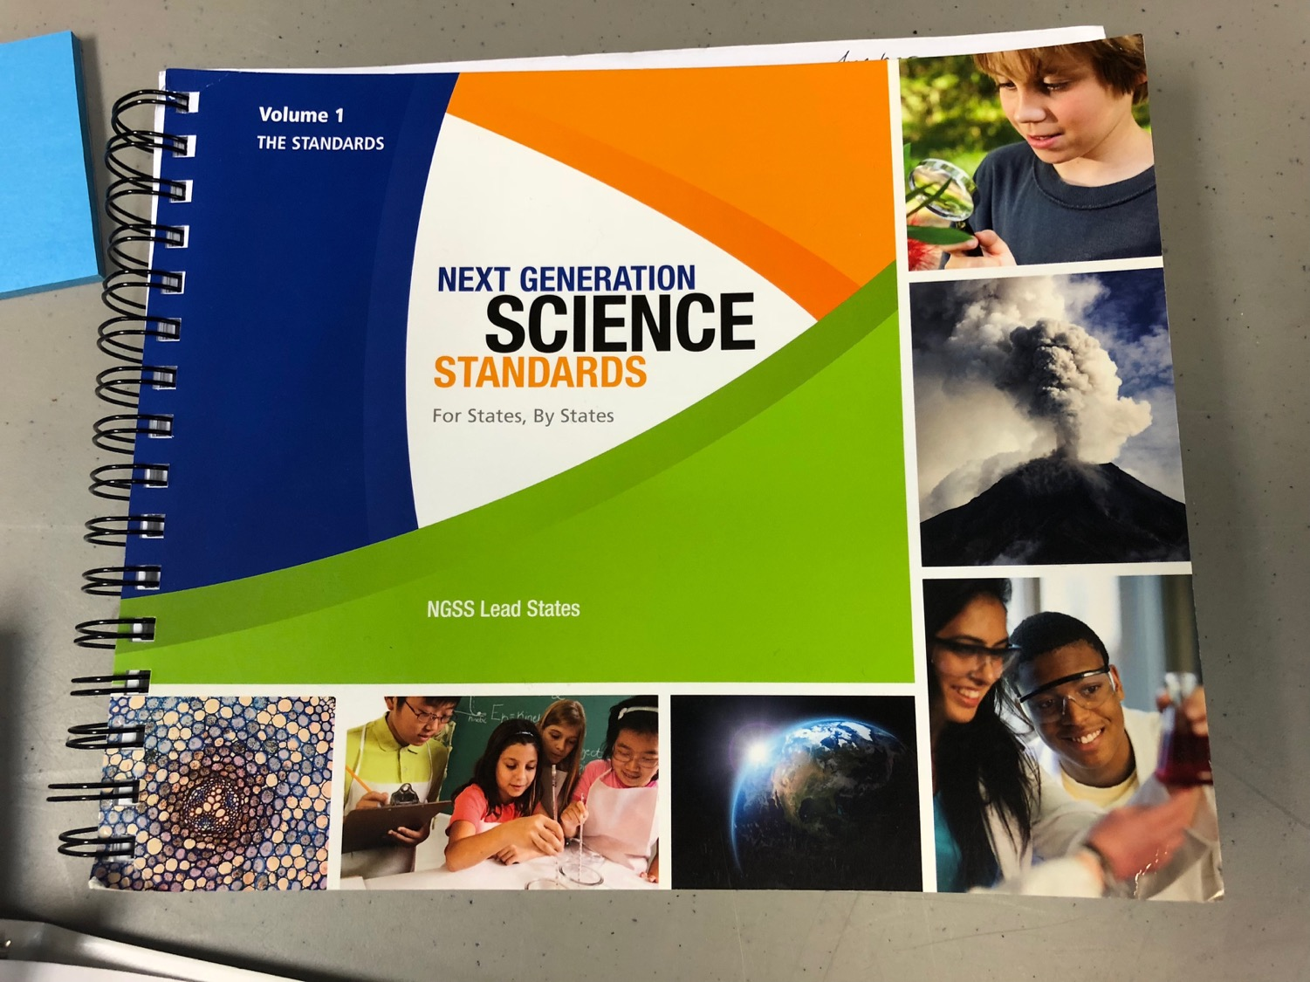

Slide 31
Where do we go from here?
Harvest & use 2018-19 HRW wheat crop: mill & baking, seed saving, re-plant
F.S. Recipe Development
Build on Skagit June 10 F2S 5-County event & networking: www.farmtoschoolskagit.org
WSDA F2S – Community of Practice conference calls
Pre-K & Headstart opportunities for whole grain
Open Source model
Share! Share! Share!
Seek out others working & creating in this space – NOT re-invent the wheel.
Still a long way to go!!!

Slide 32
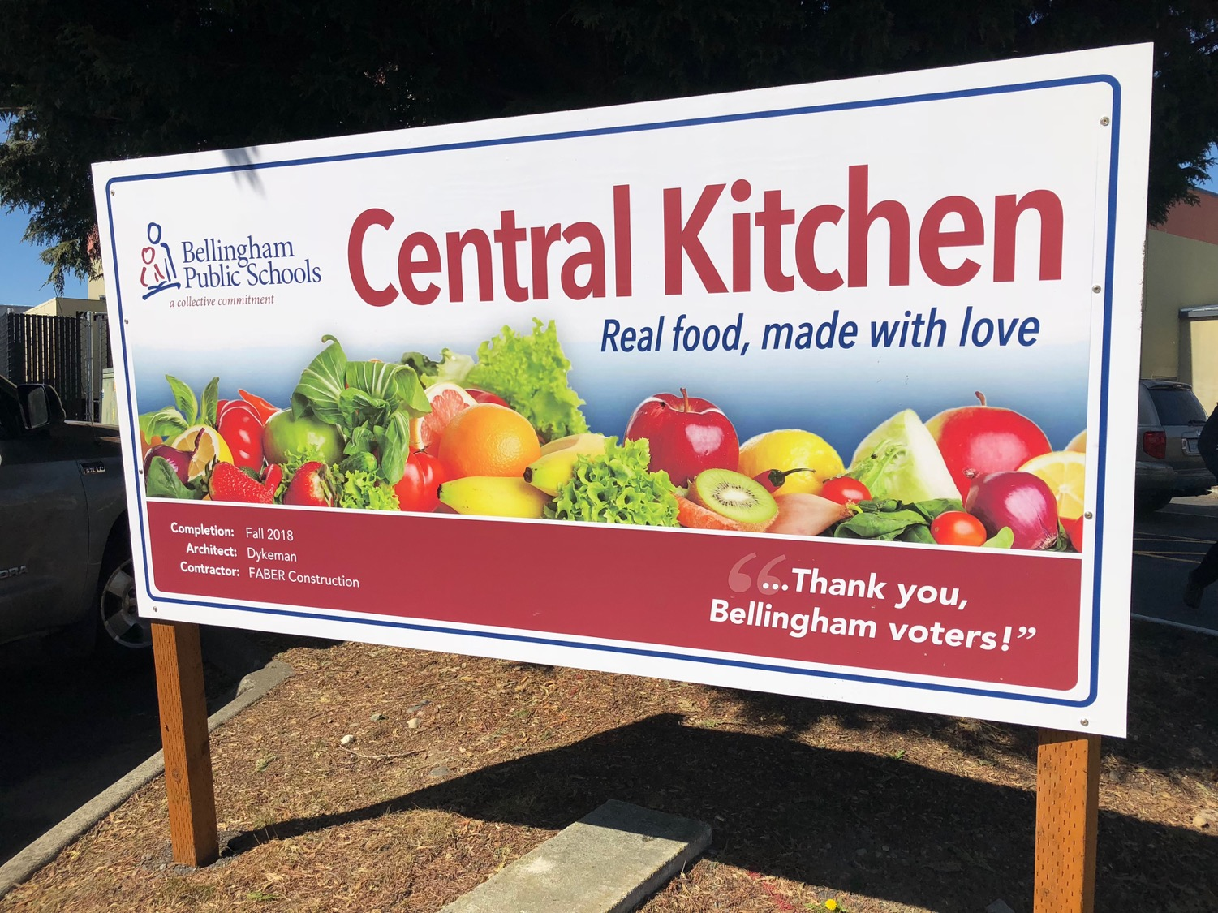

Slide 33
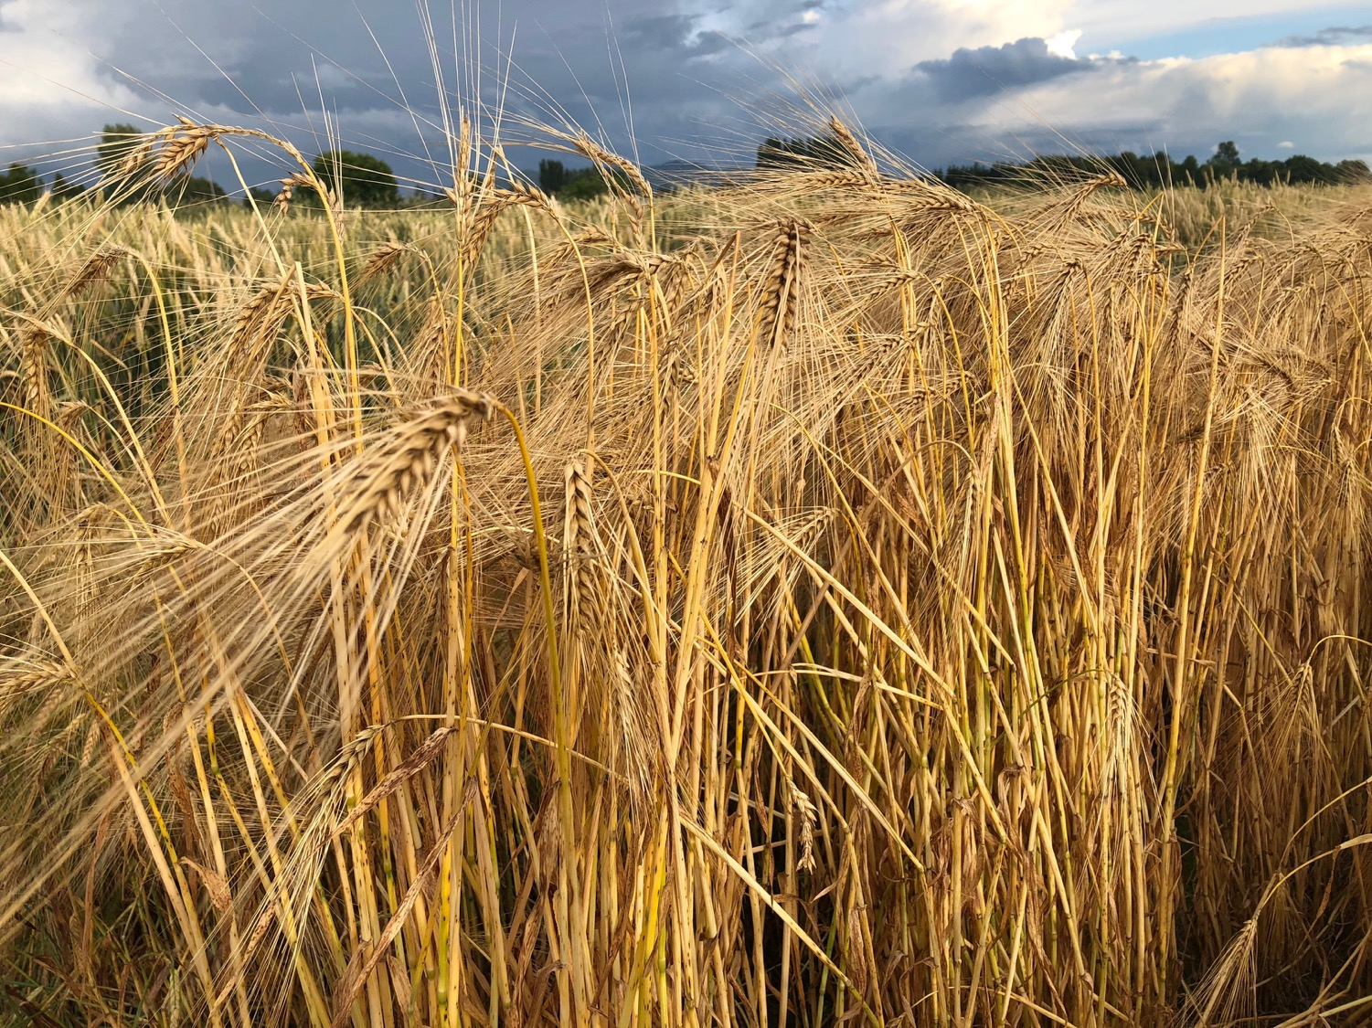
Some Insights and Observations:
Research and build out your local resources, farmers, infrastructure partners, champions & proponents. Synergy!
“Path of Least Resistance”: Align with the early adopters and build out from there.
Smaller School Districts seem to be more open and accommodating than the larger ones?
Sustain support for the “good models” over time – take the long view. The others will follow!
Start small but start something!

Slide 34
Thank You! Steve Crider, Farm to School Lead – Viva Farms steve@vivafarms.org www.farmtoschoolskagit.org

