Slide 1
Cover Crop Rotations and Sustainability
Inland Northwest Artisan Grains Conference July 12th-13th, 2019

Slide 2
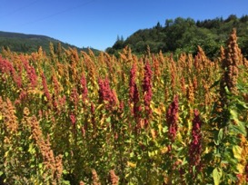
Session: Cover Crop Rotations and Sustainability
Facilitator
Julianne Kellogg
WSU PhD Student in Crop Science
Current research emphasizes understanding crop variety impact on human health.
Past MS research on participatory quinoa breeding for organic systems.
Included publishing a WSU Extension bulletin on growing quinoa
Email: julianne.kellogg@wsu.edu

Slide 3
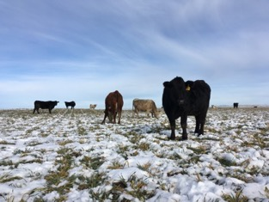
Session: Cover Crop Rotations and Sustainability
Session Speaker
Leslie Michel
Soil Scientist for the Okanogan Conservation District
Working on MS in Soil Science, plan to defend in Fall of 2019
Member on the Washington Soil Health Committee and actively involved in soil health activities throughout Washington and the PNW
Talking today about cover crops in low rainfall wheat-fall regions and integrating livestock
Email: lmichel@wsu.edu

Slide 4
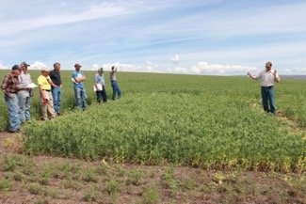
Session: Cover Crop Rotations and Sustainability
Session Speaker
Doug Finkelnburg
UI - Area Extension Educator
BS/MS Environmental Sciences, UI
Crop diversification & sustainability
Cover crops & grazing in high rainfall dryland cropping systems
Email: dougf@uidaho.edu

Slide 5
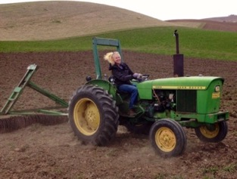
Session: Cover Crop Rotations and Sustainability
Session Speaker
Rachel Wieme –
Postdoc Researcher at WSU Pullman
PhD in Soil Science from WSU
Presenting on alternative cropping systems for Palouse Agriculture: Diversification and management comparisons
Email: Rachel.wieme@wsu.edu

Slide 8
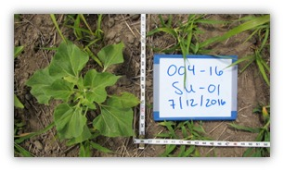
Incorporating cover crops
Year 1
Year 2
Year 3
Year 4
Year 5
Winter Wheat
Cover Crop
Winter Wheat
WW
Fallow
Fallow
Fallow
100 years of wheat-fallow
Summer or chem fallow
Notes:
Trying to add diversity to our system
And keep soil covered
Living roots

Slide 9
Cover crop rotations; four treatments
Year 2
Year 3
July
Aug
Sep
Oct
Nov
Dec
Jan
Feb
Mar
Apr
May
Jun
July
Aug
WW
Fall cover crop
WW
Spring cover crop
Summer cc
Stockpiling
Chemical fallow control
WW=Winter wheat; CC= Cover Crop
Notes:
Fall– harder to get seed germination in low precip areas
Better returns on soil indicators – moisture, pH increases, biological activity
Spring
3 ½” soil moisture OR 10% flowering OR management goal
Check field often to know when to terminate
No replacement for a shovel
This isn’t a rotisserie grill that you can “set it and forget it”
Don’t put in hard to reach area, encourage farmers to put them near homesteads, and places dive by regularly

Slide 19
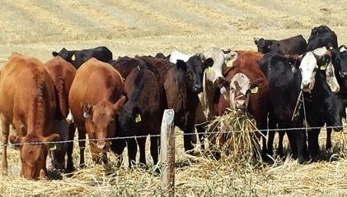
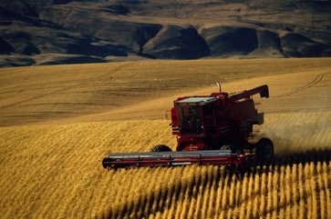
Cover Crops & Grazing in high rainfall dryland cereals systems

Slide 20
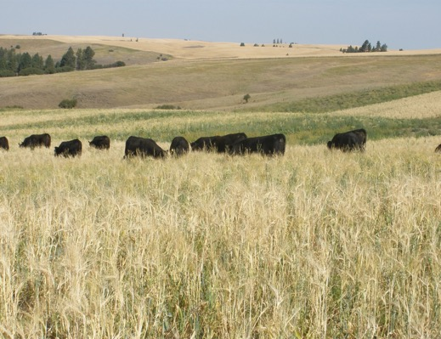
High quality late-summer gazing options limited
Spring crops less reliably profitable than winter wheat

Slide 21
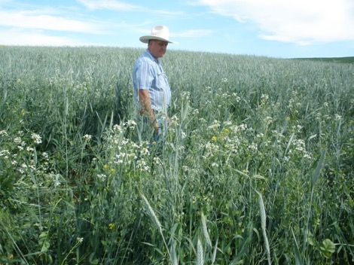
MIXED SPECIES COVER CROPS
Alternate spring crop
Lengthens crop rotations
May suppress crop diseases
Grazing cycles nutrients
6 way seed mix used: forage oats, forage radish, forage turnips, spring peas, spring canola and spring triticale

Slide 22
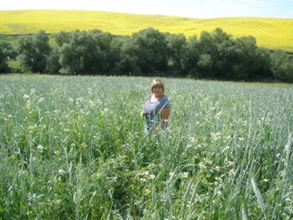
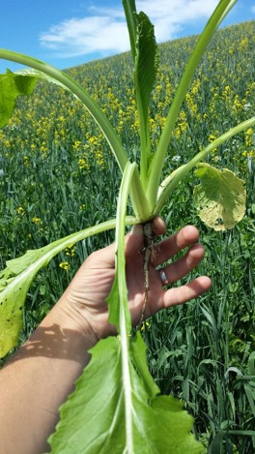
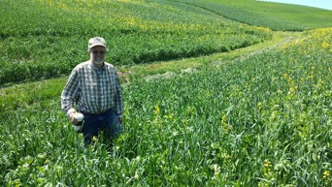

Slide 23
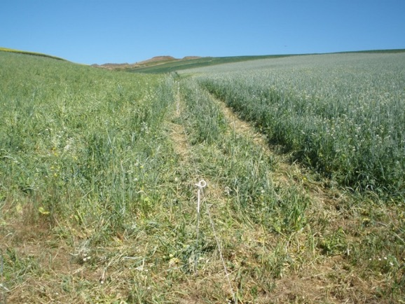

Slide 24
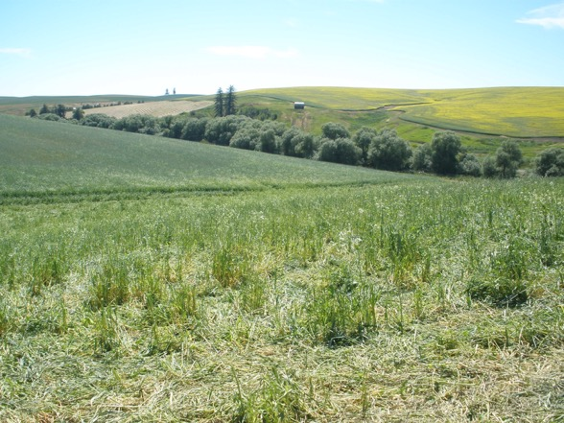

Slide 25
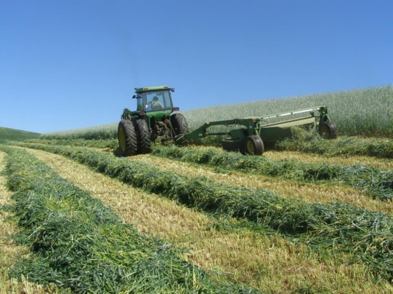

Slide 26
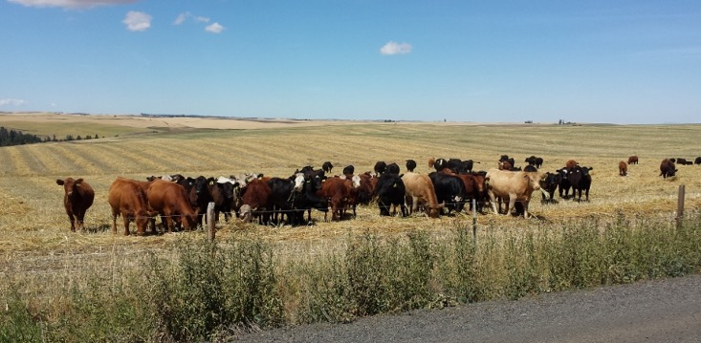

Slide 27
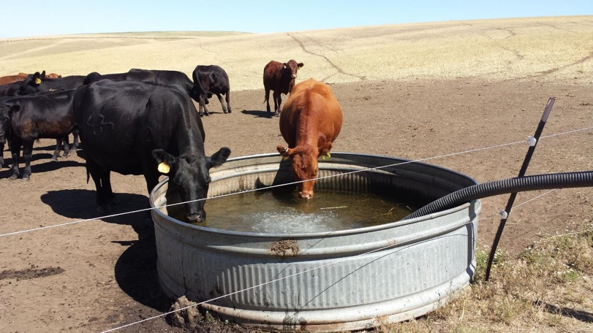
Cover Crops Demonstration Project in North Central Idaho
https://www.nacaa.com/journal/index.php?jid=451
https://www.covercropstrategies.com/articles/132-video-case-study-raising-cover-crops-for-grazing

Slide 29
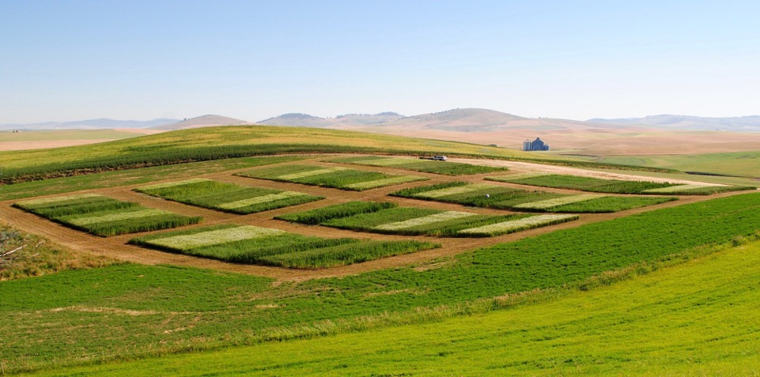
Alternative Cropping Systems Research for Palouse Agriculture
Session: Crop Rotations, Cover Crops and Sustainability

Slide 30
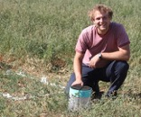
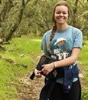
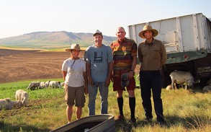
Comparing Conventional, Mixed, and Organic dryland cropping systems on the Palouse
Jonathan Wachter, Alex Davis
Zakarison Partnership

Slide 31
Comparing Conventional, Mixed, and Organic dryland cropping systems on the Palouse
Potential benefits of diversified cropping systems
Improved soil health, resource-use efficiency, increase yields, diversify revenue, reduce dependence on external inputs & reduce negative externalities
Integrated (mixed) crop-livestock systems
Enhance productivity, encourage perennial & forage crops

Slide 32
The project:
Long-term systems study to compare cropping systems
Initiated 2012
Conventional
Winter Wheat – Spring Wheat – Spring Pea
Mixed
Winter Wheat – Spring Wheat – Grazed Winter Pea forage
Organic (Crop)
Alfalfa/grass hay (3yr) – Grazed Pea forage – winter wheat
Organic (Hay)
Continuous Alfalfa/grass hay (5 yrs)
Measuring the productivity, economic performance, and soil quality of these systems over time

Slide 33
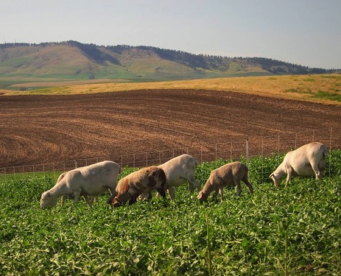
Highlights 2012-2016
Grazed legume forages increased subsequent wheat yields with reduced nitrogen inputs
Organic SWWW in OrgCrop was similar to CONV and MIX, but with slightly lower protein
Winter wheat yields higher than the county averages
Organic perennial alfalfa & grass- based systems were the most profitable.

Slide 34
Enterprise budgets
 | Treatment | Sales | Operating Costs | Returns over operating costs | Returns over total costs
2012 – 2016 5-year Average |  | $US per acre
 | CONV | 347 ± 116 | 226 ± 25 | 120 ± 116 | -5 ± 69
 | MIX | 319 ± 132 | 189 ± 43 | 130 ± 116 | 0 ± 73
 | ORG Crop | 471 ± 227 | 119 ± 25 | 247 ± 81 | 106 ± 169
 | ORG Hay | 627 ± 212 | 83 ± 20 | 294 ± 85 | 249 ± 147

Slide 35
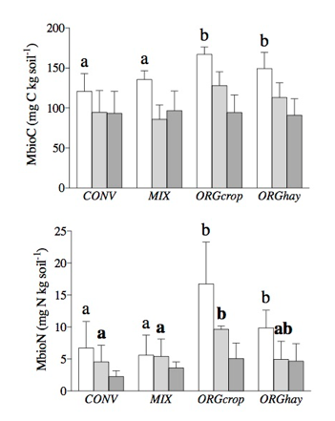
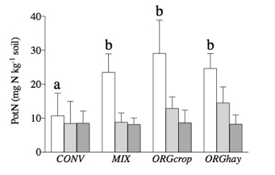
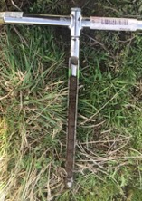
Highlights: Soil Quality
Organic perennial alfalfa & grass-based systems improved biological soil quality (as measured in year 5)
Trends of decreasing soil carbon in CONV and MIX, stable in ORG

Slide 36
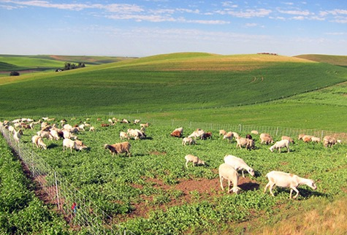
Summary 2012-2016
Integrating perennial crops into organic farming systems can build soil and profits
Grazing is a way to produce revenue from a green manure crop
“Diversification”

Slide 37
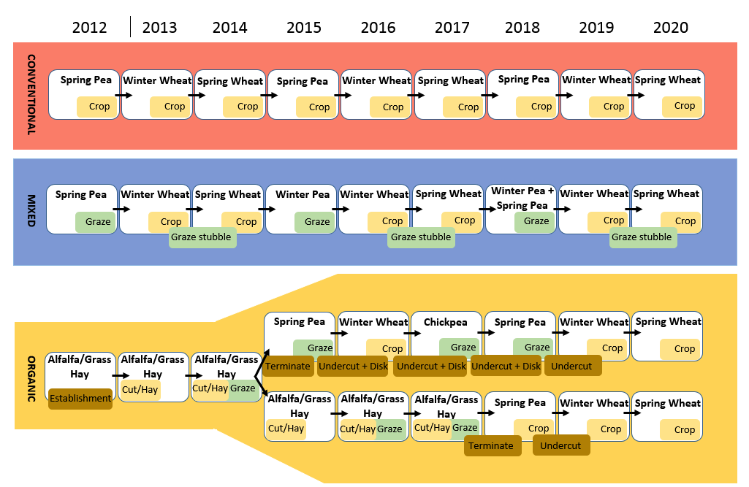
Continuing the project:
Economic stability over time
Productivity
Soil quality, esp. Biological health
Ecosystem services: Monetary value on topsoil, organic C, lime requirement, & plant-available nutrients

Slide 38
Audience, ask your questions!

Slide 39
More questions? Contact a speaker:
Leslie Michel
lmichel@wsu.edu
Doug Finkelnberg
doug@uidaho@edu
Rachel Wieme
rachel.wieme@wsu.edu
Facilitator, Julianne Kellogg
julianne.kellogg@wsu.edu

