Slide 1
INLAND NW
BRANDING
ARTISAN
MARKETING
GRAINS
A BRIEF LOOK INTO OUR
MISSION / AUDIENCE / BRAND

Slide 2
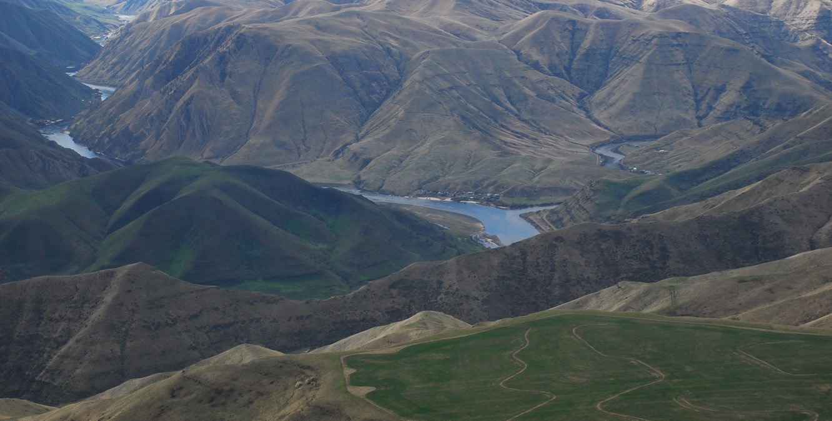
OUR MISSION
& AUDIENCE

Slide 3
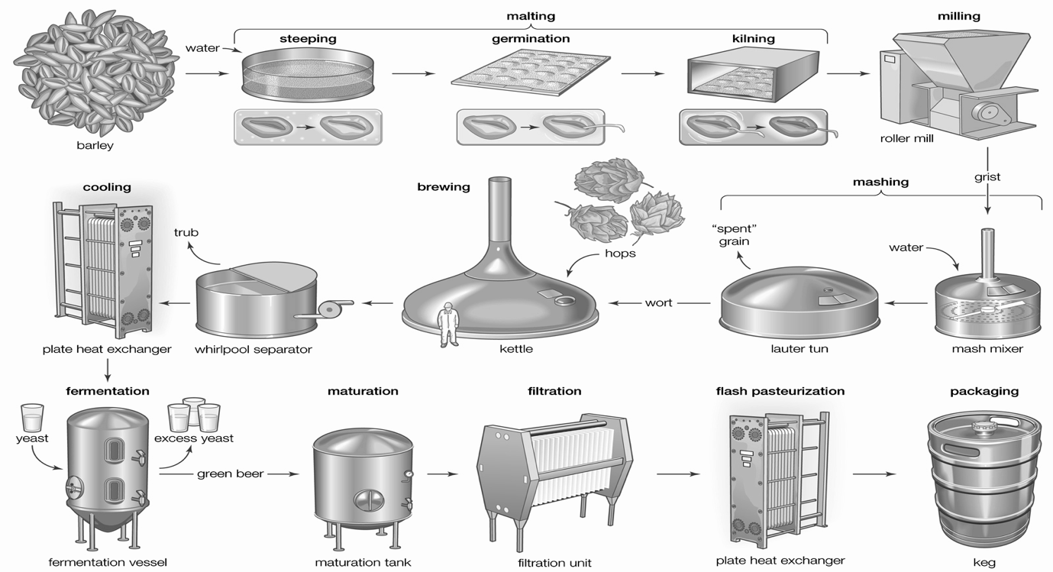

Slide 4
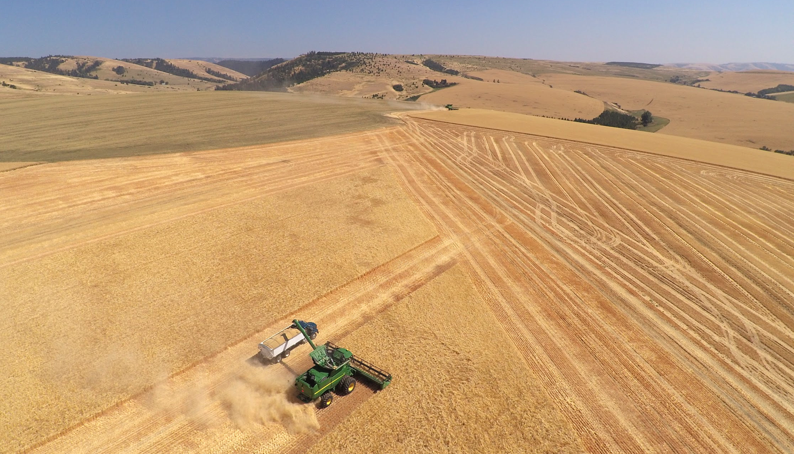
MARKET-BASED CONSERVATION
ENABLED BY PREMIUM MALT
Through Mainstem Malt, you support family farms, re-localization of grain economies, on-farm water conservation efforts, and a constant push towards comprehensive agricultural sustainability. Radical supply chain transparency invites you to travel upstream from your favorite malty products.

Slide 5
MANY SUPPLY CHAIN STAKEHOLDERS
FARMERS
RESEARCHERS
PLANT BREEDERS
AGRICULTURAL SUPPLIERS
MALTSTERS
EQUIPMENT SUPPLIERS
LOGISTICS
PARTNERS
QUALITY ANALYSIS LABS
BREWERS
DISTILLERS
MILLERS
BAKERS
....
BEER DRINKERS
WHISKEY DRINKERS
BREAD LOVERS
LOCAVORES
CONSERVATIONISTS

Slide 6
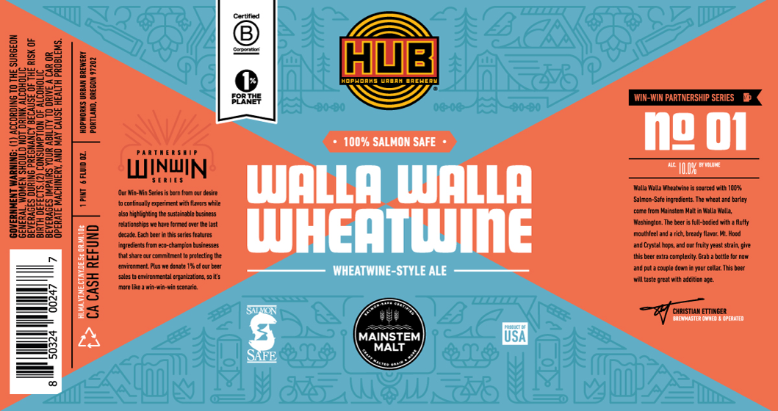
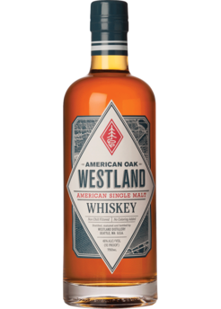

Slide 7
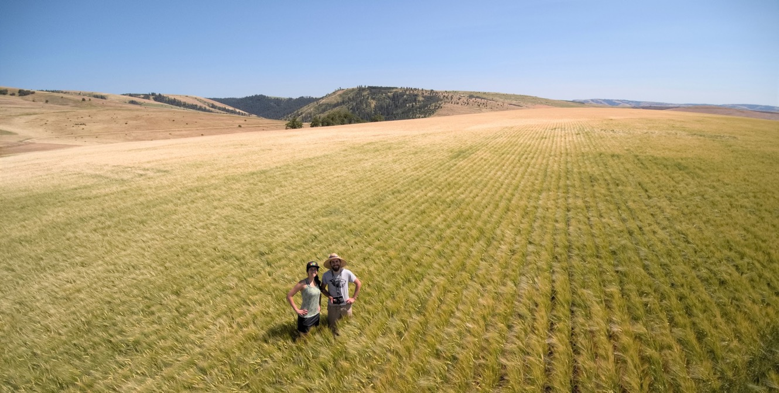
OUR BRAND

Slide 8
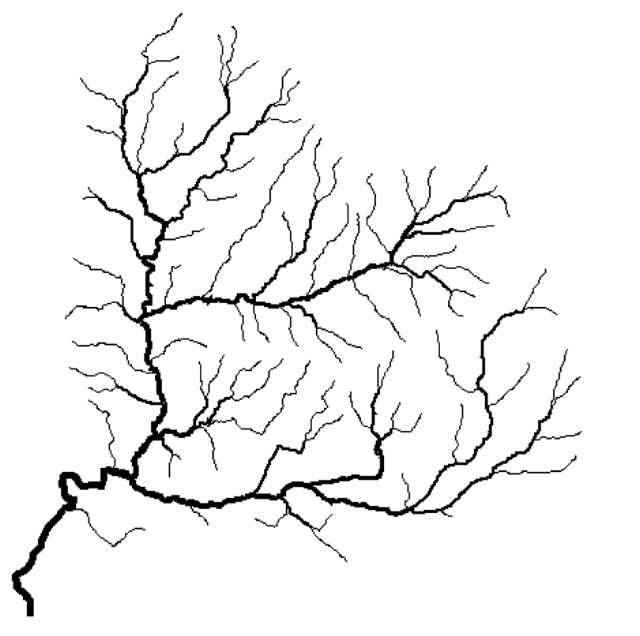

Slide 9
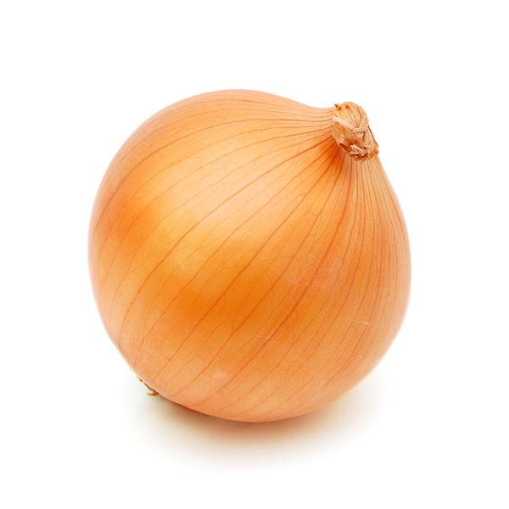

Slide 10
KEY BRANDING GUIDELINES
TRANSPARENT & HIGH INTEGRITY
RESPECTFUL & POSITIVE
FORWARD LOOKING
POLITICALLY MODERATE
AESTHETICALLY MINIMAL
PRACTICAL TO INTEGRATE
BUILT TO SCALE

Slide 11
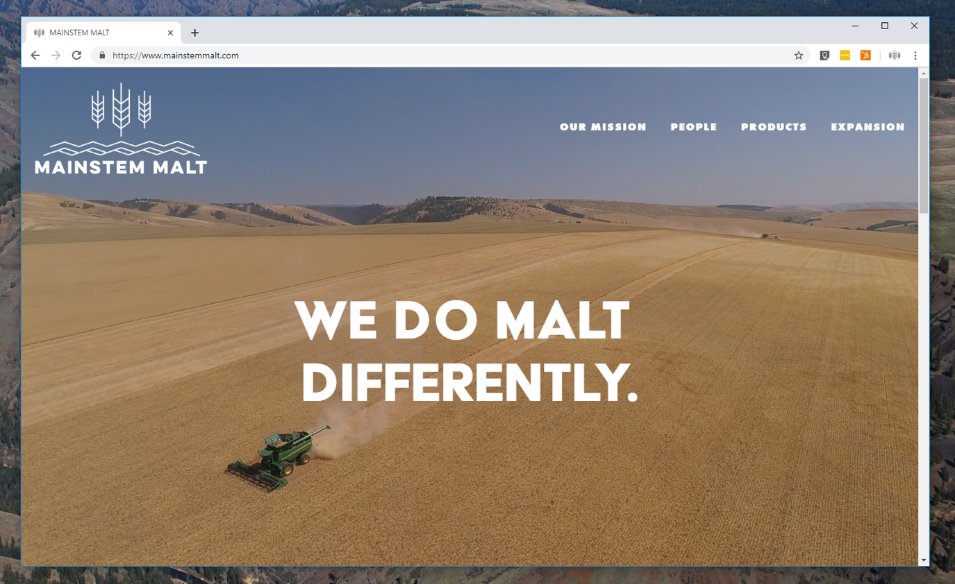

Slide 12
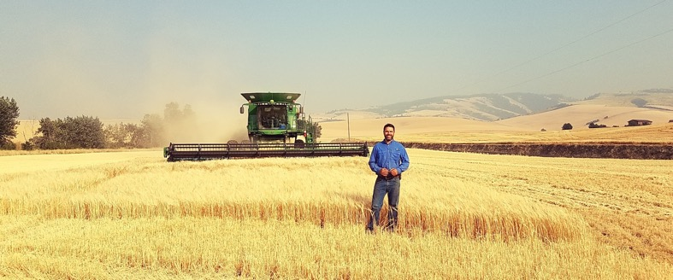
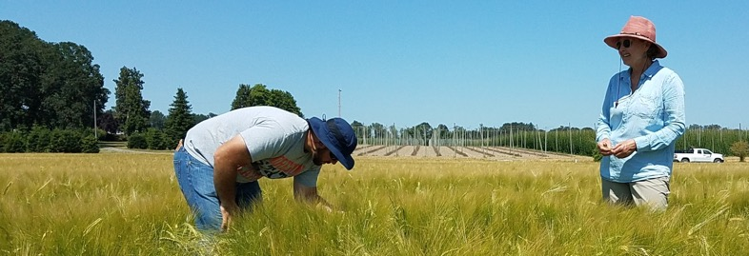
HT Rea
Farming
Goschie
Farms
Ranch
Johns

Slide 13
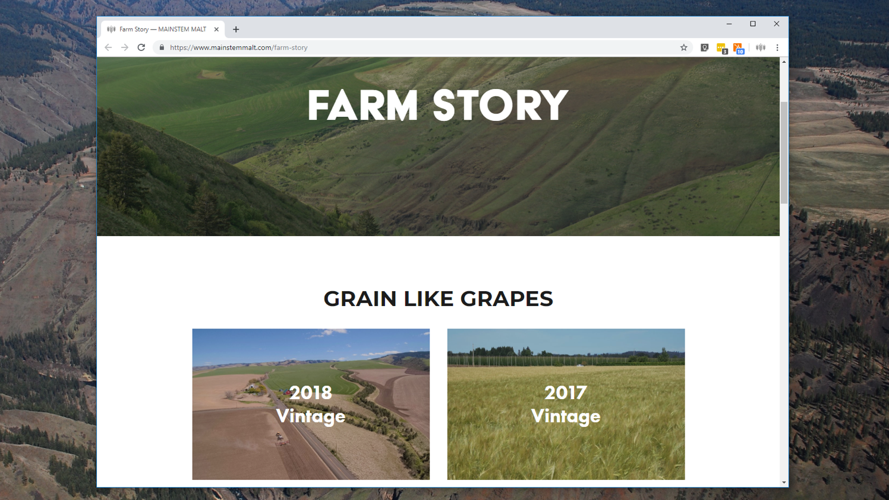

Slide 15
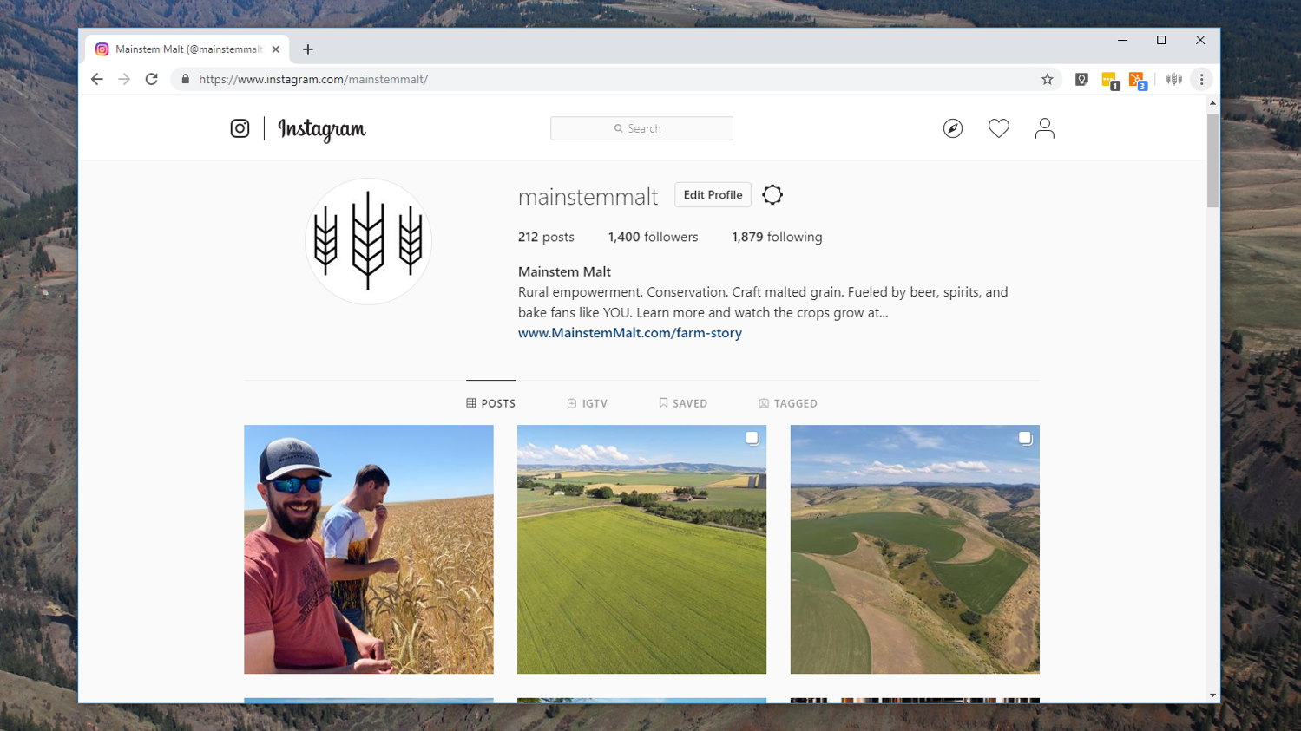

Slide 16
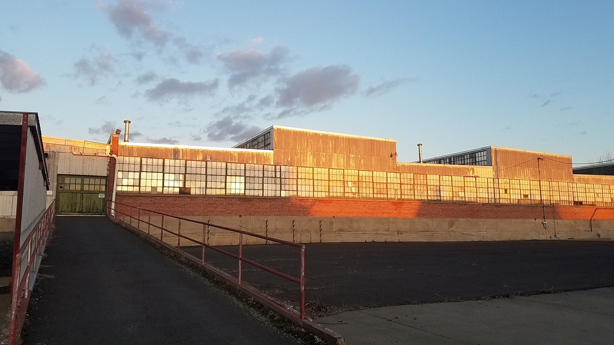
TRACE IT TO THE HEADWATERS
WWW.MAINSTEMMALT.COM

