Slide 1
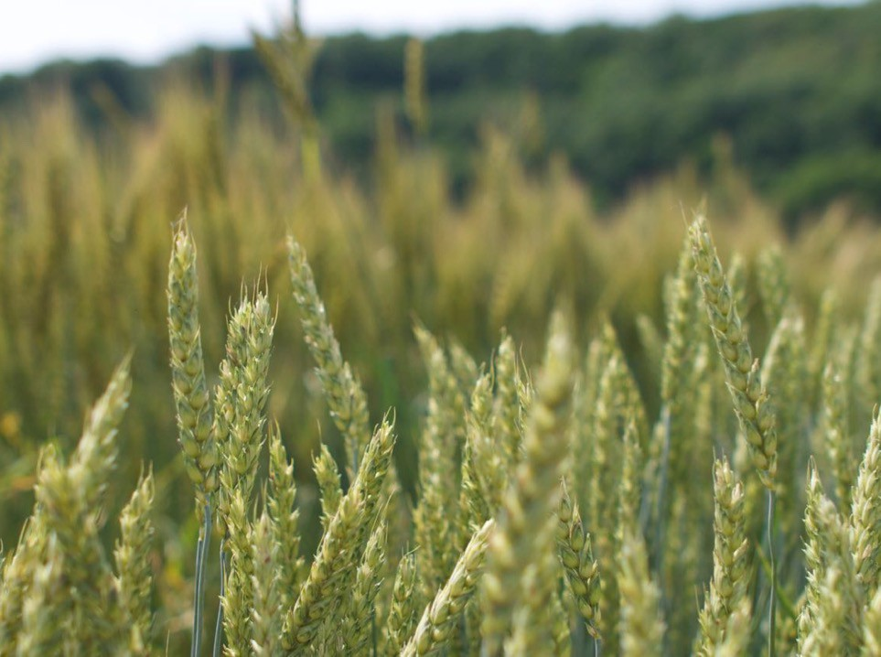









HEADS UP!
CONSIDERATIONS FOR GETTING INTO VALUE-ADDED SMALL GRAINS PRODUCTION
Justin O’Dea
Regional Agriculture Specialist, ANR Extension Program Unit, SW WA

Slide 2
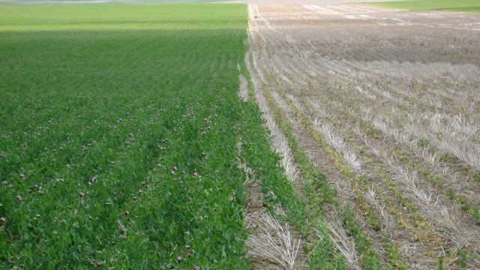
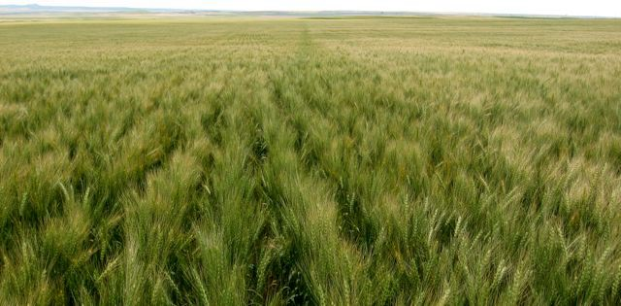
Background
Photo: J. O’Dea
Photo: J. O’Dea

Slide 3
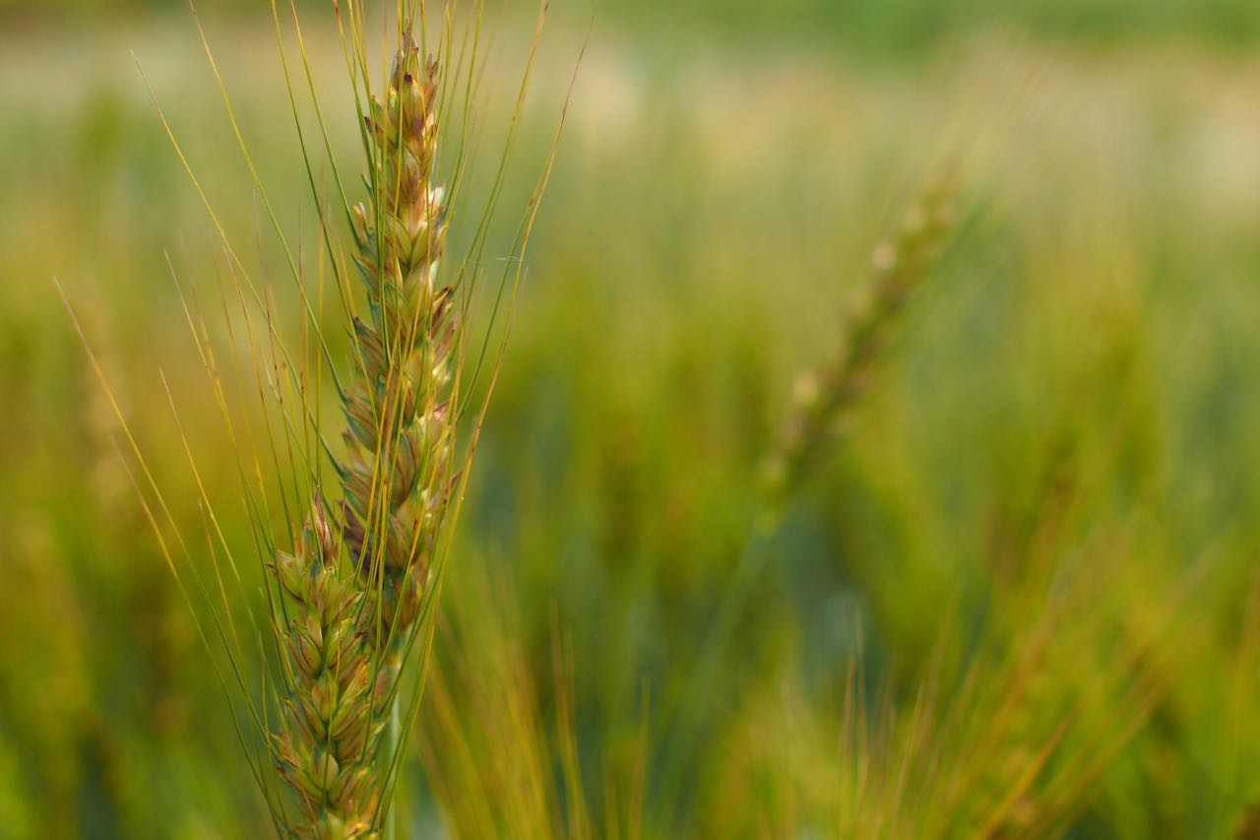

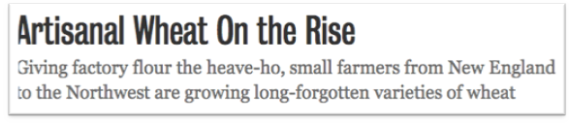
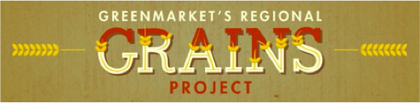
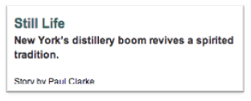

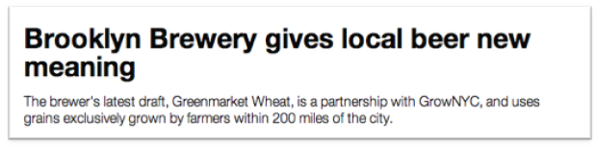
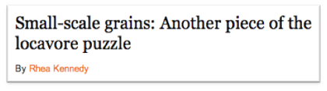





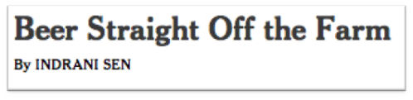





Slide 4
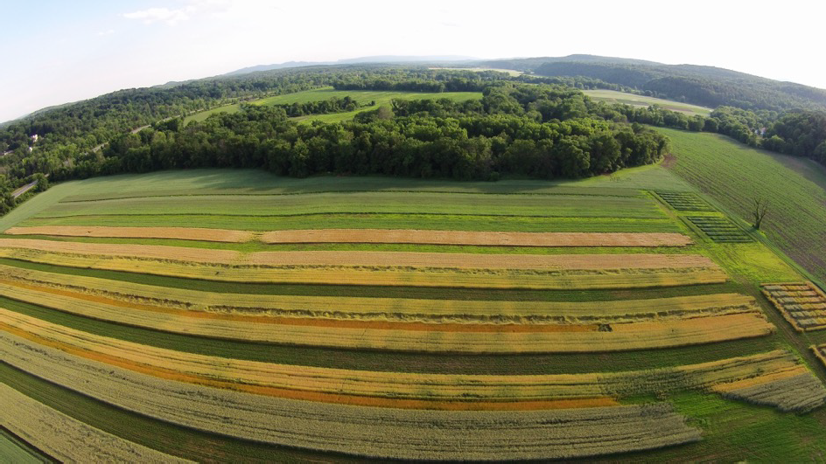


Background
Screening, trialing grain with local collaborators for market quality standards
  1 miller
  2 bakers
  2 maltsters
  2 brewers
□ 2 distillers
Photo: HV Farm Hub

Slide 5





But why farm grains, really?
1) Opportunity to capture exciting new premium market opportunities
Artisan baking (primary, premium)
Craft brewing (primary, premium)
Specialty culinary applications (primary, premium)
Craft distilling (secondary plus)
Spec. Seed (primary, premium)
Certified Organic
  Human consumption markets (primary, premium plus)
  Seed (primary, premium plus)
  Non corn/soy animal feeds (secondary)

Slide 6

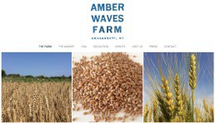
But why farm grains, really?
2) Diversify, expand market
portfolio, add stability
nExpanded offerings to your primary markets
nNovel components of CSAs
n “Full diet” marketing approach
nGrains compliment, economize other part of business, economically
nAdd non-perishable product
(relatively!) to your sales strategy- i.e. does not need to be sold immediately
Amanda Merrow & Katie Baldwin, Amagansett, NY

Slide 7
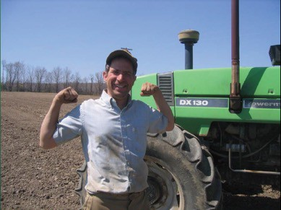
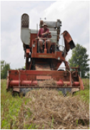
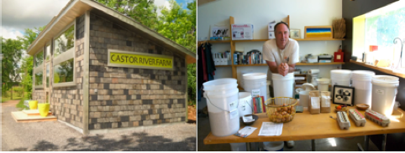
But why farm grains, really?
The allure of production economy
  Can be grown efficiently on a larger-scale
  Equipment-oriented vs. hand labor
  Relatively low pest & disease control demand (compared to many
horticultural crops)
□ Dry goods vs. perishables
Thor Oeschner: Ithaca, NY
George Wright: Ottawa, ON

Slide 8
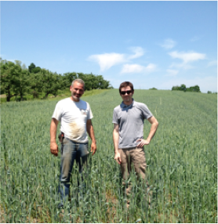
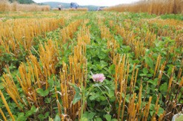
But why farm grains, really?
4) Rotational benefits
Overwinter and/or cool season cash crop option
Break weed, disease, and pest cycles
Potential soil health benefits
  Carbon returns (in veg systems)
  Soil stabilization (in veg and/or
row crop systems)
□ Can be nurse crop for forages, certain legume cover crops/ green manures
Photo: Teresa Rusinek
Photo: J. O’Dea

Slide 9
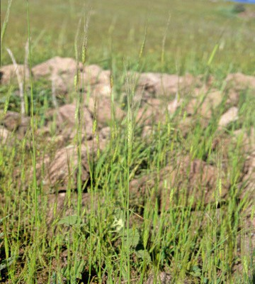
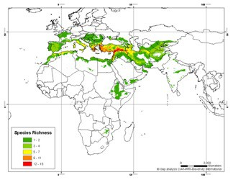
But why farm grains, really?
5) Good growing climate/environment
Grain origins:
  Semi-arid origins, evolution
  Dry summers, Mediterranean
  Low disease pressure
  Unhindered grain maturity
n Consistent high quality grains

Slide 10
But why farm grains, really?
5) Good growing climate/environment
Grain origns:
  Semi-arid origins, evolution
  Dry summers, Mediterranean
  Low disease pressure
  Unhindered grain maturity
n Consistent high quality grains
□ Western PNW (esp.)- Reliable rainfall!
“Dryland agroecosystem yields in the northern Great Plains (NGP) of North America are primarily limited by low and erratic water availability.”

Slide 11
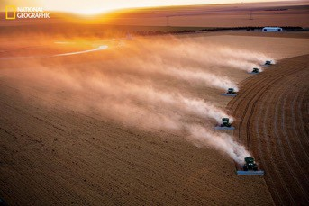
So what’s the hitch?
5) Good growing climate/environment
Grain origns:
  Semi-arid origins, evolution
  Dry summers, Mediterranean
  Low disease pressure
  Unhindered grain maturity
n Consistent high quality grains
    Land base scale
    Low population & associated pressures
    Knowledge
    Equipment
    Infrastructure

Slide 12
So what’s the hitch?
1) Land base, equipment, and infrastructure:
Economy of scale – grains favor larger-scale production capacities to pay off according to per-acre crop returns
  capital intensive- Up-front costs likely high
n Limited capital? - Resourcefulness & strategy
  Larger acreages than horticultural crops (generally)
n Especially difficult in western PNW- size and value
  Demands larger field equipment
  Demands post-harvest mgmt. infrastructure
  Demands mechanical knowledge and/or aptitude
n Especially re: Used, older equipment
n Mind older machinery safety issues also!
  Demands innovation for accommodating smaller scale equipment and infrastructure

Slide 13
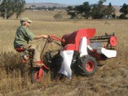
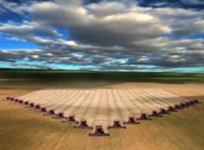
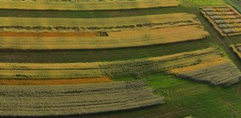
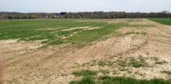


Land base, Equipm’t, Infrastructure
Assessing your assets:
Access to capital, resources, equipment
  Rental, custom op’s., sharing (reliable?)
  Land rental, land trust/PDRs?
Siting & appropriate acreage re: economy of scale
  Varies widely according to business structure & marketing approach re: crop value per-acre
  Reasonable access to post-harvest facilities,
Photo: HV Farm Hub
markets?
Good equipment access to fields?
Equipment scaled to field size(s)?
Appropriate soils
  Loams• well drained• 3’+ depth, flat to gentle slopes
  Rocky soils: doable, but consider moisture retention/ drainage, nutrient availability, seedbed uniformity, cultivation, and wear equipment
  Field history? soil health, soil borne diseases, weed seedbank; sod needs time and work to bring into production
Photo: J. O’Dea
Photo: WSU

Slide 14
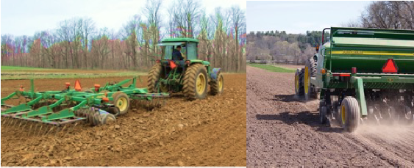
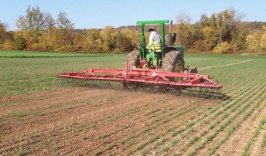

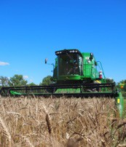
Land base, Equipm’t, Infrastructure
Reliable access to equipment for:
  Primary & secondary tillage (plow, disk, harrow etc.)
  Seeding (grain drill)
  Management (tine weeder/harrow, boom sprayer)
  Harvesting (combine; swather + pick-up header)?
Photo: J. O’Dea
Photo: J. O’Dea
Photo: J. O’Dea

Slide 15
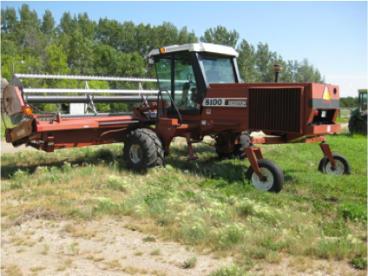
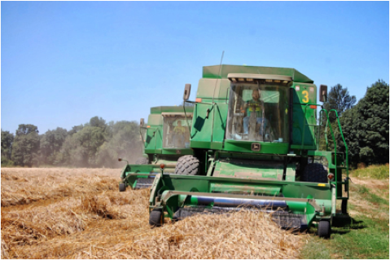
Land base, Equipm’t, Infrastructure
Reliable access to equipment for:
  Primary & secondary tillage (plow, disk, harrow etc.)
  Seeding (grain drill)
  Management (tine weeder/harrow, boom sprayer)
  Harvesting (combine; swather + pick-up header)?

Slide 16
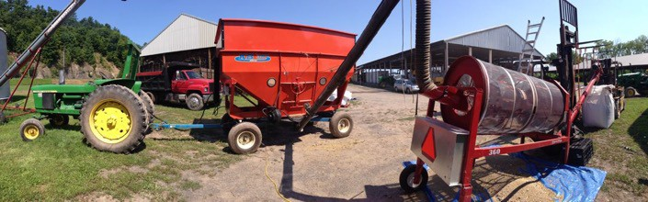
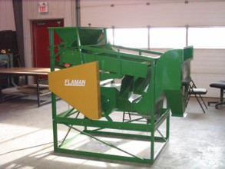
Land base, Equipm’t, Infrastructure
Reliable access to equipment for:
  Primary & secondary tillage (plow, disk, harrow etc.)
  Seeding (grain drill)
  Management (tine weeder, boom sprayer)
  Harvesting (combine; swather + pick-up header)?
  Cleaning (barrel, screen cleaners, fine-scale separators), moving (augers, gravity wagon, truck, forklift)
Photo: J. O’Dea

Slide 17
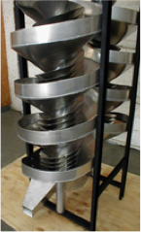
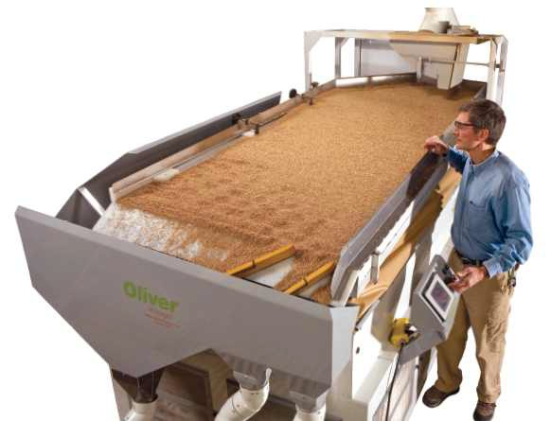
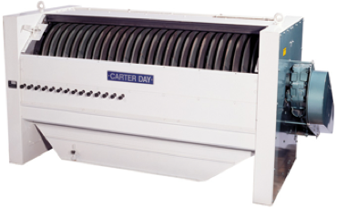
Land base, Equipm’t, Infrastructure
Reliable access to equipment for:
  Primary & secondary tillage (plow, disk, harrow etc.)
  Seeding (grain drill)
  Management (tine weeder, boom sprayer)
  Harvesting (combine)
  Cleaning (barrel, screen cleaners, fine-scale separators), moving (augers, gravity wagon, truck, forklift)

Slide 18
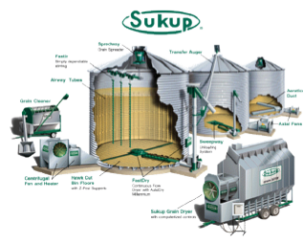
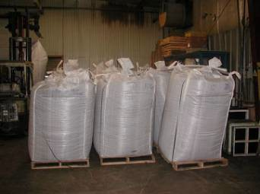
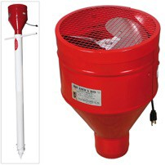
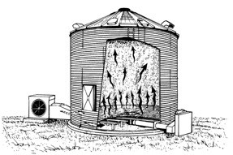

Land base, Equipm’t, Infrastructure
Reliable access to equipment for:
  Primary & secondary tillage (plow, disk, harrow etc.)
  Seeding (grain drill)
  Management (tine weeder, boom sprayer)
  Harvesting (combine)
  Cleaning (barrel, screen cleaners)
  Drying and storing (aerator/drier, covered space & bags, or bins; rodent proofing measures, insect control*)

Slide 19
So what’s the hitch?
2) Production knowledge & meeting grain quality standards- esp. new grain growers, & in the Western PNW:
W. PNW Extension resources- limited, not comprehensive (yet!)
New W. PNW grain growers- harder to find local peer growers, mentors
New growers- unfamiliar with grain quality standards, and how to manage for them • Experienced commodity growers- learning to work with local markets & their expectations
High production potential regions, Western PNW moisture=
  Rainy weather may interfere with timely seeding
  Added challenge to meet grain protein standards for bread wheats
  Grain lodging potential (wind and/or summer rain, high fertility)
  Higher disease, pre-harvest sprouting potential
  Added grain drying & storage challenges, spoilage potential
Small, independent operations- Quality consistency issues (different weather, lack of ability to aggregate and mix qualities)

Slide 20
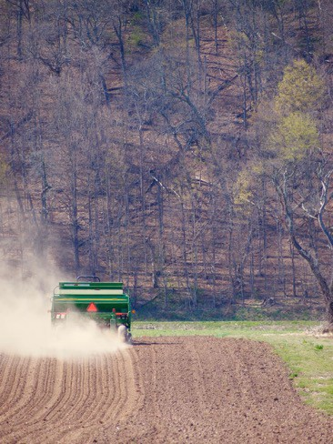
Production knowledge, grain quality
Set yourself up for success.
Follow a broadleaf crop- but avoid vetch. Grassy crops host small grain diseases.
Choose a species and variety that suits your needs. This is foundational.
n Satisfactory agronomic perf. + good match for your market(s)
n Disease resistance- FHB, rust, scald, viruses? Pre-harvest sprouting resistance? Lodging resistance?
□ Weed control is especially important for spring grains- esp. late plantings
n Winter grains - good weed control before planting
n Spring Grains – good weed control before & after planting + early planting (later plantings
= competition with more & more dominant
summer annual weeds)
Photo: J. O’Dea

Slide 21
Production knowledge, grain quality
Set yourself up for success.
Seed timely, at appropriate rates. Use a grain drill.
  Efficient, manages stand uniformity, grain quality
  Winter: Late Sept-Late Oct depending on latitude, 1-3” depth, depending on moisture
  Spring: March to early-mid April, depending on latitude• 1-2” depth, depending on moisture
  Untimely, late plantings-
n Winter- poor establishment, winterkill, virus risk
n Spring- poor establishment, virus risk, 0.5-1 bu/ac yield loss by the day after early-mid April.
Don’t neglect fertility.
  Deficient stands=
low weed competition, low yield & quality potential
  Legumes are a great rotational crop but avoid over-fertilizing with N.
Photo: J. O’Dea

Slide 22
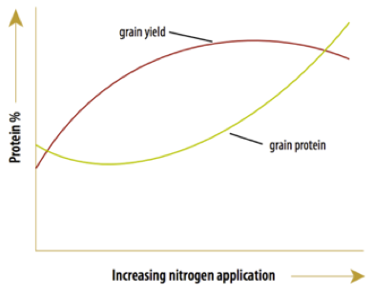
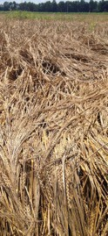
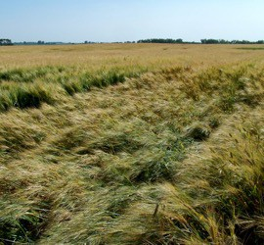
Production knowledge, grain quality
Manage Protein Levels
  Protein is dependent on available N (assuming other nutrients are adequate), diluted by available water
  Adequate N fertility for desired quality
n Malting barleys need N to support yields, but not for protein boost
n Bread wheats need N beyond max yield needs to raise gluten content
  Variety plays a role
  Legumes can help– biologically mediated N release, but need to be given credit in fertility strategy.
  Over fertilizing with N = lodging
n Lodging resistant varieties help
Photo: J. O’Dea

Slide 23
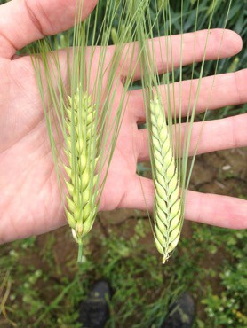
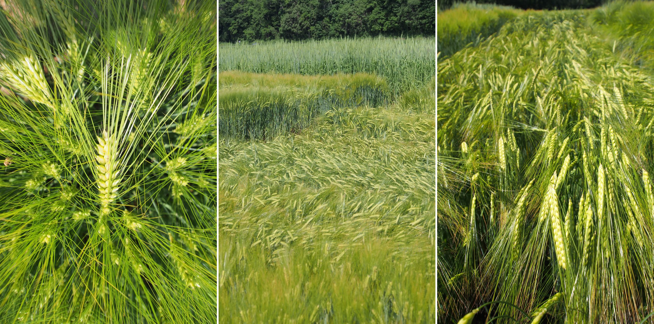
Production knowledge, grain quality
Malting Barley (48 lbs/bu, ~2 bu/ac)
Winter: higher yield potential, lower protein potential, some winter damage risk
Spring: lower yield potential, higher protein potential
2-row= more uniform kernels, cultural preference
6-row= more enzymatic power, other possible agronomic benefits
□ 2-row vs. 6-row? Both suitable due to breeding, BUT check with your market
Feed varieties may yield higher & have increased nutritional value but have undesirable malting qualities
Sprouting damage and vomitoxin are surefire dealbreakers for malting.
Photo: J. O’Dea Photo: J. O’Dea

Slide 24
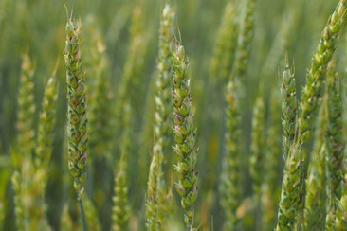
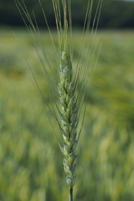
Production knowledge, grain quality
Wheat (60 lbs/bu, ~2 bu/ac)
Photo: J. O’Dea
Winter: higher yield potential, lower protein potential, soil moisture at planting?
Spring: lower yield potential, higher protein potential
Soft white wheats: pastry flours, malting
Soft red wheats: pastry flours
  Higher sprout damage resistance than SW’s
Hard red, white wheats: bread flours
Ancestral wheats (need dehuller for most, $):
  Einkhorn (hulled)
  Emmer (hulled)
  Spelt (hulled)
  Durum
Moderately winterhardy/cold adapted
Sprout damage, vomitoxin can be a dealbreaker.
Photo: J. O’Dea

Slide 25
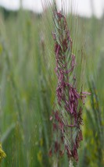
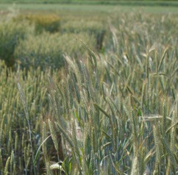
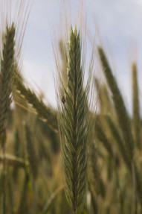
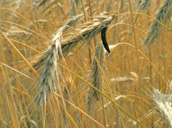
Production knowledge, grain quality
Rye (56 lbs/bu, ~1-1.5 bu/ac )
Photo: J. O’Dea
Mostly winter varieties
Open-pollinated: Cheaper, narrow variety choice, lower yielding
Hybrid: German (KWS), more expensive but higher yielding, expanding varieties; has specific seeding rates
Wide array of uses, including malting
Planting-depth sensitive: ½”- ¾” in EU
Very winterhardy/cold-adapted
Tolerant of poorer soils (acidic, lower fertility, drainage)
Very weed competitive
Can become a weed
Ergot is a surefire dealbreaker.
Photo: Sam Miegs
Photo: J. O’Dea

Slide 26




Production knowledge, grain quality
Oats (32 lbs/bu, ~2-4 bu ac)
“The rye of spring grains”
□ Competitive, adaptable
Winter oats very uncommon in US. Least winterhardy small grain
Hulled- More common, superior agronomically, need dehulling equipment
Hulless- Less variety choice, poorer agronomically, lower “shelf life”, eliminates dehulling step > attractive for small operations
Culinary end uses- milling oats (rolled, steel cut, groats etc.)
Animal feed- low value
Malting?

Slide 27





Production knowledge, grain quality
Avoid a fail…
Tine weed (pre + post), herbicide (pre and/or post), consider undersowing clover
Integrated pest managment
  Rotation, timely planting, resistant varieties, adequate fertility, robust soil health, scout and know your disease risks, fungicide/pesticide products
  Scout field for evidence of scab/FHB (Fusarium), ergot
– manage accordingly
Photo: J. O’Dea
Photo: J. O’Dea
Photo: J. O’Dea
Photo: J. O’Dea

Slide 28




Production knowledge, grain quality
Avoid a fail…
Tine weed (pre + post), herbicide (pre and/or post), consider undersowing red clover
Integrated pestmanagment
  Rotation, timely planting, resistant varieties, adequate fertility, robust soil health, scout and know your disease risks, fungicide/pesticide products,
  Scout field for evidence of scab/FHB (Fusarium), ergot
– manage accordingly
  Watch for loose smut
n Rotation + use certified and/or treated seed.
Have your harvest, drying, cleaning, and storage equipment & plan in order!!
  You may need to clean & dry immediately
Monitor grain maturity, moisture as harvest approaches.
Photo: Sam Miegs
Photo: Sam Miegs

Slide 29


Production knowledge, grain quality
Target your harvest timing
Harvesting before 12-13% and drying down mitigates sprout damage, molds, weathering etc.
Waiting for grain to dry completely in-field - save time, energy, $, BUT risk in-field yield & quality decline
Target to balance these factors
Photo: Louisa Winkler

Slide 30




Production knowledge, grain quality
Target your harvest timing
Harvesting before 12-13% and drying down) mitigates sprout damage, molds, weathering etc.
Waiting for grain to dry completely in-field - save time, energy, $, BUT risk in-field yield & quality decline
Target to balance these factors
□ MC readings can be misleading, observe maturity stages
Photo: J. O’Dea
Photo: J. O’Dea
Visual
Sensory
Photo: J. O’Dea
Photo: J. O’Dea
Photo: J. O’Dea

Slide 31


Pre-post-harvest moisture control
Target your harvest timing
Harvesting before 12-13% and drying down) mitigates sprout damage, molds, weathering etc.
Waiting for grain to dry completely in-field - save time, energy, $, BUT risk in-field yield & quality decline
Target to balance these factors
MC readings can be misleading, observe maturity stages
  Visual
  Sensory
Moisture testing
  Confirm moisture levels
  Samples must be representative
  Targeted MC level dependent on drying capacity
Photo: J. O’Dea
Photo: J. O’Dea

Slide 32

Production knowledge, grain quality
Harvest:
Think warm, dry afternoons into evenings-
when grain is driest, and humidity is lowest
Clean immediately, ASAP if needed
  Green matter
  Chaff, weed seeds, fines, shrunken/diseased kernels
Measure harvest grain moisture, dry/aerate as needed:
  16-18% Moisture- consider heated aeration (<110°F keeps germination viable)
  14-15% Moisture- needs aeration
  12-13% Moisture- is stable
Drying at night & in rainy weather is inefficient:
Understand equilibrium moisture content, & use it
Understand pest & grain spoilage risks & management in storage
Moisture can vary with humidity & temperature, monitor throughout storage.

Slide 33

Production knowledge, grain quality
Grain Quality tests:
Choose a reputable lab that gives the quality parameters your market wants
The sampling may be as important as the sample
  SAMPLES MUST BE REPRESENTATIVE in space, market- clean (& graded ?)
n Unrepresentative good test results may disappoint the end-user when the rest of the lot doesn't perform accordingly
n Unrepresentative poor test results may cost you a sale or a premium
  Consider separate storage, testing of notably different grain lots
  Make sure your market understands the test and it’s limitations, margin of error

Slide 34

Production knowledge, grain quality
Grain quality target basics:
Test Weight: General measure of grain quality- low test weight generally indicates grain developed in stressed growing conditions
DON: Concentration of Deoxynivalenol, i.e. ”vomitoxin” from Fusarium infection
Falling number: Indicates level of sprouting damage, esp. for wheats
RVA: Indicates level of sprouting damage and proximal “shelf-life” of germination capacity for malting barleys
Protein: Percent grain crude protein concentration for approximating gluten concentration, effect on malting, and feed value
Germ: Percent kernels with capacity to germinate for malting and seed
Plump: Percent kernels >6/64” wide; proximal indicator of kernels that filled well & uniformly with a high starch concentration

Slide 35


Production knowledge, grain quality
Malting barley quality basics Test Weight: 48 lbs/bu DON: < 0.5ppm, ≤ 1 ppm Falling number: N/A
RVA: > 120 = sound grain •
< 50 = severe sprout damage
Protein: 9.5-12.5% • 13.5% for 6-rows • under threshold is more workable than above it
Germ: > 95%
Plump: > 80%
For more details explore: American Malting Barley Association • Craft Maltster’s Guild • Hartwick Center for Craft Food & Beverage

Slide 36




Production knowledge, grain quality
Wheat quality basics:
Test Weight: 60 lbs/bu
DON: < 2 ppm • ≤ 1 ppm for finished wheat products- FDA regulated
Falling number: > 350 = sound grain • < 200 = sprout damaged
RVA: N/A
Protein: > 12% for bread flour •
< 10% for pastry flours • > 12% for malting
Germ: > 95%- only for seed, malting Plump: 80%- for malting
See Gwirtz et al. (2006): Wheat Quality in the United States of America.

Slide 37




Production knowledge, grain quality
Rye quality basics:
Test Weight: 56 lbs/bu
DON: < 2 ppm • ≤ 1 ppm for finished milled products- FDA regulated
Falling number: > 120 = sound grain • < 100 = sprout damaged
RVA: N/A
Protein: ?
Germ: > 95%- only for seed, malting Plump: 80%- for malting
Ergot not included in quality testing- be vigilant!
□ Use certified and/or treated seed.
Photo: U-Nebraska-L
Photo: U-Sask.

Slide 38

Production knowledge, grain quality
Oat quality basics:
Test Weight: 36-40 lbs/bu
DON: < 2 ppm • ≤ 1 ppm for finished milled products- FDA regulated
Falling number: ? RVA: N/A
Protein: ?
Germ: > 95%- for seed Plump: ?
Thins: < 12% percent < 5/64” Dehulled groats: < 8% dehulled
□ See Winkler & Murphy (2017) Producing Milling Oats in Western Washington: Guide to Grain Quality Optimization and Marketing

Slide 39
So what’s the hitch?
3) Market Risks
Nascent, fledgling markets; economic immaturity
  Learning curves, growing pains, low economic resilience & risk thresholds
  Grower and market may be in the same state:
n Ripe for bottlenecks, misunderstandings, unclear expectations
n Contract: it will force you to talk through all this.
□ Some new businesses just might not last- many, varied reasons
Balancing personal and business relationships
Juggling multiple premium markets vs. wholesale
□ Balancing market mgmt. efficiency vs. maximum profit n Additional infrastructure needed to keep grain lots separate n Smaller vs. bulk deliveries
n More personalities and business habits to navigate
n Potentially complicated pricing
Eastern WA growers:
  Limited access & distance to premium, direct markets… out of the loop
  Potential challenges with product differentiation from commodity grain?

Slide 40






Take home points…Happy grain growing!
Do your homework, do the math-
try to be realistic about operation size/scale.
Consider more than one market to mitigate risk
Learn your market(s), choose wisely, explore innovative business structures & marketing.
  Establish secondary back-up markets
= livestock feed and/or distilling
Contract to assure that expectations clear
  Pre-contract for primary markets
Photo: J. O’Dea
Photo: J. O’Dea
Photo: J. O’Dea
□ Connect with secondary markets before sale in case of failed premium sales
Shoot for high quality grain, and know how to maintain it-
increases chance for sales, premiums, customer loyalty
Have your harvest, drying, cleaning, and storage plan in order
  Know how to supply an appropriate, representative grain quality test to your buyer
  ALWAYS deliver grain CLEAN and DRY.
Photo: J. O’Dea
Photo: J. O’Dea
Photo: J. O’Dea

Slide 41
THANK YOU
Photo: J. O’Dea

Slide 42



WSU- Western PNW grain production, general : thebreadlab.wsu.edu/growing-grains- west-of-the-cascades/
WSU- Field equipment for modest sized grain operations: cru.cahe.wsu.edu/CEPublications/ EM116E/EM116E.pdf
WSU- Milling Oats in W. WA: pubs.cahnrs.wsu.edu/publications/pubs/em109e/
WSU- general grains: smallgrains.wsu.edu/ • Pest Mgmt.: pnwhandbooks.org
WSU/OSU/U of I: Organic Small Grain Production in the Inland Pacific Northwest: A Collection of Case Studies: cru.cahe.wsu.edu/CEPublications/PNW683/PNW683.pdf
OSU- Barley: barleyworld.org/
OSU: Managing Nitrogen for Yield and Protein in Hard Wheat: catalog.extension.oregonstate. edu/sites/catalog/files/project/pdf/fs335.pdf
U of I Barley: Winter- www.extension.uidaho.edu/nutrient/pdf/smallgrain/NorthernWinterBarley.pdf • Spring- barley.idaho.gov/pdf/spring_barley_production_guide.pdf
Grain enterprise budgets: WSU- ses.wsu.edu/enterprise_budgets/ • OSU- arec.oregonstate.edu/oaeb/ • U of I- www.uidaho.edu/cals/idaho-agbiz/crop-budgets • MSU (organic): www.canr.msu.edu/organic_agriculture
/uploads/files/Organic%20Crop%20Budgets%20Final.xlsx
NDSU- Grain Drying & Storage: www.ag.ndsu.edu/graindrying
□ Grain Equilibrium Moisture Content charts: www.ag.ndsu.edu/graindrying/documents/GrainEquilibriumMoisture ContentCharts.pdf • Cool Grain to Prevent Pests: www.ag.ndsu.edu/graindrying/images/cool-grain-to-prevent-storage- problems-poster
Cornell- Harvest and Storage of Malting Barley: nmsp.cals.cornell.edu/publications/factsheets/factsheet82.pdf
Cornell- Timing Malting Barley Harvest: fieldcrops.cals.cornell.edu/small-grains/malting-barley/timing-malting- barley-harvest
PSU- Managing Stored Grain: ento.psu.edu/extension/factsheets/pdf/manageStoredGrain.pdf
Book- The Organic Grain Grower (by Jack Lazor, VT farmer)

