Slide 1
2017 Barley Analysis Summary
Layton Ashmore
Washington State University

Slide 2
Our lab – What we do
Instrumental methods of beverage analysis
Extraction, separation, detection, and identification of flavor and aroma compounds and their precursors
Two methods: Volatile analysis (GC) and Nonvolatile analysis (LC)

Slide 3
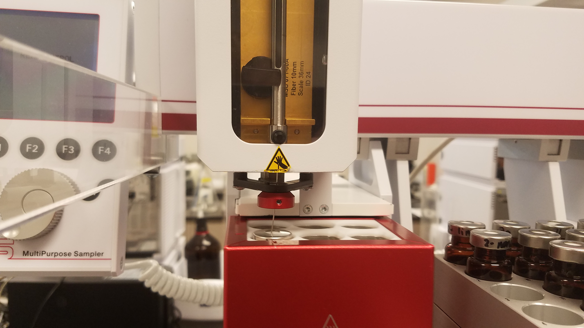
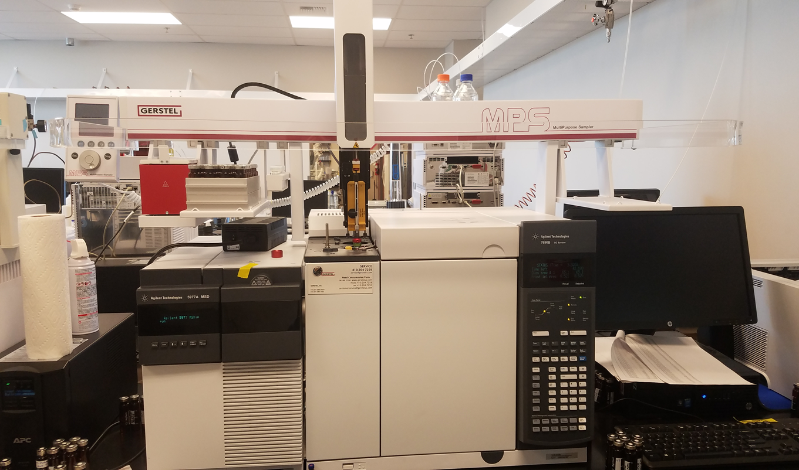
Our lab – Volatile Analysis
Headspace Solid Phase Microextraction (HS-SPME)
Efficient extraction of volatile components
Minimal sample alteration
GC-MS
Detection and identification of compounds through NIST libraries
Gerstel MPS HS-SPME autosampler
Agilent 7890/5977 GC-MS, “Ethel”

Slide 4
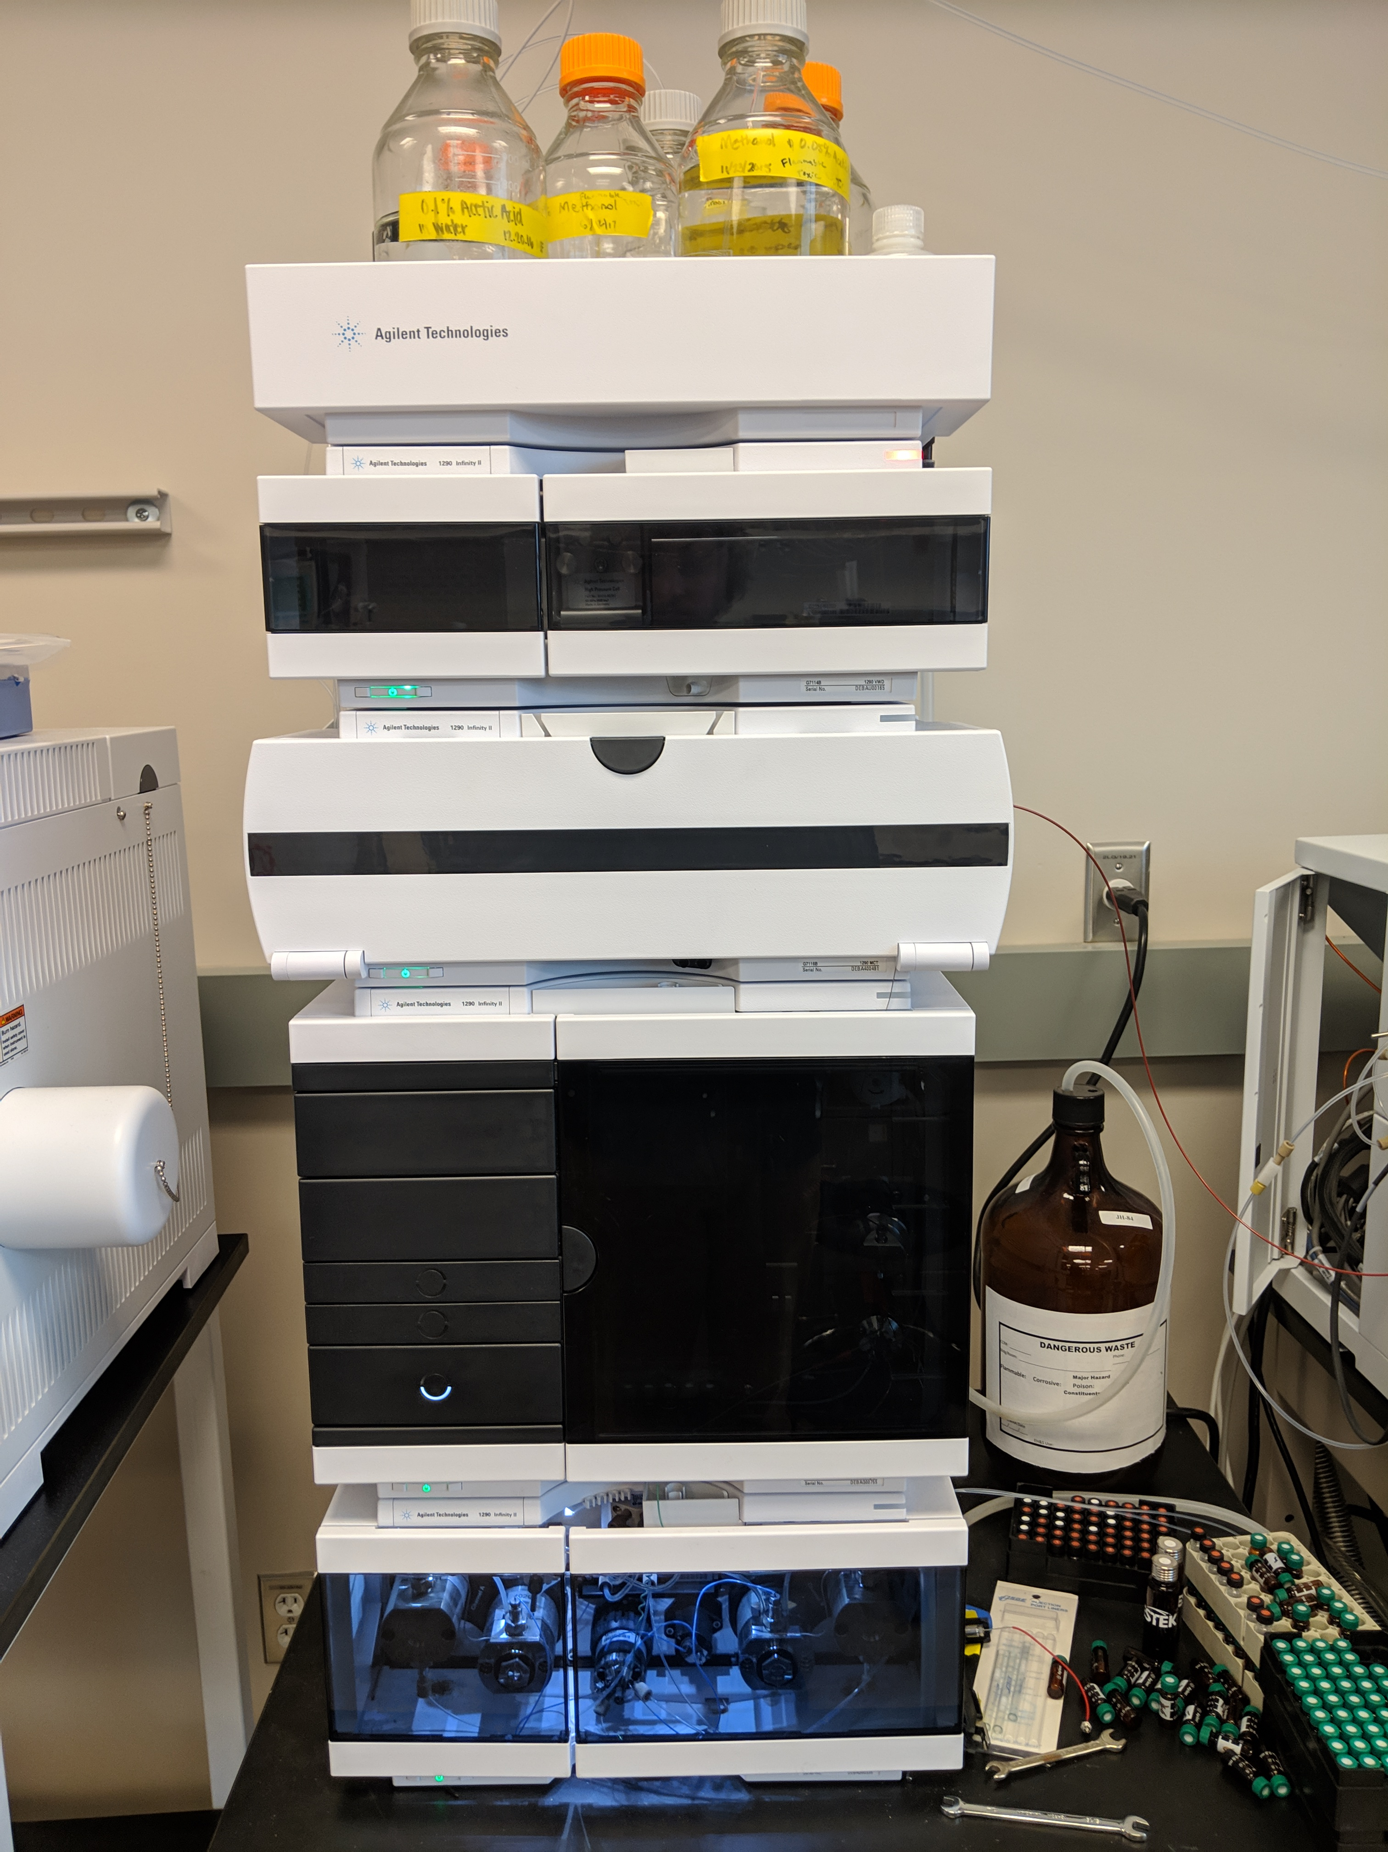
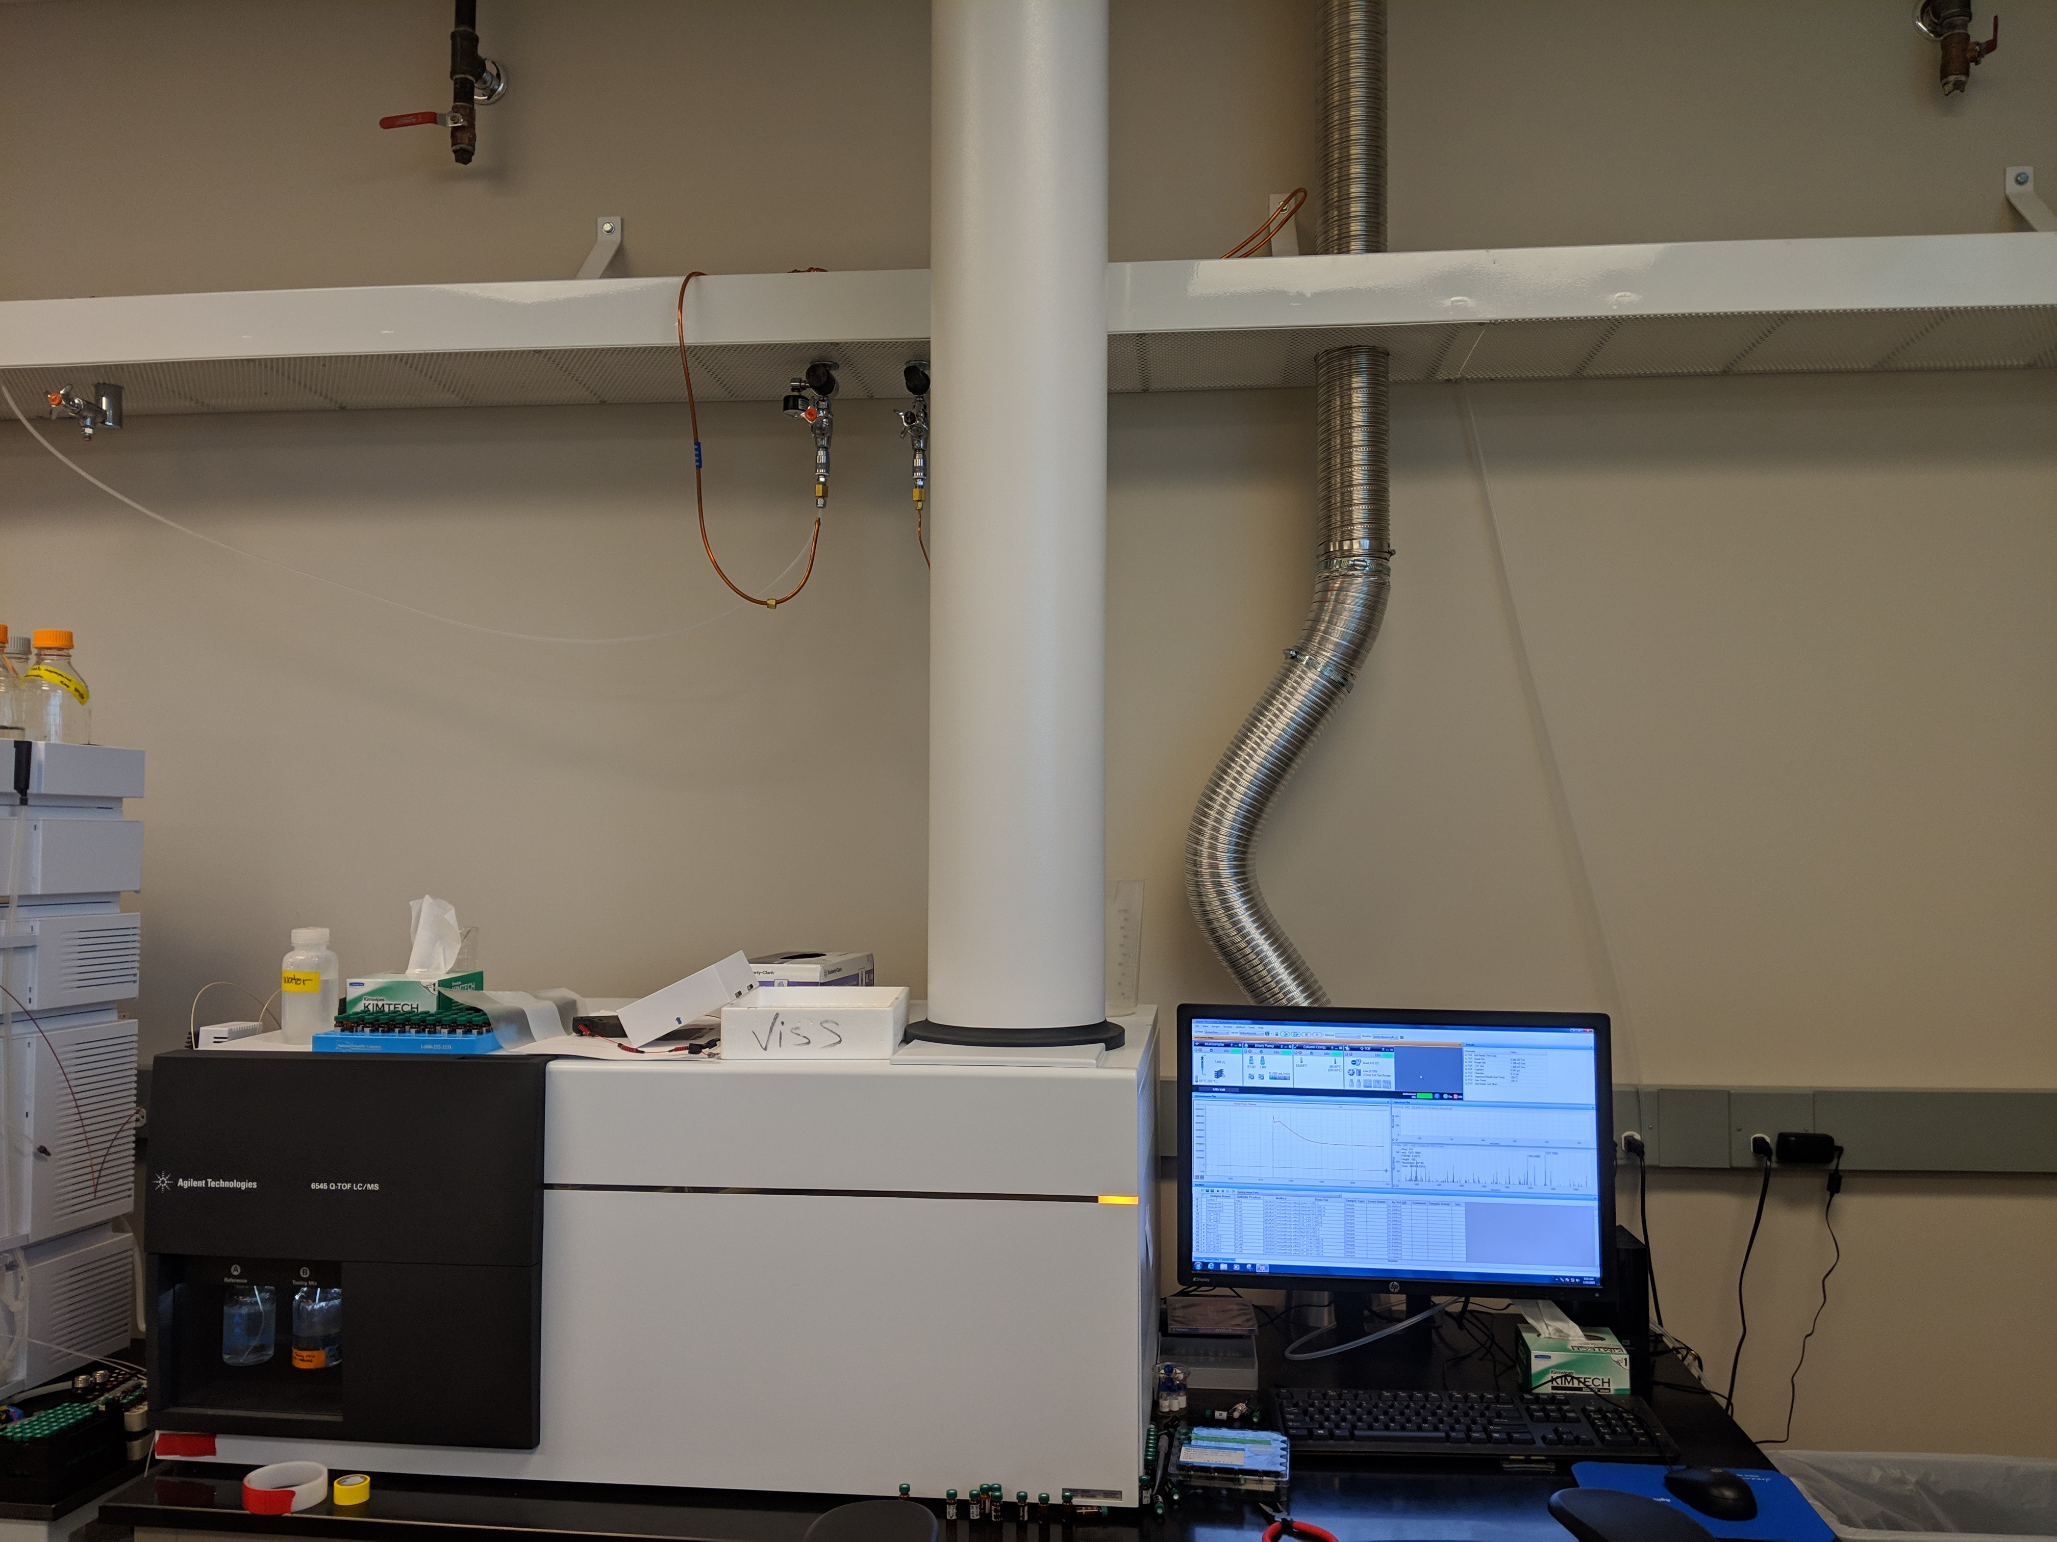
Our lab – Nonvolatile Analysis
Ultra-high Pressure Liquid Chromatography (UHPLC)
Efficient separations based on water/organic solvent affinity
Only sample prep: filtration
QToF/MS
Highly accurate mass profiling
Lookup of compounds through metabolomic databases
Agilent Infinity II UHPLC
Agilent 6545 QToF/MS, “Mortimer”

Slide 5
Our lab – Barley Breeding Trials
Volatile analysis
Sandstone fresh-make whiskeys
Individual batches from each 2017 breeding trial
No malting (no barley alteration)
No barrel contact (no non-volatiles)
Barley hot water steeps
Mimic mashing conditions for beer and distillated spirit production
Nonvolatile analysis
Barley hot water steeps
Get an idea of bound flavor compounds and flavor precursors
First pass: Untargeted, searching for “unknown unknowns”

Slide 6
Results – Sandstone Whiskey
Major aroma compounds: ethyl esters
Ethanol + fatty acid
Can be yeast or plant derived
Main source of separation (PC1): Still system
107.58 and 107.8 distilled on separate system
79% of variance

Slide 7
Results – Sandstone Whiskey
Outliers removed
Horizontal separation (PC1)
49% of variance
Driven mostly by dodecanoic acid ethyl ester
Vertical separation (PC2)
40% of variance
Driven mostly by pentadecanoic acid ethyl ester
Most likely yeast derived aroma compounds

Slide 8
Results – Sandstone Whiskey
Likely plant-derived compounds
Terpenes, unsaturated aldehydes
PC1: Trans-2-nonenal
~49% of variance
Oxidation product
“Wet newspaper”, “cardboard”
117.x strains separated from 120.x strains
PC2: Terpenes
~38% of variance

Slide 9
Results – Barley Steeps (Volatiles)
Samples grown in Pullman and Olympia
Separations unclear
Important volatile compounds:
Fatty acid ethyl esters
Phenolics/flavonoids
Semi-volatiles, mouthfeel and antioxidant properties
Oxidation products
1-octen-3-ol
nonanal
1-hexanol
2-octanone

Slide 10
Results – Barley Steeps (Nonvolatiles)
Samples grown in Pullman and Olympia
PC1: Growing area
40% of variance
Mostly driven by unsaturated fatty acids
PC2: 107.x and Hanever Strains
20% of variance
Potential terpenes (208.1479/mz)

Slide 11
Results – Takeaway
Biggest contributor to whiskey aroma: Fatty acid ethyl esters, trans-2-nonenal
Some terpene contribution
More than 2 double bonds = from barley
Biggest contributor to barley volatiles: Oxidation products (1-octen-3-ol, nonanal), phenolics
Biggest contributor to barley nonvolatiles: Unsaturated fatty acids
How does it all fit?

Slide 12
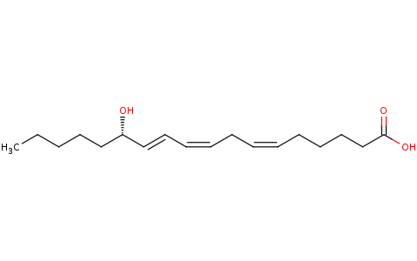
Results – Takeaway
From QToF data: Major driving factor = 294.2195m/z ion
From: Metlin Database (https://metlin.scripps.edu)

Slide 13
Results – Takeaway
From QToF data: Major driving factor = 294.2195m/z ion
trans-2-nonenal?
From: Metlin Database (https://metlin.scripps.edu)

Slide 14
Results – Takeaway
From QToF data: Major driving factor = 294.2195m/z ion
1-octen-3-ol
trans-2-nonenal?
From: Metlin Database (https://metlin.scripps.edu)

Slide 15
Results – Takeaway
From QToF data: Major driving factor = 294.2195m/z ion
Lipoxygenase
1-octen-3-ol
trans-2-nonenal?
From: Metlin Database (https://metlin.scripps.edu)

Slide 16
Results – Takeaway
From QToF data: Major driving factor = 294.2195m/z ion
Lipoxygenase
“cis-1,4-pentadiene”
From: Metlin Database (https://metlin.scripps.edu)

Slide 17
Results – Takeaway
Lipid oxidation by lipoxygenase – produces key volatile aroma compounds and aroma precursors
Trans-2-nonenal – off flavor in beer (“wet newspaper”), potential lactone formation in whiskey
Cis-3-hexenal – off flavor in beer and wine (“grassy”), hexalactone precursor in whiskey
1-octen-3-ol – off flavor in beer and wine (“mushroomy”), octalactone precursor in whiskey

Slide 18
Future work
Collect more data for better statistical analysis
Quantification of potential flavor markers
Fatty acid analysis
LOX activity
Sulfur compound analysis (DMS, DMSO, DMDS)
Analyze 2018 barley
Analyze year 1 whiskey

Slide 19
Acknowledgements
Dr. Tom Collins
Dr. Stephen Bramwell
Dr. Kevin Murphy
Sandstone Distillery
WSU Wine Science Center

