Slide 1
Food Quality & Functionality of Naked Barley
OSU Barley World
Jordyn Bunting
Notes:
Masters Food Science and Technology
Advised by Pat Hayes and Andrew Ross, Brigid Meints

Slide 2
‘Developing Multi-use Naked Barley for Organic Farming Systems’
Funded by USDA-NIFA-OREI
Composed of research, extension, and outreach
barleyworld.org/orei-project
eorganic.info/barley
Evaluate agronomic, food, feed, malting and brewing performance under organic conditions
Notes:
US Dept of Ag – Institue of Food and Ag – Organic Ag Research and Extension Initiative
Goal of OREI project: breed for organic agriculture to support organic growers, gardeners, processors, and consumers
My role: food
- my background with cooking and I knew nothing about barley prior
- spoiled in PNW when it comes to grains
- had to practice working with it as whole grain and flour (made me appreciate wheat flour on a new level)
Barley as a food
- surprising lack of research on food quality despite barley being the 4th most produced crop in the world

Slide 3
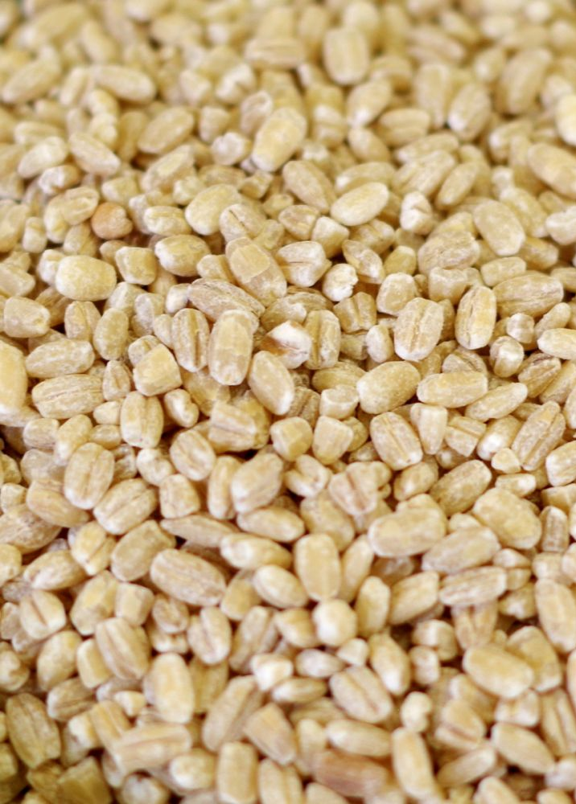
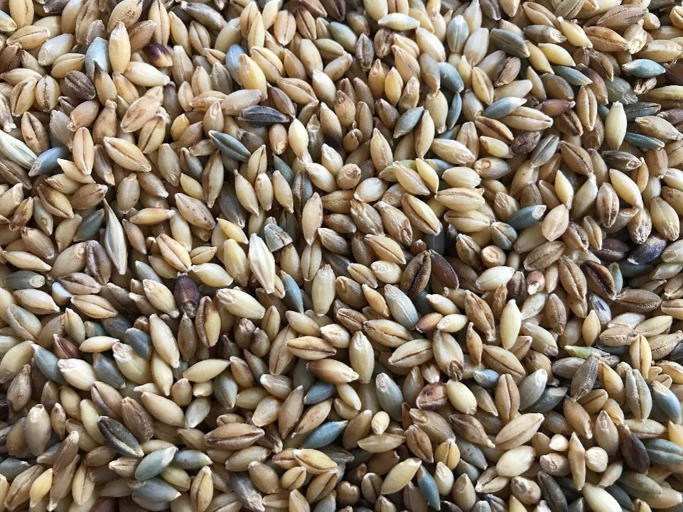
Covered
Pearled
Naked
Notes:
Lipids made by barley kernel cause hull to adhere to it
Loss of function in gene results in naked barley
Trait spread 8,000 years ago
Preferred for food
No need for pearling
True whole grain with all the nutrition

Slide 4
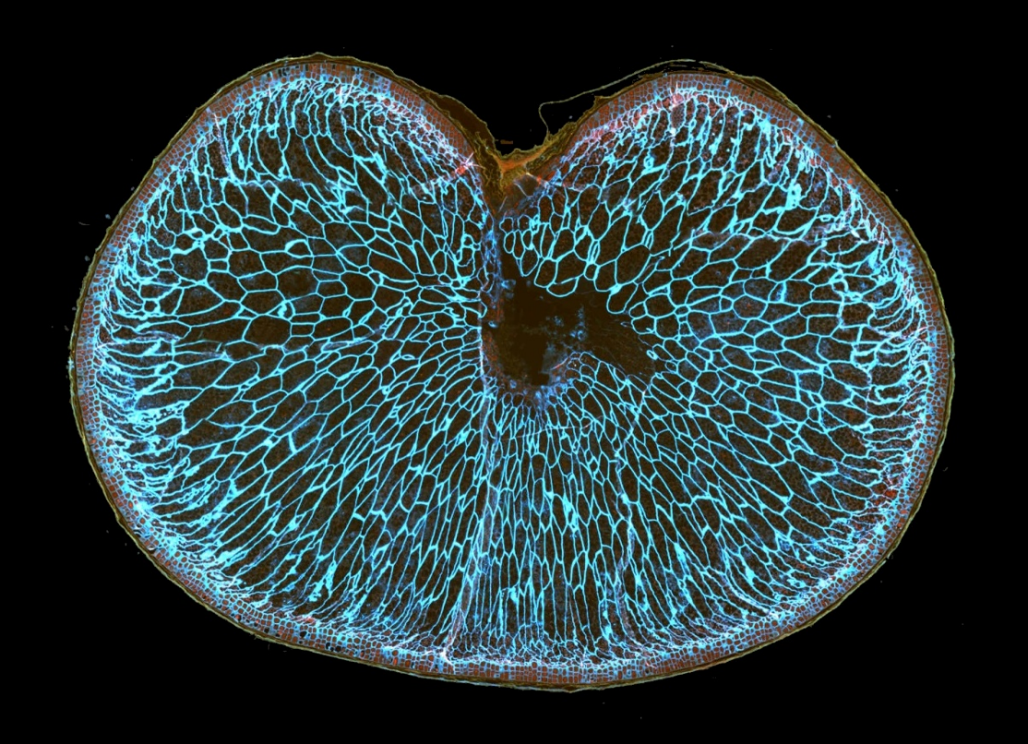
The Food Industry & Barley
Beta-Glucan
Extractive vs Whole grain model
FDA approved health claim
3 g Beta-Glucan per day
VTT Technical Research Centre of Finland
Notes:
- beta glucan staining pic.
- different approaches to incorporating fiber in food: extraction of high BG varieties vs. utilizing whole grain
We have embraced the whole grain model
- influenced by local advocates of whole grain baking
- flavor & nutrition as a driving force
- Barley as a source of fiber along with minerals, vitamins, phytochemicals
- smaller spikes in blood glucose/insulin, lower cholesterol, nourish gut microbiome
- Modern societies greatly deficient in fiber – plagued by preventable diseases
- food industry struggling to utilize barley – sensory qualities and proper utilization

Slide 5
Challenges with Barley
Changes in multiple sensory attributes
Variety of barley matters
Need best variety for a particular product
Need to embrace barley for what it is
Notes:
Can’t just add barley in products to increase fiber
- Negative sensory attributes reported in lit.:
- darker color, difficult dough handling (lacks cohesiveness), decreased bread volume from weaker dough strength, crumb is denser & more crumbly, changes in flavor profile
- results in limited amounts of incorporated barley (up to 50% barley flour), balance adding enough fiber for health benefits with limiting negative sensory attributes
Can’t use unspecified variety of barley and expect consistent results (see picture)
- How do I even choose the optimum barley? What guidelines are there?
- Cereal quality tests are often based on wheat functionality; so many unknowns when it comes to barley as a food despite it being 4th most grown cereal crop – it’s been outcompeted by wheat in our society
- Lack of specification framework for determining “good” quality barley for a particular product
Embrace barley
- Problems with lit. and negative sensory attributes:
- lit. trying to hide barley in wheat products; stop trying to make barley perform like wheat
- based on the American palette and preference for white bread-like products
- overtime, as trends to eat whole grains grow for more flavor and more nutrition, hopefully the general public’s taste preferences changes
Time to begin building this framework to benefit food product developers, food processors, breeders, and farmers

Slide 6
Building a Framework
Developing quality & functionality parameters
Benefit food manufacturers, breeders, and farmers
Using 35 varieties grown in OR, MN, WI, NY
Quality & functionality testing
384 line Diversity Panel
Hardness & Beta-Glucan
Genome-Wide Association Study (GWAS)
Notes:
Benefits
Food processing & product development: establish what qualities are important, how to use quality/functionality tests to determine which variety of barley is best for a food product
Breeders: establish what qualities are important to breed for a particular market
Farmers: select varieties with good food quality traits for a particular market that grow well in your region
Using 35 varieties
- advanced breeding lines
- Genetics x environmental role
- mix of winter, spring, and facultative lines
Diversity panel
- small amount of quality testing: hardness and beta-glucan
- GWAS: identifying QTL for hardness and beta-glucan

Slide 7
Assessing Quality
Beta-Glucan
Starch Profile
Hardness
Color
Protein
Threshability
Pre-harvest Sprouting
Notes:
Quality & functionality
what I desire as a cook: flavor, aroma, texture, appearance, application flexibility
what I desire as a food scientist working for a food company: same as above + consistency + quantifiable tests that can predict performance in product
Imagine working for a food company that makes crackers that needs to be a particular diameter to fit in the package
Challenges in barley quality & starting from scratch:
- AACC cereal quality tests for wheat won’t give results for barley
- lots of unknowns in what is even considered “good” barley quality
- need for further testing of varieties for particular end uses
Protein: measured but relevance is uncertain
Beta glucan: want at least 4% for health benefits – need to address MW distribution; absorbs a lot of water
Starch Profile: Waxy vs normal vs high amylose – affects cooking properties like time, water uptake, viscosity, texture
Hardness: wheat biochemistry is different, low for malting, low for milling/flaking
Color: antioxidant capacity
Threshability: need lines that thresh clean for minimal cleaning
Sprouting: Resistance to or ideal for varieties meant to be sprouted?

Slide 8
Assessing Functionality
Water absorption
Starch Pasting
Starch Gel Strength
Cooked Grain
Color, texture, yield
Batter Flow
Bread Tests
Volume, Texture, Staling Rate
Changes in Fiber Molecular Weight
Processing method matters
Ross, A., B. Meints, k. Murphy, and P.M. Hayes. 2017. Functionality testing of multi‐ function naked‐barleys for food uses. Poster session presented at the Whole Grain Summit, Vienna, Austria.
Notes:
SRC challenge
- good for wheat and predicting functionality; key steps in test method fail for barley
Bread (40% barley flour)
Sprouting

Slide 9
Choosing a Variety
Bread
Volume, Texture, Staling Rate
Water absorption
Whole Grain Applications
Color, Cooked Grain Traits
Flake Applications
Hardness
Noodles
Pasting Viscosity
Pancakes, biscuits, muffins, etc…
Batter flow
Ross, A., B. Meints, k. Murphy, and P.M. Hayes. 2017. Functionality testing of multi‐ function naked‐barleys for food uses. Poster session presented at the Whole Grain Summit, Vienna, Austria.
Notes:
Need to test performance in a food product
Using tests to guide decision making
Whole grains
- salads, sprouts, stews, risotto
Flakes
- porridge, muesli

Slide 10
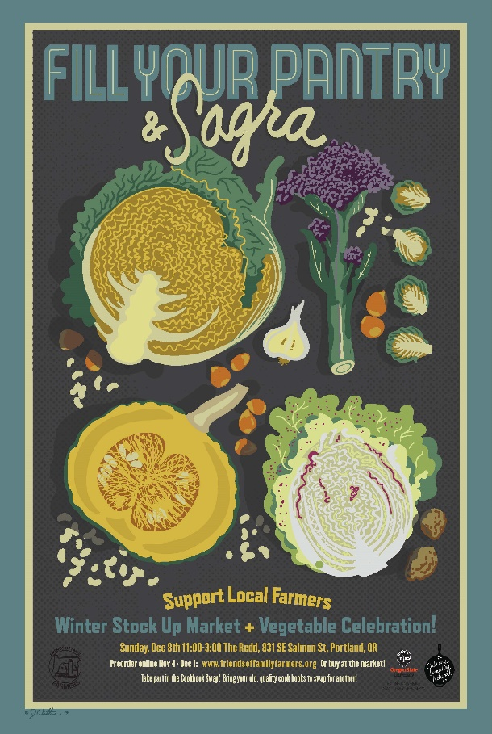
Culinary Outreach
Notes:
Thanks to CBN & Katie for the support
Promote variety showcase tickets

Slide 11
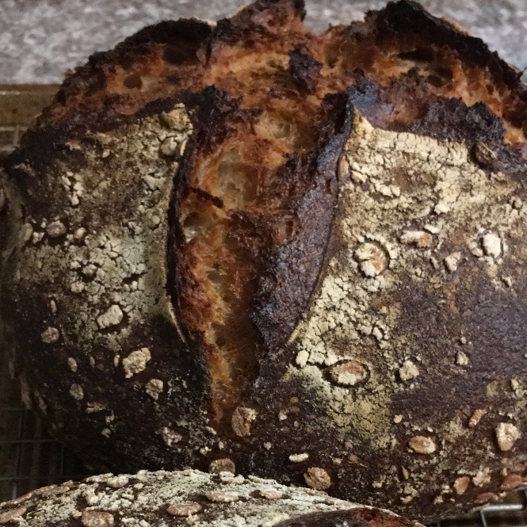
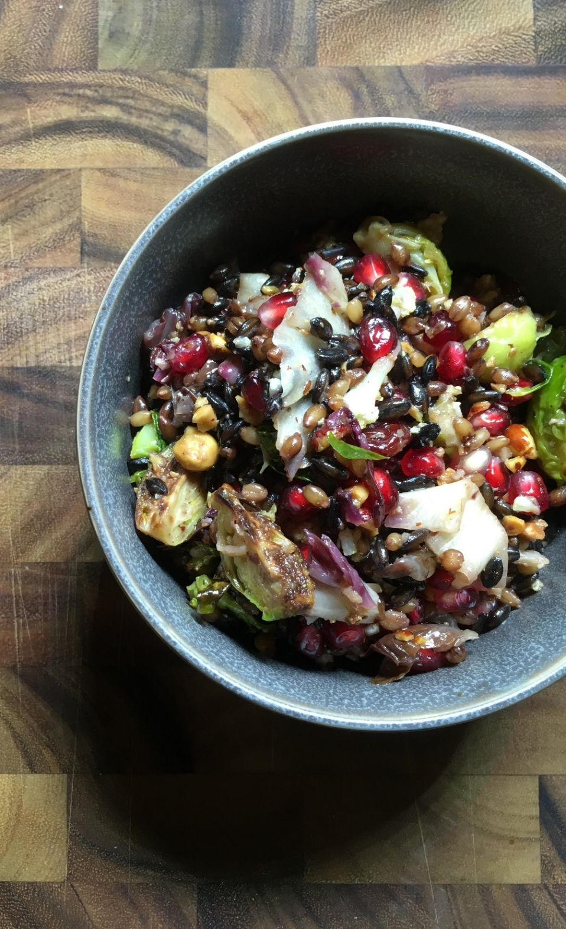
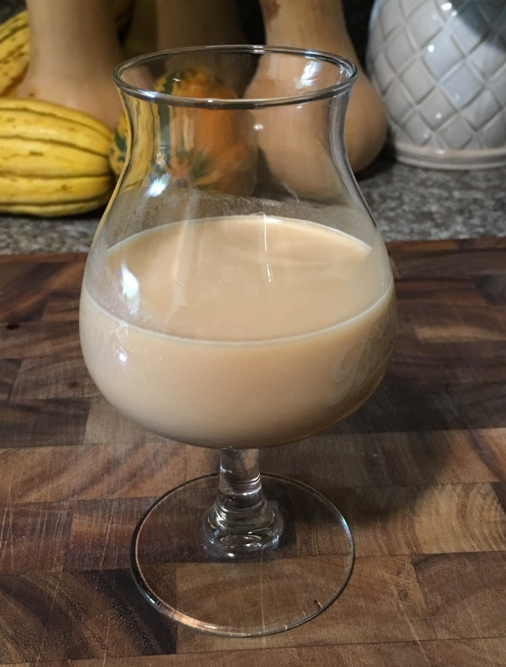
Applications with whole kernels, flakes, and flour
Going beyond yeast fermentations
Notes:
Whole grain salad, porridge bread & crackers, hazelnut barley milk, kombucha

Slide 12
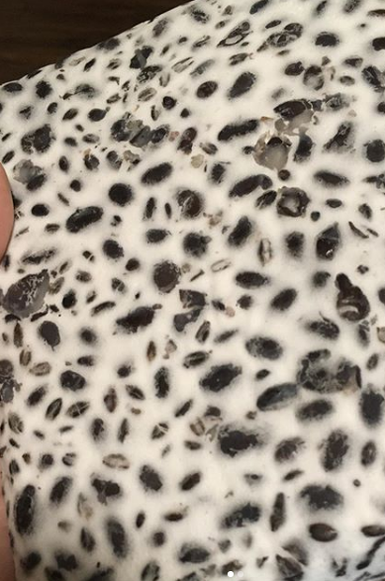
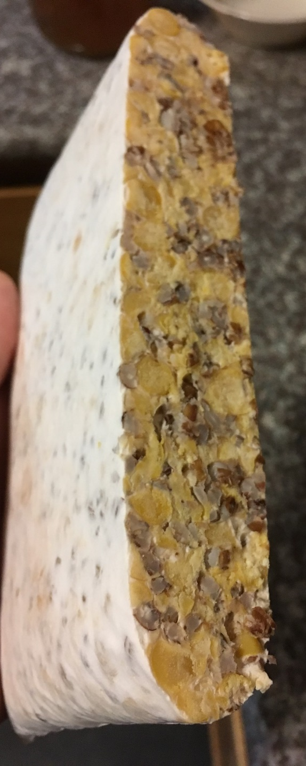
Notes:
Tempeh, Koji (miso, soy sauce, chocolate)

Slide 13
Jordyn Bunting
jordyn.bunting@oregonstate.edu
Instagram:
jordyn___b
OSU Barley World
barleyworld.org/orei-project
Instagram:
multibarley
Barleyworld
Culinary Breeding Network
Culinarybreedingnetwork.com
Instagram:
culinarybreedingnetwork
eOrganic
eorganic.info/barley
Notes:
Contact info
Asking the crowd: who has experience working with barley in food? What qualities are important to them?

