Slide 1
Hot Steep Malt Sensory Exploration
Evan Craine
evan.craine@wsu.edu
Sustainable Seed Systems Laboratory
At WSU

Slide 2
Breeding a Malt Quality Barley
Brewers
Maltsters
Consumers
Breeders
Farmers

Slide 3
Hot Steep Methodology
Developed at Briess Malt & Ingredients Co.
Beta tested by Briess, New Belgium, and Highland Brewing
Validated by ASBC Sensory Technical Committee (2017)
Casey Poirier
Lindsay Barr
Anna Sauls
http://blog.brewingwithbriess.com/wp-content/uploads/2017/06/16665013_1418196804918202_565611224690862981_o.jpg
https://highlandbrewing.com/imager/assets/general/Team/1419/Headshot-19_a84301d2d7bce2ab03b003a3a8334b6e.jpg

Slide 4
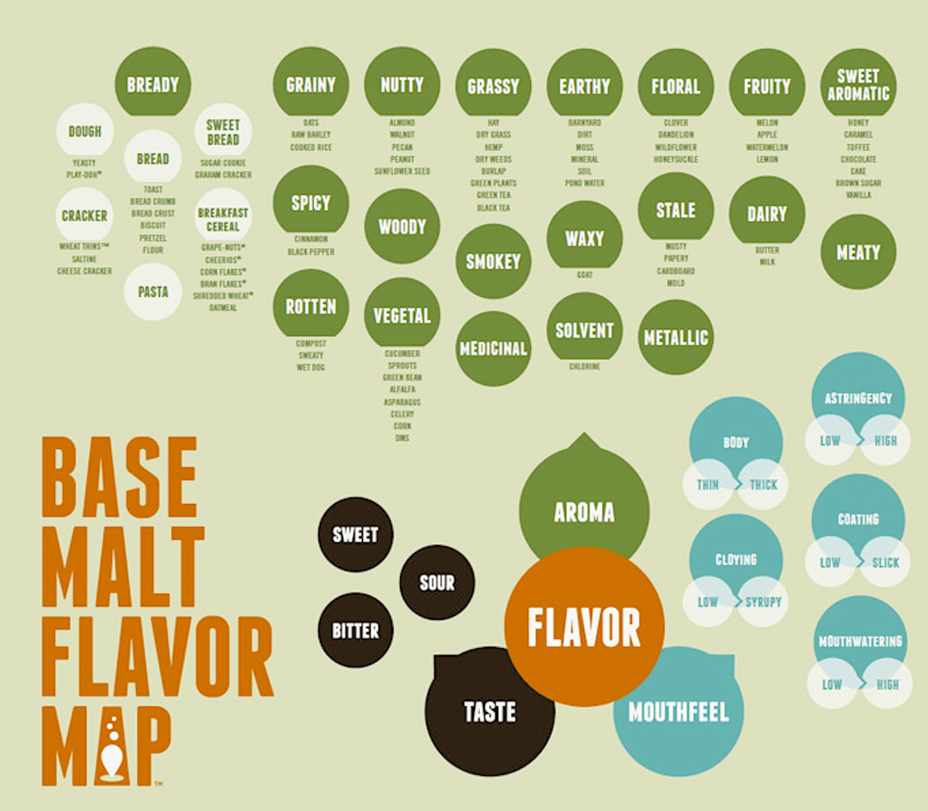
https://www.google.com/url?sa=i&source=images&cd=&cad=rja&uact=8&ved=2ahUKEwi4qvrPy8bhAhWljlQKHaIuBYQQjRx6BAgBEAU&url=https%3A%2F%2Fwww.craftbeer.com%2Fcraft-beer-muses%2Fbeer-malt-science-breakthroughs&psig=AOvVaw1Tp836y2wgjCIRw8gaCopl&ust=1555022296681515

Slide 5
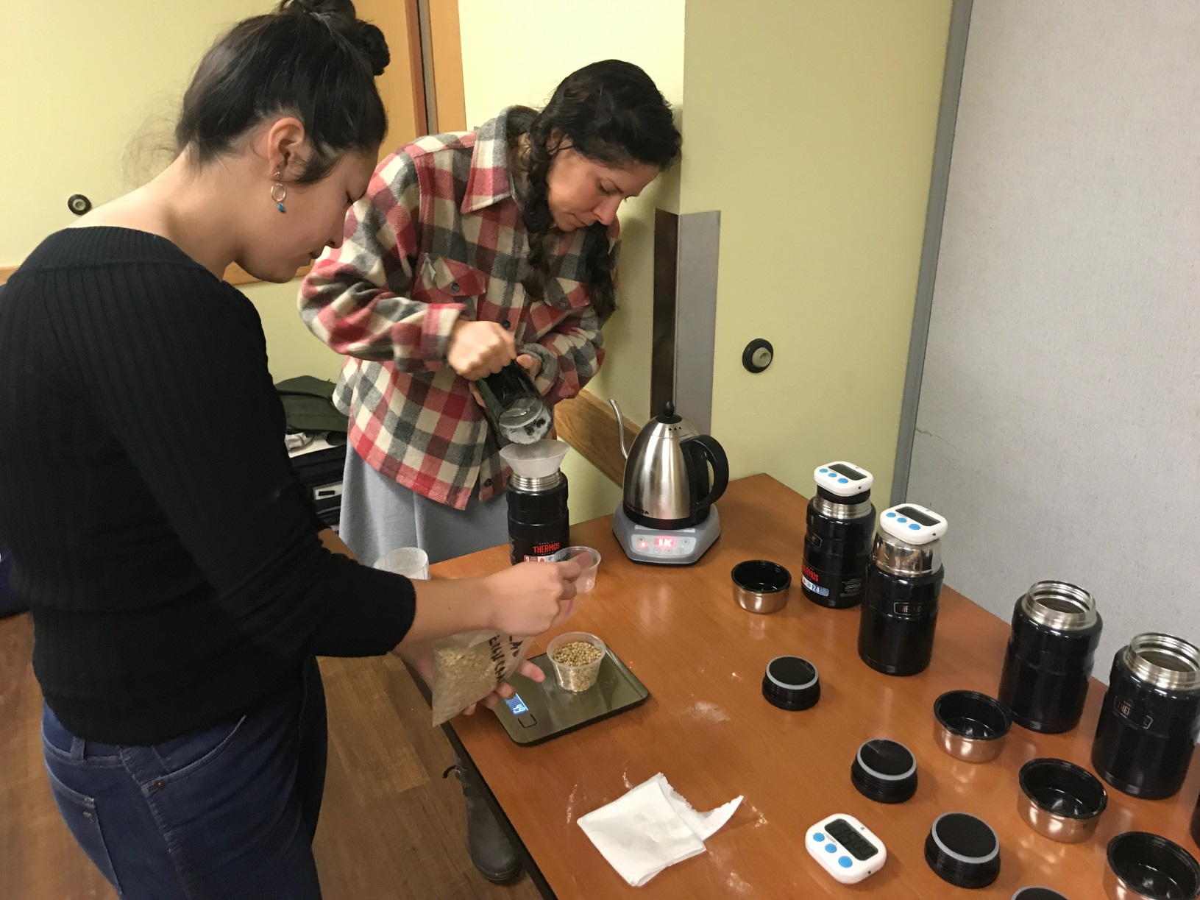
Hot Steep Process

Slide 6
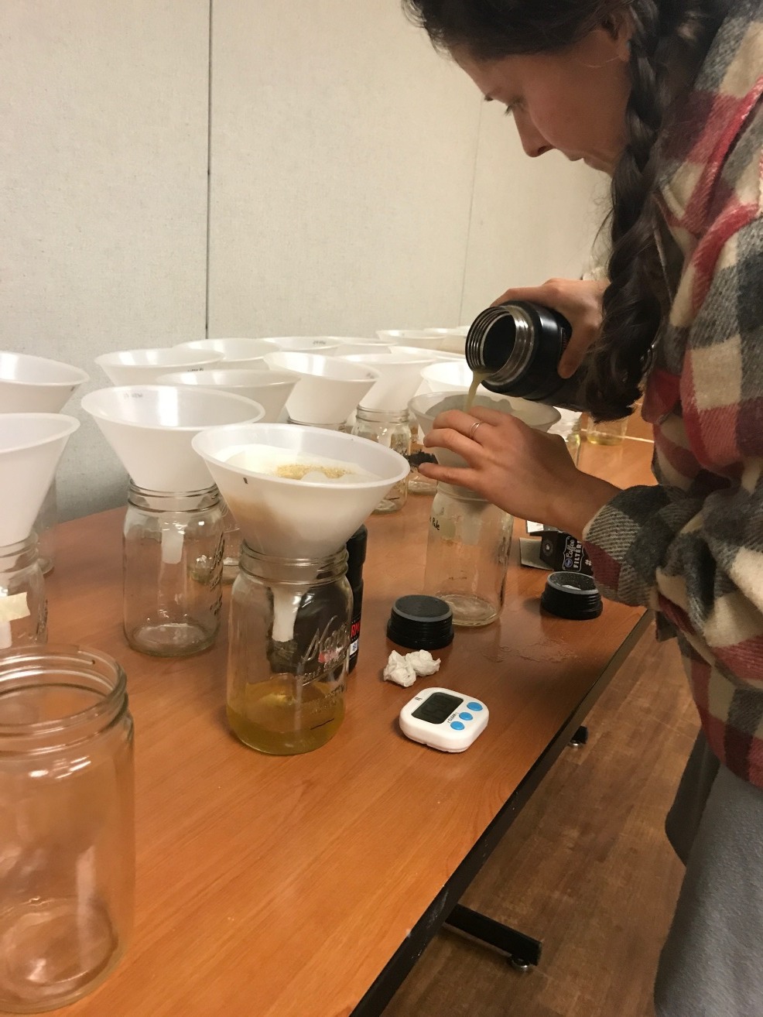
Hot Steep Process

Slide 7
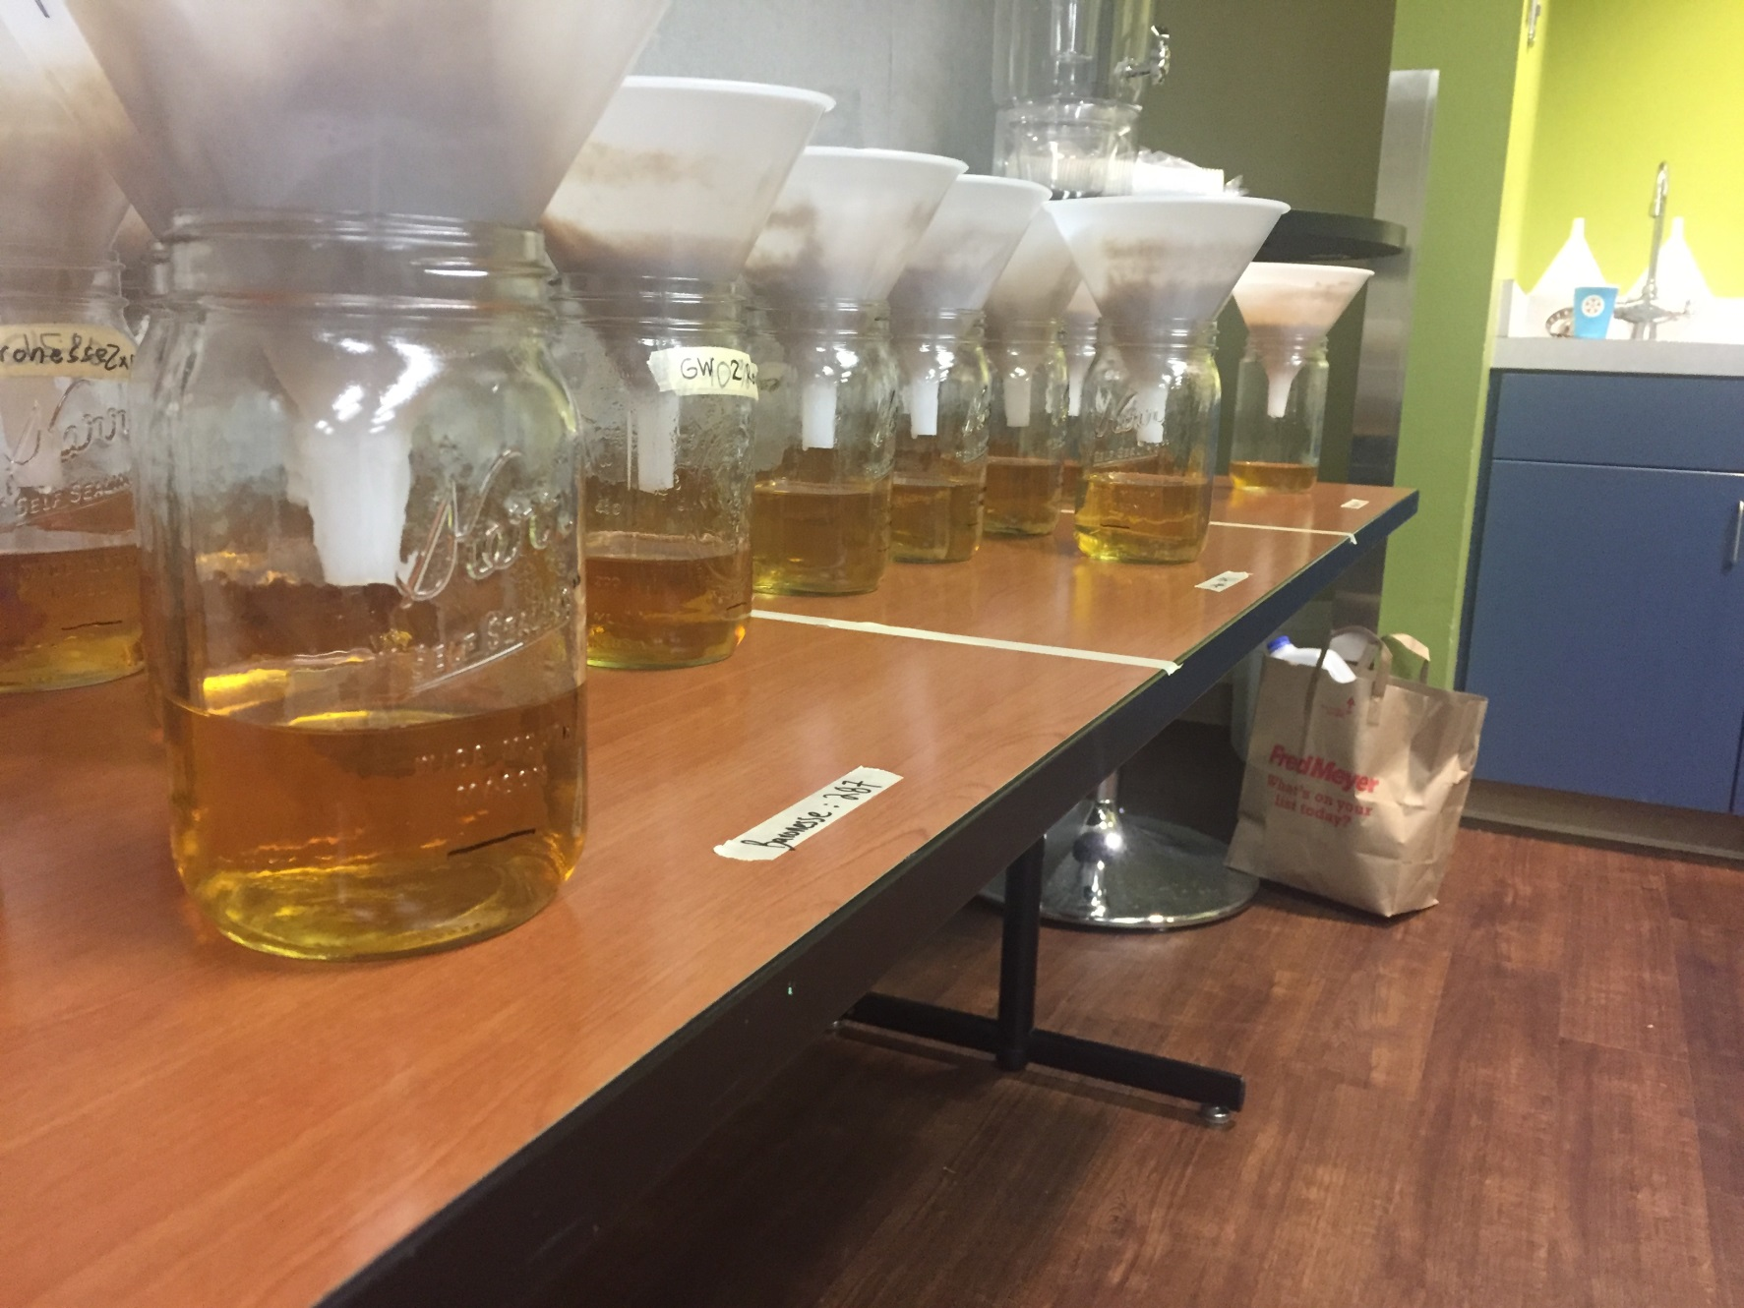
Hot Steep Process

Slide 8
Intro to Tasting
Look
Sniff
Sip (slurp!)
Savor
Report perception

Slide 9
DraughtLab
Download
Join Description
*wait for code*
Conduct sensory eval.
Report back
Repeat

Slide 10
Sample 1 162

Slide 11
Sample 2 328

Slide 12
Sample 3 680

Slide 14
Samples
162 | 328 | 680
CDC-Copeland | 117.17 | 120.14

Slide 15
Samples
162 | 328 | 680
CDC-Copeland | 117.17 | 120.14
American Malting Barley Association (AMBA) Survey

Slide 16
Samples
162 | 328 | 680
CDC-Copeland | 117.17 | 120.14
American Malting Barley Association (AMBA) Survey

Slide 17
Samples
162 | 328 | 680
CDC-Copeland | 117.17 | 120.14

Slide 18
Samples
162 | 328 | 680
CDC-Copeland | 117.17 | 120.14

Slide 19
Samples
162 | 328 | 680
CDC-Copeland | 117.17 | 120.14

Slide 20
Samples
162 | 328 | 680
CDC-Copeland | 117.17 | 120.14

Slide 21
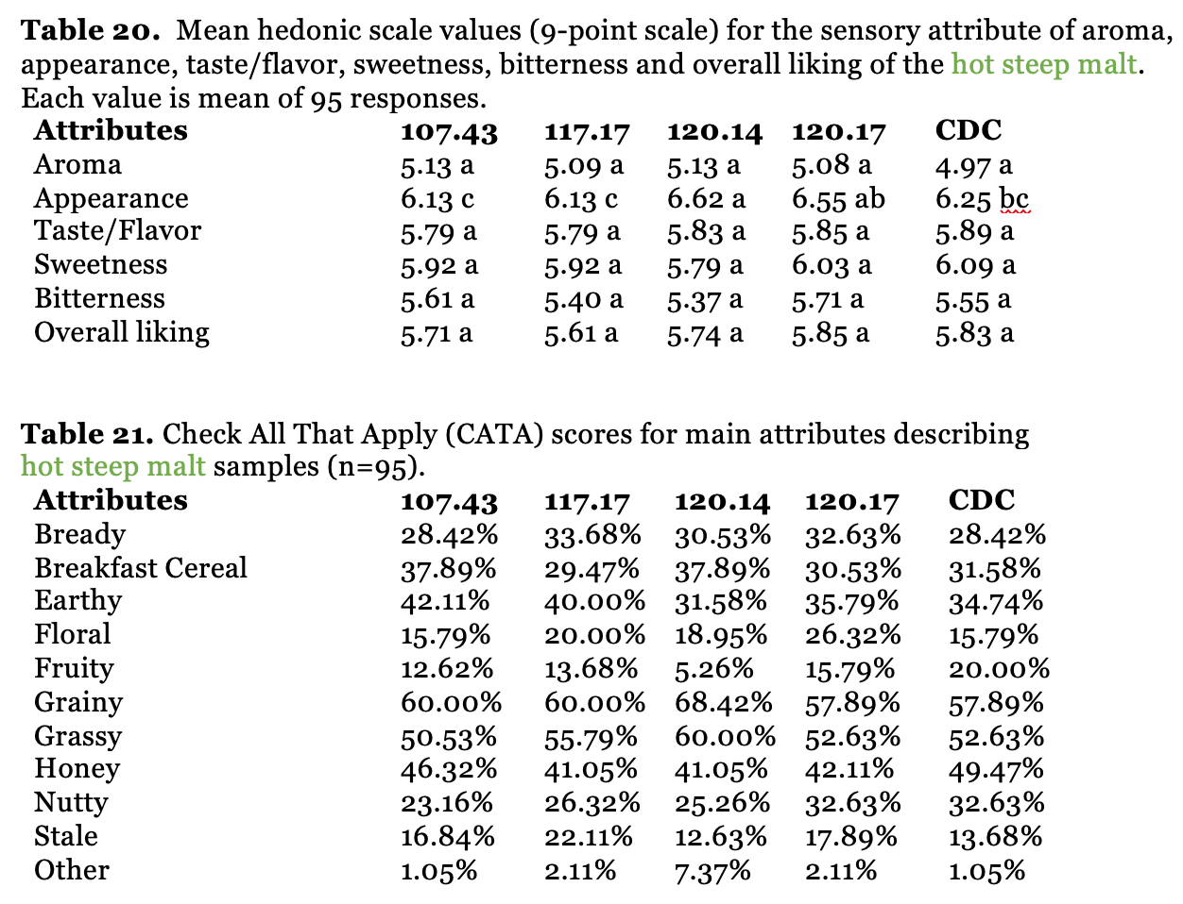

Slide 22
680: 120.14

Slide 23
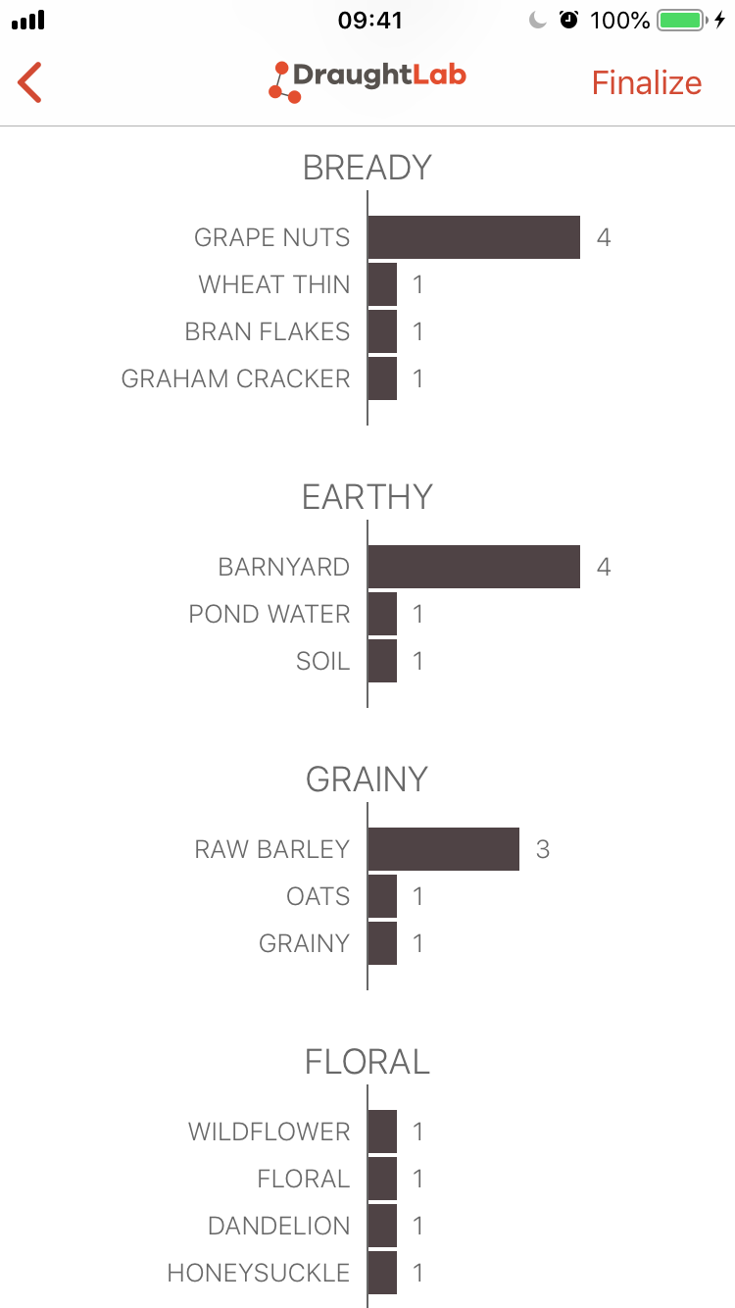
680: 120.14

Slide 24
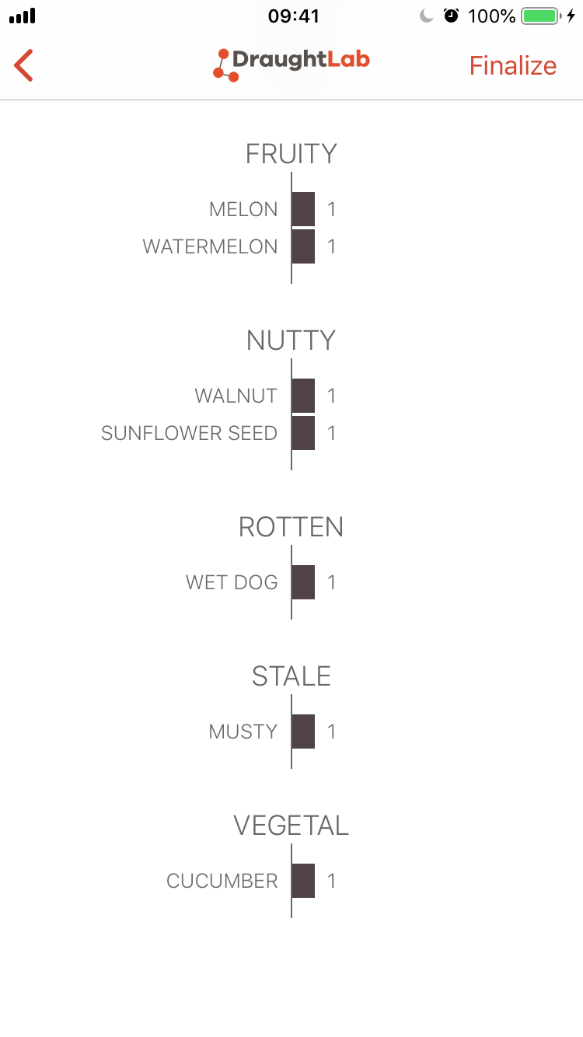
680: 120.14

Slide 25
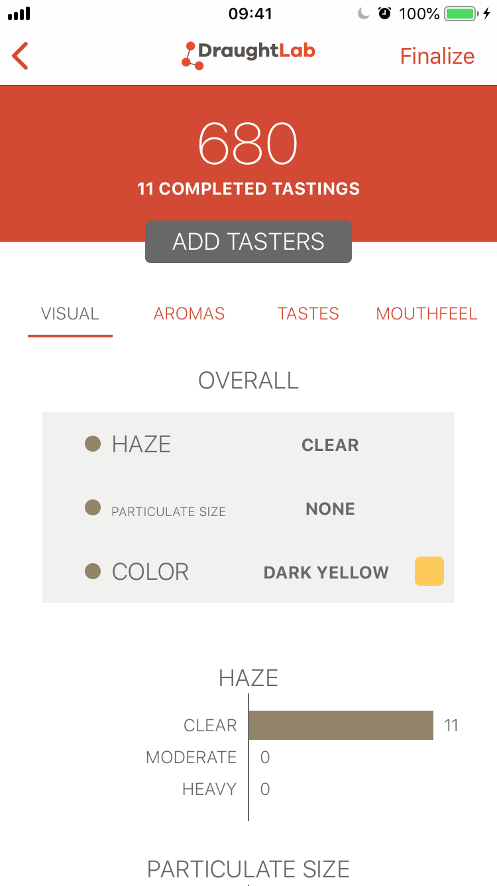
680: 120.14

Slide 26
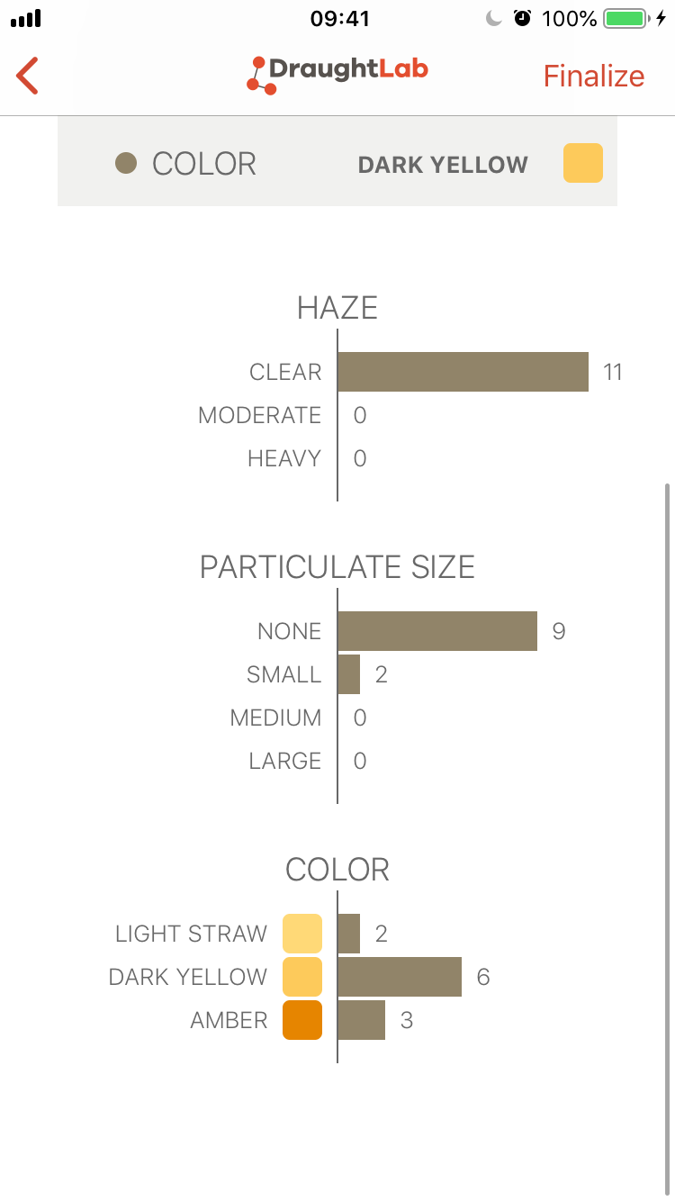
680: 120.14

Slide 27
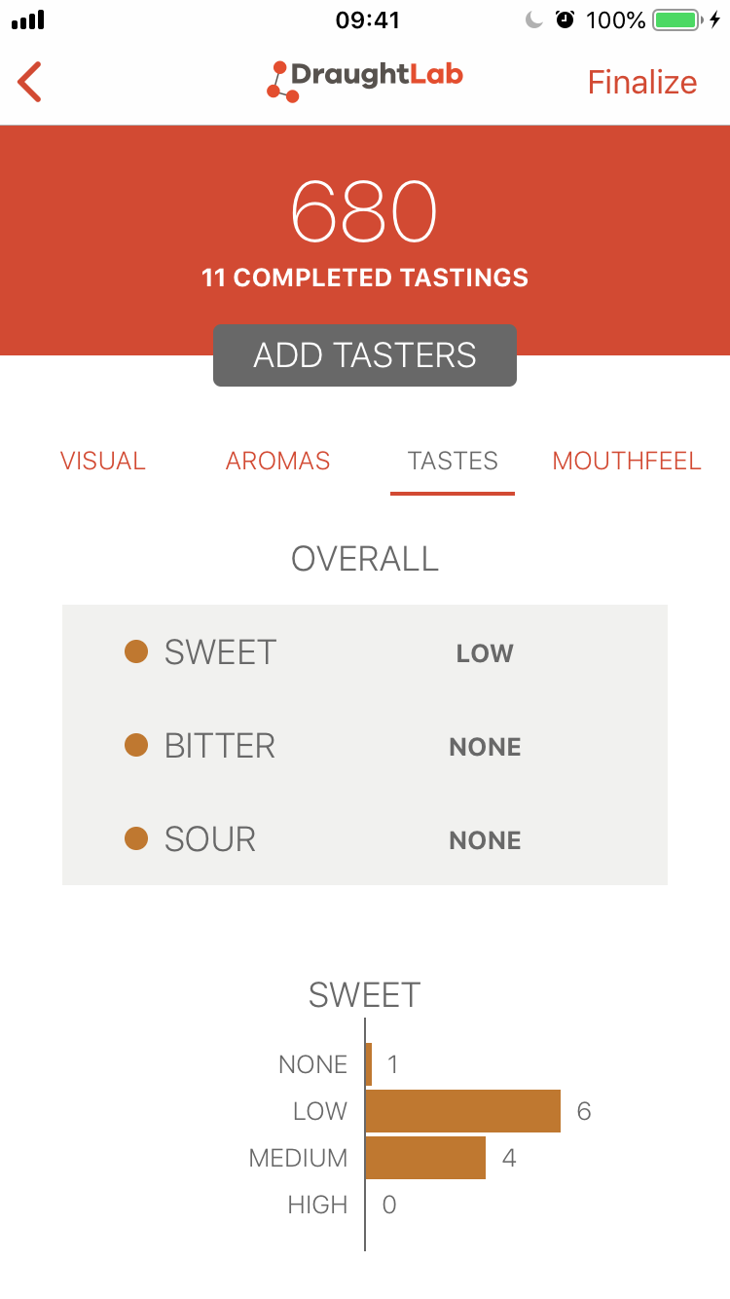
680: 120.14

Slide 28
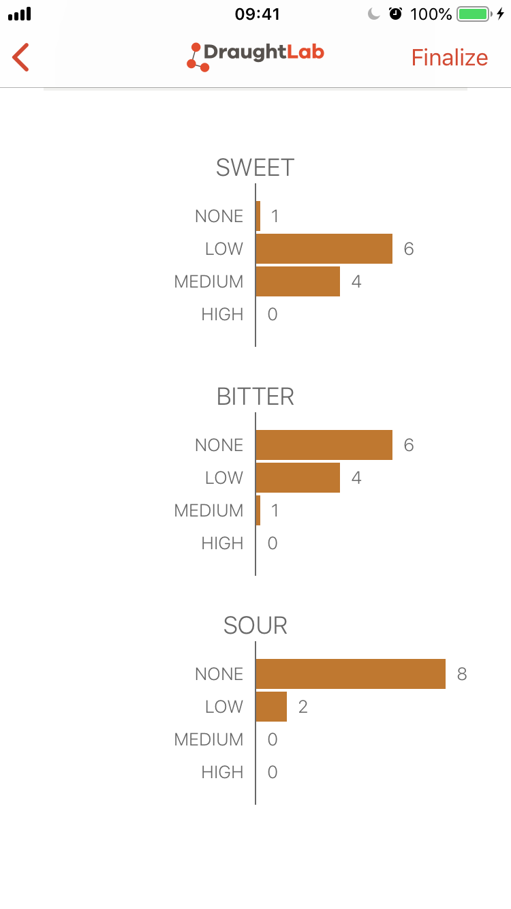
680: 120.14

Slide 29
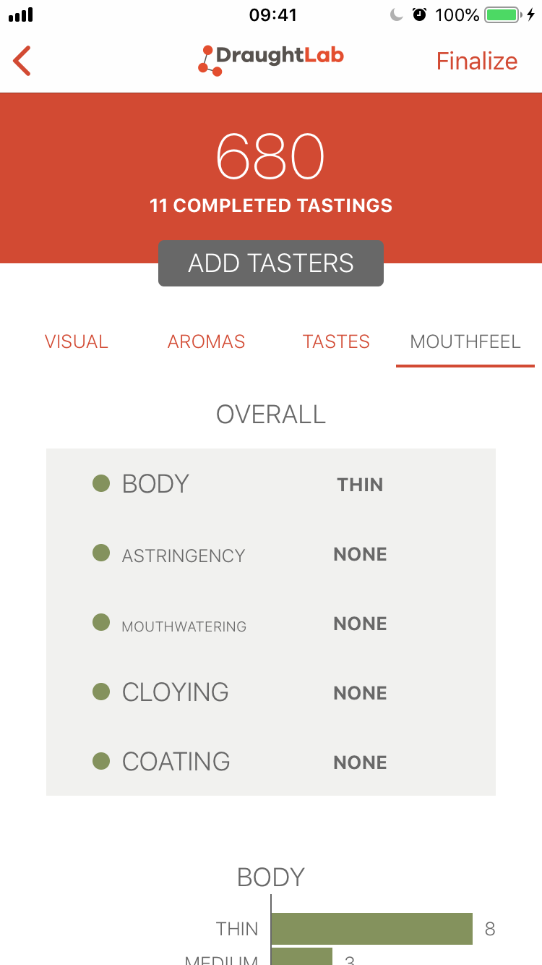
680: 120.14

Slide 30
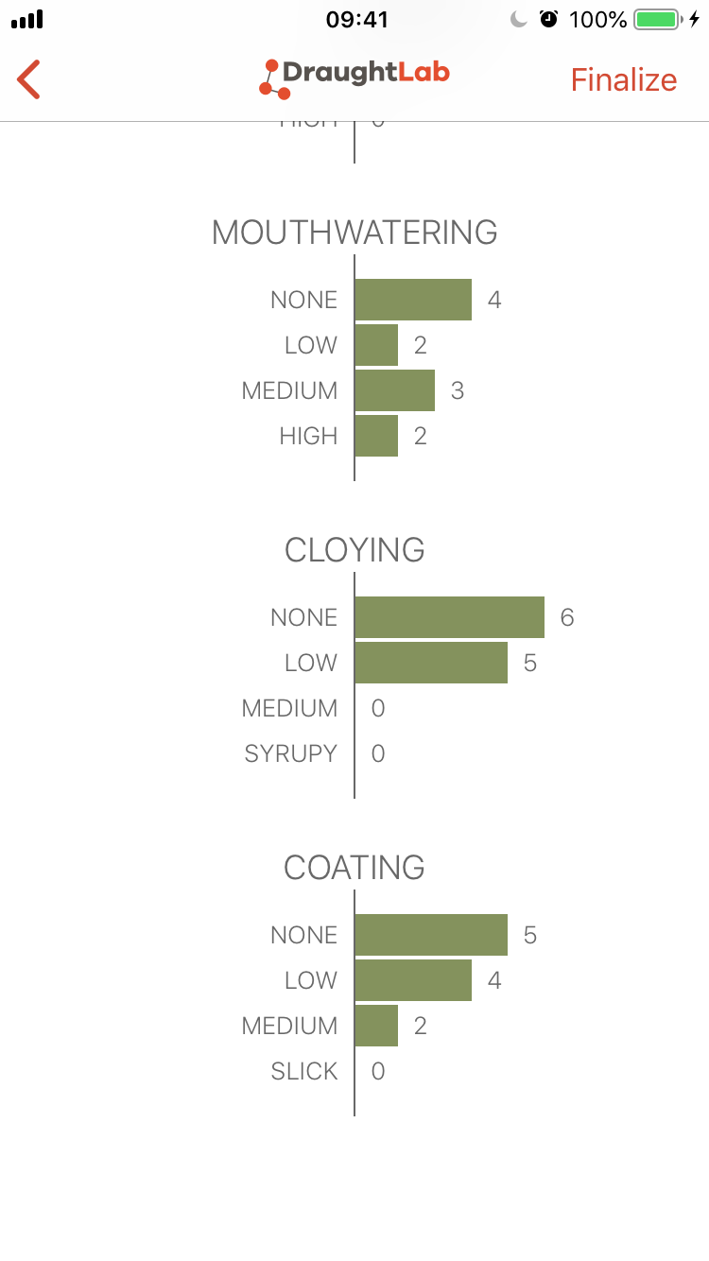
680: 120.14

Slide 31
328: 117.17

Slide 32
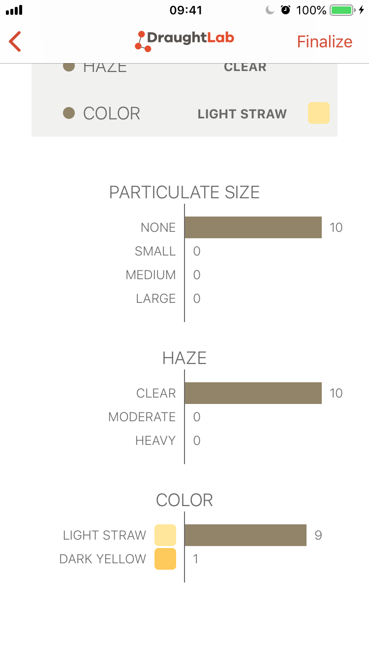
328: 117.17

Slide 33
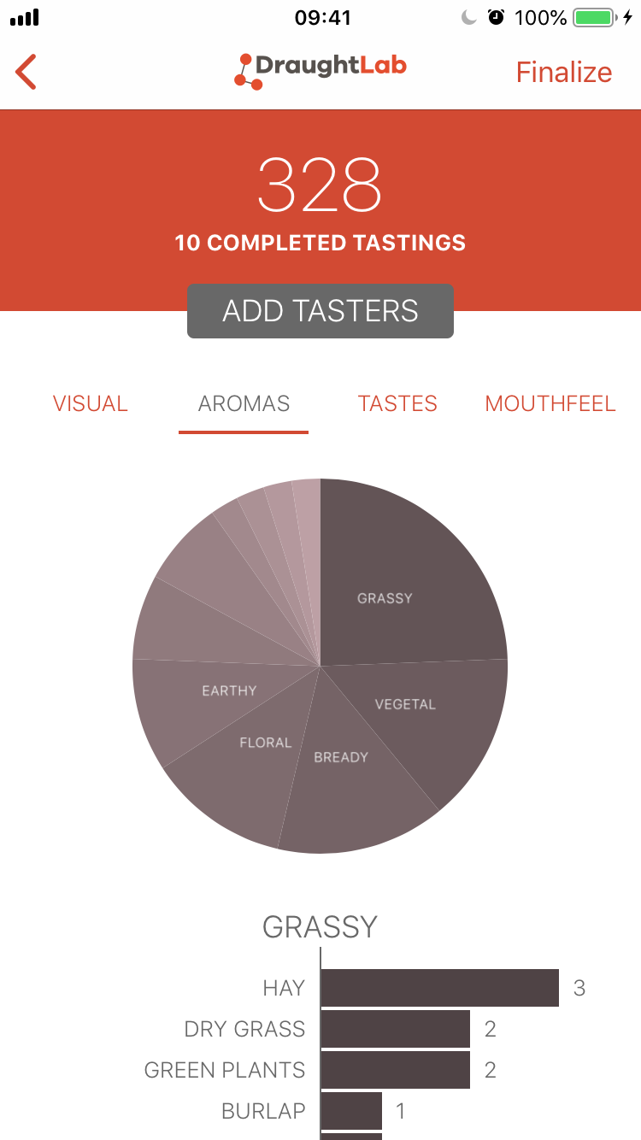
328: 117.17

Slide 34
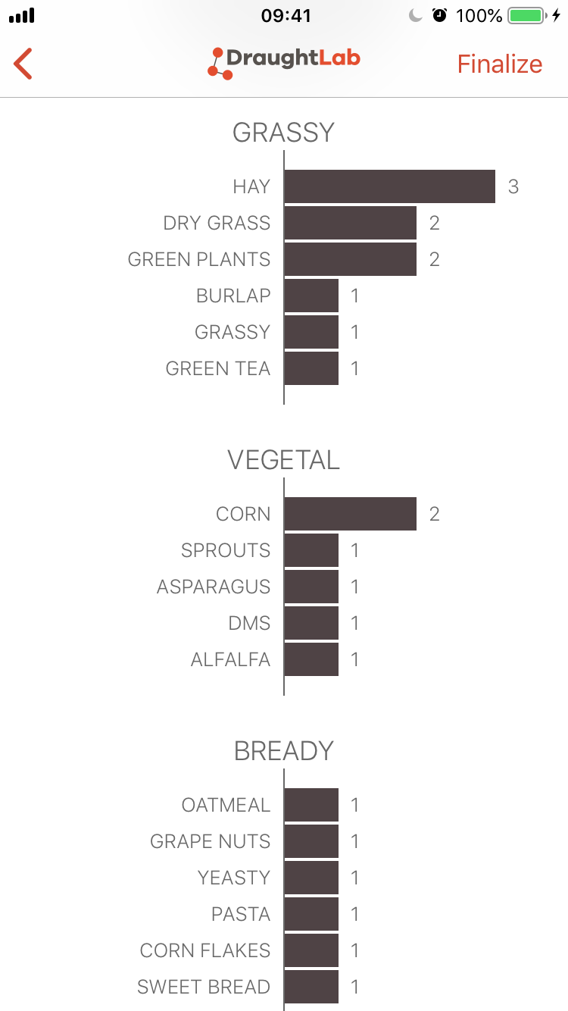
328: 117.17

Slide 35
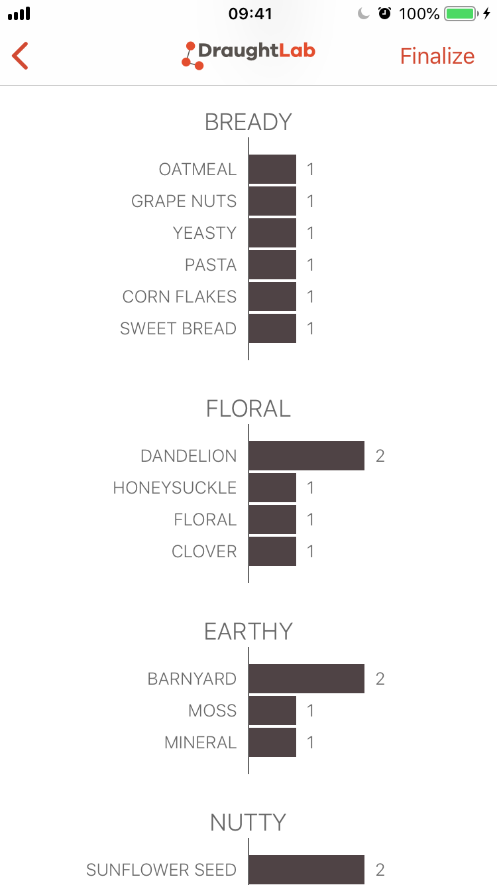
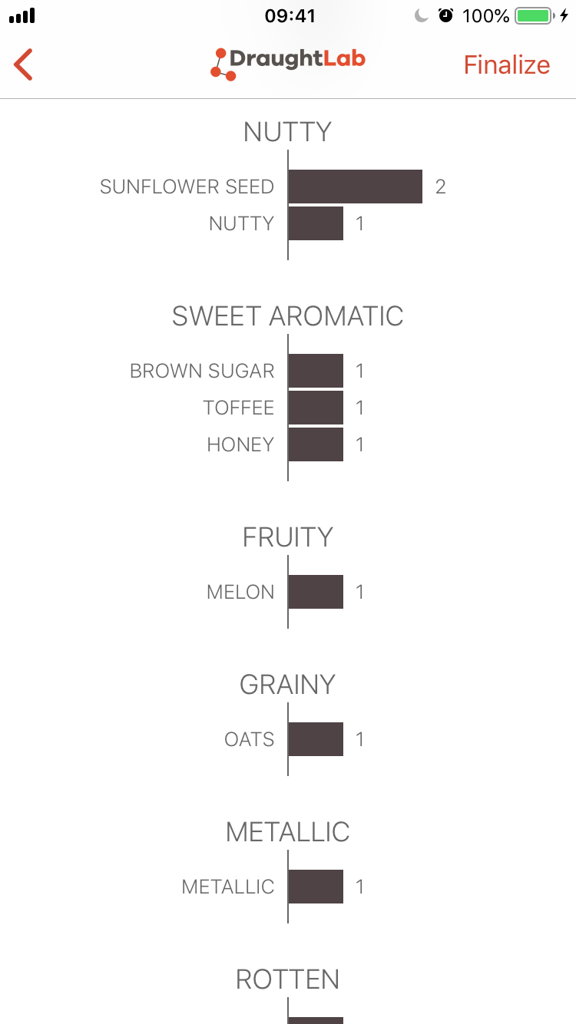
328: 117.17

Slide 36
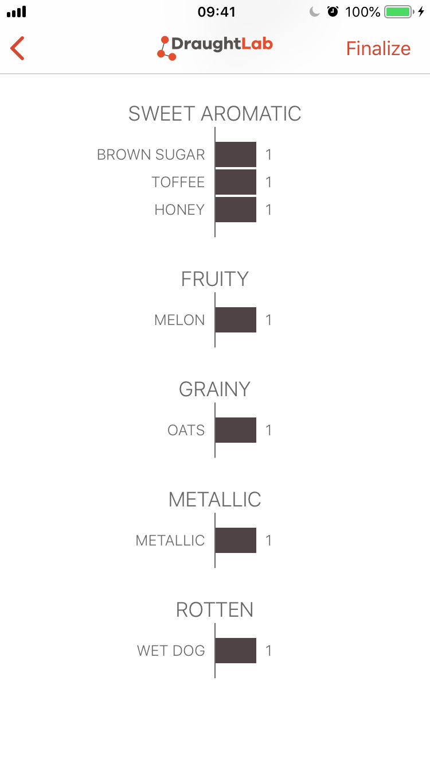
328: 117.17

Slide 37
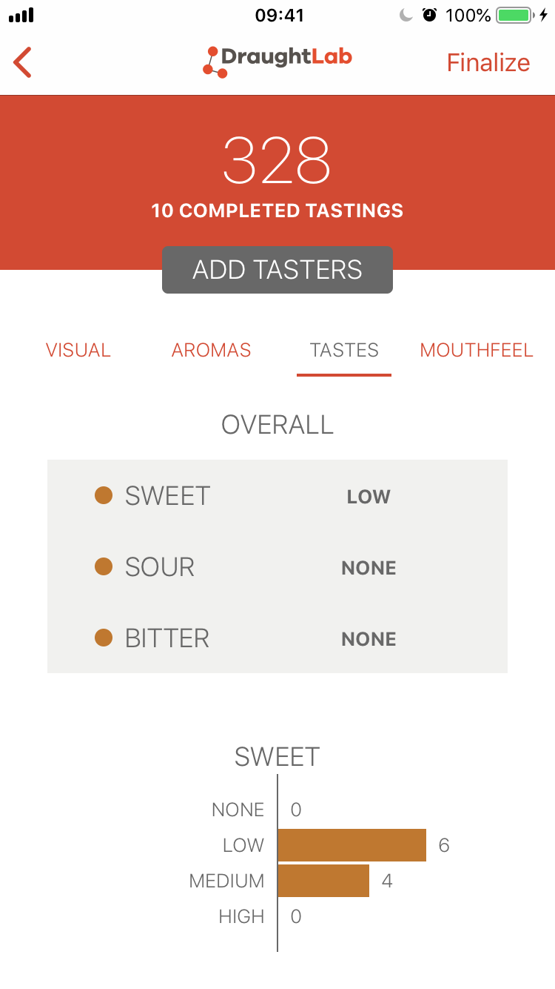
328: 117.17

Slide 38
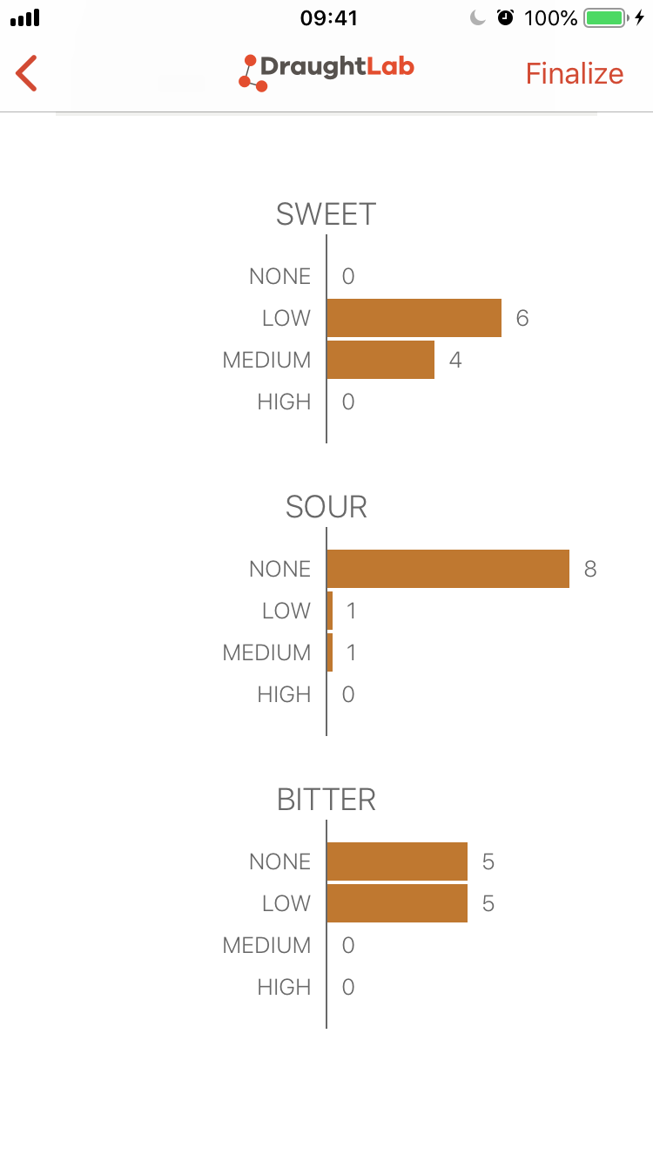
328: 117.17

Slide 39
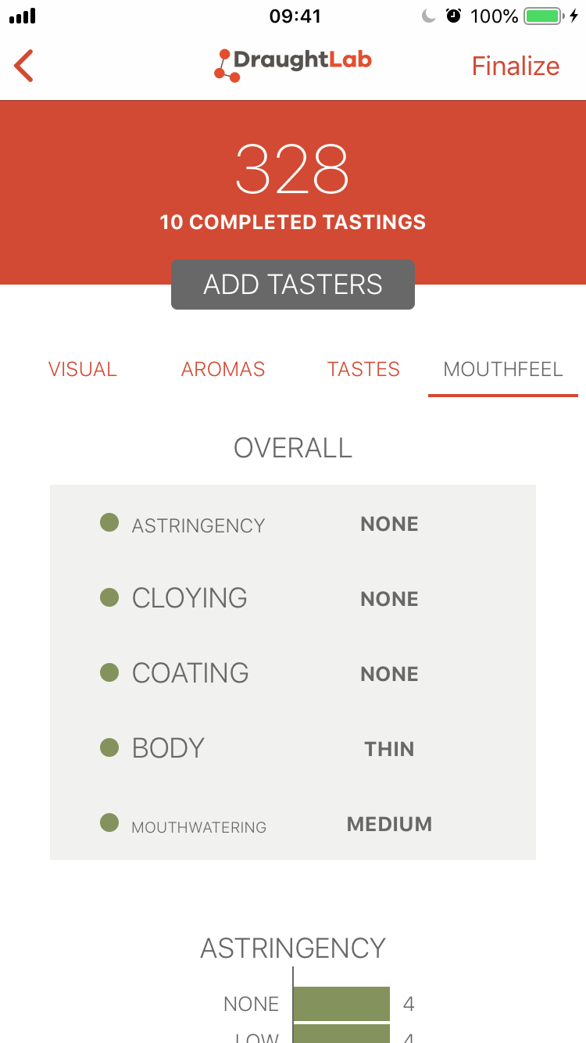
328: 117.17

Slide 40
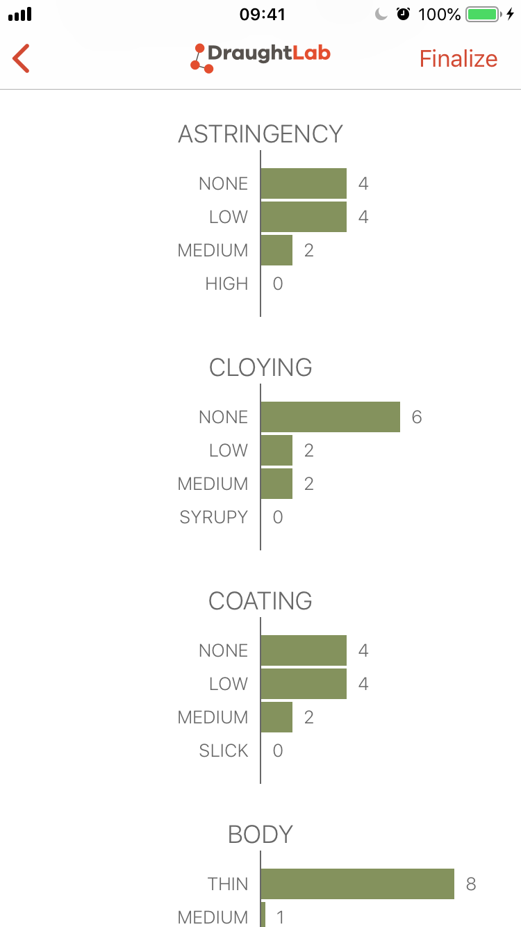
328: 117.17

Slide 41
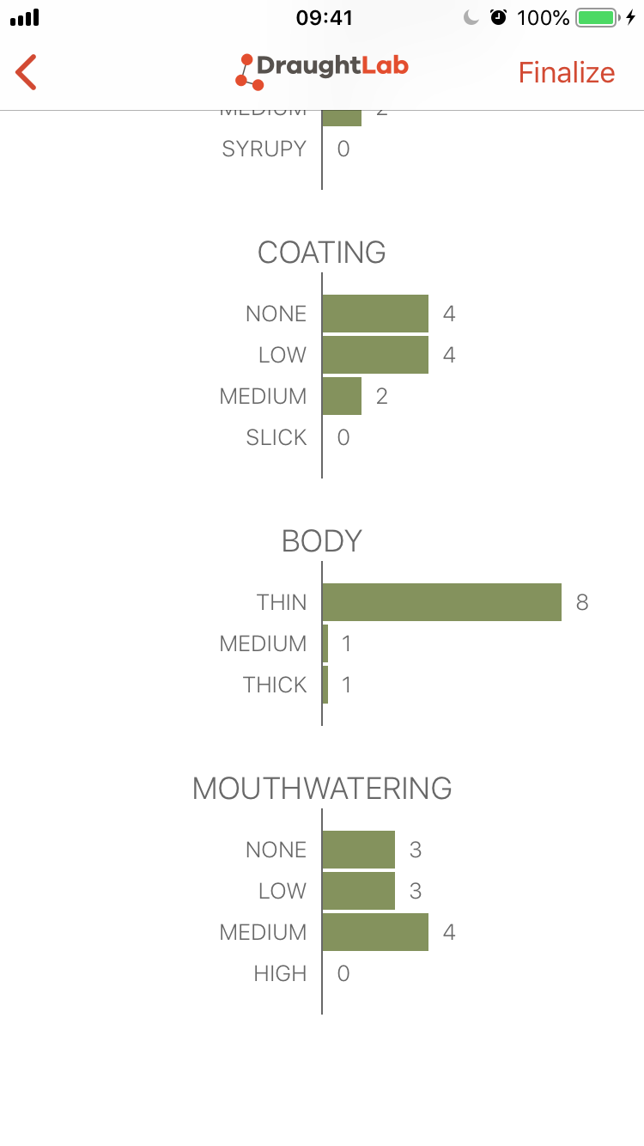
328: 117.17

Slide 42
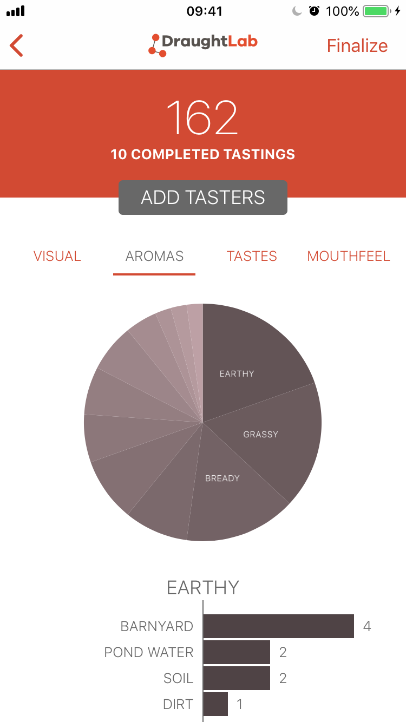
162: CDC-Copeland

Slide 43
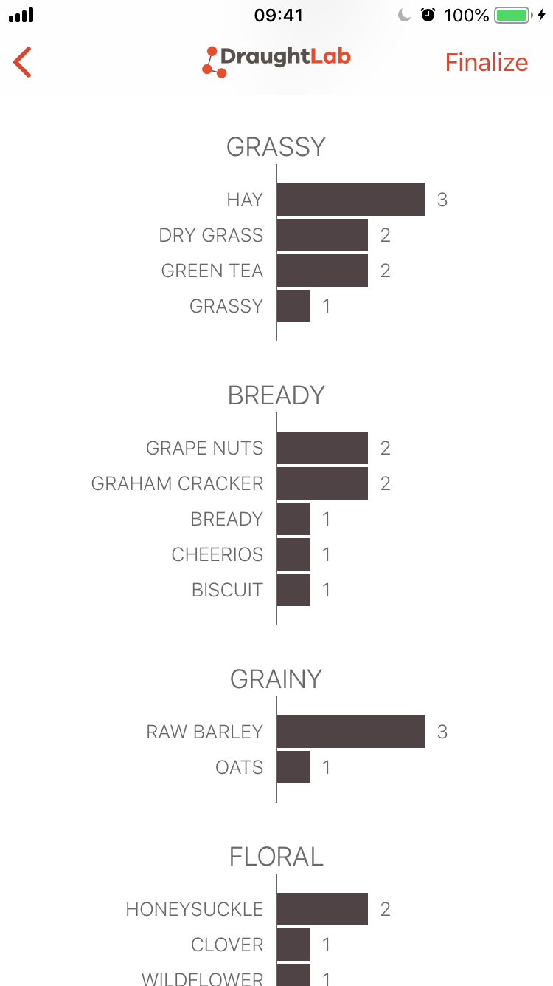
162: CDC-Copeland

Slide 44
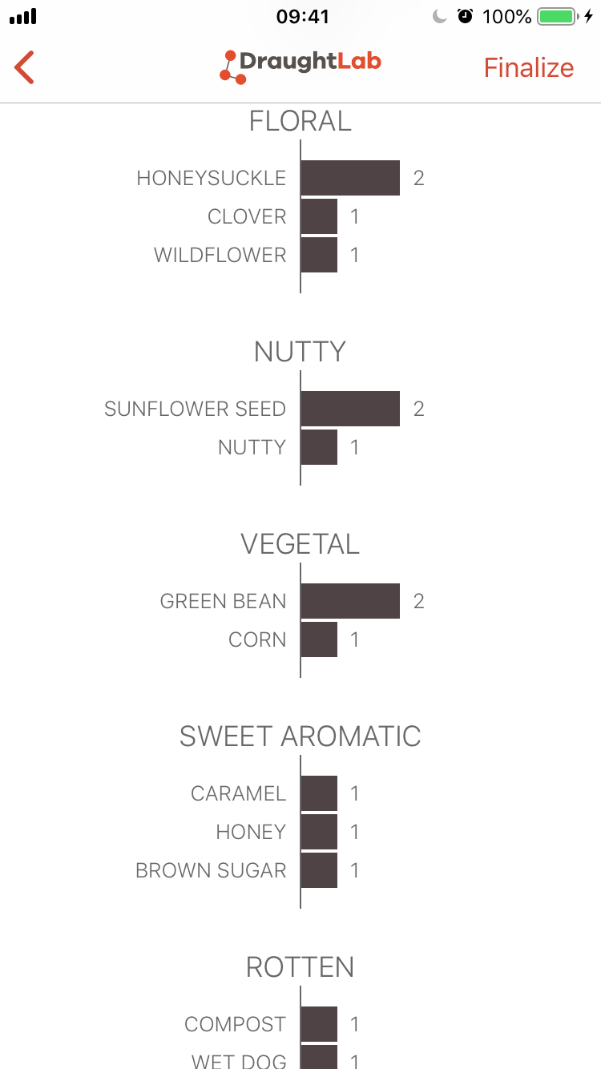
162: CDC-Copeland

Slide 45
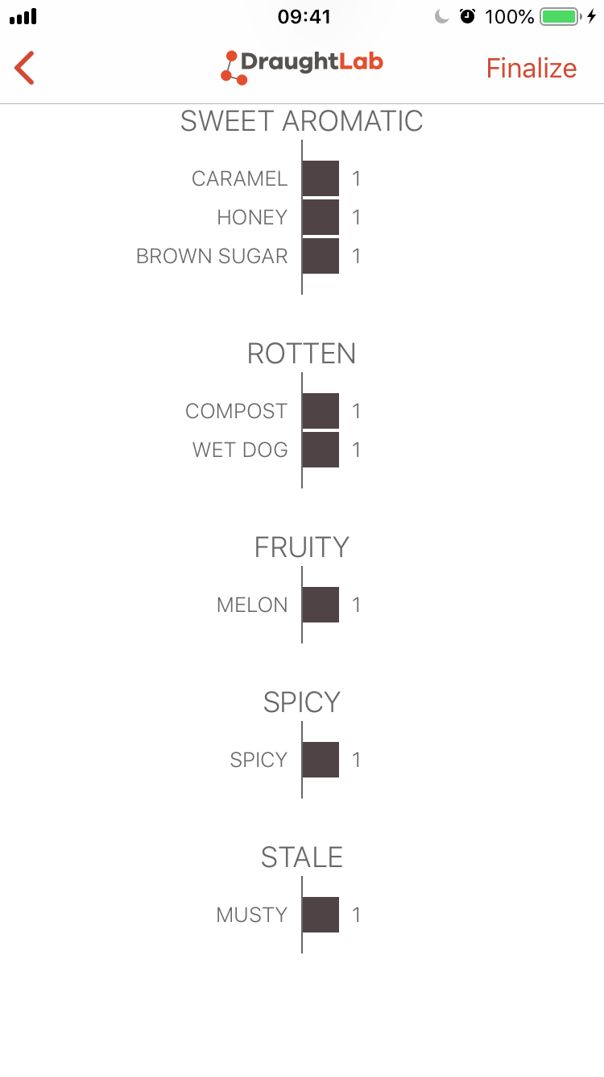
162: CDC-Copeland

Slide 46
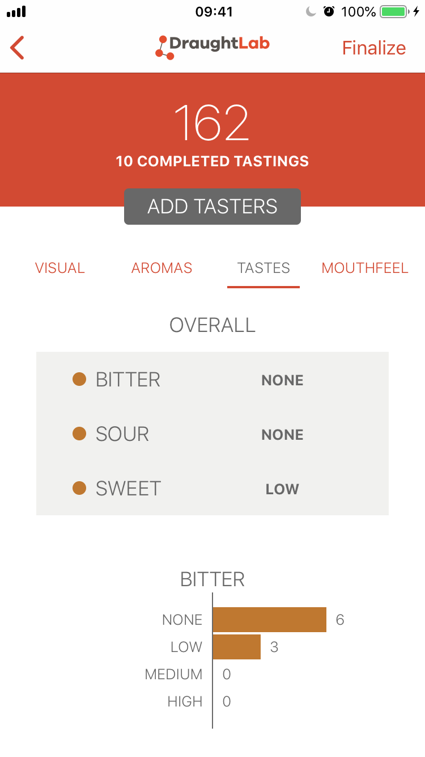
162: CDC-Copeland

Slide 47
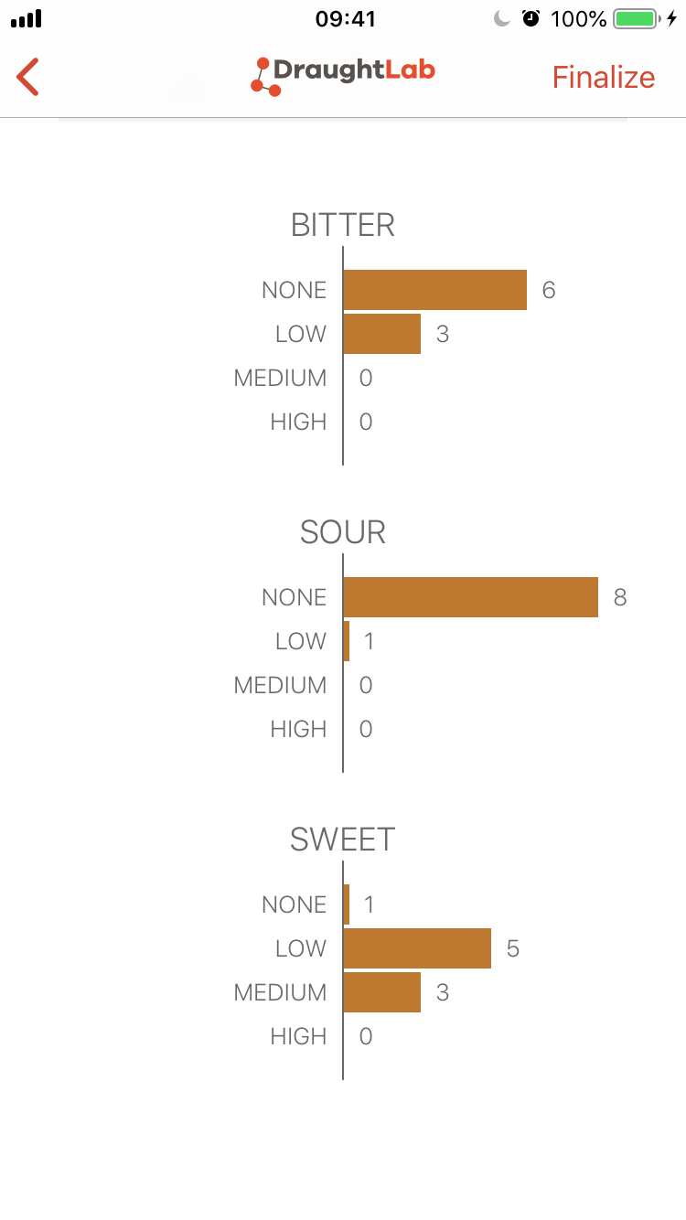
162: CDC-Copeland

Slide 48
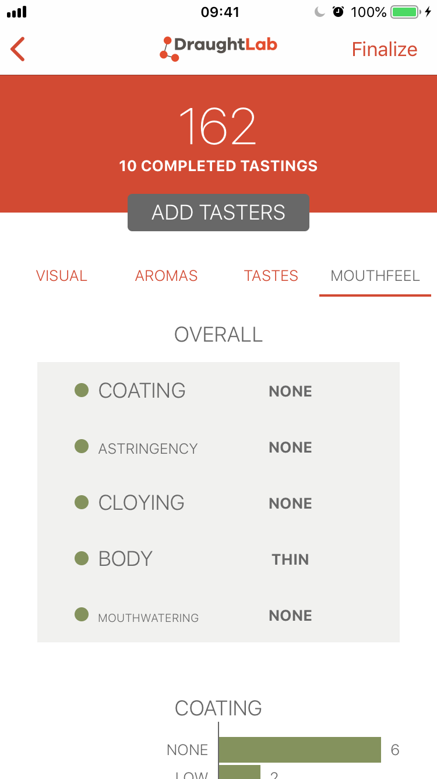
162: CDC-Copeland

Slide 49
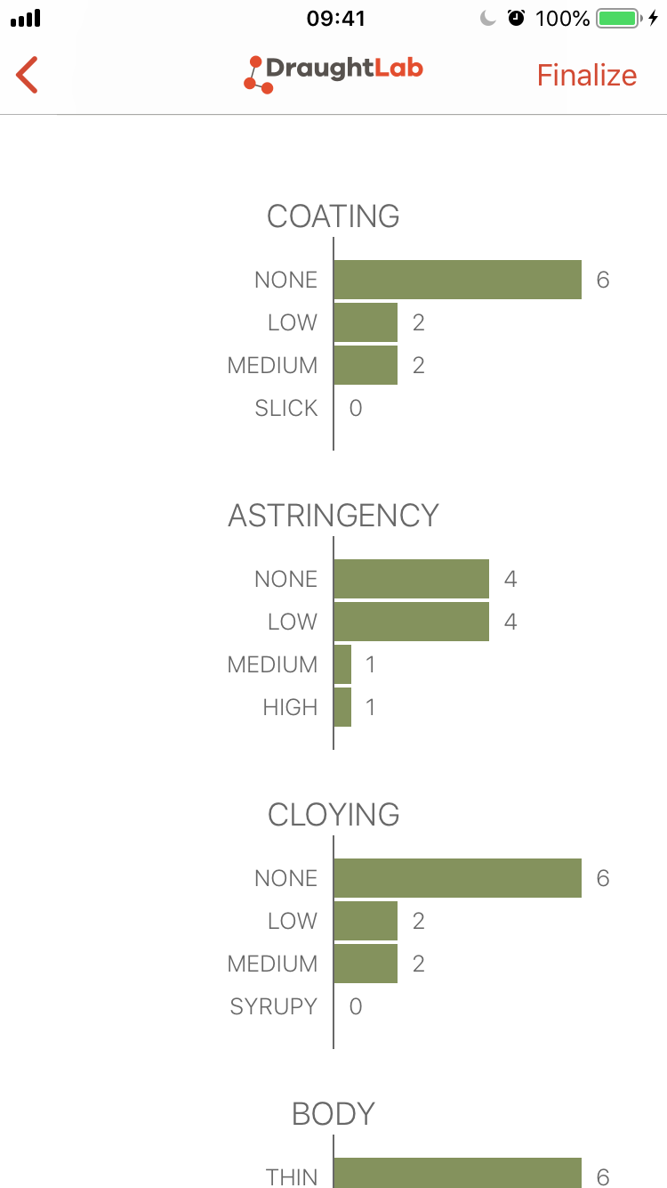
162: CDC-Copeland

Slide 50
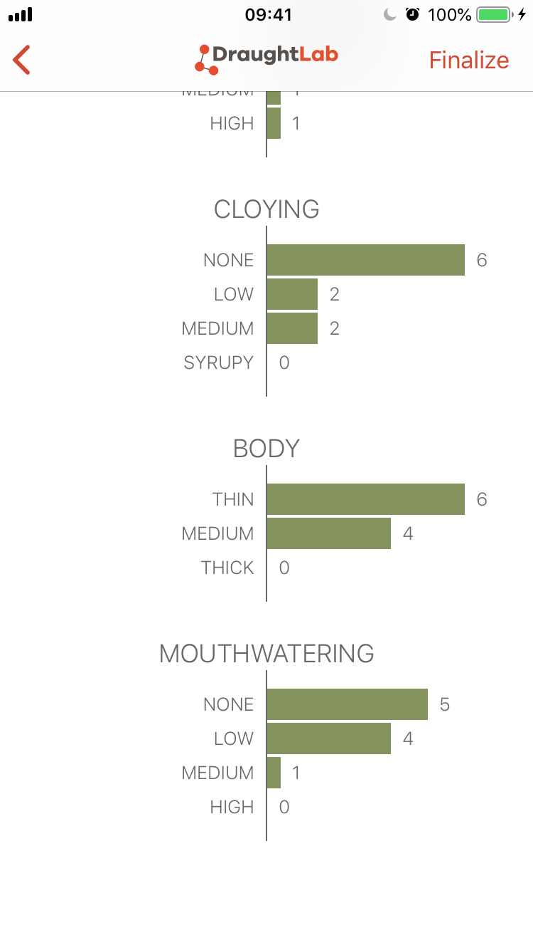
162: CDC-Copeland

Slide 51
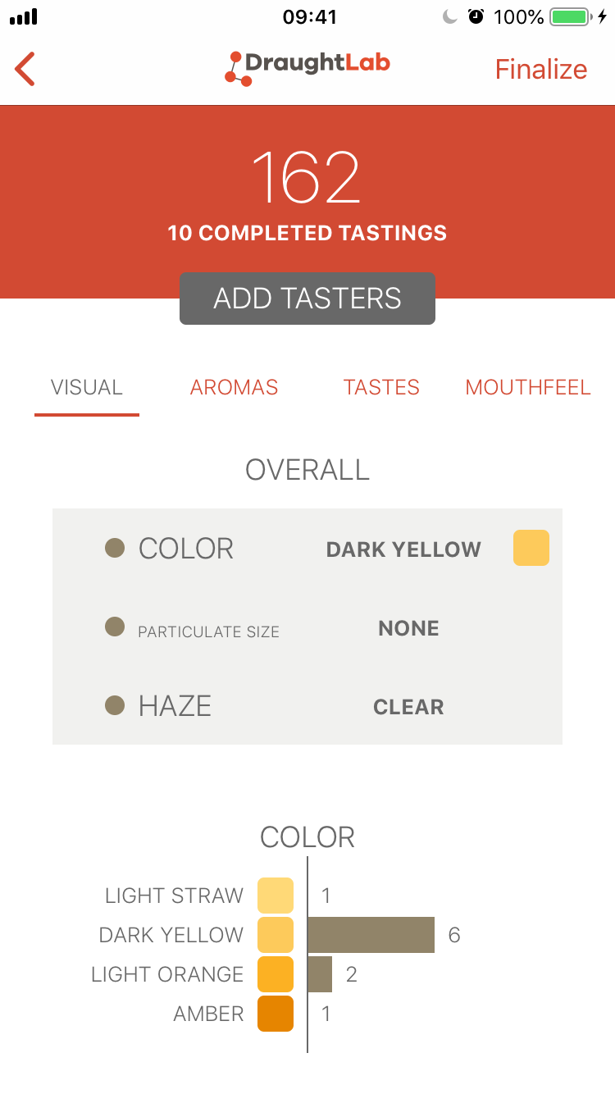
162: CDC-Copeland

