Slide 1
Financial Resources for Your Artisan Start-Up
Jesika Harper
Relationship Manager-AgVision

Slide 2
Contact Information
www.northwestfcs.com
Northwest Farm Credit Services
Jesika Harper
Relationship Manager-AgVision
Jesika.harper@northwestfcs.com
509-340-5216
Notes:
2

Slide 3


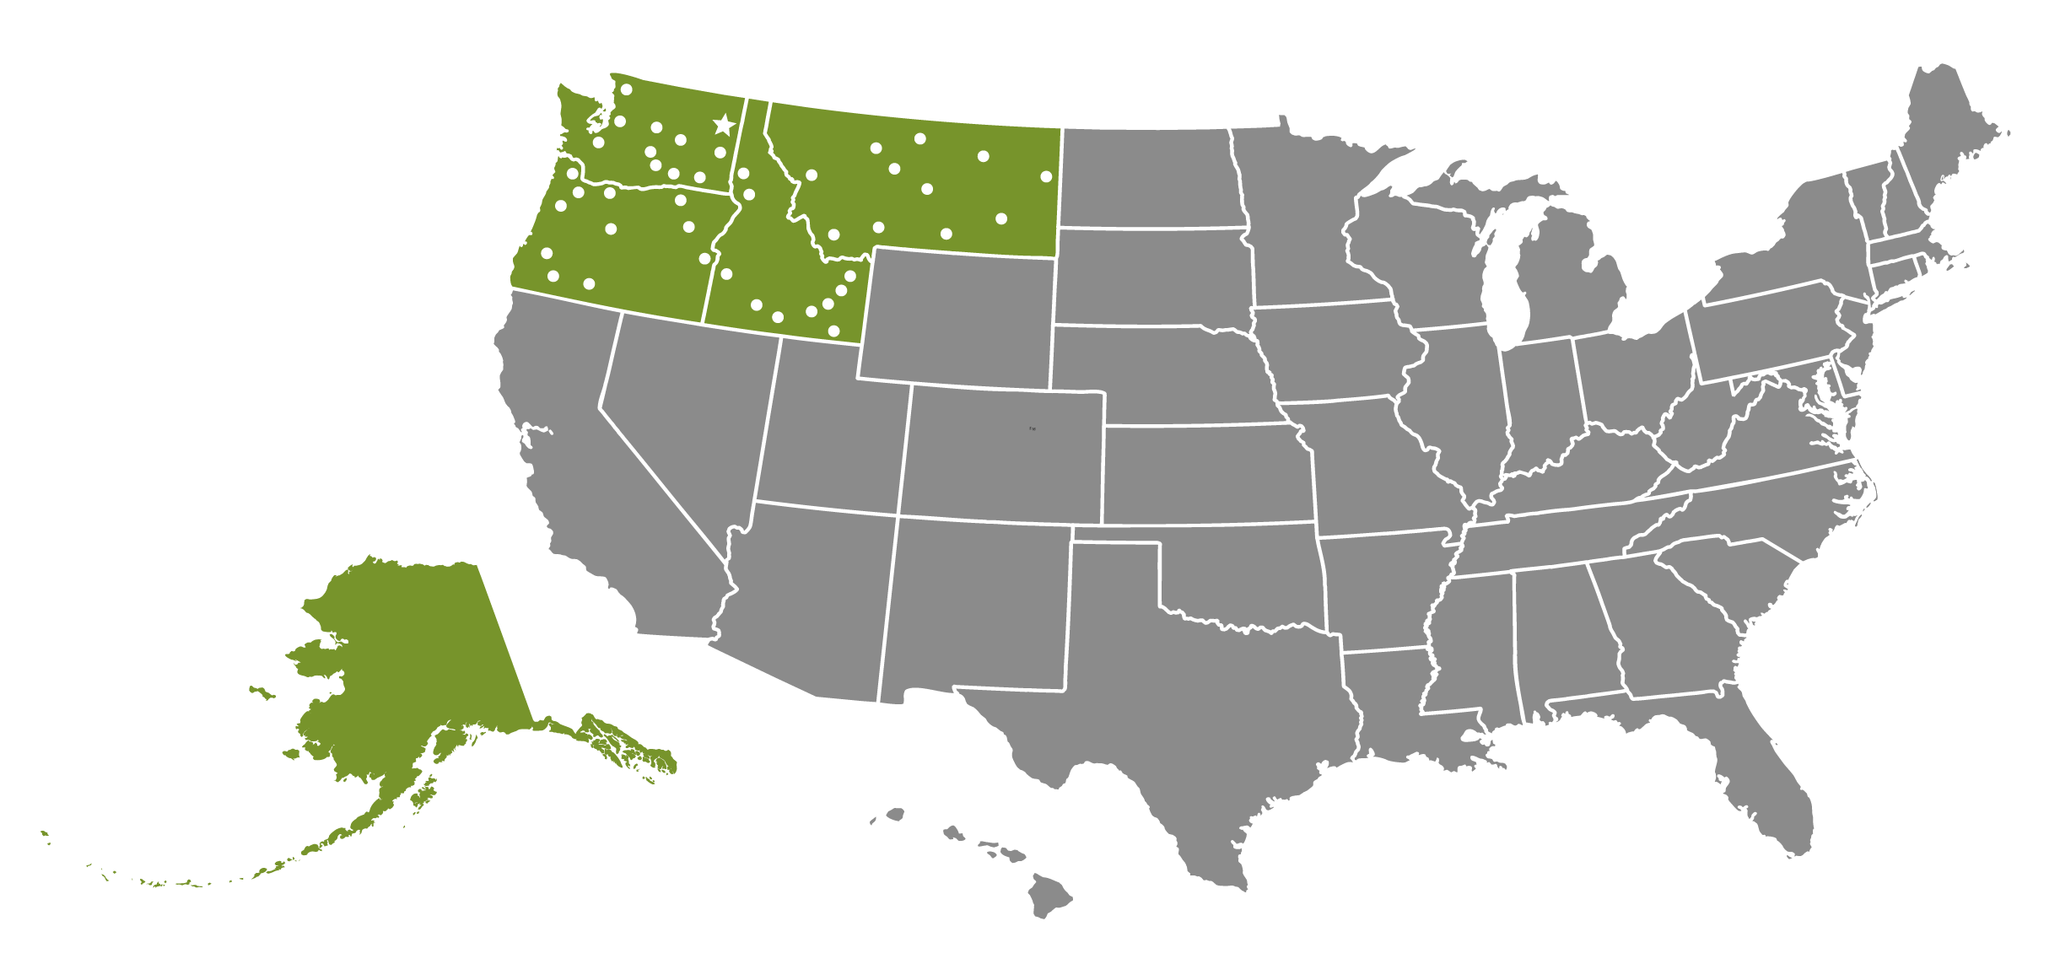
16,675 customer-members
44 Branch locations
713 Employees
14 Directors
187 Local advisors
Notes:
Cooperatively owned by over 16,000 customer-members
Serving Idaho, Montana, Oregon, Washington and Alaska with 44 branch offices
Serving Food and Fiber companies throughout the Pacific Northwest and U.S. (using Northwest FCS Capital Markets team)

Slide 4

Real estate financing
Operating lines of credit
Equipment financing
Crop insurance
Country home loans

Slide 5
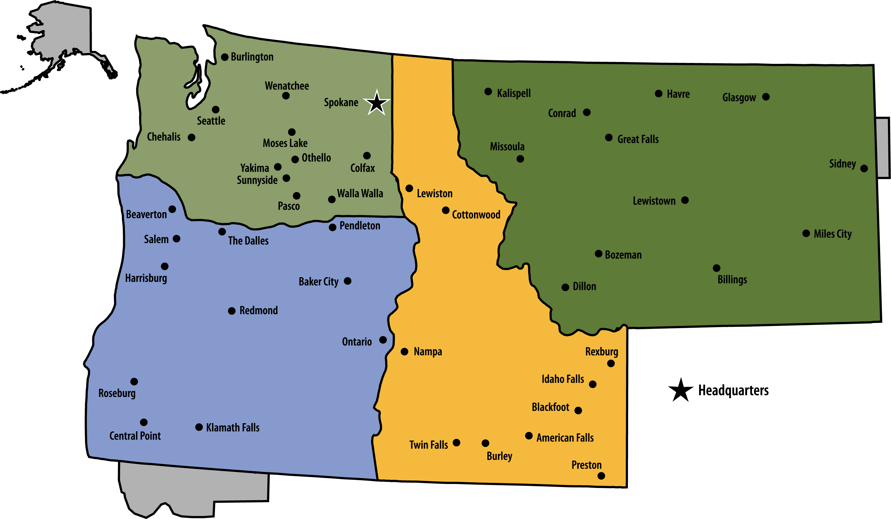
Northwest FCS Locations

Slide 6

Young (35 years of age or younger)
Beginning – 10 years of farm management experience or less
Small – annual gross farm income less than $350,000
Outreach Focus: Military Veterans, urban/local producers
Helping new ag producers
grow.

Slide 7
AgVision Program Benefits
Reduced Underwriting Criteria
Fee waivers
  Appraisal fees
  Loan origination fees
Competitive interest rate
Educational / Technology benefits
  $500 reimbursement for technology purchases
  $500 travel reimbursement to educational commodity workshops/conferences
  $1,000 credit toward Northwest FCS succession and strategic planning consulting services or Family Business Succession Seminar

Slide 8
AgVision Program Eligibility
Provide adequate collateral for the loan
Have a cash flow budget that projects repayment ability for the loan
Have a minimum 650 Credit Score
Financial information and business plan indicates operation will show positive financial progress or have other sources of income
Have sufficient agricultural education, business, and/or work experience
No debt concession from any lender within the last seven years

Slide 9
AgVision Partners/Tools
We work and partner with government agencies
Farm Service Agency (FSA)
  FSA Guarantee: 90%
    This reduces risk when collateral position is weak, which is common with our AgVision customers
  FSA Down Payment Program (5-45-50)
    The borrower brings a 5% down payment, the FSA finances 45% and Northwest FCS finances 50%.
    Northwest required to issue a 30 year note
Washington State Beginning Farmer Bond Program
  Borrow up to $517,700 with below-market interest rate loans, if you have never owned and operated farm ground before
  Payment Assistance Loan (PAL) Program is a loan program in partnership with the State that helps with down payment when using the Bond program.

Slide 10

RateWise™ Program
Rewards young, beginning and small producers for continuing management education with interest rate reductions on new loans
Participants can earn interest rate reductions of 0.25%, 0.50% and 0.75% for three years
Credits earned for Northwest FCS workshops, university conferences, industry specific workshops, Farm and Food Expo, etc.
Register at northwestfcs.com/RateWise

Slide 11
Agricultural Lenders
Northwest Farm Credit Services
Farm Service Agency (FSA)
Commercial Banks
Community Banks
Private Investors (family, friends, CDFIs – Craft 3)
Seller financing

Slide 12
Application Materials
Balance Sheet
  Verifications of assets & liabilities
  Inventory & Equipment List
3 years tax returns
Projected Cash Flow Budget
Business Plan (helpful may not be required)
Purchase & Sale Agreement (real estate)
Entity documents (if appropriate)

Slide 13
How Lending Decisions are Made
5 C’s of Credit
  Character
  Capital
  Capacity
  Collateral
  Conditions

Slide 14
Character
Management experience
Your experience in the industry
Business plan
  Three-legged stool
    Production
    Processing
    Marketing
Credit history
  Have a good credit score

Slide 15
Credit Report
  What is a credit score and why is it important
    Predicts financial risk over time
  Credit scoring is used by lenders, insurers, and others to evaluate your credit behavior
  Credit Score above 660
  Have no late payments (payment history 35% of FICO)
  Have low credit card balances (amounts owed 30%)
  Have no outstanding collections, bankruptcy, foreclosure
  Credit history (length 15% of FICO score)
  Other (Credit mix in use & new credit – 20%)
  Review your credit report at least once a year www.annualcreditreport.com

Slide 16
How Do I Rate?
Different models have different ranges
Credit Scores typically range between 300 to 850
  Excellent Credit: 750+
  Good Credit: 700-749
  Fair Credit: 650-699
  Poor Credit: 601-649
  Bad Credit: Below 600

Slide 17
Credit Bureau Reports
Why do lenders look at these scores?
History shows:
  Above 800 – less than 1% delinquency rate
  Above 700 – less than 5% delinquency rate
  Under 600 – 51% delinquency rate
  Under 550 – 71% delinquency rate

Slide 18
Capital
What you own versus what you owe
“Snapshot” in time of your financial position
Financial Statement: Balance Sheet
Financial ratios
  Debt/Asset ratio = Total Liabilities ÷ Total Assets
    Want to see this ratio below 65%
  Working Capital = Current Assets – Current Liabilities
    Must be positive
    Funds for down payment and expansion

Slide 19
Capacity
Income and expenses of the operation
Your ability to repay the loan
Financial Statements:
  Income Statement
    Net income = Revenue less Expenses
  Cash Flow Budget
    Monthly projection of Revenue and Expenses
Notes:
Net income margin of 10% of your gross income:
Net income margin is the net after-tax income of a business, expressed as a percentage of sales. It is used in ratio analysis to determine the proportional profitability of a business

Slide 20
Collateral
The security that backs up the loan
  Typically the asset being purchased
  Examples: crops, equipment, real estate
Match collateral with type of loan
  Operating loan – crops, products, equipment
  Real Estate loan – ground being purchased
Advance Rate = Loan Amount/Collateral Value
  Example: Equipment = 75% maximum advance rate

Slide 21
Conditions
Structure of the loan
Term = length of loan
Rate = fixed, variable, or combination interest rates
Repayment schedule = monthly or annual
Liable Parties = borrowers, co-signers, or guarantors
Covenants = life insurance, collateral monitoring reports, capital purchase restrictions, etc.
If there is weakness in the other C’s, conditions can be used to mitigate the risk

Slide 22
Questions?

