Slide 1
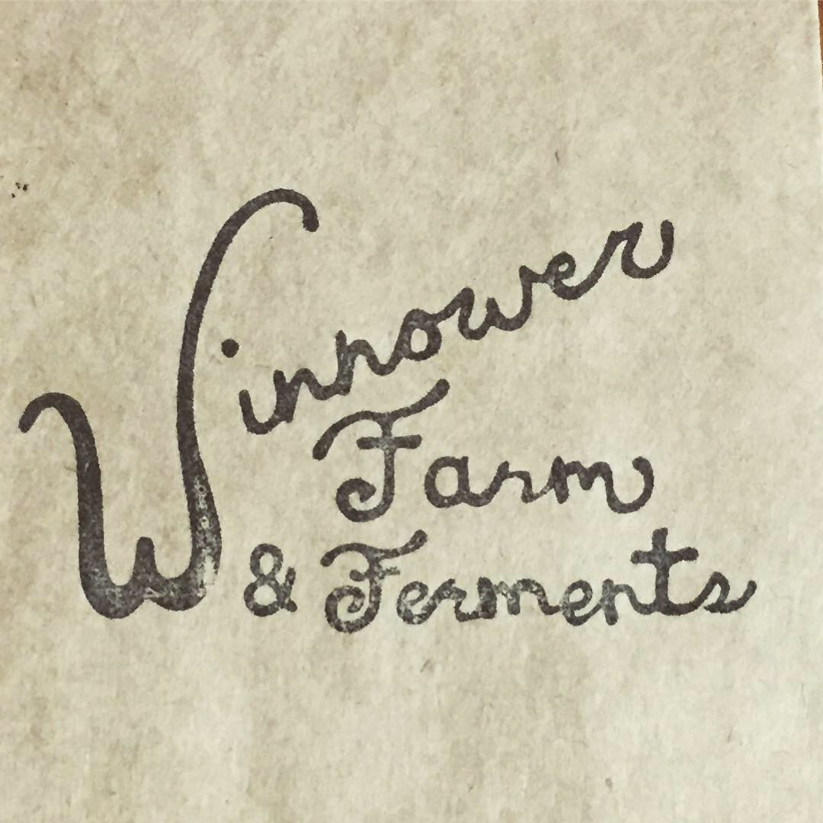
A small, diverse, organic farm in Boise, Idaho,
growing a range of heirloom and new grains, vegetables, seed production, broiler chickens, and value-added goods.

Slide 2
ONE:
A COLLABORATION BETWEEN FARM AND BAKERY
DIRECT GRAIN PRODUCTION
Notes:
Seed source, Thresher Artisan Wheats of eastern Idaho. Delayed other seed sources by waiting too long.
CSA bit - seed cost, initial tractor work and labor fees paid upfront with the rest to be paid after harvest.

Slide 3
-We are growing a ten-acre plot of Dayn (a newly developed hard white spring wheat) on contract for Gaston’s Bakery.
-We plan to grow heritage grains next season.
-Our relationship is similar to a CSA allowing the farm to begin production with less financial risk.
-Local farm-to-mill operations are one of many ways to support the revival of regional, heritage grain production.

Slide 4
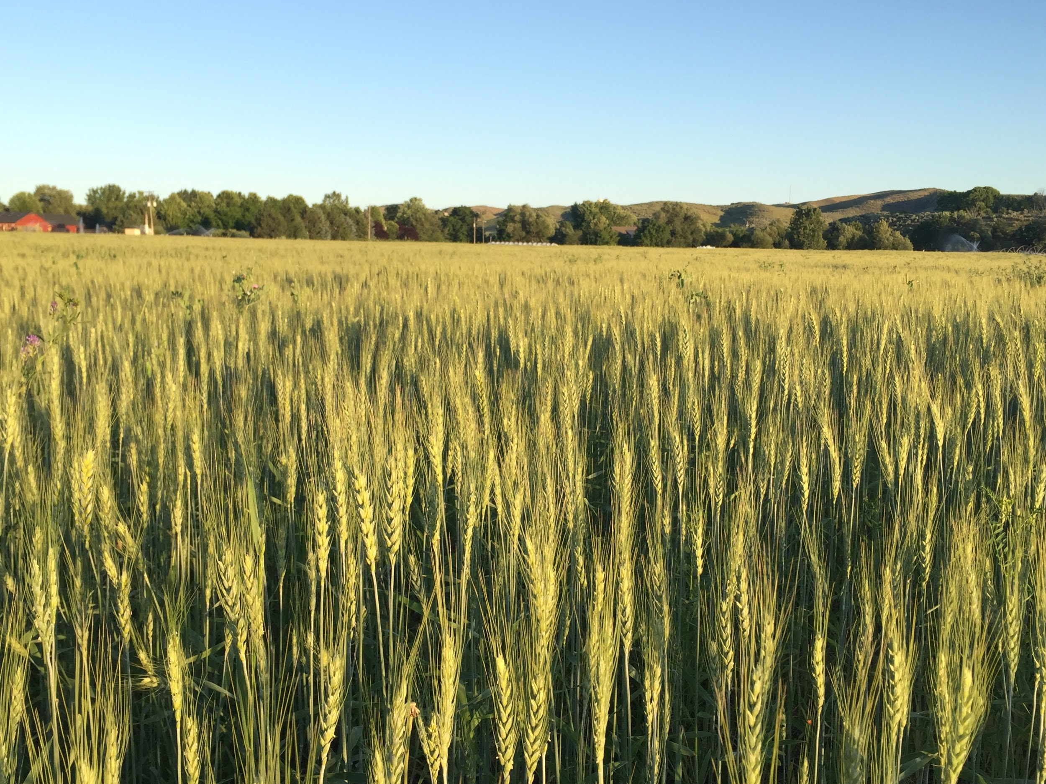

Slide 5
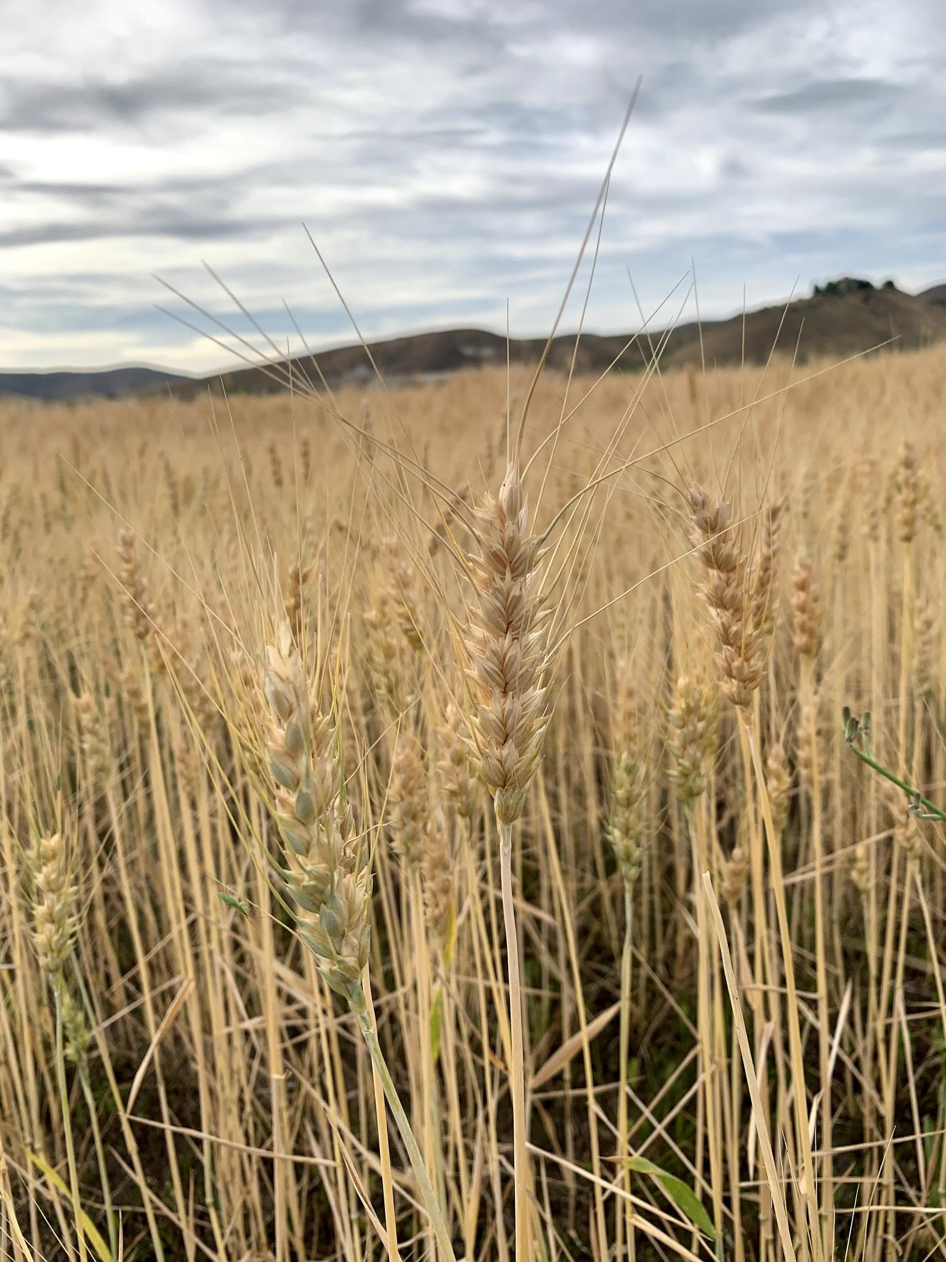
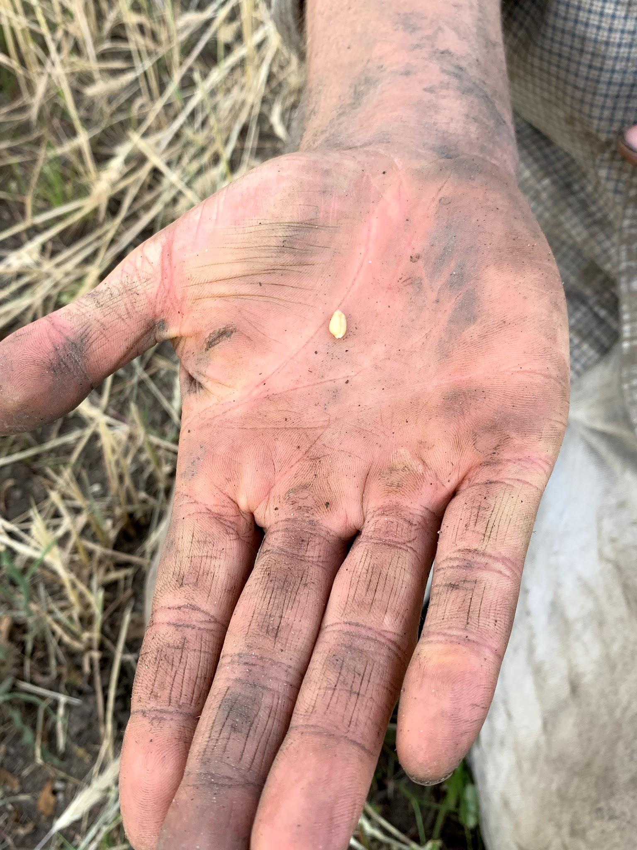

Slide 6
TWO:
SEED STEWARDING AND THE REVIVAL OF
HERITAGE GRAIN PRODUCTION
Notes:
Seed source, Thresher Artisan Wheats of eastern Idaho. Delayed other seed sources by waiting too long.
CSA bit - seed cost, initial tractor work and labor fees paid upfront with the rest to be paid after harvest.

Slide 7
-Tending a range of heritage and heirloom grains for the Rocky Mountain Seed Alliance’s Heritage Grain Trials project.
-A potential role of small grain growers is to trial varieties to monitor performance in the many microclimates of our region. Reviving the seedstock of heritage grains year by year!
-Tending smaller plantings of grain is a great introduction for individuals beginning production in this field.
Notes:
Grains grown for RMSA - wheat, barley, rye, oats, quinoa, einkorn, emmer, sunflower, amaranth, sweet & field corn.
Sold seed to Thousand Springs Mill of Buhl.

Slide 8
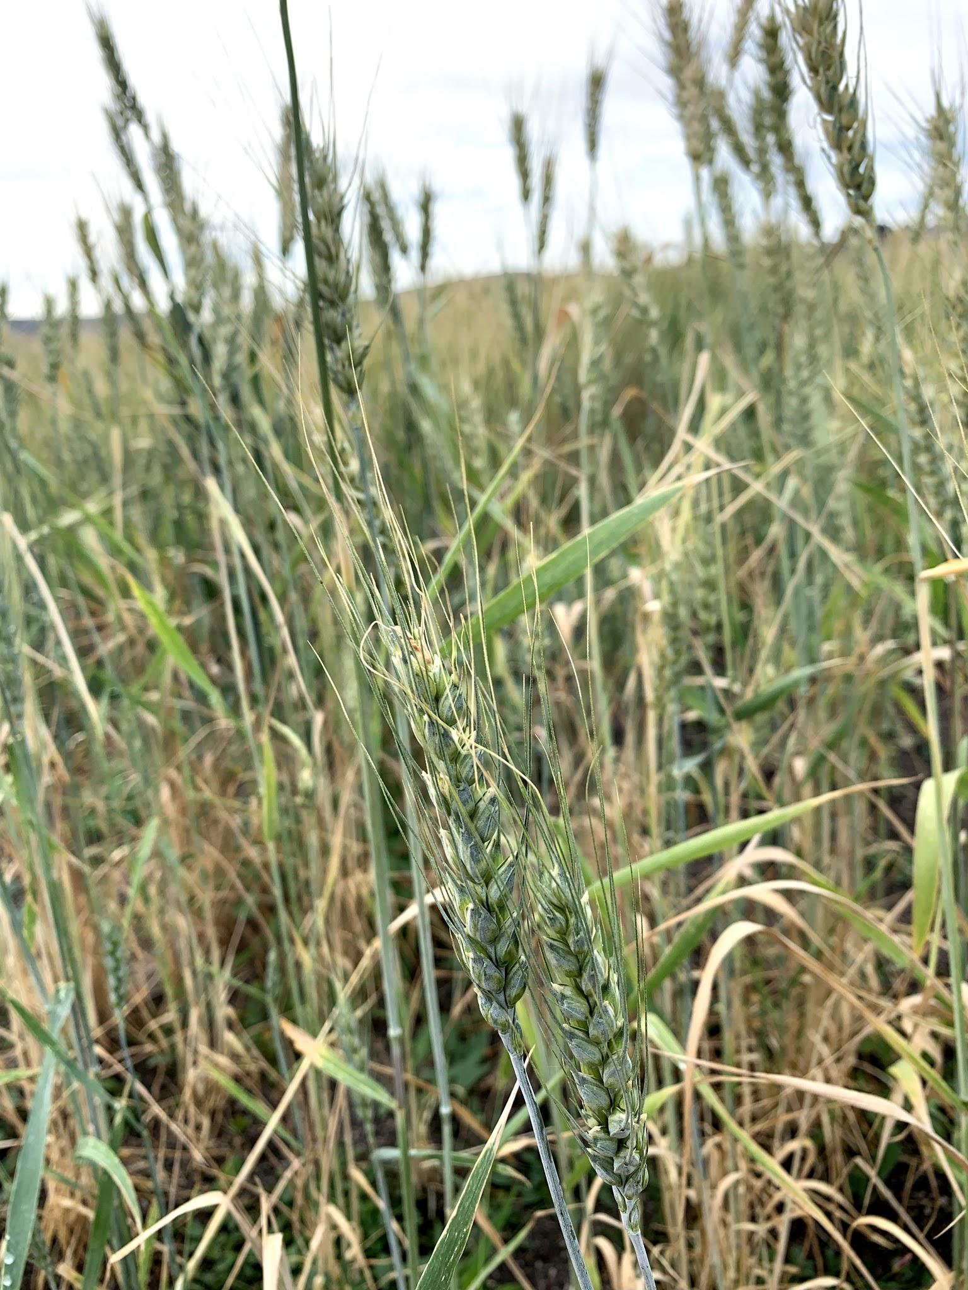
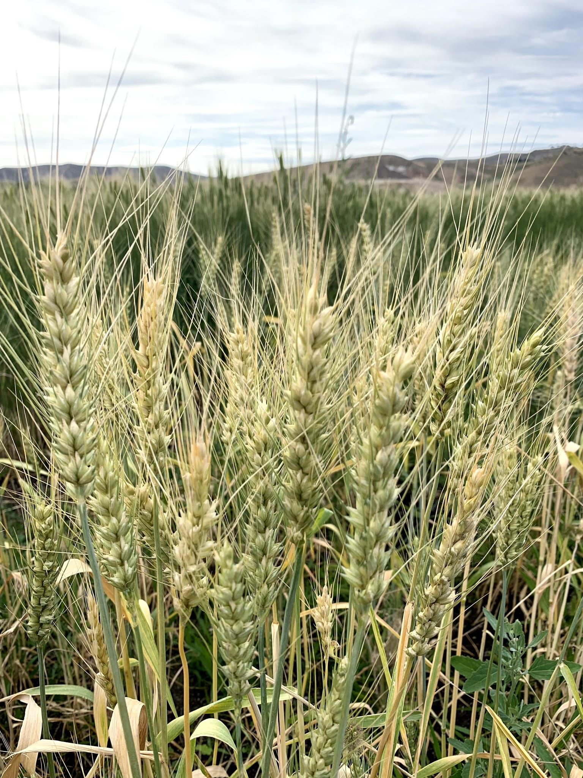
WHEAT
Notes:
Lofthouse & Chiddam Blanc wheat

Slide 9
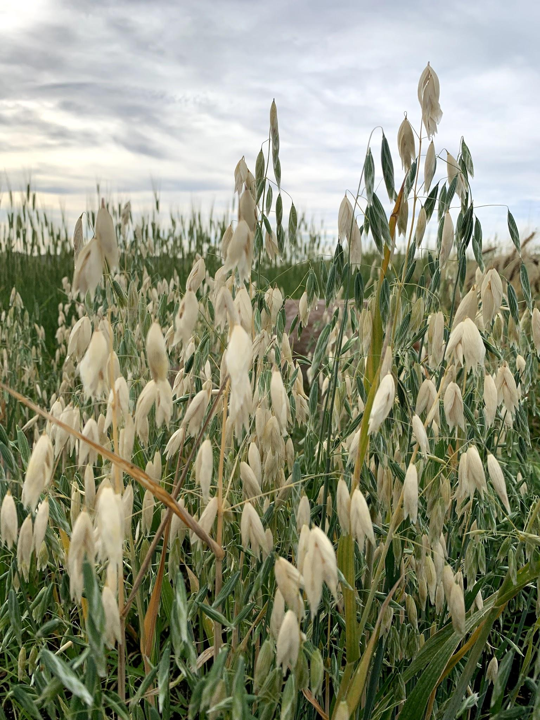
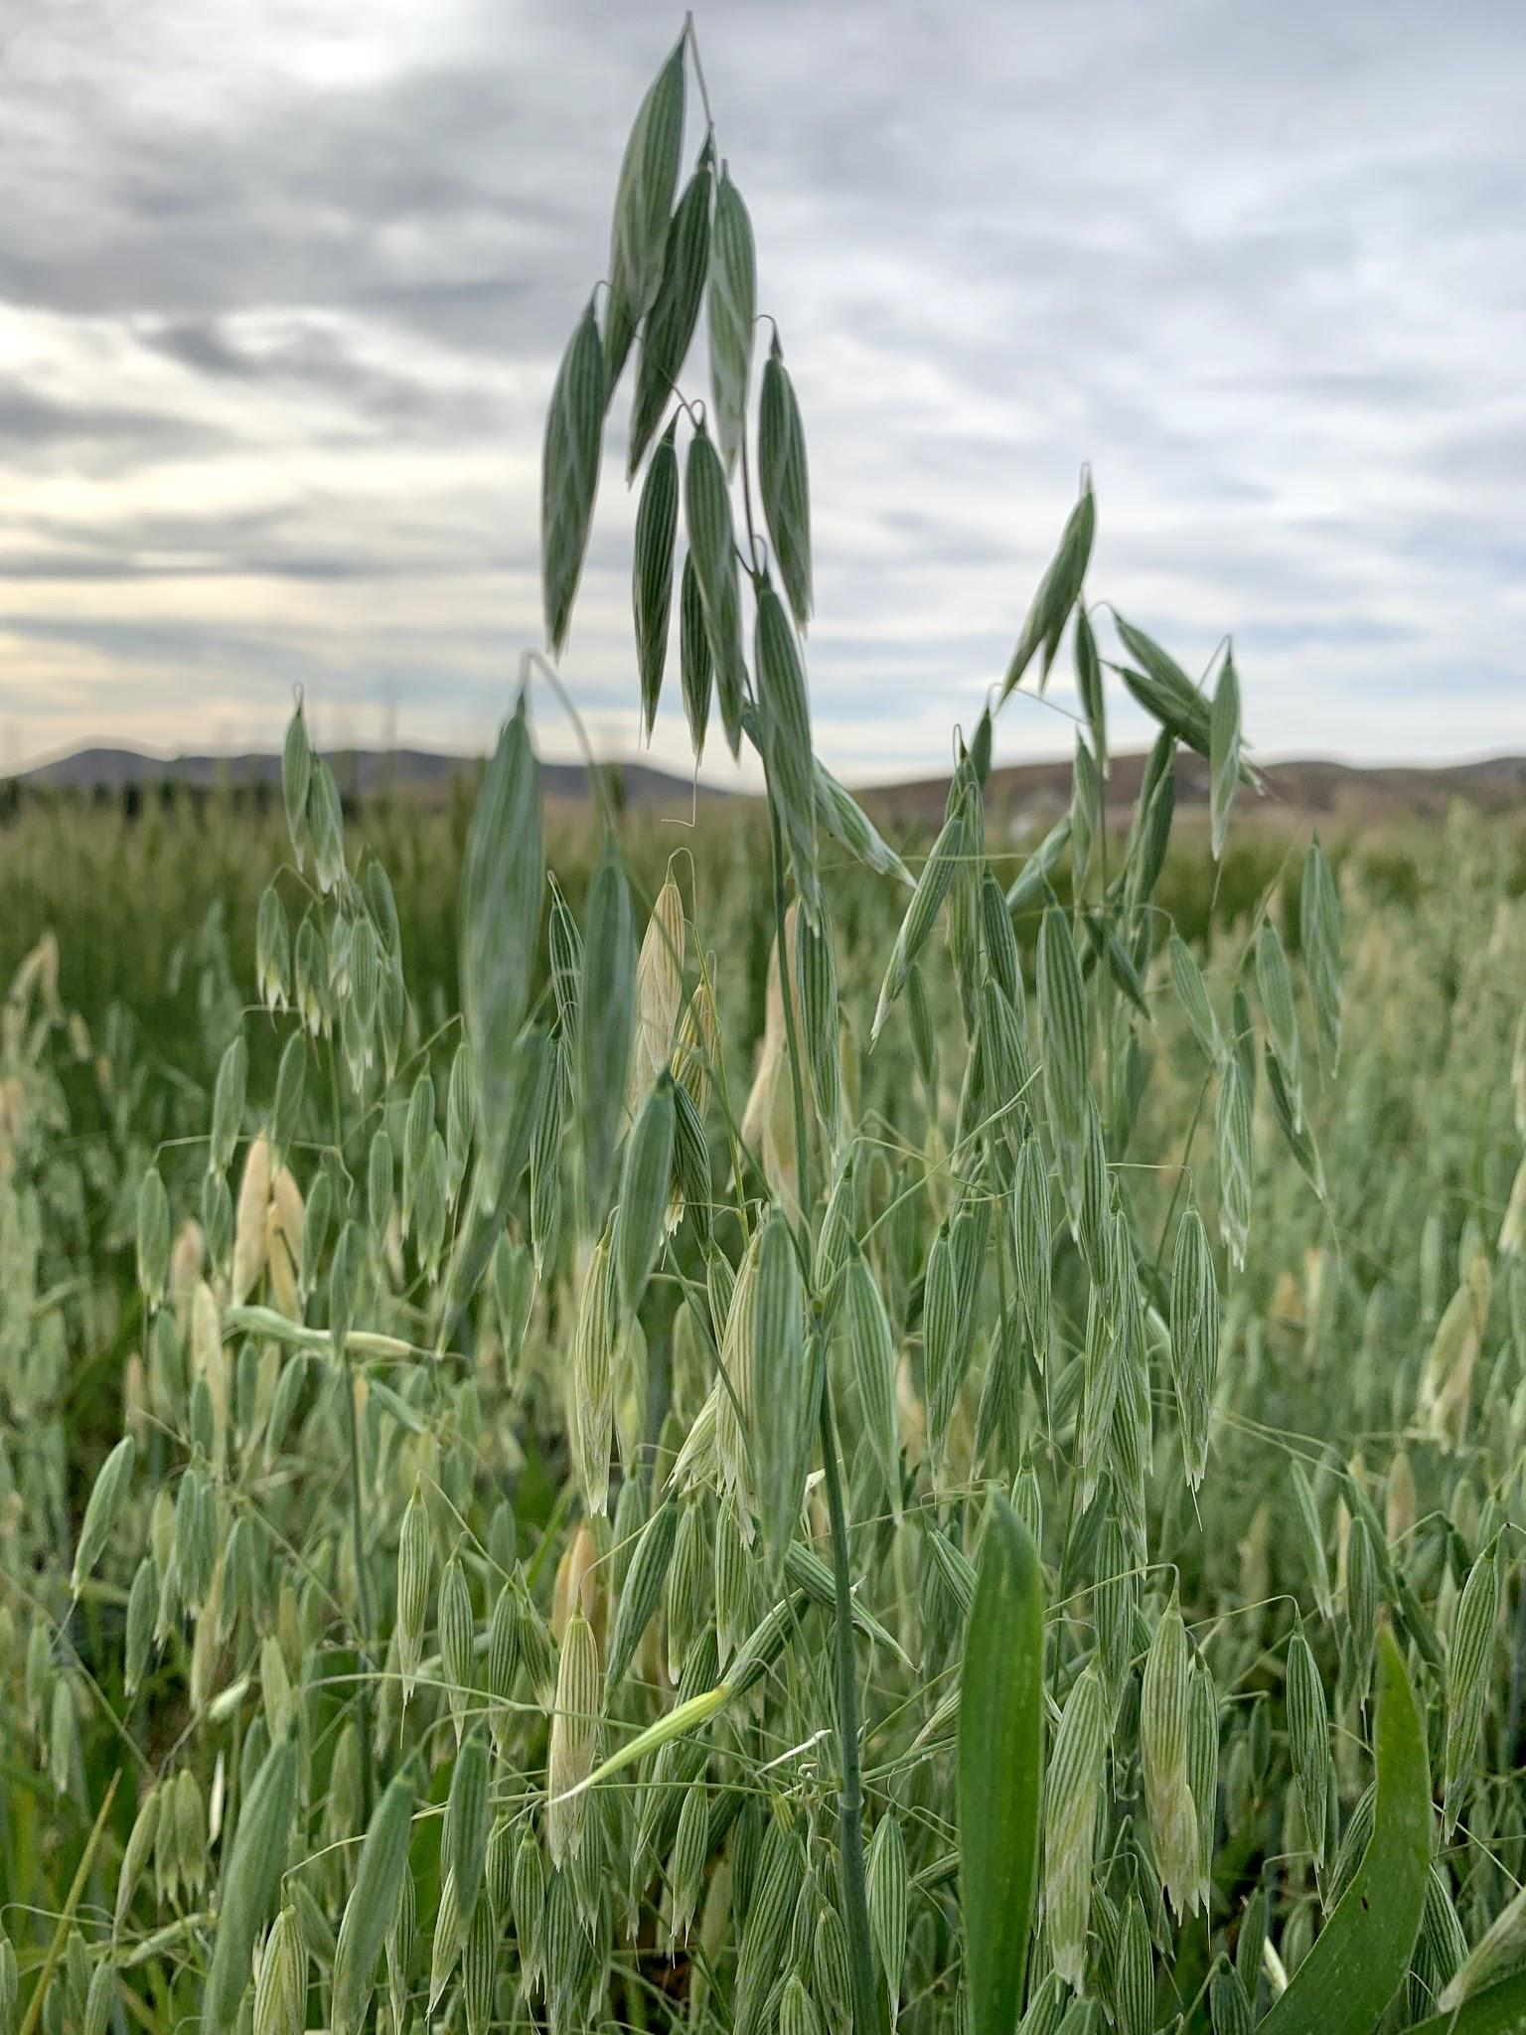
OATS
Notes:
Torch River (fellow SRSC grower Thumbs) & Terra (OSU) oats

Slide 10
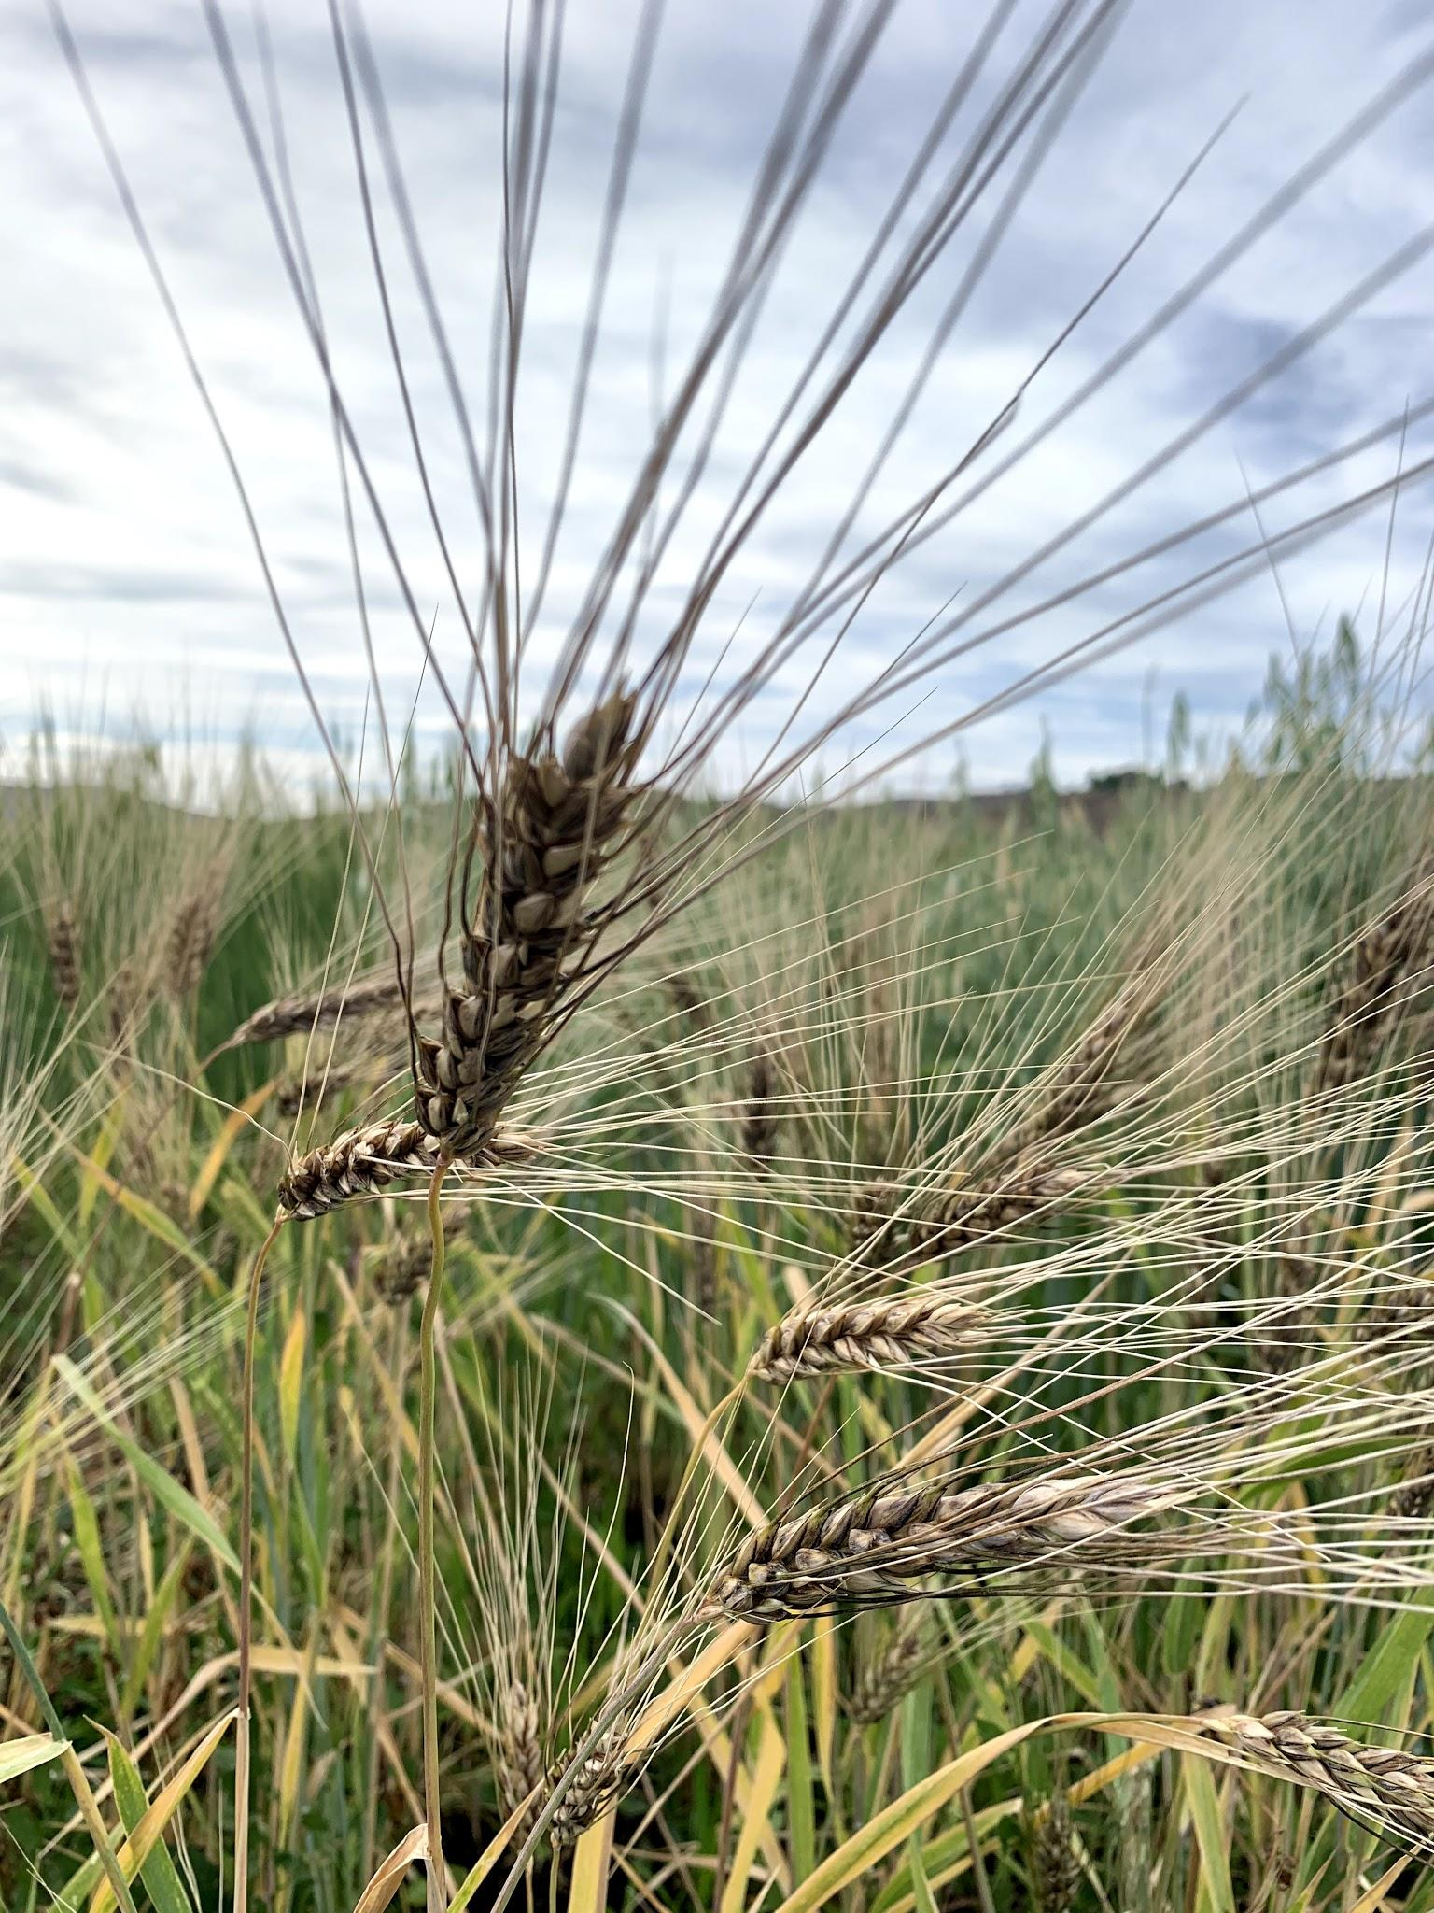
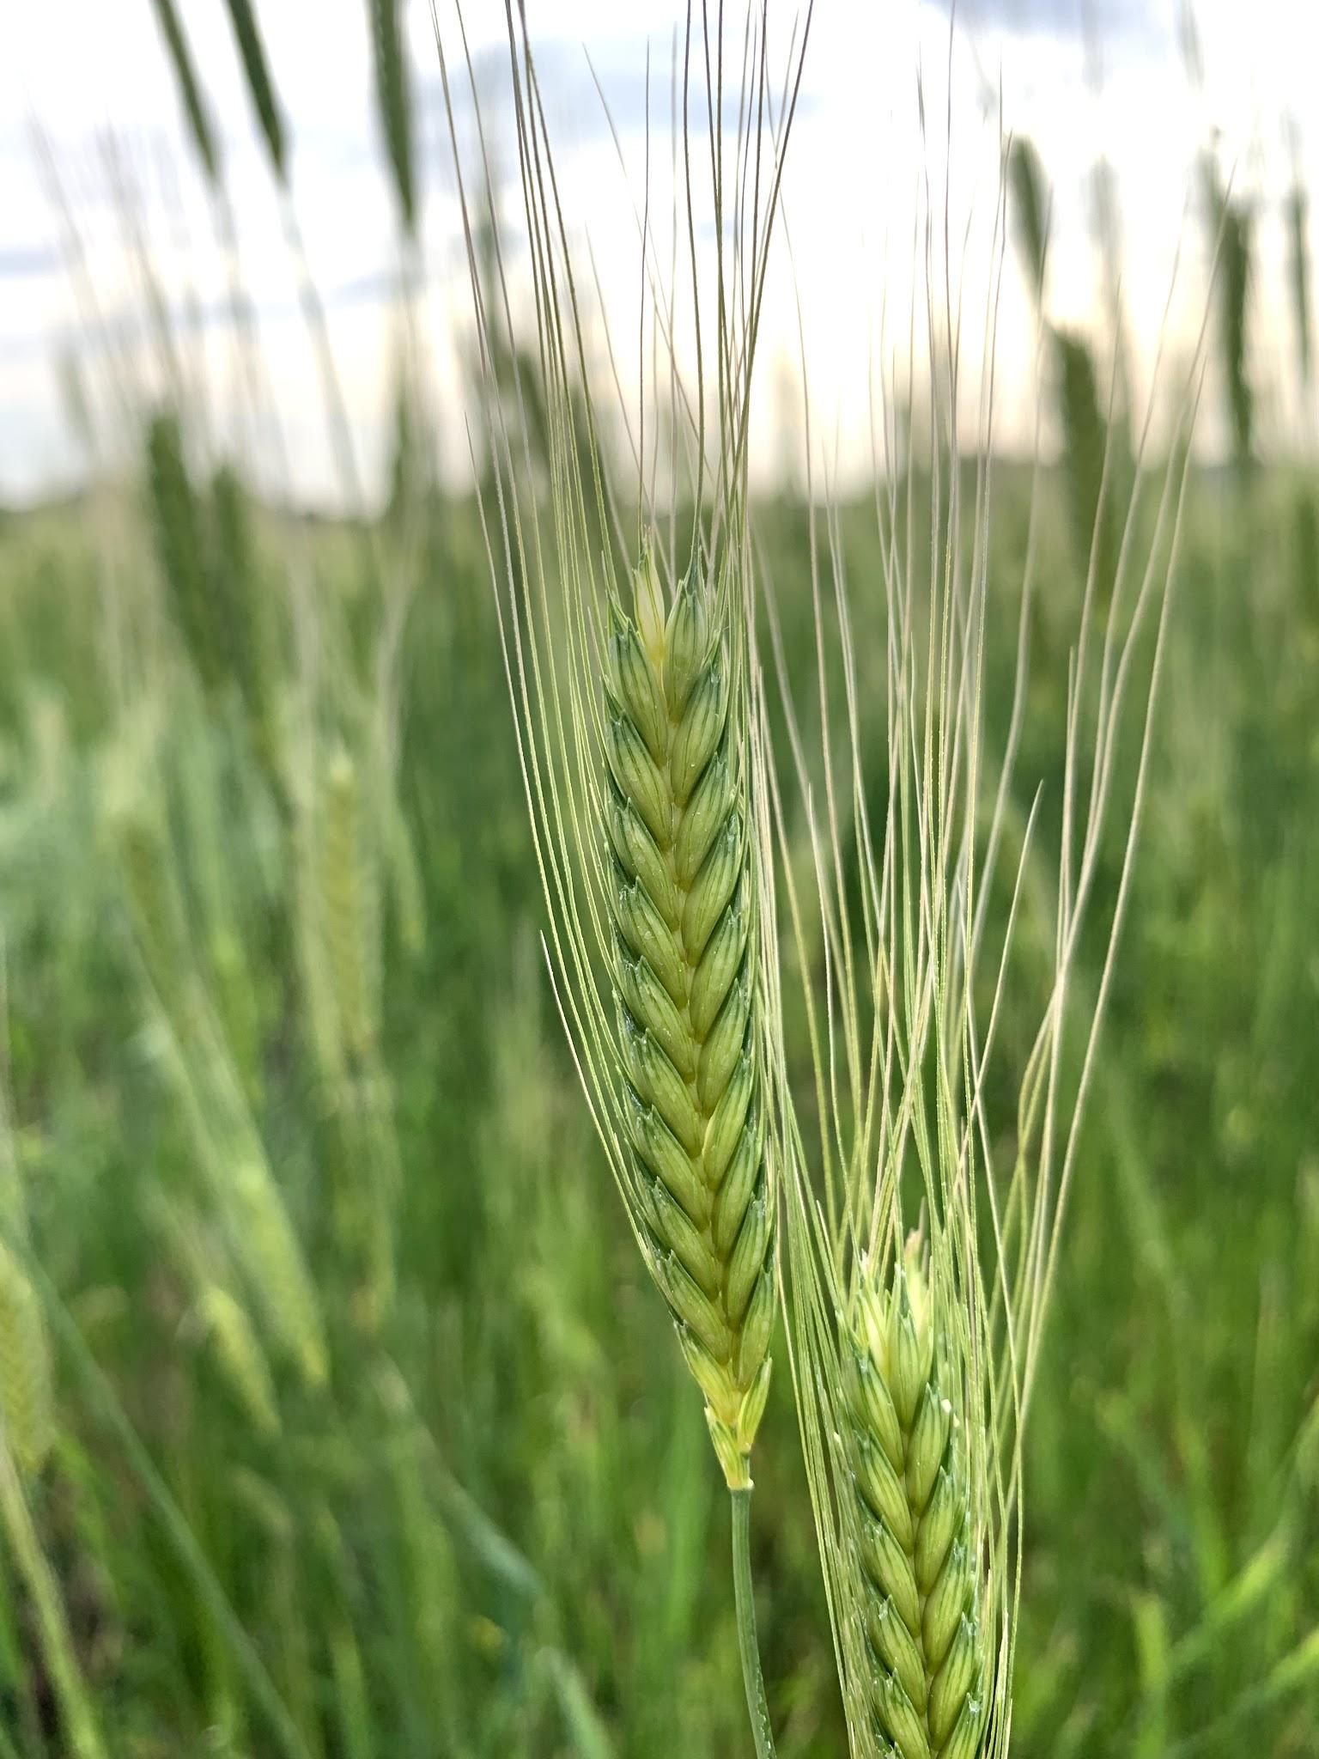
EMMER
&
EINKORN
Notes:
Ethiopian Blue-Tinged Emmer (RMSA) & einkorn (from Adaptive Seeds thru Lonesome Whistle Farm)

Slide 11
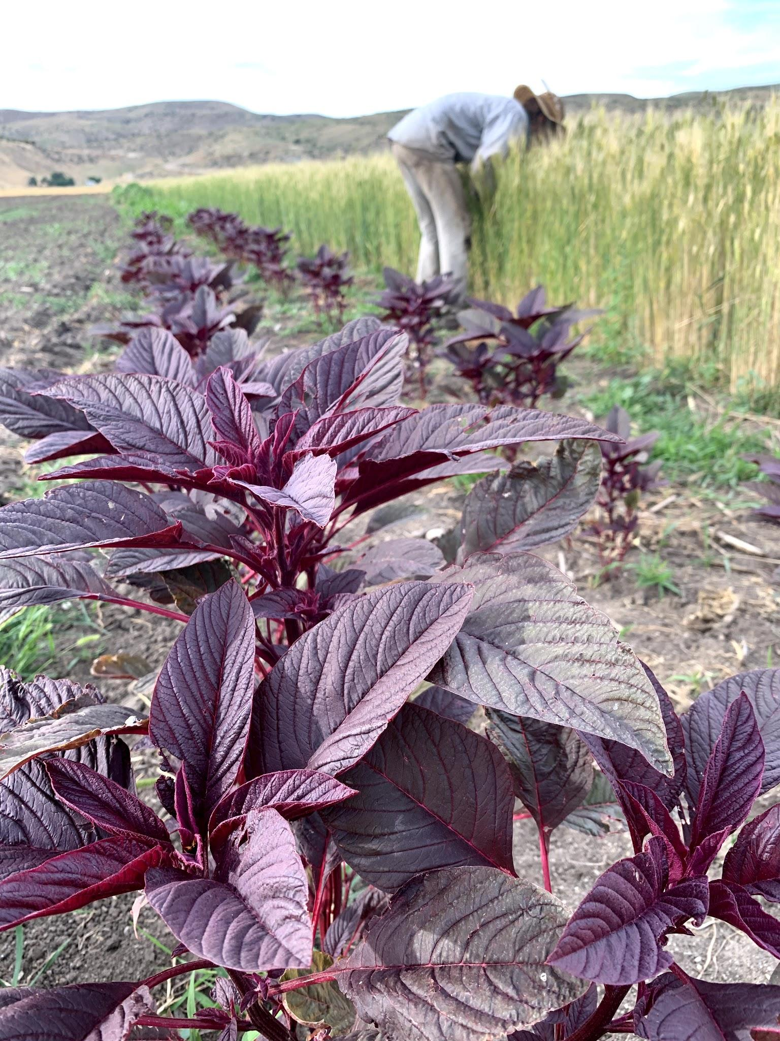
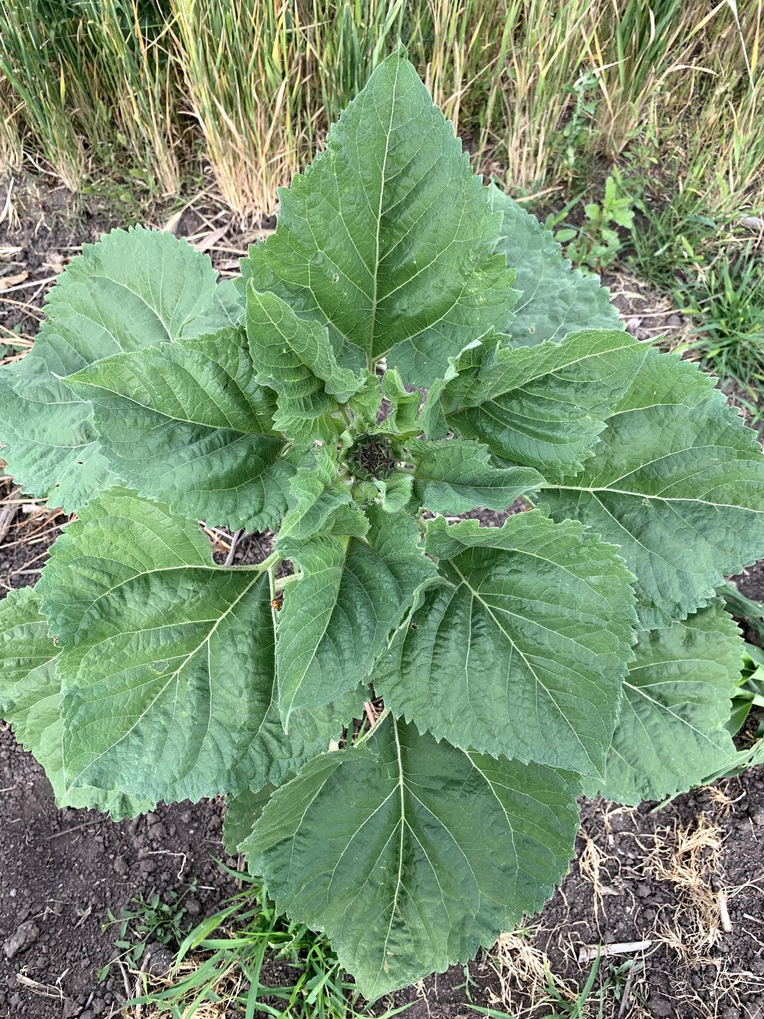
AMARANTH
&
SUNFLOWER
Notes:
Vietnamese Red (Vietnamese Red) & Hungarian Black-Seeded (Adaptive Seeds)

Slide 12
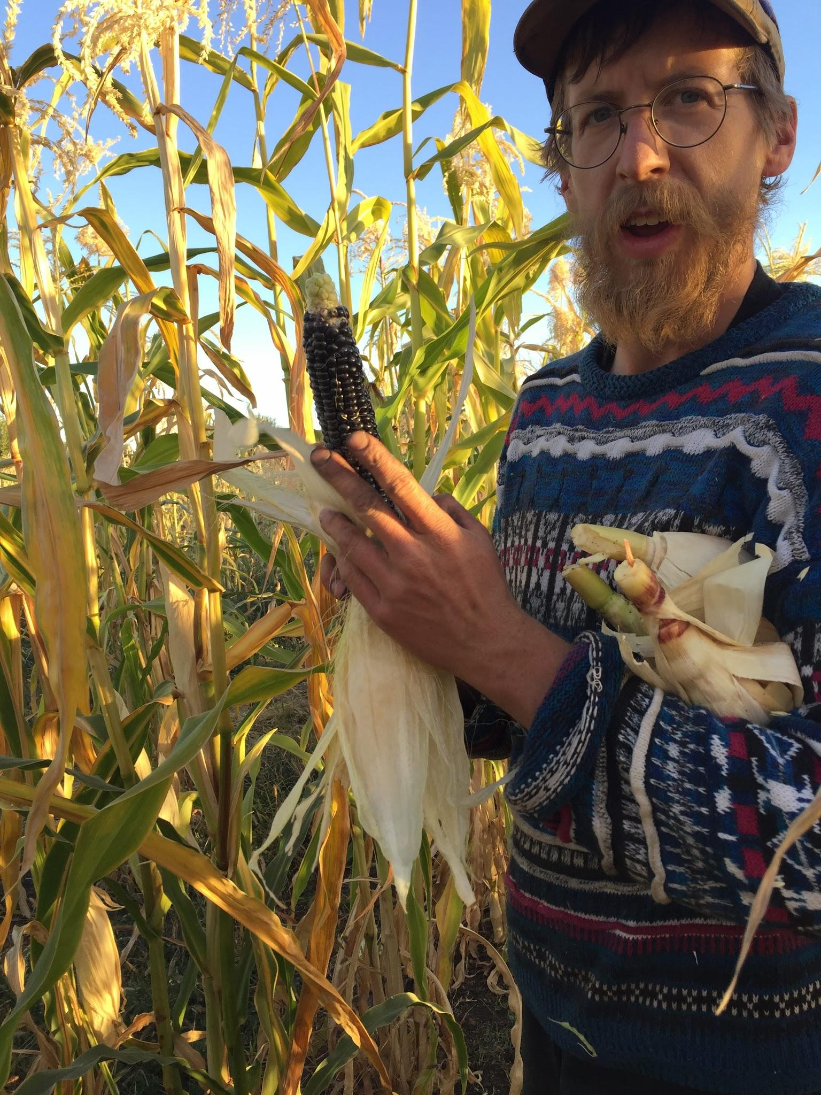
THOUGHTS ON
HEIRLOOM CORN...
The flour corn grown at Winnower Farm originally was grown by the Hopi tribe.
This variety was passed on to an Idaho seed steward forty years ago.
It is very important to be mindful of our seeds’ origins, their history, and the people that cherish them. We are continually learning the best way to interact with the communities today that grow and enjoy these seeds.

Slide 13
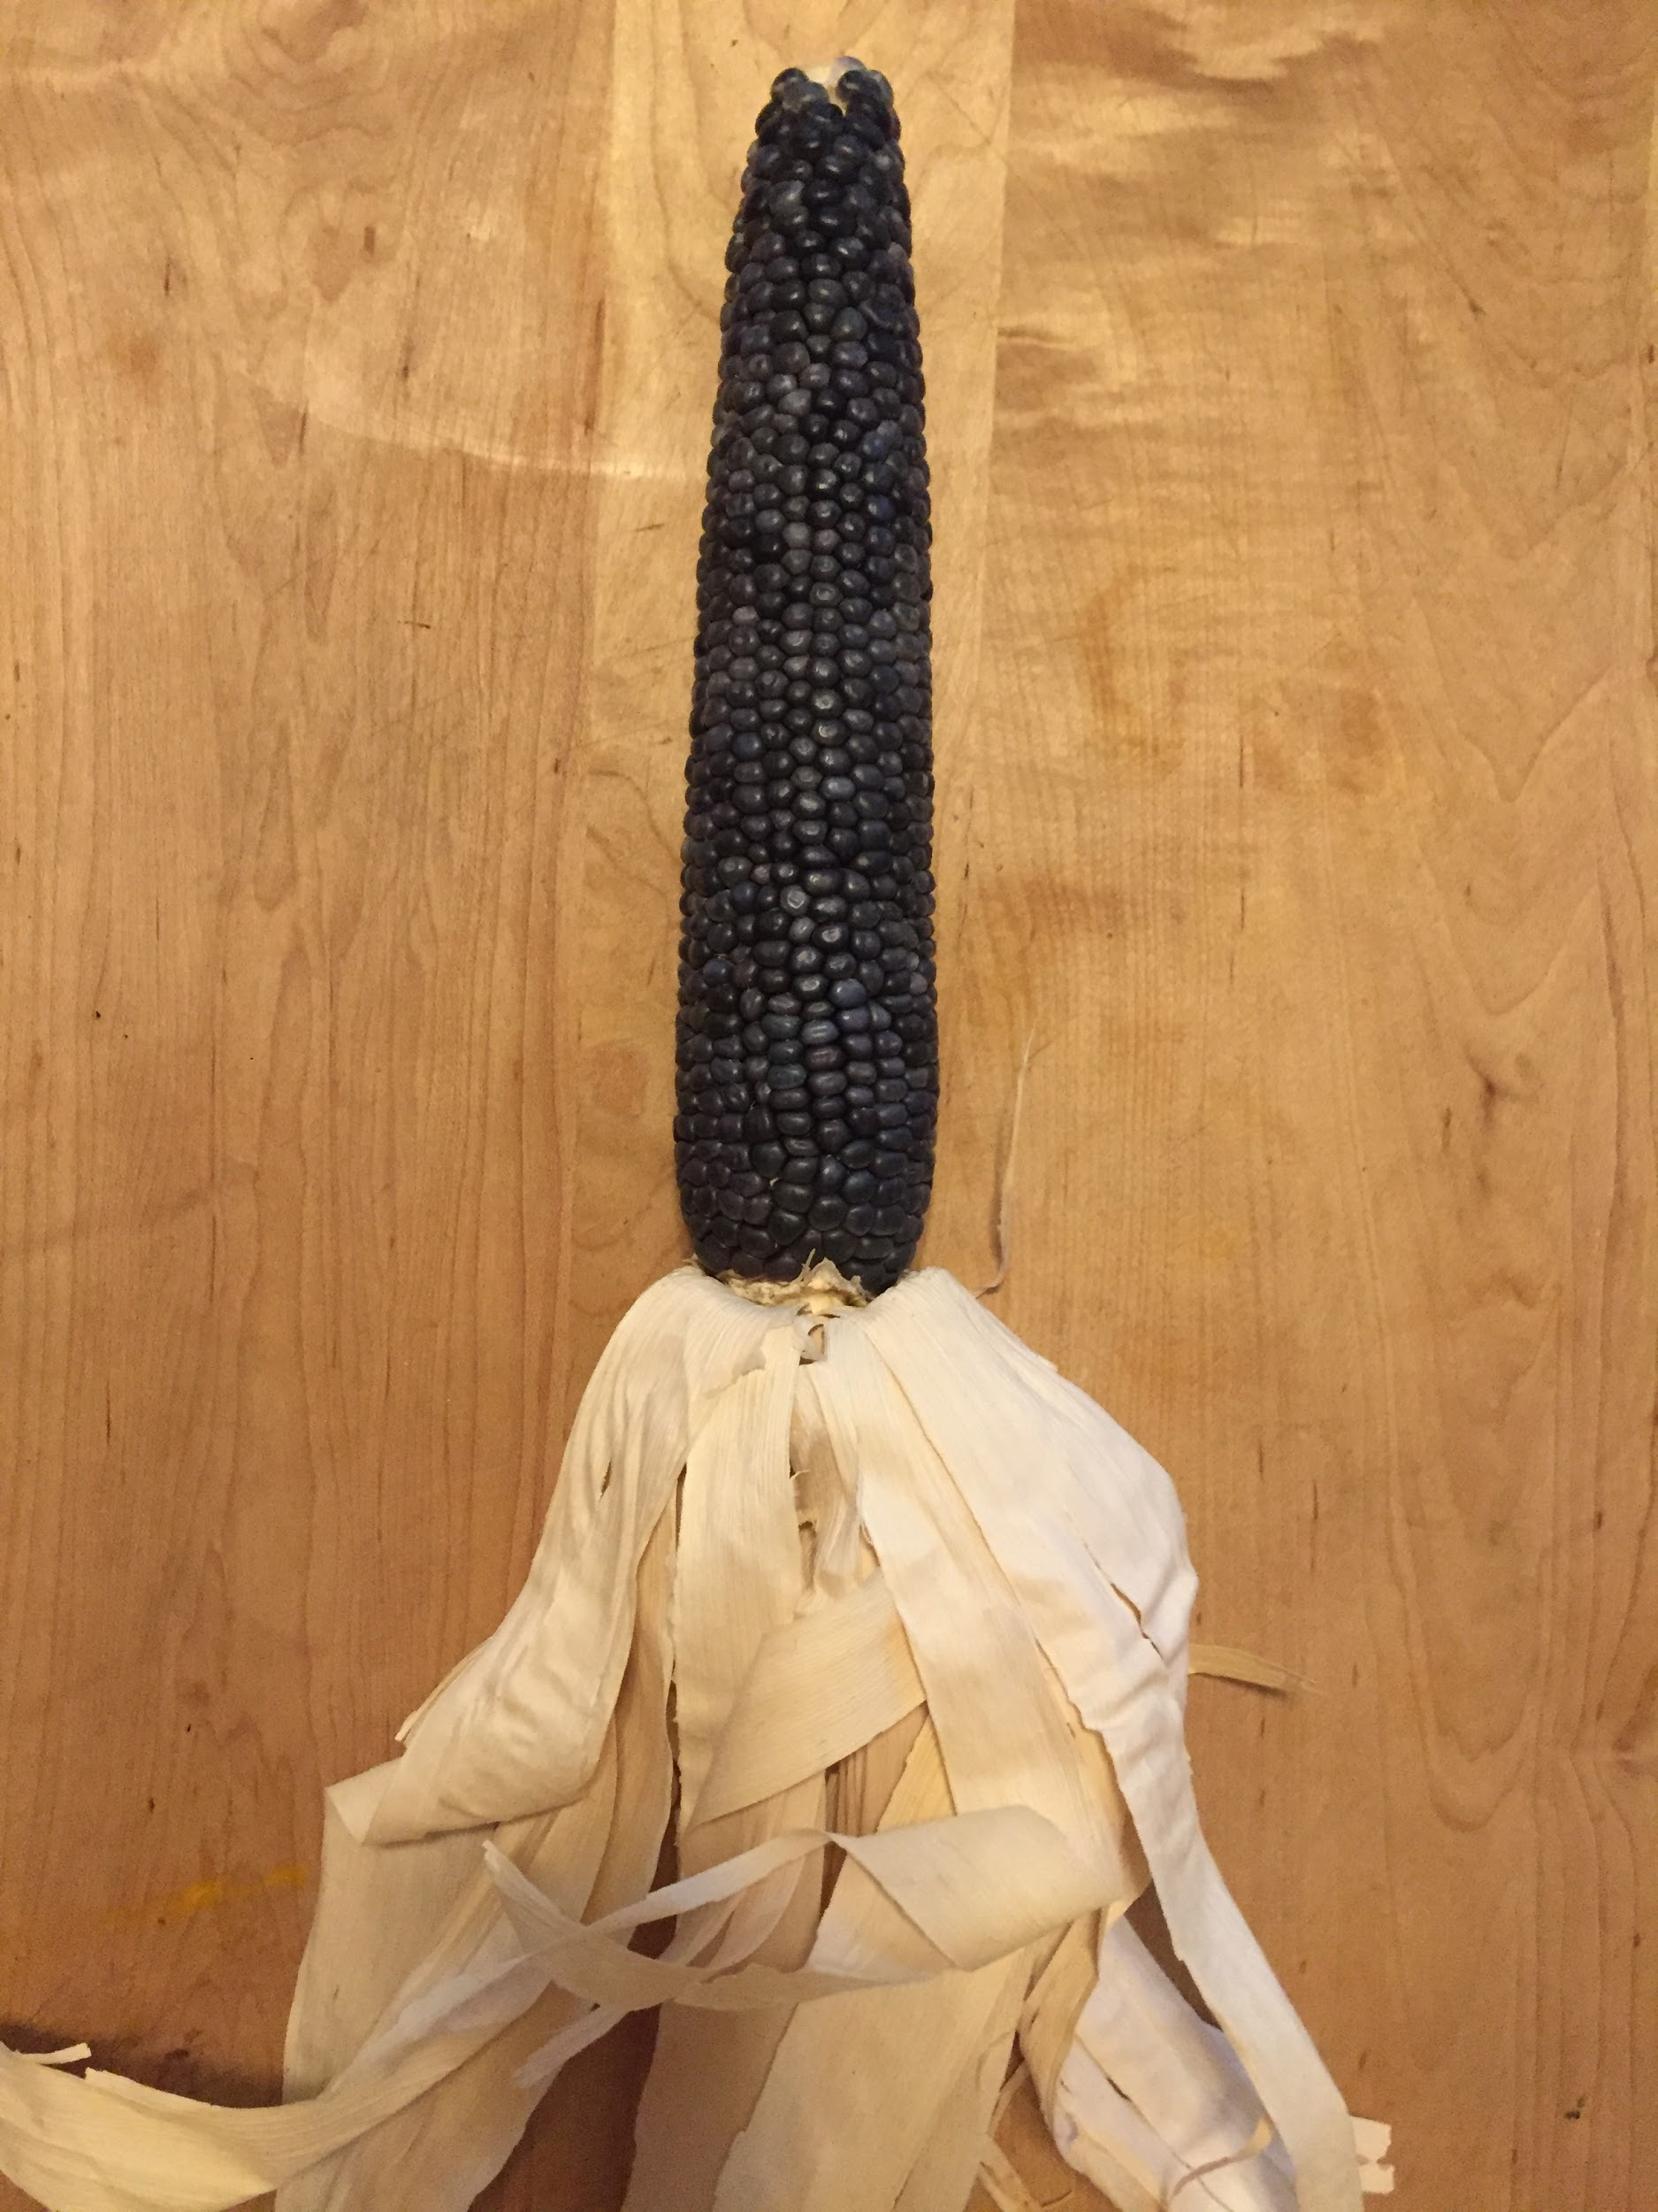
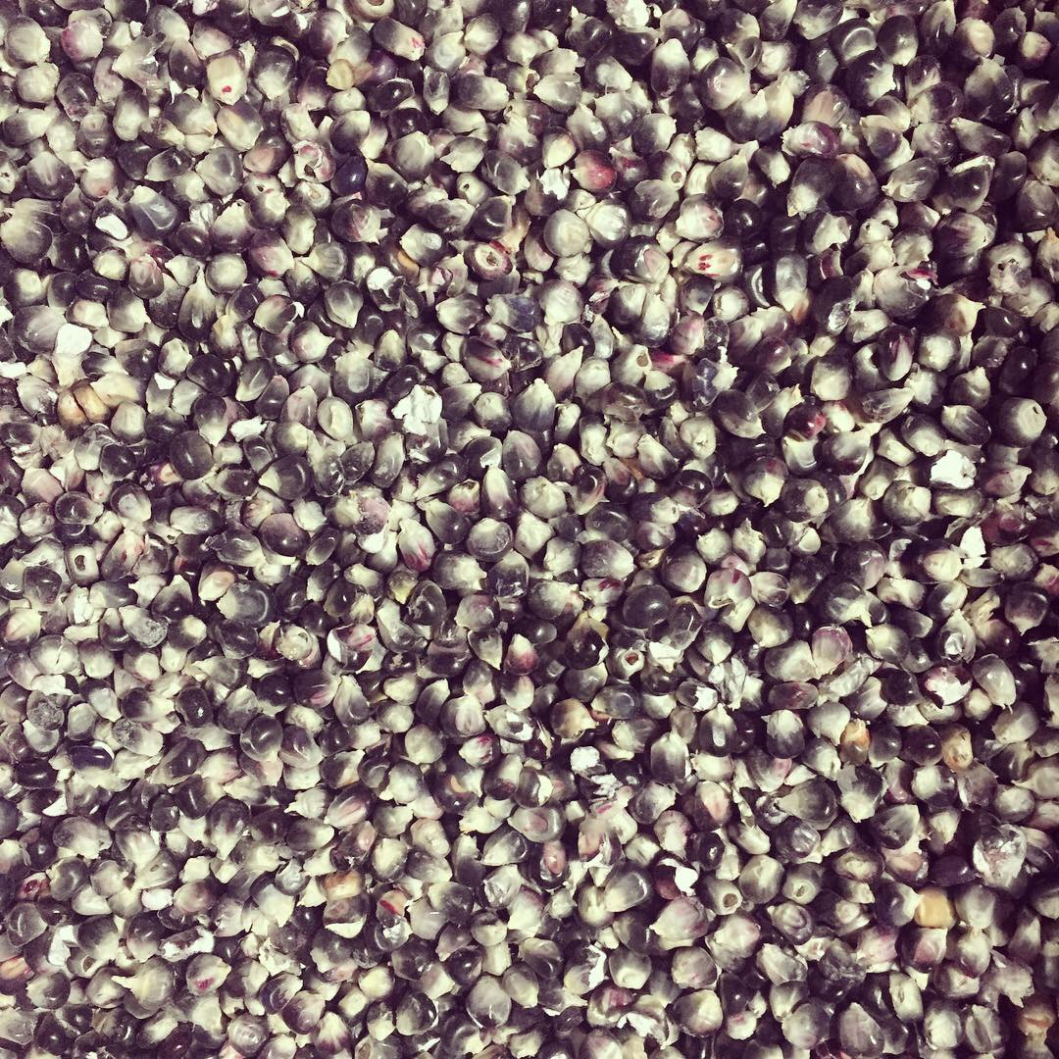

Slide 14
THREE:
SMALL-SCALE GRAIN PROCESSING
Notes:
Seed source, Thresher Artisan Wheats of eastern Idaho. Delayed other seed sources by waiting too long.
CSA bit - seed cost, initial tractor work and labor fees paid upfront with the rest to be paid after harvest.

Slide 15
-We are experimenting with a low-cost, bicycle-powered corn dehuller.
-Equipment and infrastructure costs are steep for individuals hoping to grow grain economically.
-Successful examples of small-scale processing influence other farms to diversify into grain production!
Notes:
Hope to share our experiences and successes through open-source outlets.
Will eventually begin working on a wider range of grain processing equipment.

Slide 16
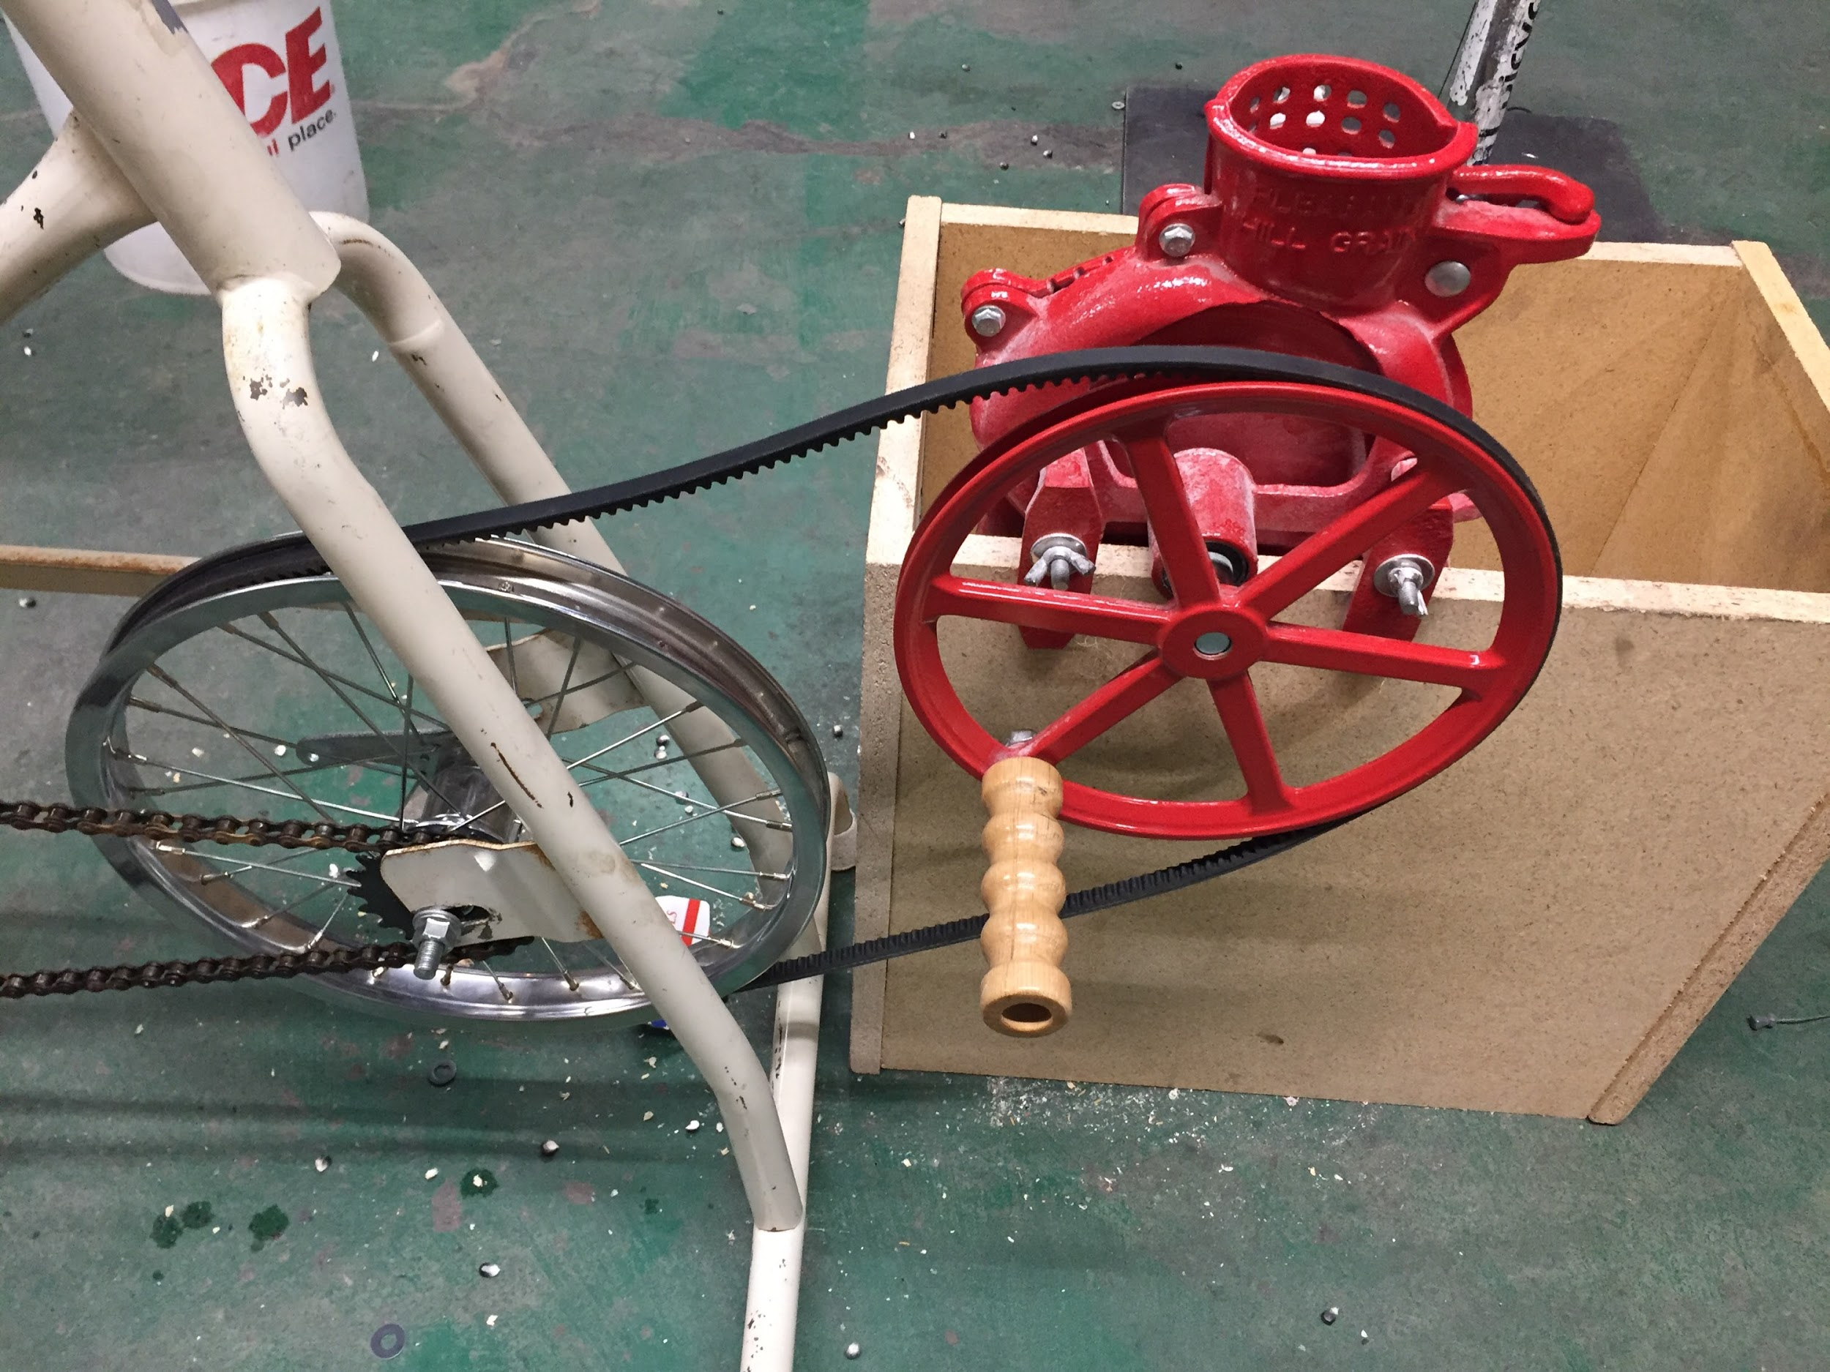
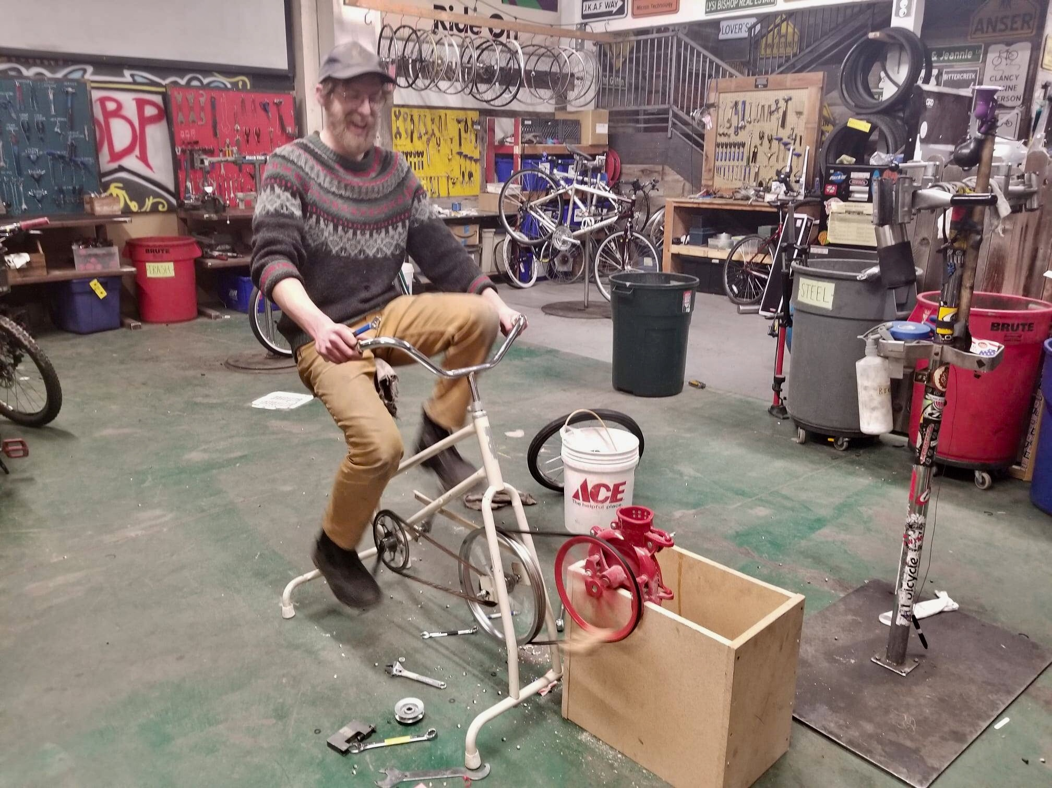

Slide 17
Notes:
Earliest version with several changes since first run.

Slide 18
Thank you all for listening, sharing, teaching, growing, eating, and enjoying grains.
Notes:
I

