Slide 1
A Local Community For Artisan Bread Bakers
What’s Your Jam?

Slide 2
Better Late Than Never
Seattle Culinary Academy Bakeshop
Skagit Grain Gathering
Local, Flavor, Nutrition
Launched Grain to Bread Event – June 2018
Cereal Scientist Andrew Ross
Mockmill - Paul Lebeau
Ceor - Guy Frenkel Bread Artist
Teresa Greenway – Perfect Sourdough
Moon Family Farms
LABB Founders

Slide 3
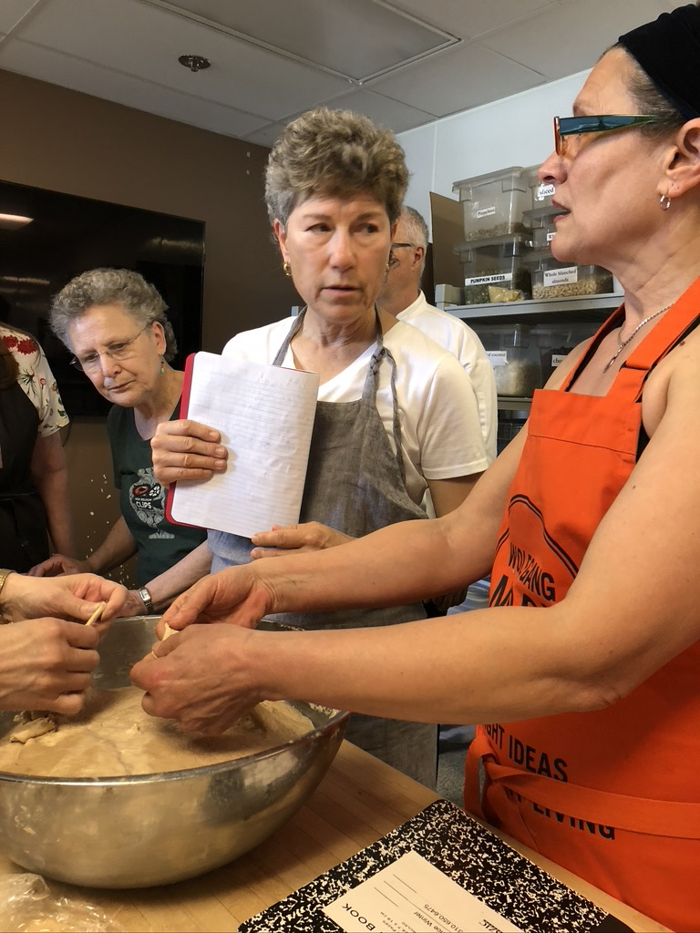
Hybrid Of Existing Themes
BBGA – Community for Professional Bakers
LABB – Los Angeles Bread Bakers – 2443 – Anateur Bread Club - Meetup
CBC – Chicago Bread Club – Website – Non-Profit – Shulamis Rouzad
PDX Whole Grain Bakers Guild - Instagram
Notes:
Kathy Turk
Patrice Winter
Guy Frenkel

Slide 4
Seed Germinating
Support the regional grain movement
Create & foster a local “offline”, “analog”, community
Gather to exchange, share, commune, educate
Bake, Learn, Bake, Learn, Bake, Learn
Experiment with local flours and grains
Flour as ingredient, explore/experiment with grains
Kinship and network vast community

Slide 5
Initial Invitation - NWBB
We are part of the good food movement, supporting the regional grain economy, helping new bakers learn the craft, lending support to start-up businesses, serving as a resource for the purchase of local grains and flours, sharing techniques and methods and getting conversations started through interesting programming. We care about the health of people and planet and look to advance both through the baking of delicious, nutritious bread. A wide variety of events will be hosted up and down the Puget Sound corridor and a fee will be charged when necessary and simply to cover the costs of the event venue and speaker fee if there is one. All voices matter so please be sure to email us with suggestions on event venues, topics, or activities that interest you.

Slide 6
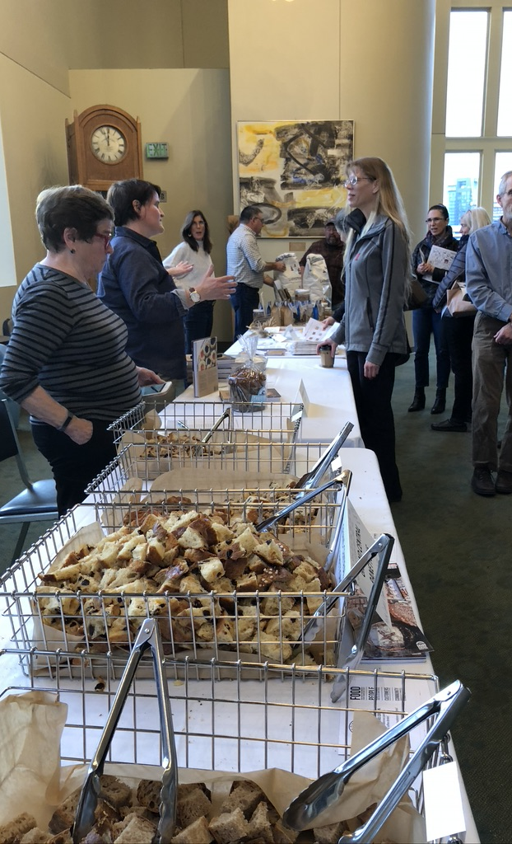
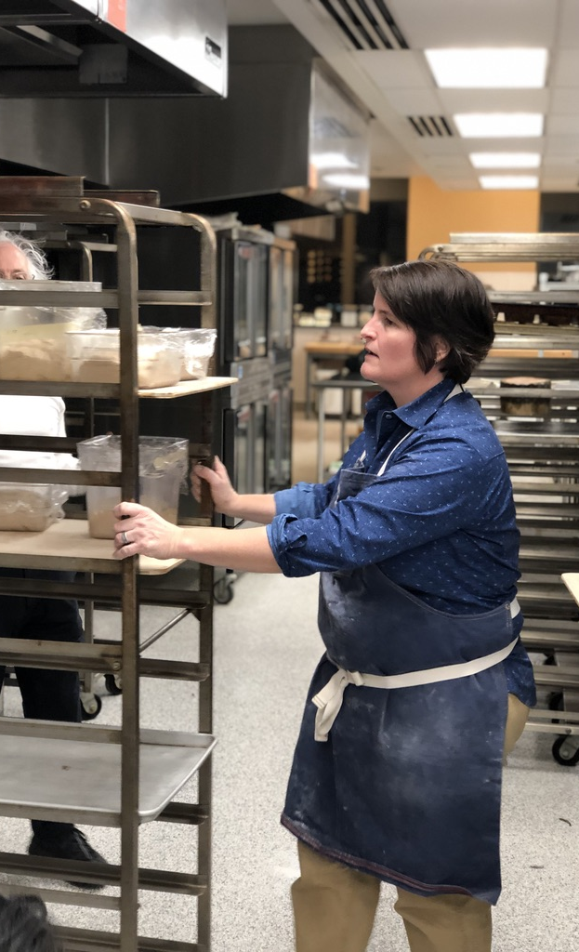

Slide 7
PAST EVENTS – 13 Events (Roughly Monthly)
10/2018 - Meet The Baker | Standard Bakery now Zylberschteins
11/2018 - Heritage Grains Event | Uniting Bakers, Millers & Growers
11/2018 – Hands On with Ellen King - HEWN
Breaking Bread | Getting Feedback and Tips From Artisanal Baker
Cascadia Grains Conference - 2019
That’s A Some Pizza – Behind The Scenes with Will Grant
Going with The Grain: A Tasting Featuring Cairnspring Mills
Rise & Shine| Sourdough Waffles
Liquid Bread | Lowercase Brewery
Community Bread Bake | Wood Fired Oven
Bread & Chocolate | Theo’s Tour
Let’s Roll | Thanksgiving Dinner Table
Heritage Baking Exchange | Holiday Favorites Reimagined – Replace 25% AP

Slide 8
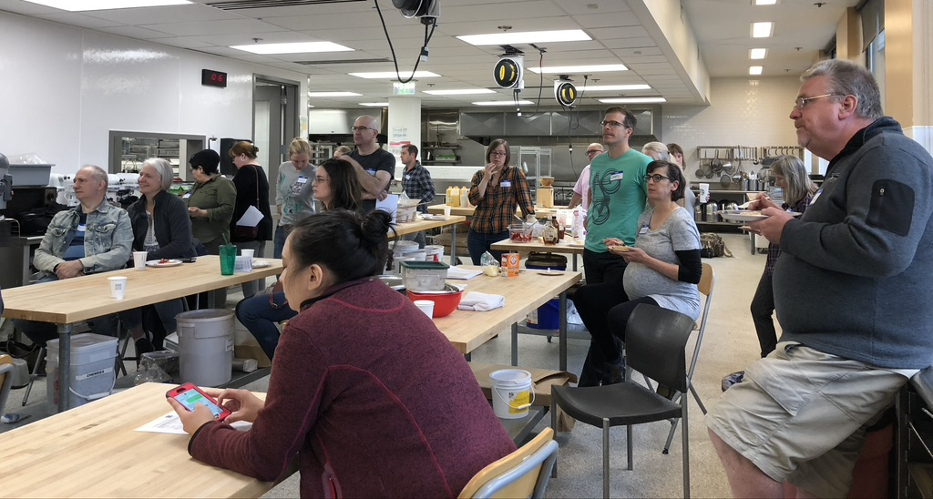
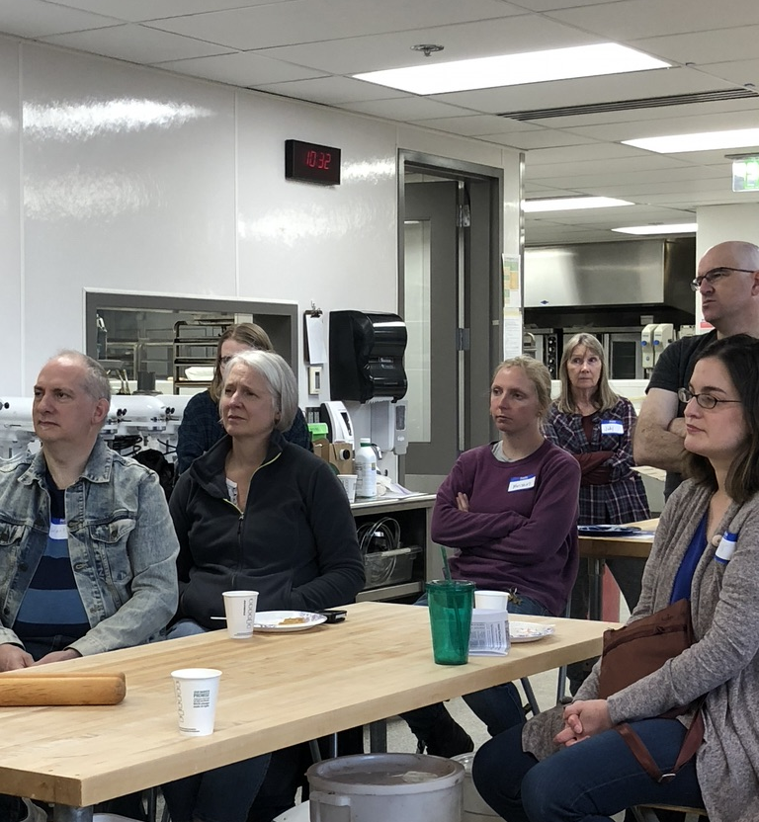
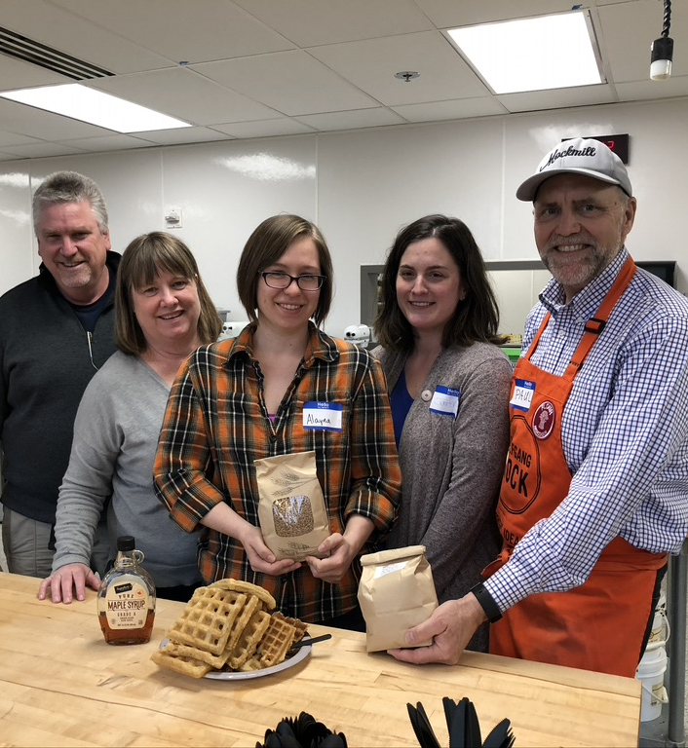
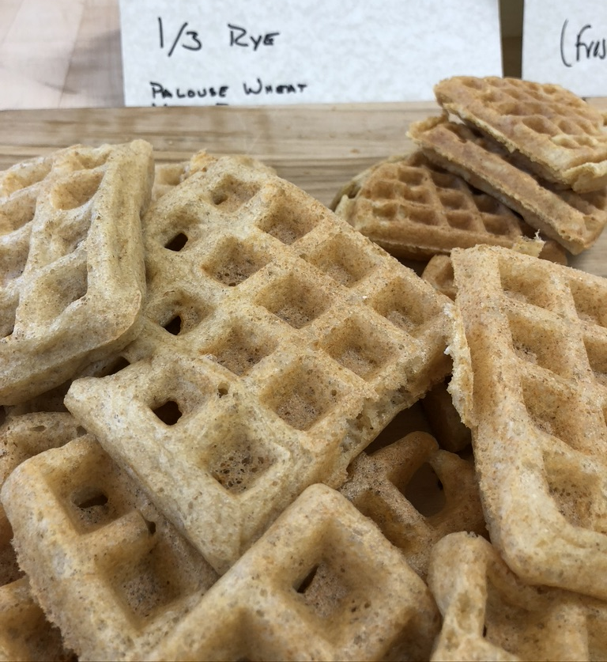

Slide 9
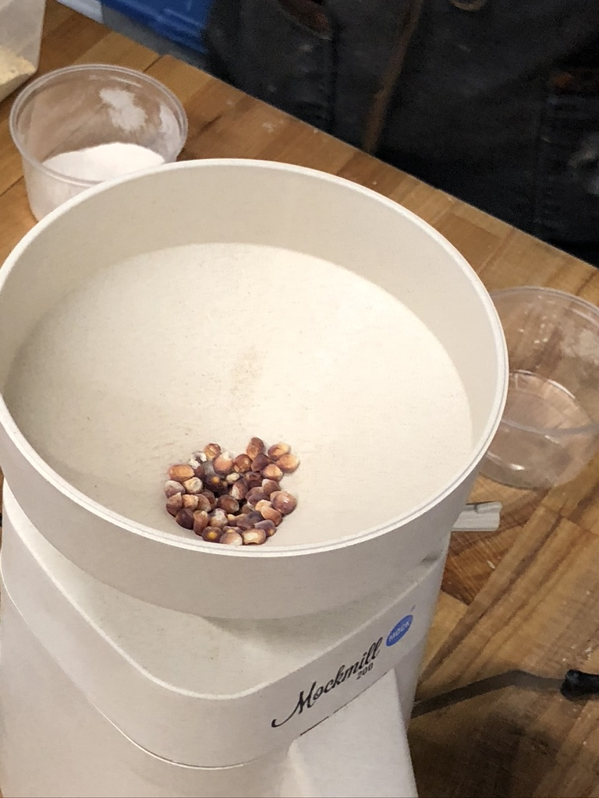
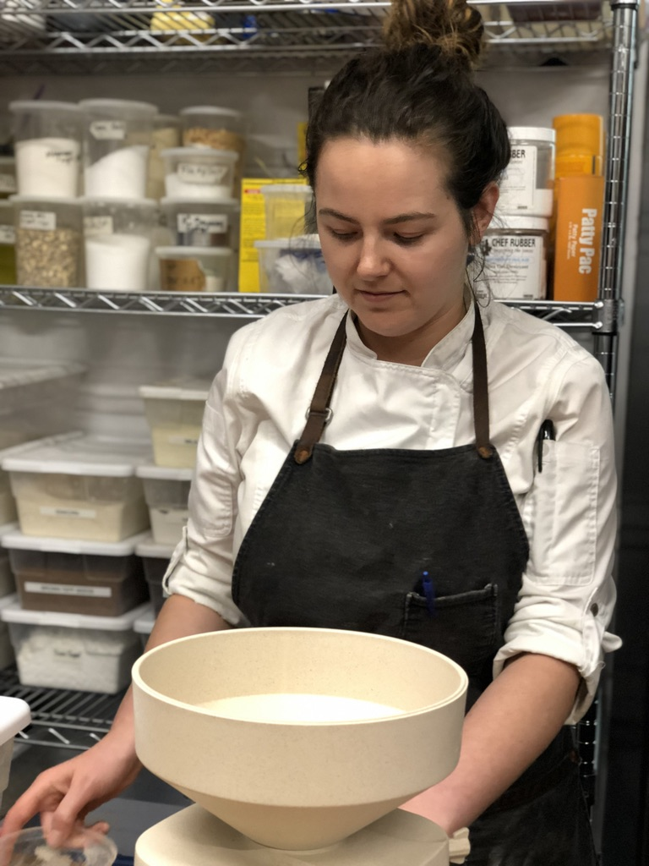
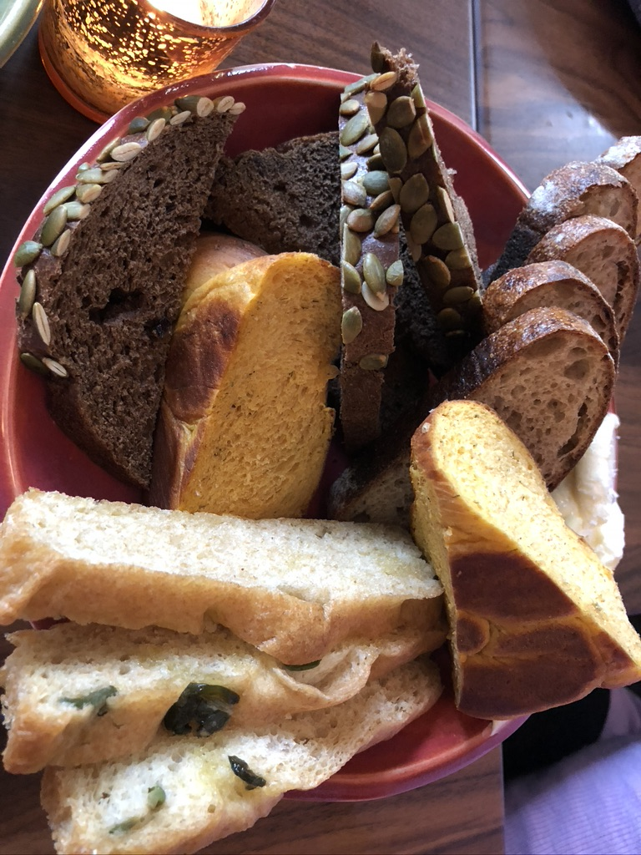

Slide 10
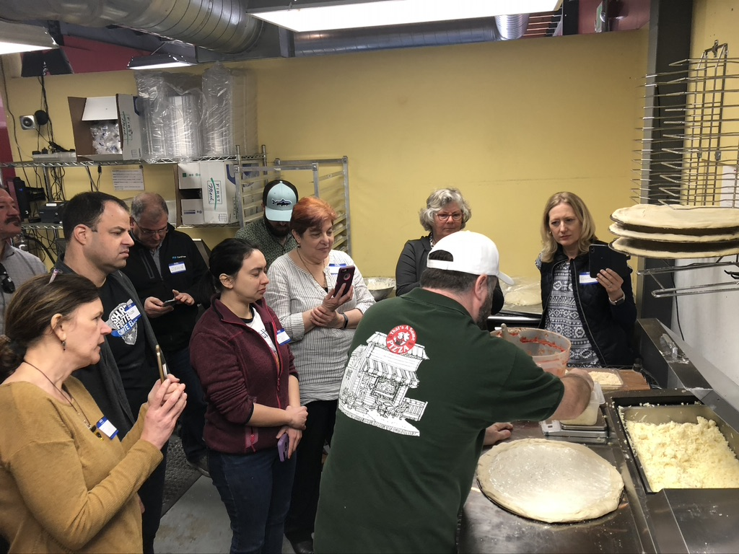
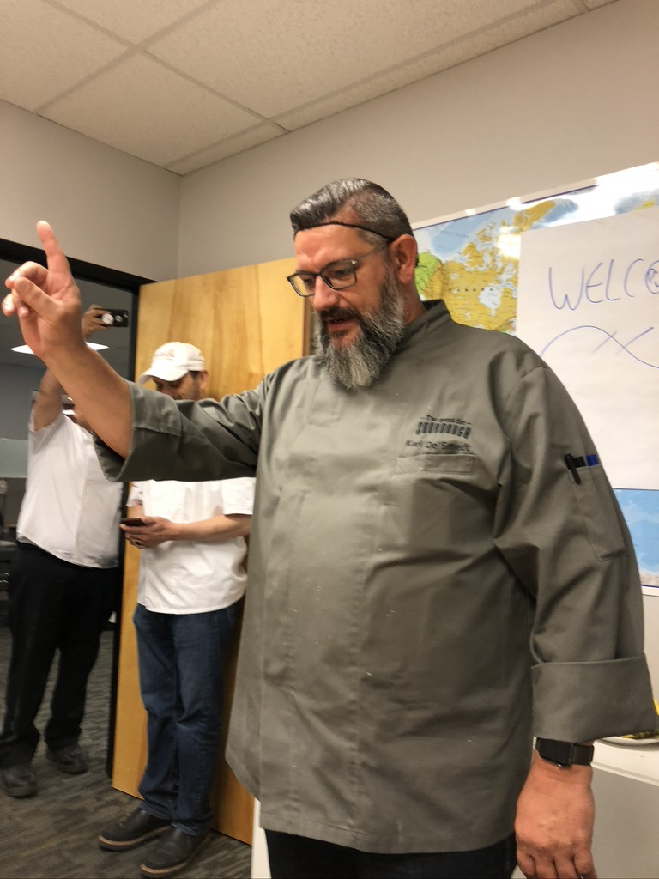
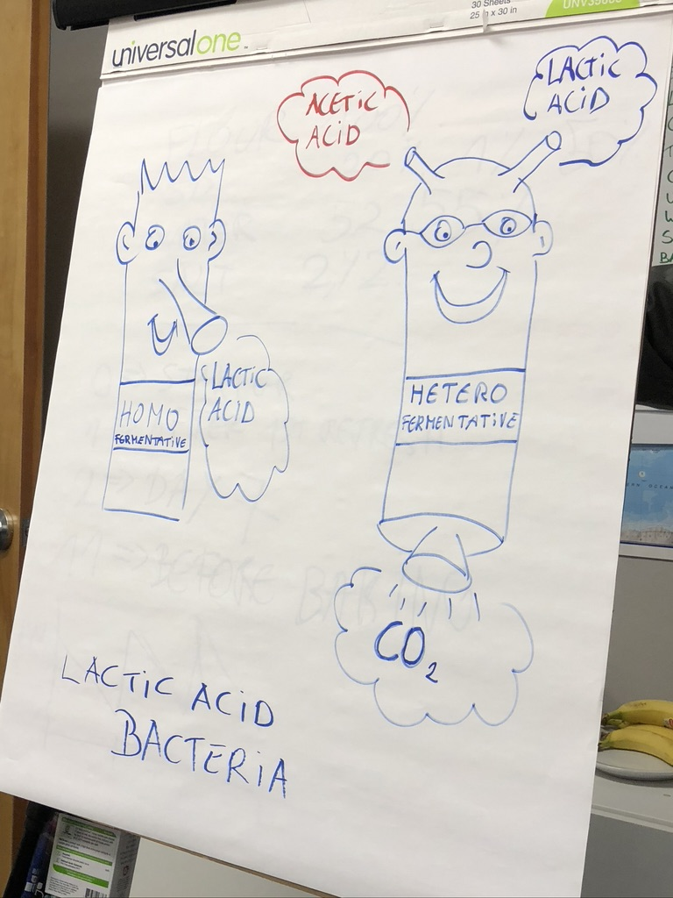
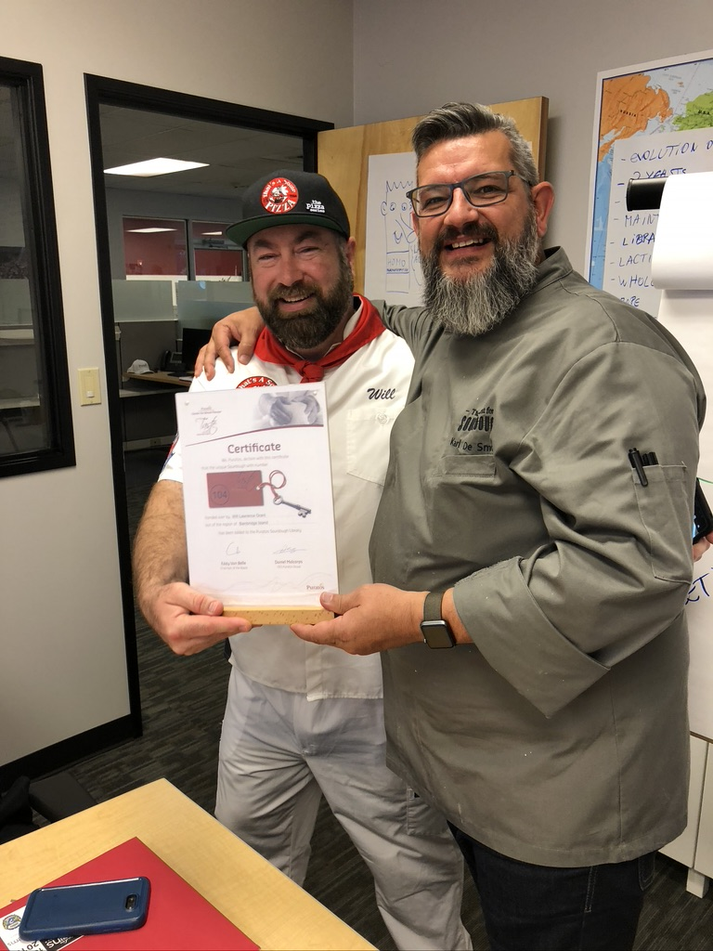
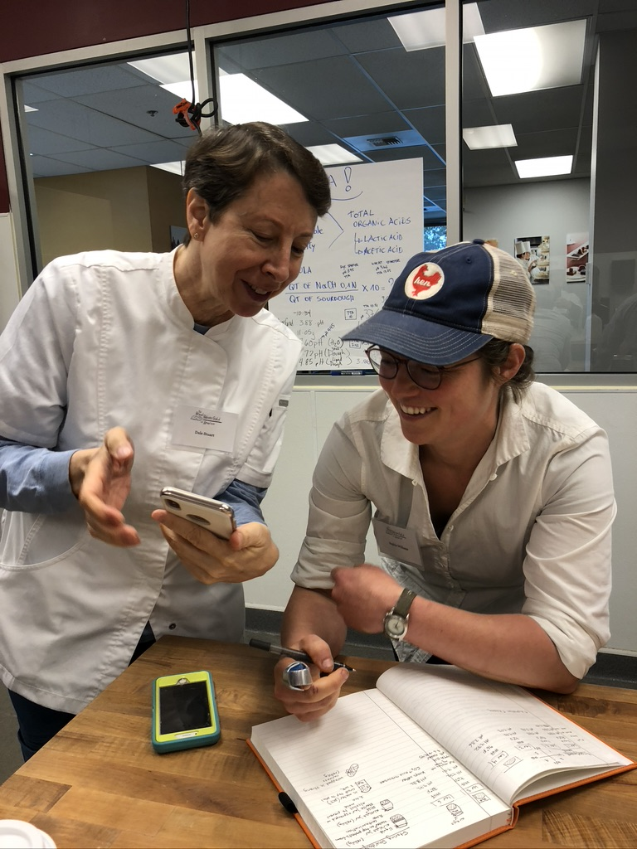
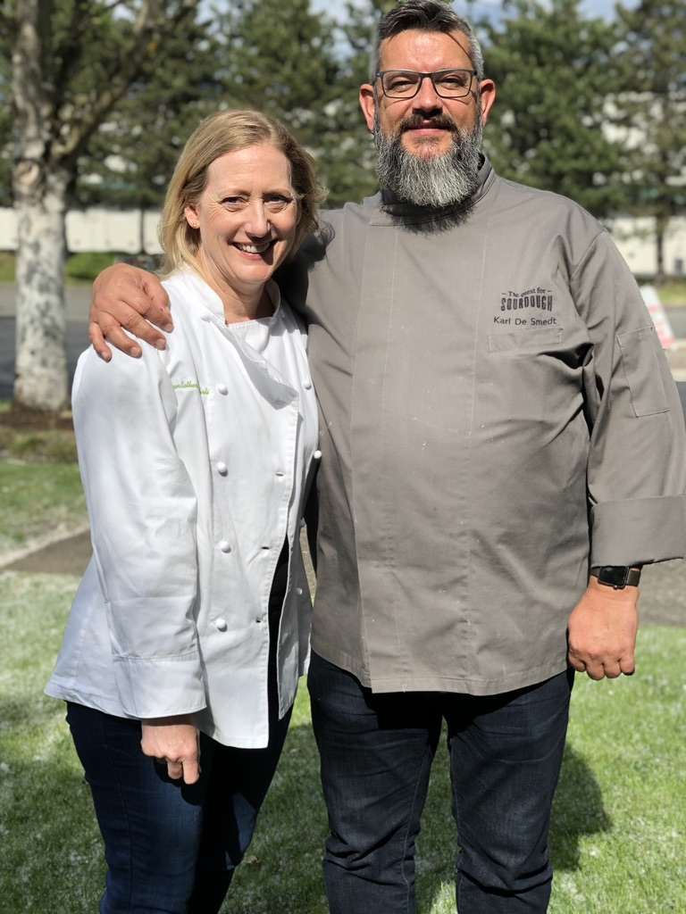
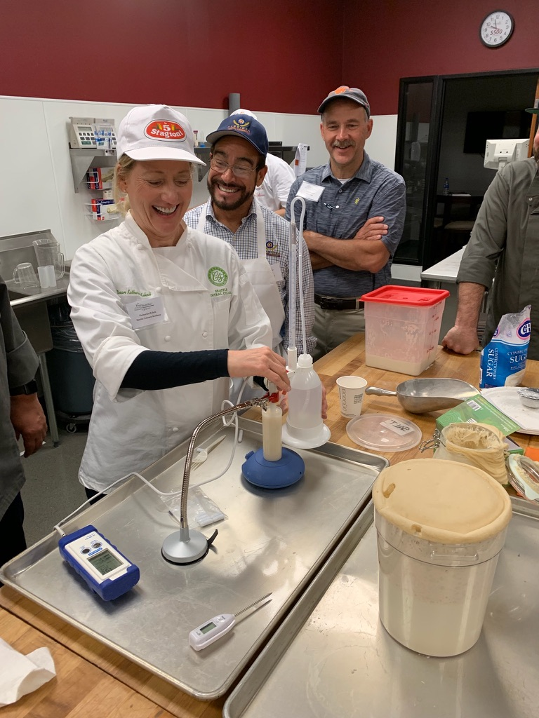
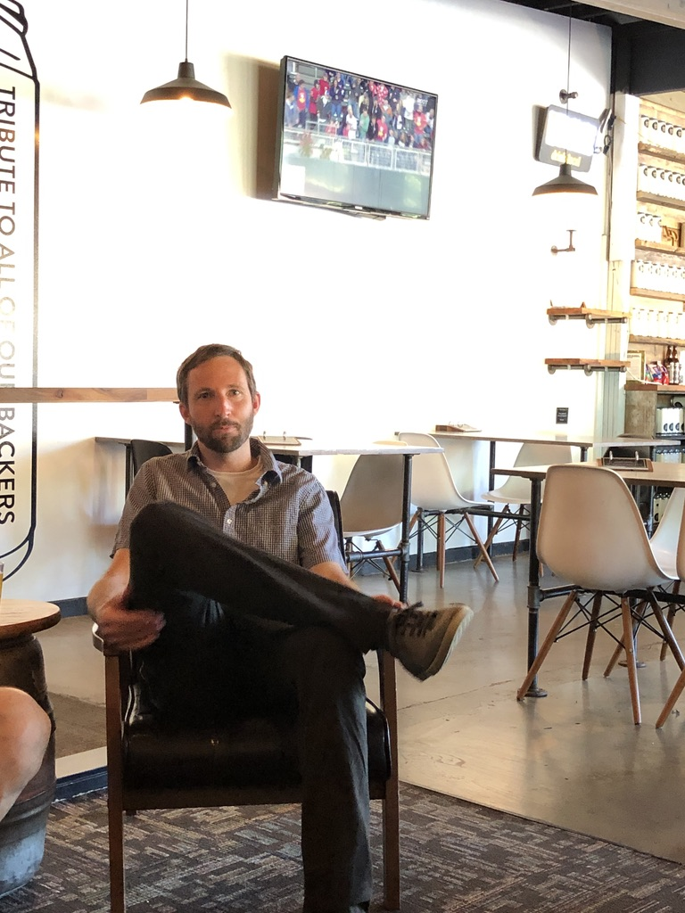

Slide 11
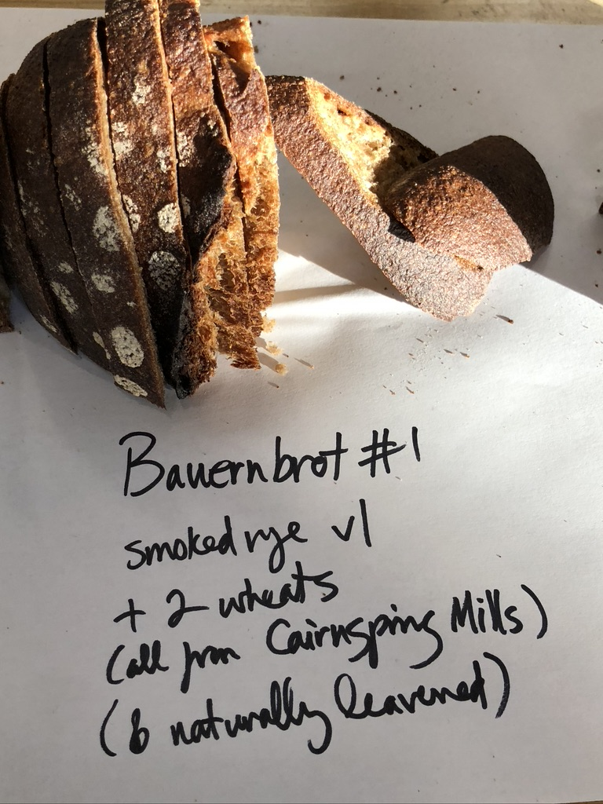
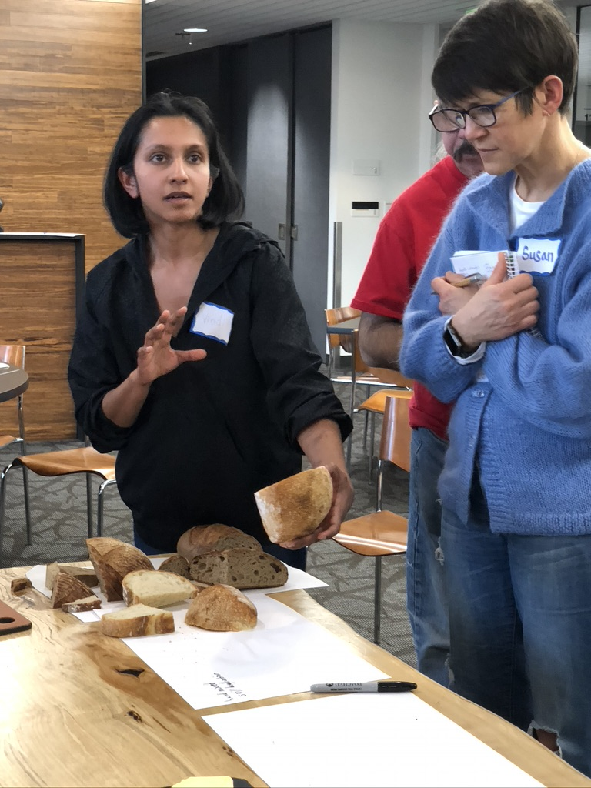

Slide 12
Bread Baking, Like Gardening, A Happy Place
We’ve Met A Lot of Awesome Stakeholders
WSU Grain Researchers,
Eastern & Western WA Farmers – Seth Small, Jessica Moon
Pioneering Millers – Cairnspring Mills
A Sourdough Librarian – Karl de Smedt
Award Winning Pizzaiola – Will Grant
Celebrated Heritage Grain Baker – Ellen King
Bread Artist – Céor – Guy Frenkel
Grand Central’s – Mel Darbyshire
Cascadia Regional Grain Creators
Everyone has been so darn happy and helpful

Slide 13
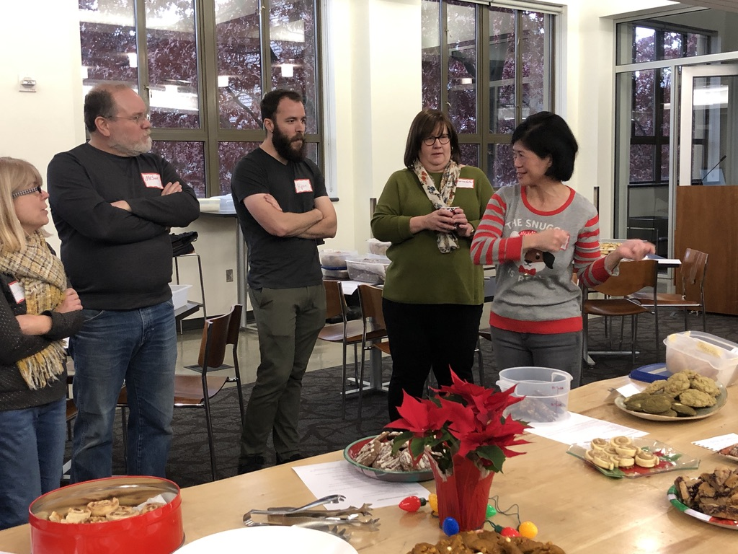
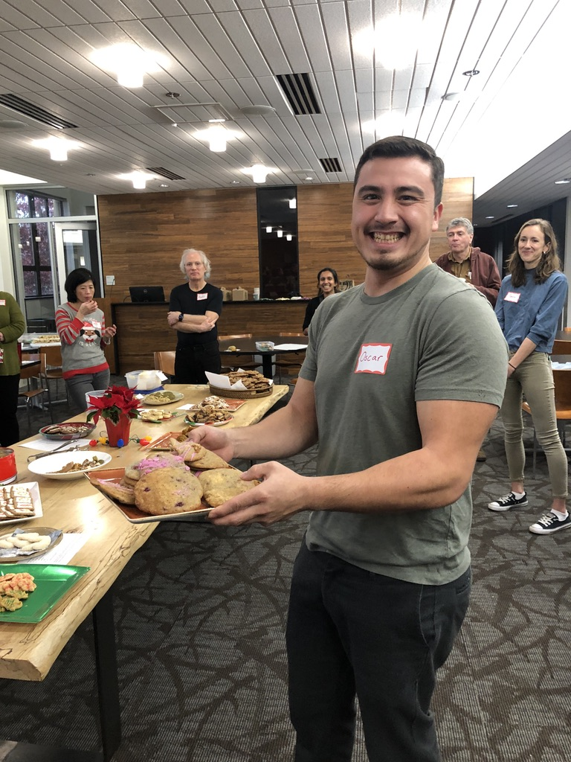
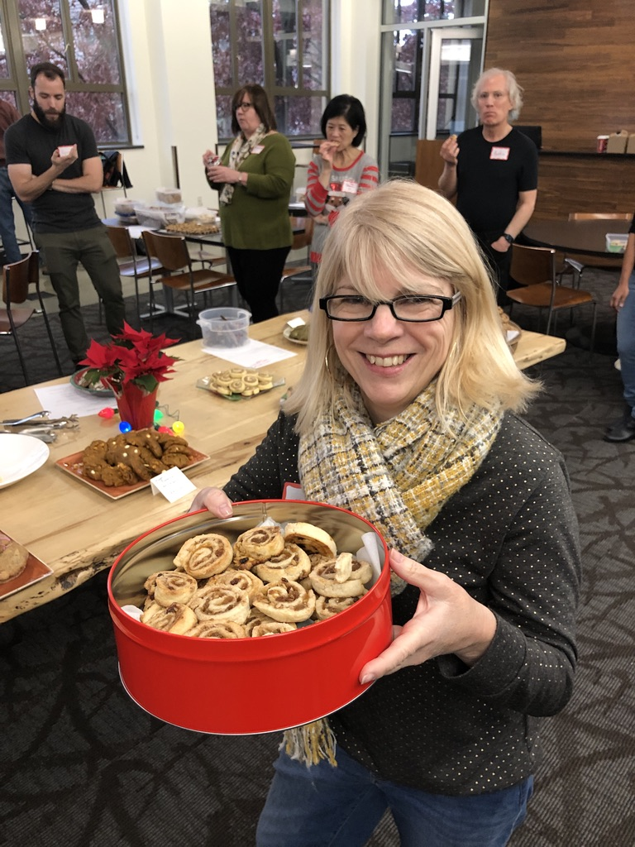
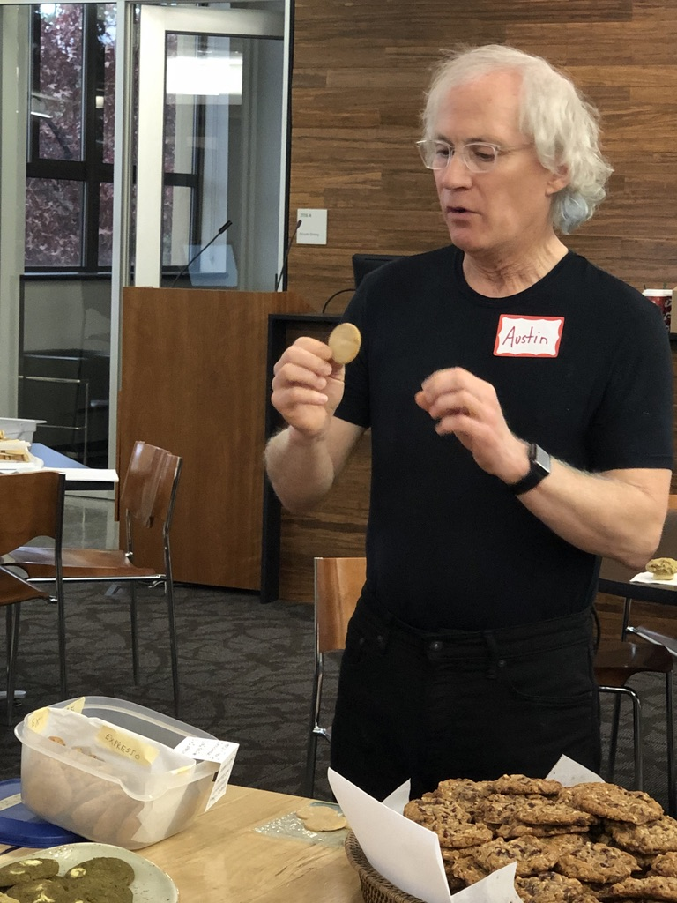
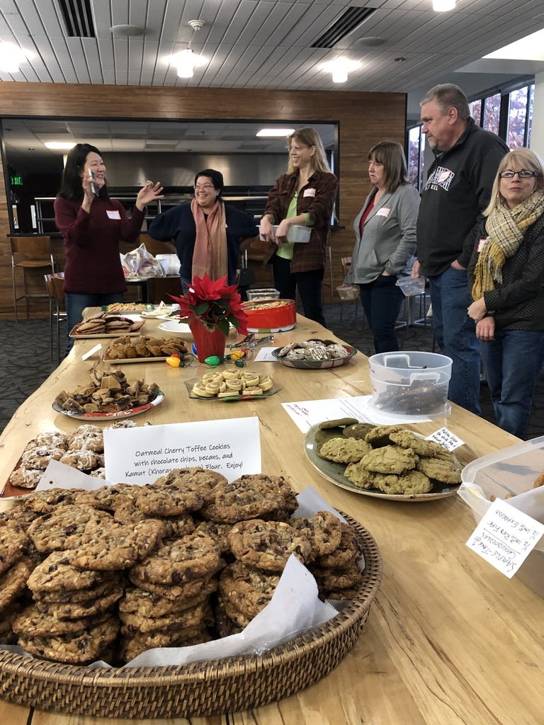
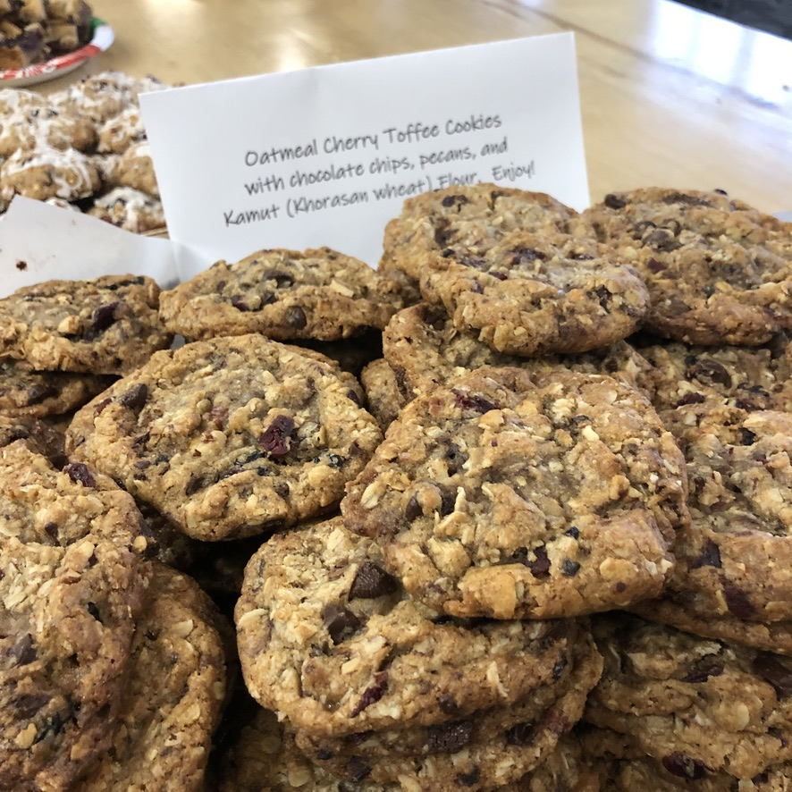

Slide 14
In General – About Us
Currently use Meetup for event management – @350 members and growing
Non-Profit business structure, filing for 501c3
Both Women & Men, Maybe 60/40
Wide range of ages, don’t ask, don’t tell
Scientists, Researches, Professional Pastry Chefs, Classically Trained and Self Taught, Artisan Bread Writers, Working Professionals, Software Engineers, Serious Home Bakers, Educators
Saturday’s or Sunday’s work best.
”Grain On” – Passionate about sourcing & sharing
Initial Goal Once A Month
All about connection – truly breaking bread together

Slide 15
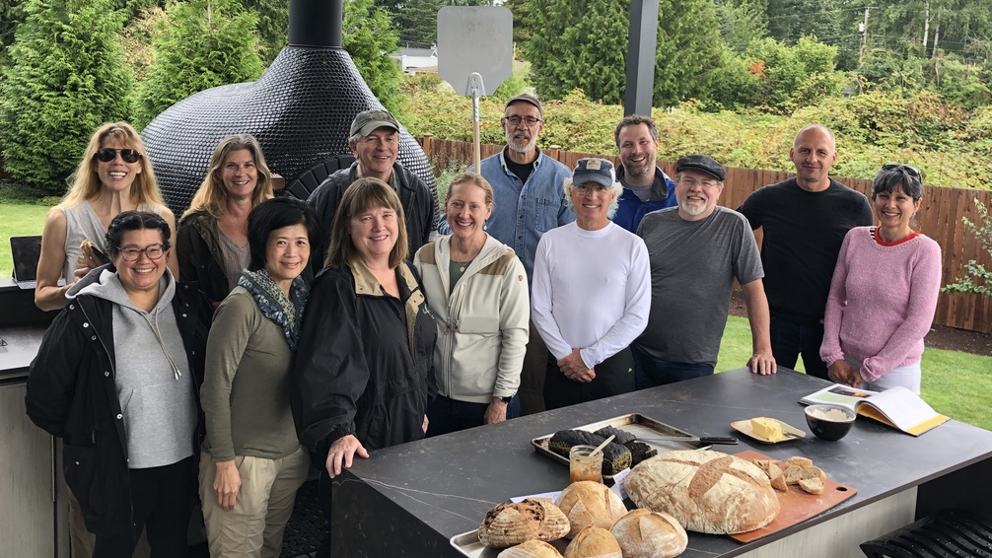

Slide 16
UPCOMING EVENTS – FIRST HALF 2020
Behind the Scenes at Grand Central Baking – 2/22 - Waitlisted
Sourdough Croissants – 3/22 – Waitlisted
Breaking Bread – Knowledge Share – 4/11 or 4/18
Friday Night Pizza Party – Can You Taste the Difference – 5/22
Community Bread Bake – Wood Oven – Must Contain Rye – 5/23
Road Trip – Bluebird Grain Farm – Mill, Farm Tour, Lunch… - 5/30
Summer - Inland Grain Conference

Slide 17
Some Challenges
Time
Integration Tools – Social Media
Currently No One-Stop-Shop
Event Management
Organization Management
Venues
Homes
Where in city
Ovens

Slide 18
Opportunities As Non-Profit
Support Regional Grain Movement & Grain Literacy
Host A Baking Competition Featuring Local Grains
Local Artisan Bread Expo
Support Education Forums
Develop Scholarships
Organize/Database for Grain Direct from Farmers
Advocacy
Cottage Laws
Build A Community Bread Oven
Other Ideas…

Slide 19
We Could Be Your Jam…
Invited to check us out.
MEETUP:
https://www.meetup.com/Northwest-Bread-Bakers/
FACEBOOK:
https://www.facebook.com/groups/NorthwestBreadBakers/
FARMERS:
Add your name to our direct sale grain list.

Slide 20
