Slide 1
sus·tain·a·ble
\səˈstānəb(ə)l\, adv
1: able to be maintained at a certain rate or level
re·gen·er·ate
\ ri-ˈje-nə-rət , -ˈjen-rət\, adv
3: restored to a better, higher, or more worthy state

Slide 2
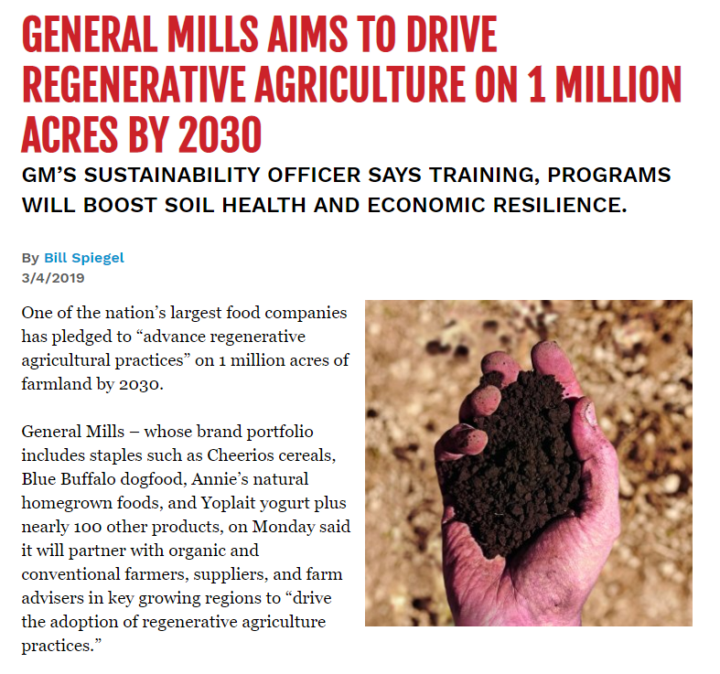

Slide 3
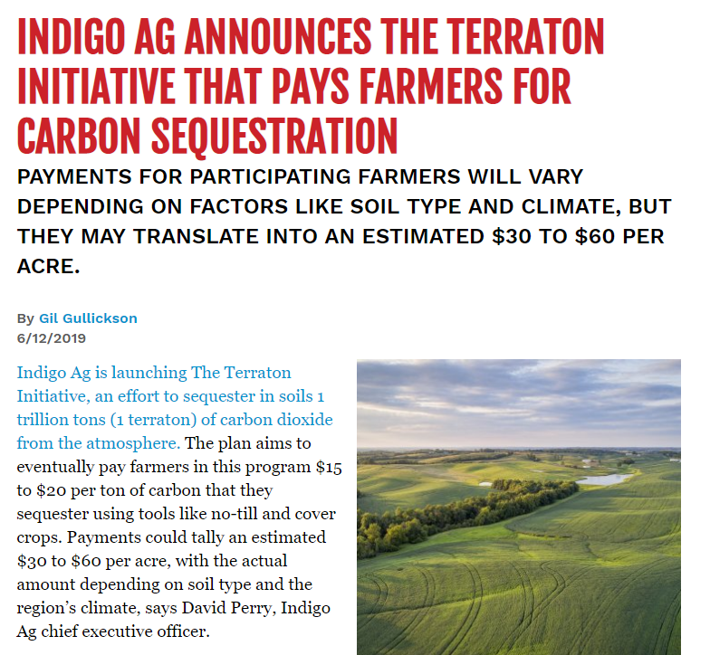

Slide 4



Slide 5
Principles of
Regenerative Agriculture
Don’t get dirty
Don’t drink the Kool-Aid
Don’t farm naked
Don’t farm insane
Don’t forget to feed the elephant
Don’t forget manure
Minimize disturbance
Minimize synthetic inputs
Maximize soil cover
Maximize biodiversity
Maximize the presence of living roots
Integrate livestock

Slide 6
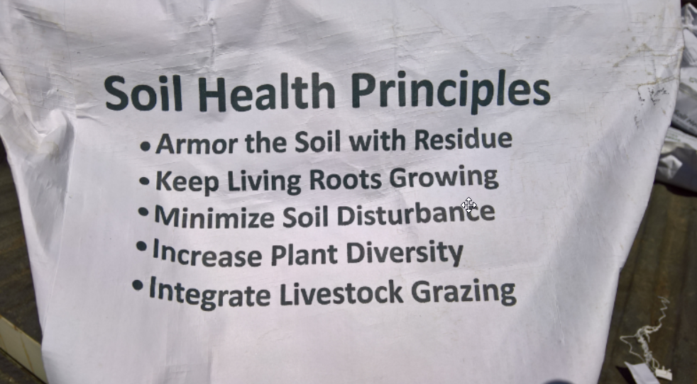

Slide 7
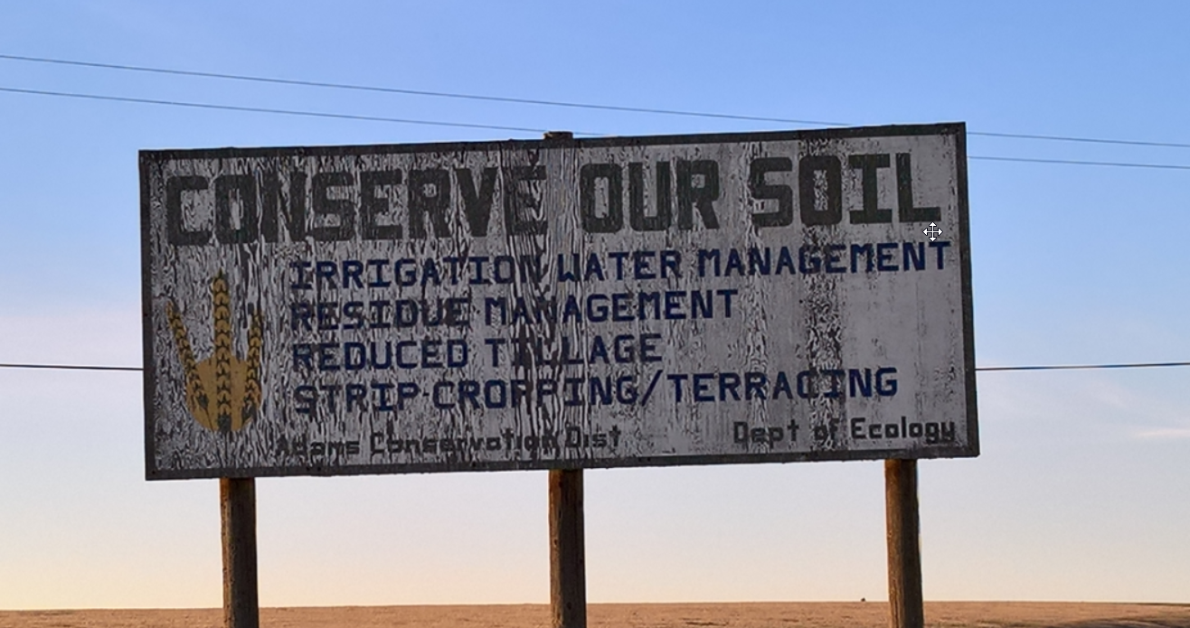

Slide 8
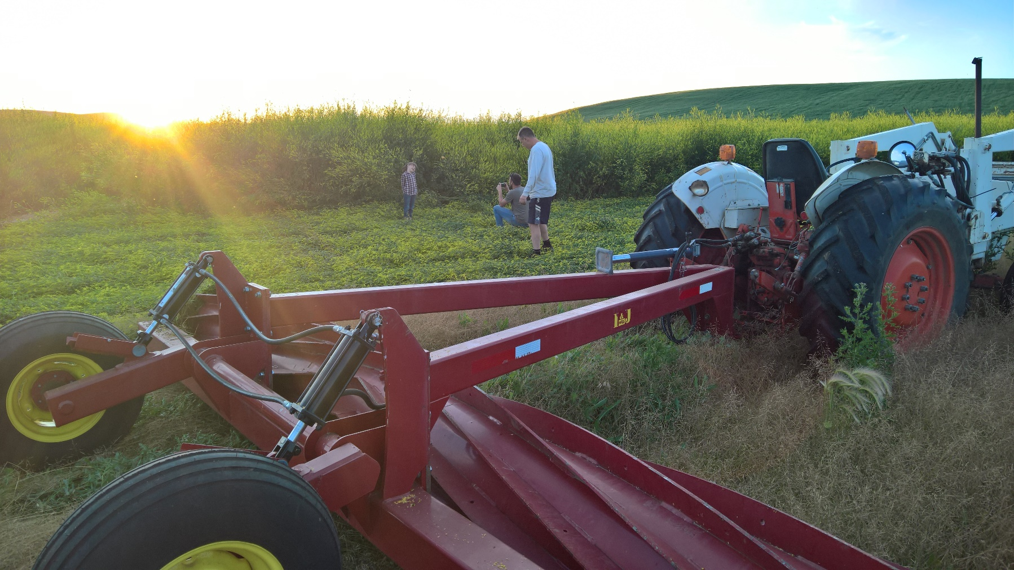
PNW Challenges
Rainfall – Timing & Quanity
Temperatures – Extremes, Daily / Annually
Cover Crop Seed Sources & Selection

Slide 9
PNW Methods of
Regenerative Agriculture
No-Till drill
Wean the addiction, green manures
Source regional proven cover crop seed
Intercropping and 4+ year rotations
Biannual companion cropping
High Intensity Holistic Management
Minimize disturbance
Minimize synthetic inputs
Maximize soil cover
Maximize biodiversity
Maximize the presence of living roots
Integrate livestock

