Slide 1
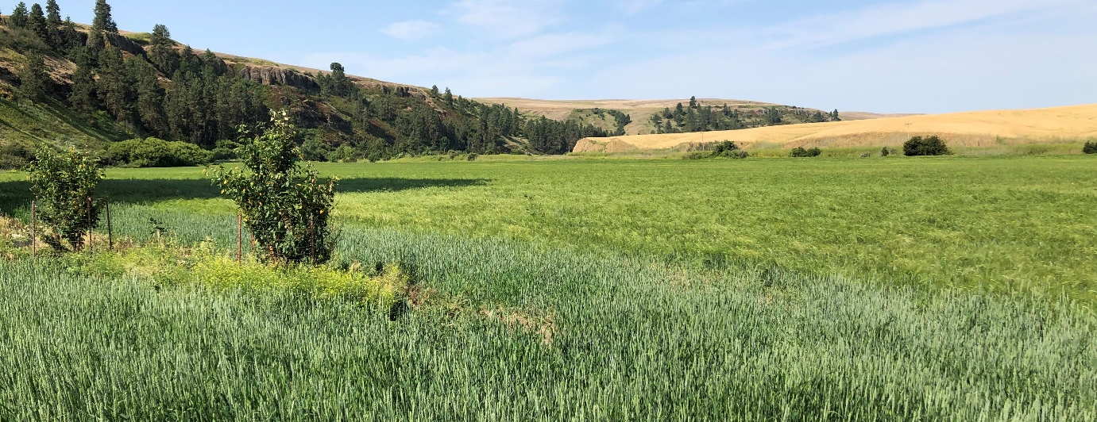
Flavorful Authenticity
Heritage Grains History,
Benefits & Methods
Richard Scheuerman & Don Scheuerman
Palouse Colony Farm; Endicott, Washington
2019 Inland Northwest Artisan Grains Conference

Slide 2
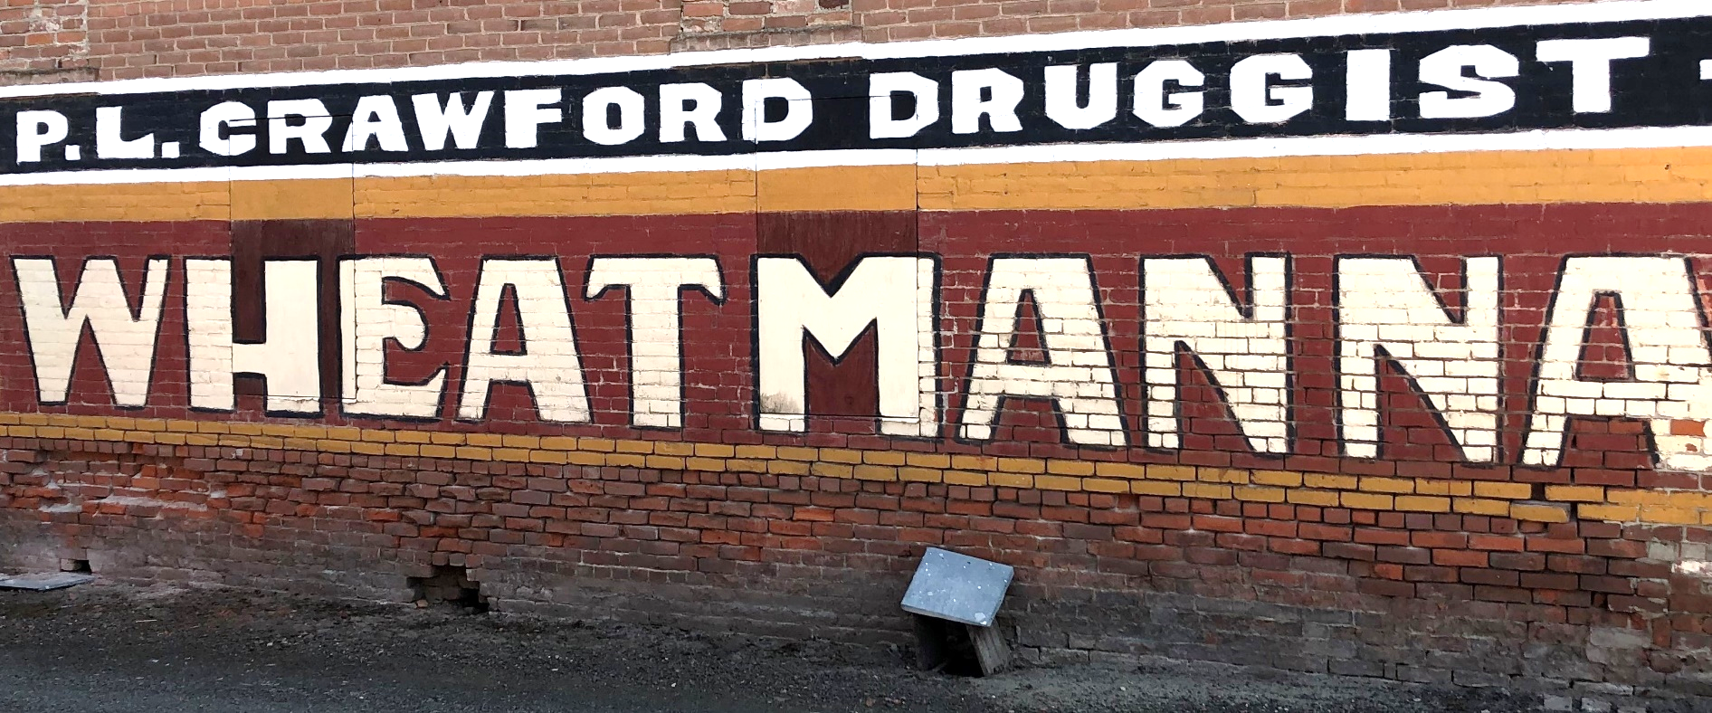
Spokane Centennial Mills “WheatManna” Wall Mural
Oakesdale, Washington
(Flour and cereal made from soft white Sonora heritage wheat)

Slide 3
Spokane Bohemian Club Brewery Sign
(Made from “Bohemian barley and hops”)

Slide 4
THREE LEADING QUESTIONS…
1. Why is this worthwhile?
2. Where can heritage seed be obtained?
2. What production models exist?

Slide 5
WHY IS THIS WORTHWHILE?
Values—heritage and health
“We went into the land of milk and honey….”

Slide 6
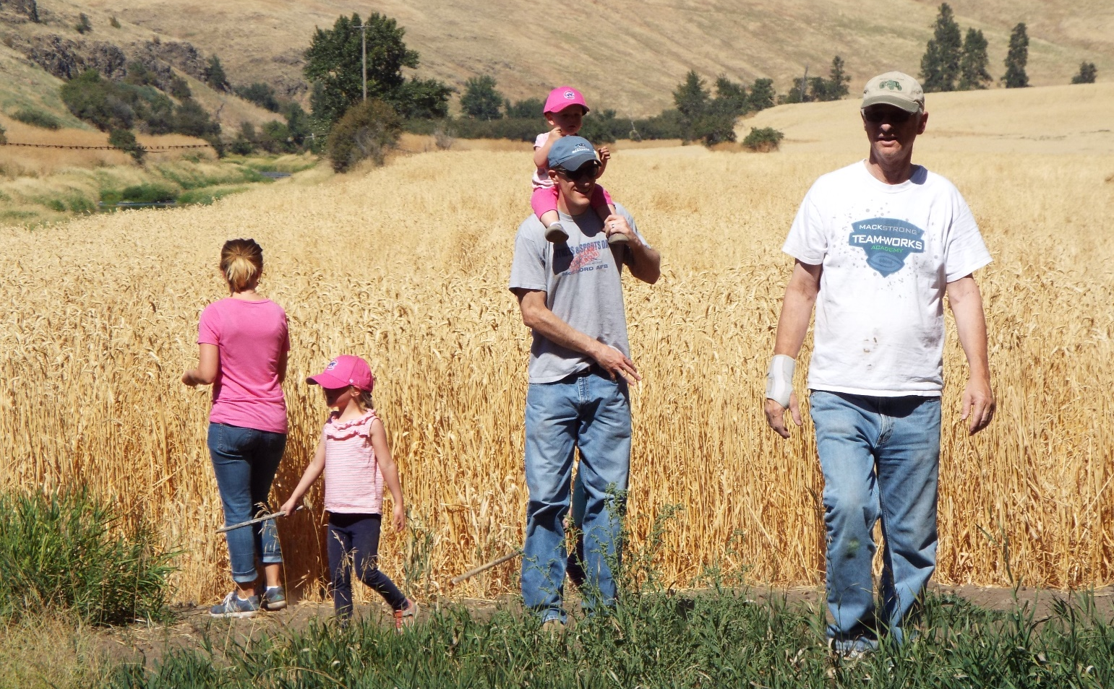
Century 21 and Next Generation Realities

Slide 7
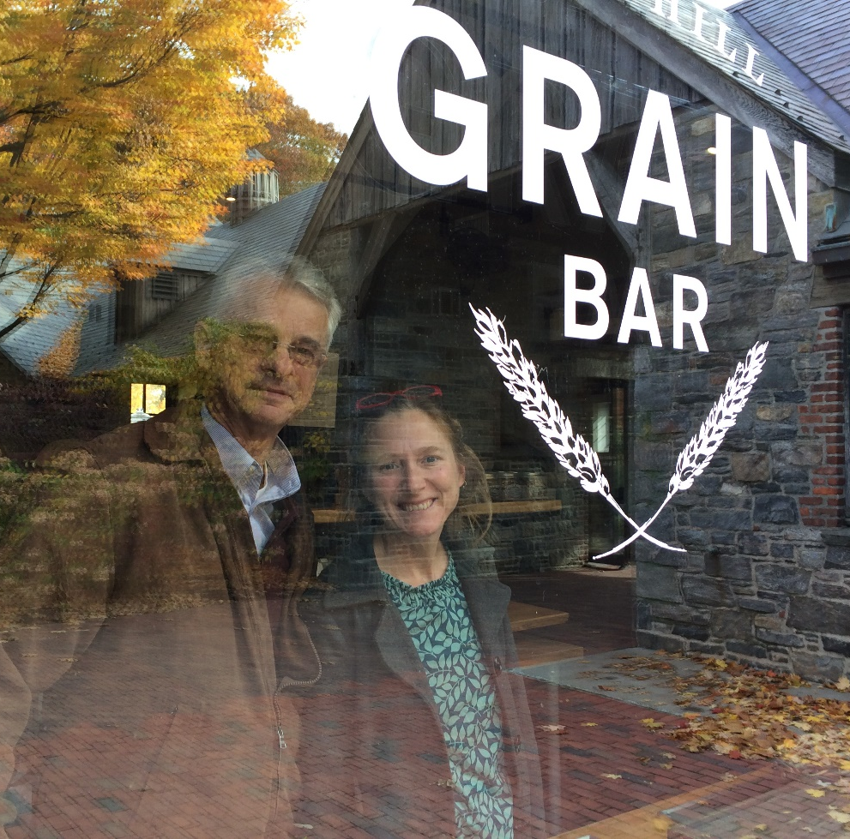
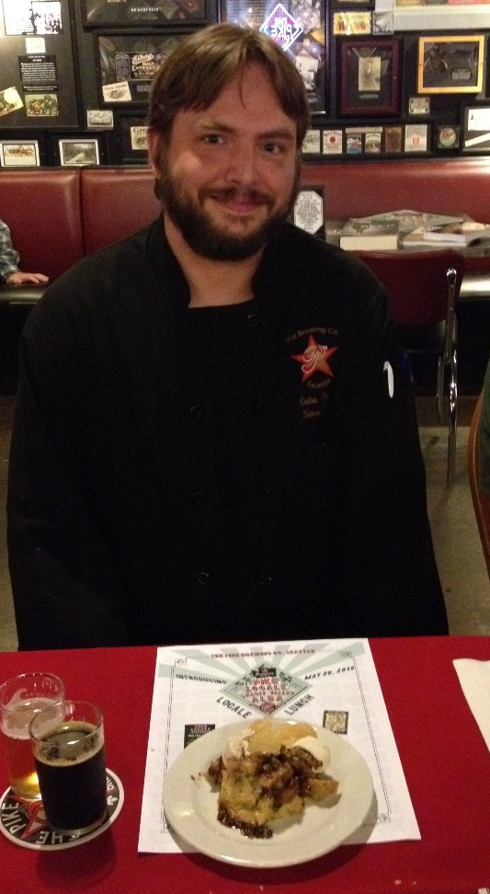
WHY IS THIS WORTHWHILE?
Profit-making opportunities—real English muffins, French crepes, Bohemian pilsners!

Slide 8
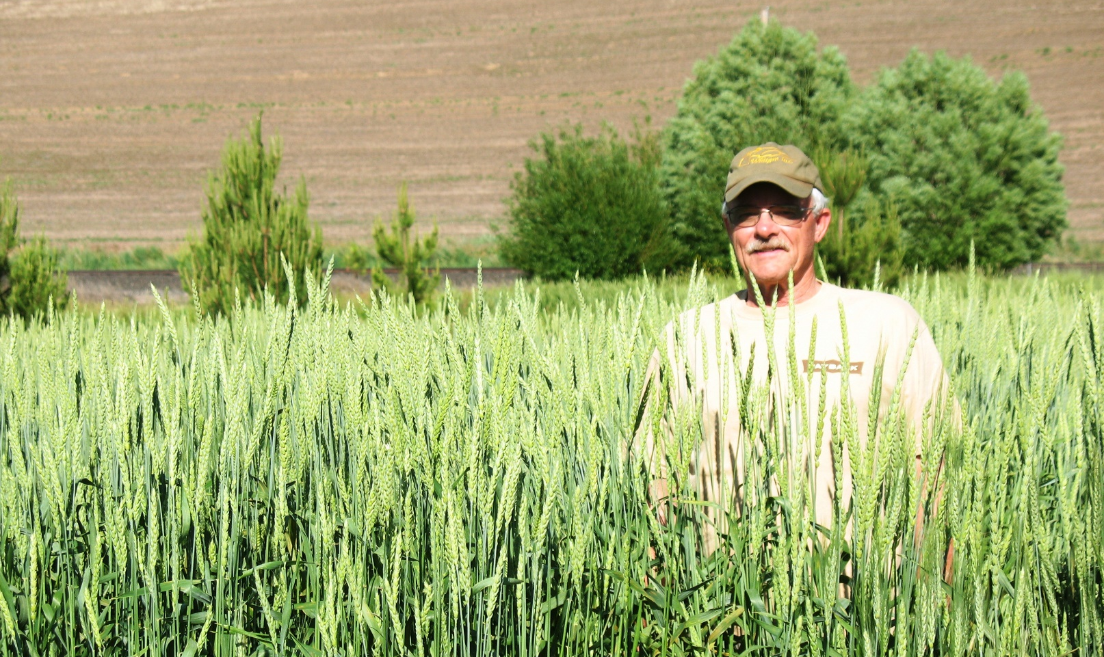
WHERE CAN HERITAGE GRAIN SEED BE OBTAINED?
Land Grant Schools, USDA, USAF?!?

Slide 9
A. WSU Research Station—Mt. Vernon, OSU-Corvallis
B. USDA Germplasm Center, Aberdeen, ID
C. USAF?!? (Yes, seek unconventional operating procedures as needed)

Slide 10
Grower/Miller Variety Location Website______________ Anson Mills Red May, Farro Columbia, SC ansonmills.com Camas Country Mill Emmer, Spelt Eugene, OR camascountrymill.com Earth Dharma Farm Fultz, Kanred Jackson, ME earthdharmafarm.com Fieldstone Organics Red Fife Armstrong, BC fieldstoneorganics.ca Hayden Flour Mill White Sonora, Farro Tempe, AZ haydenmills.com Heritage Conservancy Einkorn, Emmer Colrain, MA growseed.org Montana Flour & Grain Khorasan (Kamut) Fort Benton, MT montanaflour.com Spearville Flour Mill Red Fife, Acadia Woodstock, NB speervilleflourmill.ca
Sample Regional Seed Providers

Slide 11
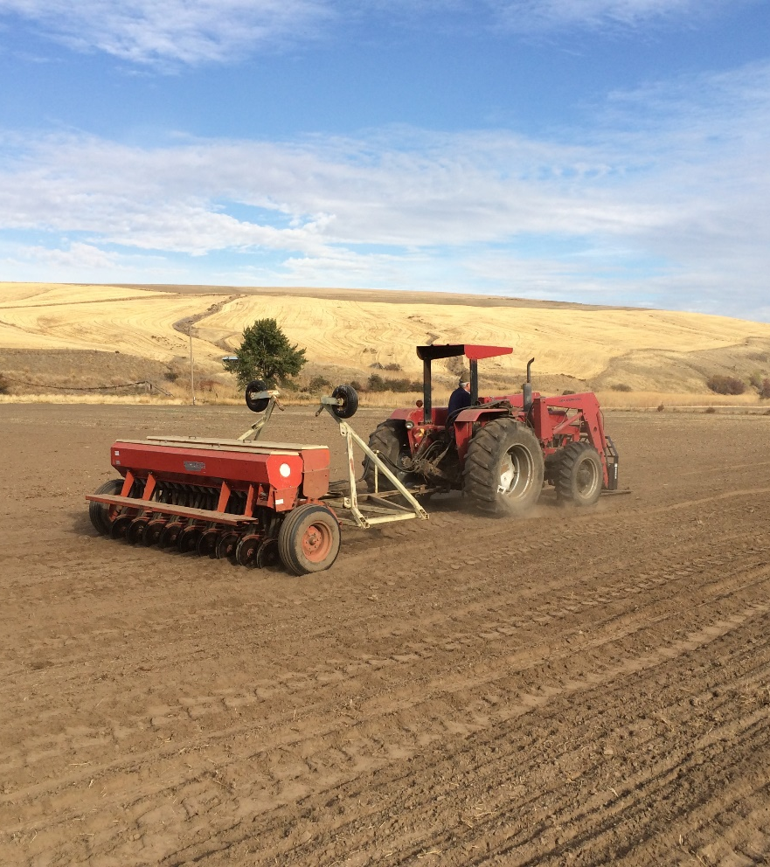
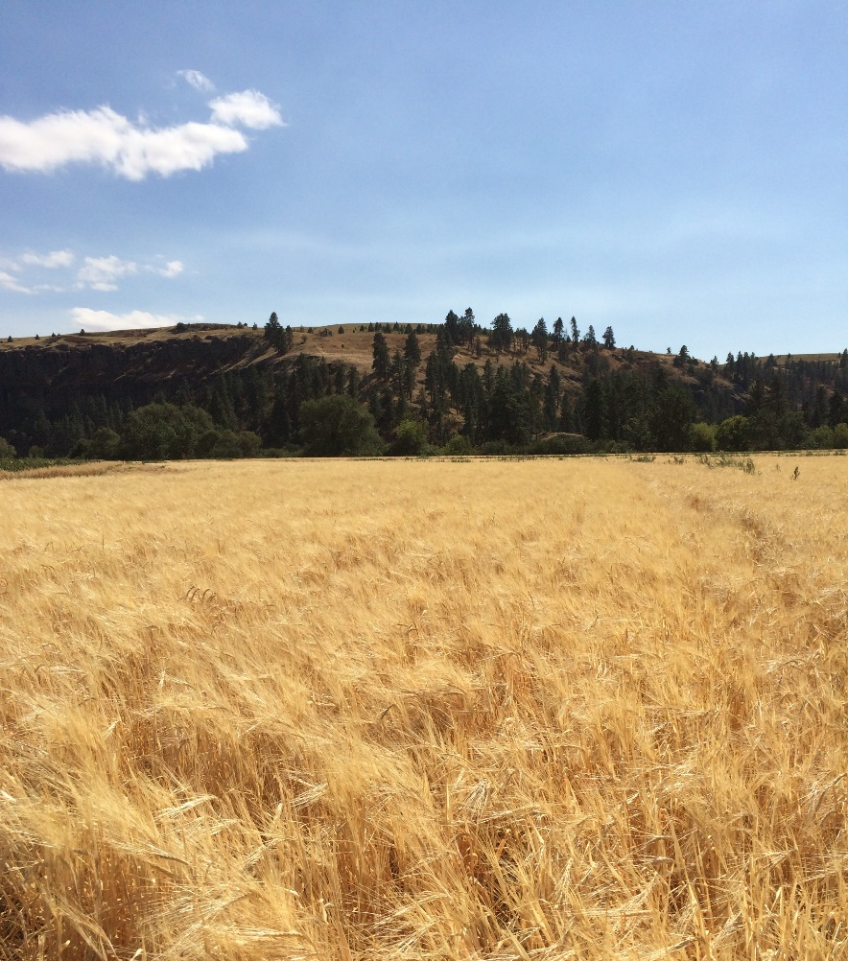
What production models exist?

Slide 12
A. Conventional
(high production, commodity markets)
B. Restorative/“Ag in the Middle”
C. Organic/Biodynamic
(lower production, specialty markets)

Slide 13
1. Participate holistically with the natural world, considering the environment in relation to educational, economic, social, and personal goals.
Core Principles of Restorative Agriculture

Slide 14
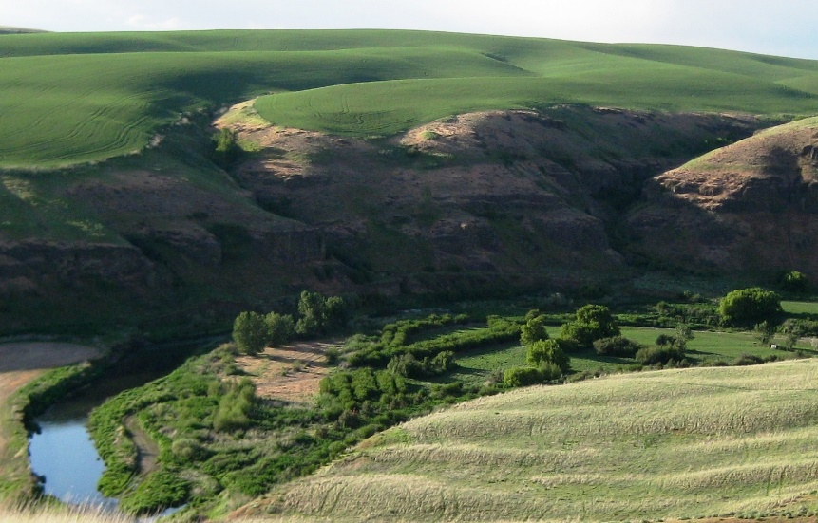
2. Value natural resources within the capacity of landscapes to promote healthy soil for production of crops by reducing erosion and artificial inputs. 3. Promote and document the diversity of local landscapes in natural flora and fauna, and in crops and livestock.

Slide 15
--Quality specifications; e. g., 2018 PCF crop: Turkey Red—61.3 TW, 13.3% protein, FN 520 White Lammas—62 TW, 14.2% protein, FN 362 --Higher mineral levels than modern cultivars (esp. iron, magnesium, phosphorus, selenium) --Significant genetic variation for disease resistance --Distinct culinary attributes (e.g., English Lammas / French Touzelle / Spanish Sonora specialty flours) --Ecotourism
21ST CENTURY HERITAGE GRAINS RELEVANCE
Source: A. A. Jaradat, Wheat Landraces: Genetic Resources for Sustenance and Sustainability (USDA-ARS, 2011)

Slide 16
Wheat Genotype Mg Ca P S K B Cu Se Fe
Primitive Grains 1,300 383 4,540 1,350 4,670 2.41 5.75 0.11 32.2
(Einkorn, Emmer, Durum)
Landrace Wheats 1,290 408 4,130 1,300 4,000 2.10 5.33 0.09 38.5
(Red Browick, Olympia)
Older Variety Selections 1,330 358 4,670 1,310 4,050 1.59 5.27 0.18 35.8
(Ella, Diamont, Prins)
Modern Hybrids 1,240 388 4,020 1,230 4,070 1.59 4.49 0.11 33.3
(Varieties released since 1970)
MINERAL CONCENTRATIONS (mg/kg) AMONG WHEAT TYPES
with Representative Varieties and Highest Values (in red)
Adapted from A. Hussain, H. Larsson, R. Kuktaite, and E. Johansson, “Mineral Composition of Organically Grown Wheat Genotypes” (2010)

Slide 17
MEANINGFUL PARTICIPATION Local Action Learn about sources of foods and the relationships of good nutrition to human health and food production to the environment. Recycle food scraps and other biodegradables into enriching garden compost and reduce use of pesticides, herbicides, and artificial soil amendments. Responsible Consumption Seek nutritious foods that have undergone less processing and have fewer additives, are high in fiber like fresh vegetables and fruits, and high in protein and minerals like grains. Buy locally grown foods and shop whenever possible at area farmers’ markets. Political Advocacy Learn from retailers and food producers about crop raising methods and product origins. Avoid domestic and imported foods that are produced in ways that are environmentally destructive or unfairly exploit workers.

Slide 18
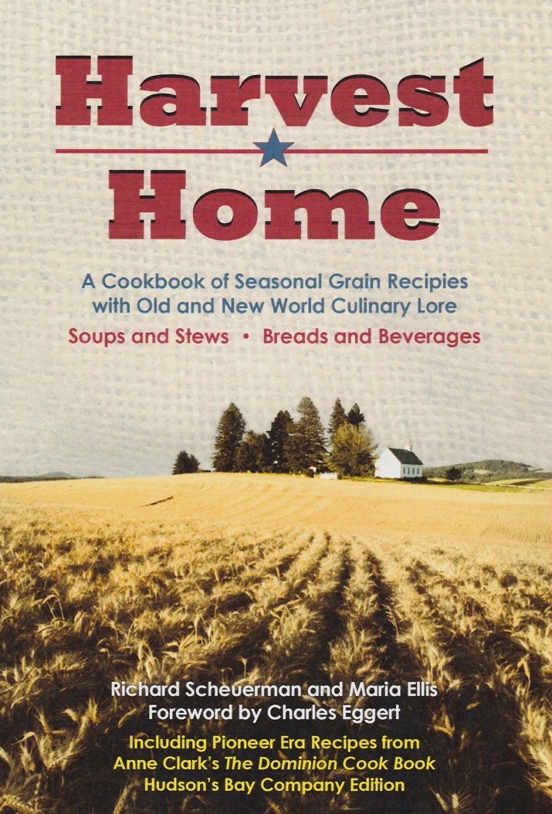
Pacific Northwest Agricultural Heritage Resources
www.palouseheritage.com

Slide 19
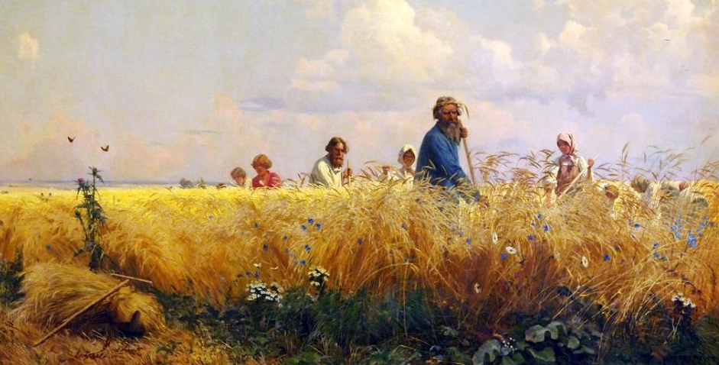
HALLOWED HARVESTS
REAPERS AND GLEANERS
IN WESTERN ART, LITERATURE, AND MUSIC
Richard D. Scheuerman
Photography by John Clement

Slide 20
Progressive change to promote the wellbeing of the land and future generations can be unwisely limited by amnesia as well as nostalgia. Amnesia is forgetting about cultural legacies bequeathed by ancestors and society, while nostalgic appeals to life in some halcyon past often overlook the very real challenges of such times. But memory is a critical discipline. We remember places, mark Bible verses, and appropriate elders’ counsel for synergy and solidarity in order to foster human flourishing and stewardship of resources for tomorrow.

