Slide 1
Introduction to Flavor Analysis
Layton Ashmore
Washington State University

Slide 2
Introduction
Basics of flavor analysis

Slide 3
Introduction – Flavor Analysis
Two main approaches:
Instrumental techniques
Chromatography (LC, GC, CE) to separate flavor compounds, followed by detection (FID, UV-Vis, MS)
May require extraction step
Alternative techniques such as GC-Olfactometry
“E-tongue” and “E-nose”
Useful for quantification
Sensory analysis
Use of human subjects to determine characteristics, flavor differences in a product, or consumer preferences
More applicable to real-world

Slide 4
Introduction – Why Sensory?
Instrumental techniques have limitations
People have threshold limits
People have difference thresholds
Mixtures of flavor compounds harder to evaluate
Consumer preference insight
Perception is complicated

Slide 5
The Senses
Overall flavor is influenced by all of the five main senses

Slide 6
The Senses – Sound
Important in food sample analysis
Less of a focus in beverage analysis
Can be useful for carbonated beverages
Ambient noise can have an effect on sensory perception¹
¹Spence, C. Physiol. Behav. 2012, 107 (4), 505–515.

Slide 7
The Senses – Sight
“First taste is with the eyes”
Color has an influence on taste
Red/Orange = “Sweet”, Green/Yellow = “Sour” for same beverage dyed different colors²
Color has an influence on flavor descriptors
White wines dyed red were described with typical red wine descriptors³
²Spence, C.; Levitan, C. A.; Shankar, M. U.; Zampini, M. Chemosens. Percept. 2010, 3 (1), 68–84.
³Morrot, G.; Brochet, F.; Dubourdieu, D. Brain Lang. 2001, 79 (2), 309–320.

Slide 8
The Senses – Feel
In beverage analysis, typically related to trigeminal nerve sensation
Referred to as “mouthfeel”
Responsible for “astringent”/“drying”, “cooling”, “hot”, “spicy”
Lingering effects

Slide 9
The Senses – Taste
Specific reactions with taste receptors on tongue
Individual receptors responsible for the five main tastes (possibly more):
Bitter
Sweet
Sour
Salty
Savory (Umami)
Prospective tastes: fat⁴, starch⁵, calcium⁶
There is no “tongue map” or “taste regions”
Based on poor translation of German paper⁷
⁴Besnard, P.; Passilly-Degrace, P.; Khan, N. A. Physiol. Rev. 2016, 96(1), 151–176.
⁵Lapis, T. J.; Penner, M. H.; Lim, J. Chem. Senses 2016, 41 (9), 755–762.
⁶Tordoff, M. G.; Alarcón, L. K.; Valmeki, S.; Jiang, P. Scientific Reports 2012, 2(1).
⁷Hänig, D.P.; Philos. Stud. 1901, 17, 576-623.

Slide 10
The Senses – Aroma
Based on olfactory response to volatile chemical compounds
Focus of barley trial sensory panel
Complicated
Ratios of compounds change overall aroma
Strong ties to memory
Influences descriptors for aromas
e.g. “TCA” (cork taint) smells like “moldy basement”
Happens in two phases
Orthonasal
Retronasal

Slide 11
The Senses – Aroma
Orthonasal olfaction
Before food or beverage enters mouth
Chemical compounds reach receptors in olfactory bulb
Signal sent to brain
Some compounds can be detected in parts per quadrillion
Depends on matrix
https://www.monell.org/research/anosmia/how_smell_works

Slide 12
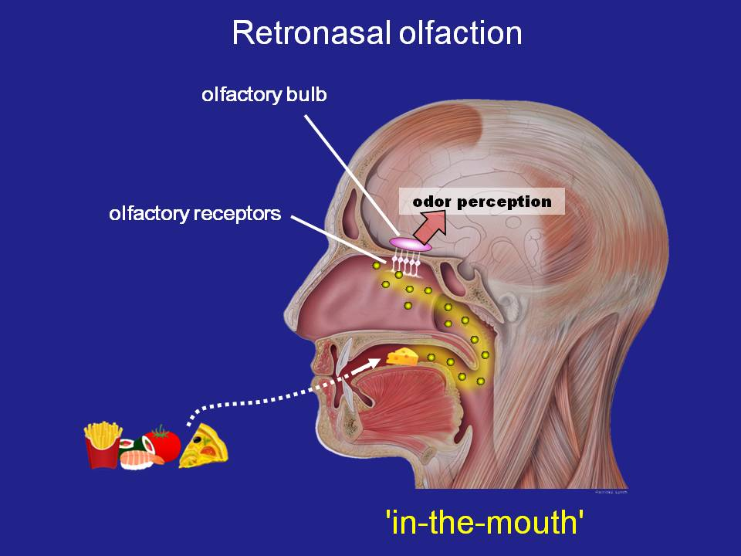
The Senses – Aroma
Retronasal olfaction
Occurs inside mouth
Body heat helps volatilize compounds
Salivary enzymes cleave bound aroma compounds
Enhanced by aeration
https://www.monell.org/research/anosmia/how_smell_works

Slide 13
The Barley Trials
Searching for beer and whiskey-worthy strains to grow west of Cascades

Slide 14
Barley Trials
Barley trials
Selected based on agronomic data, want to know differences in flavor/aroma
Chemical analysis done on hot water steeps and fresh-make whiskey from 2017 harvest
Future work to be done on 2018 harvest and year 1 aged whiskies

Slide 15
Barley Trials
Analytical results
Differences in flavor precursors
Polyunsaturated fatty acids
Differences in terpene content
Plant-based aroma compounds
No insight on whether differences are noticeable

Slide 16
Barley Trials
Barley aromas
“Grainy” – n-butanal, isobutyraldehyde
“Bready” – 2-acetyl-1-pyrroline
“Nutty” – 2-methylbutyraldehyde
“Grassy” – cis-3-hexenal, dimethylsulfide
“Earthy” – 1-octen-3-ol, 2-octanone
“Floral” - linalool

Slide 17
Barley Trials
Barley aromas
Sensory data can be used alongside analytical data to determine whether differences in strains are detectable
Descriptive analysis using sensory panelists
Future sensory work will be done on fresh-make whiskeys and beers made from each strain to determine if differences appear in the final products

Slide 18
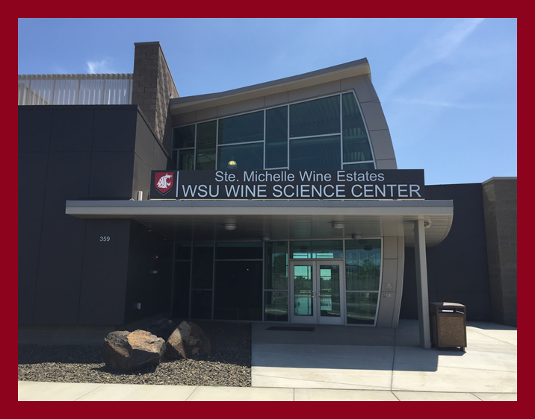
Questions?

